Slide 1
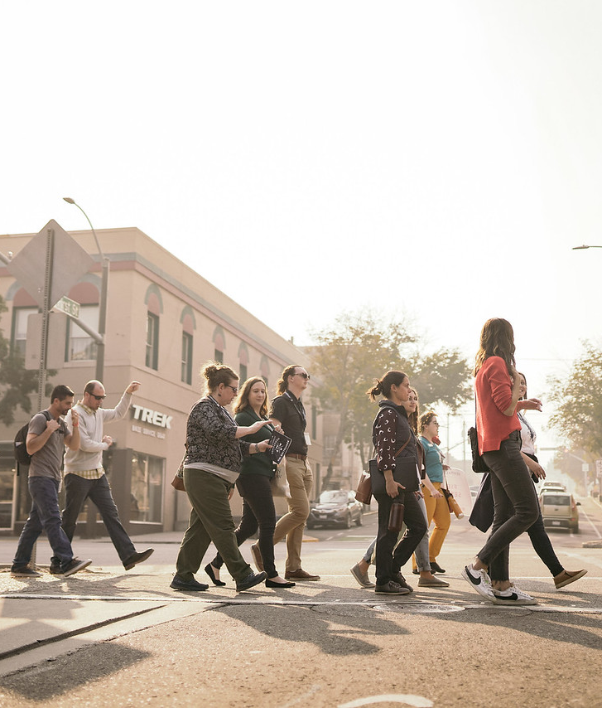

Creating Momentum Through
Preservation
Downtown Wenatchee

Slide 2
Karen Allen, Owner
Electric Hotel
Michelle Thompson, CLG Coordinator
Department of Archaeology & Historic Preservation
Breanne Durham, Program Director
Washington Trust for Historic Preservation
Think of a place that matters to you
Notes:
Introduce selves by sharing a place that matters to us
Breanne (downtown Lewiston)
Michelle
Karen

Slide 3
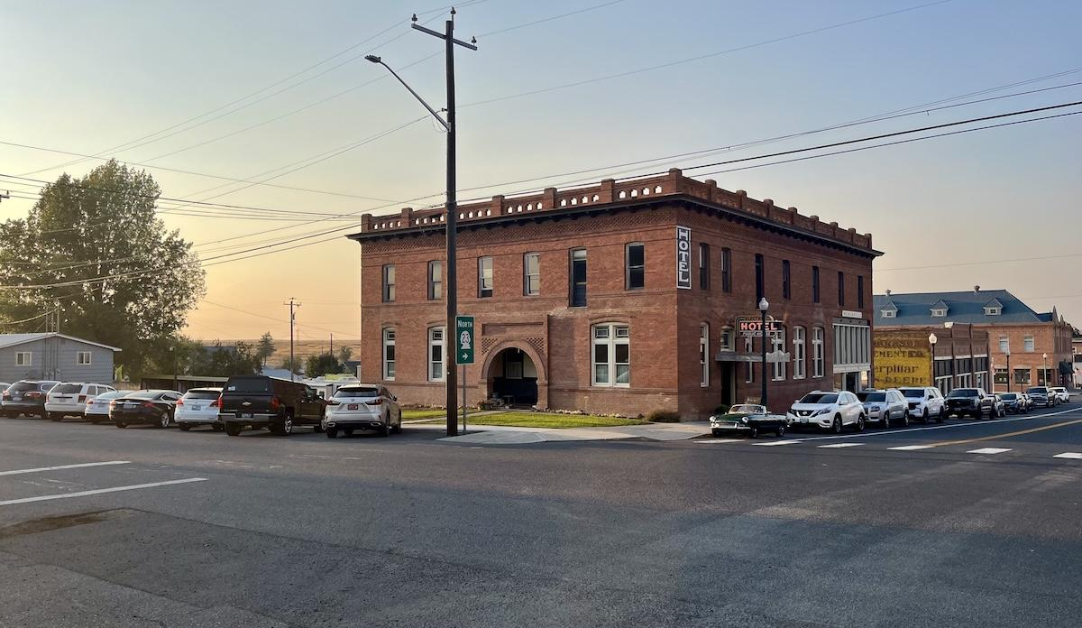
Understanding historic assets, discovering what is possible,
& sharing your vision
Case study:
The Electric Hotel
Harrington, WA
Port Townsend
Downtown Wenatchee

Slide 4
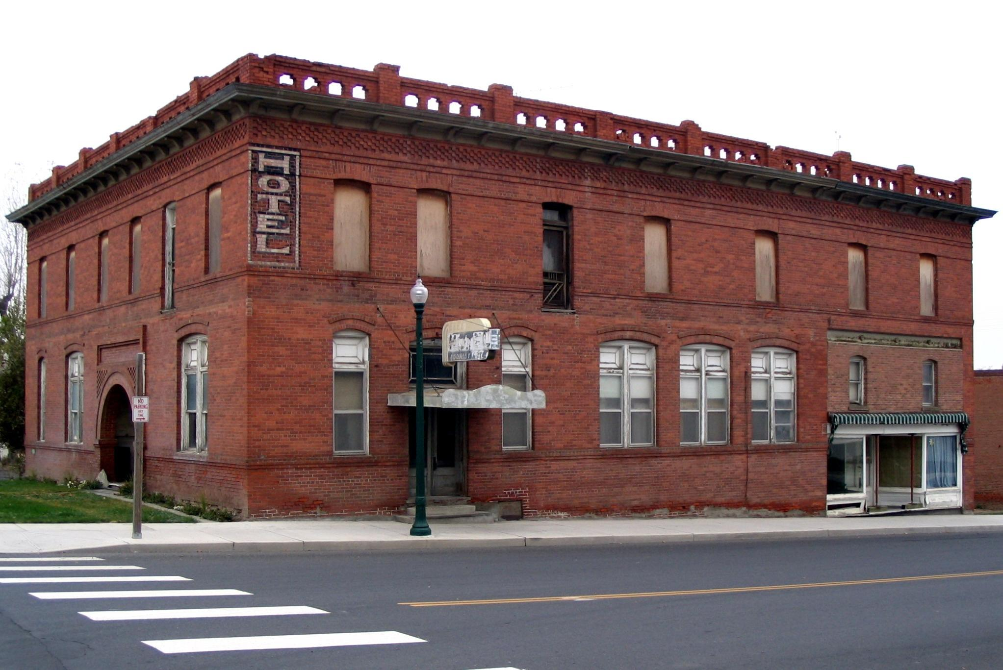
Notes:
Karen - storytell about journey to/with The Electric Hotel and Harrington community
***feel free to re-arrange photos!***

Slide 5
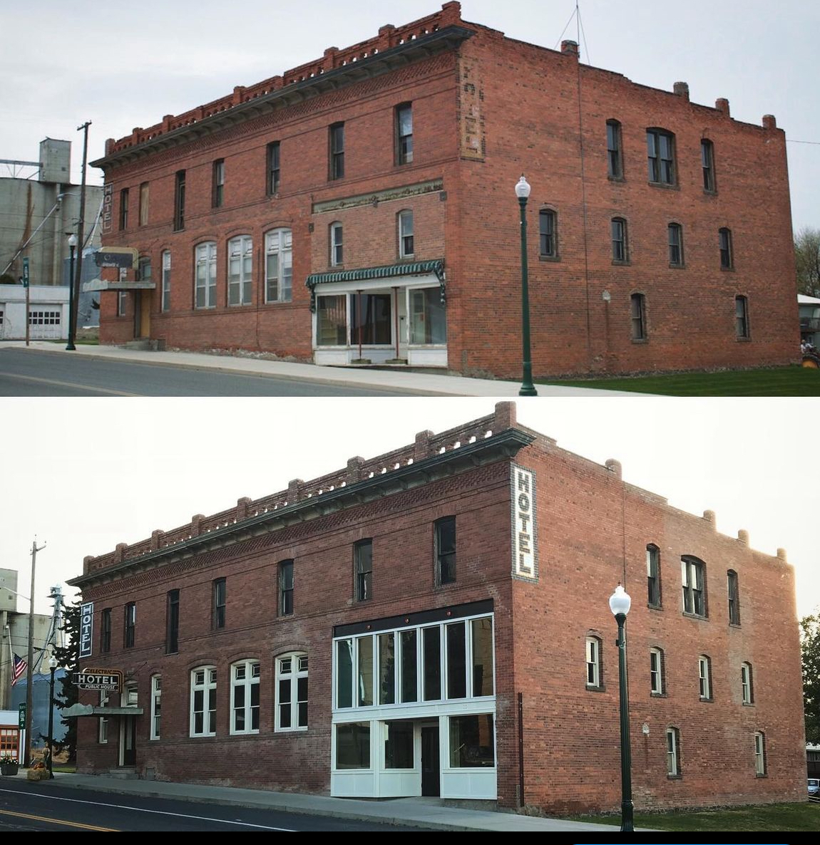
Before 2009
After 2022

Slide 6
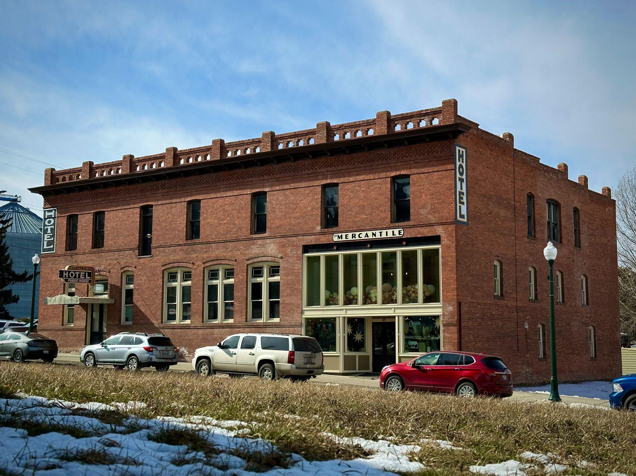
Notes:
The Mercantile in Harrington has been a game changer and huge addition to the Harrington’s downtown

Slide 7
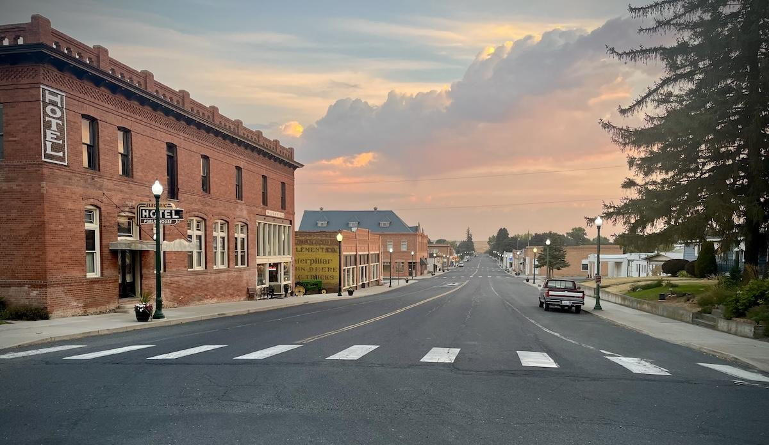

Slide 8
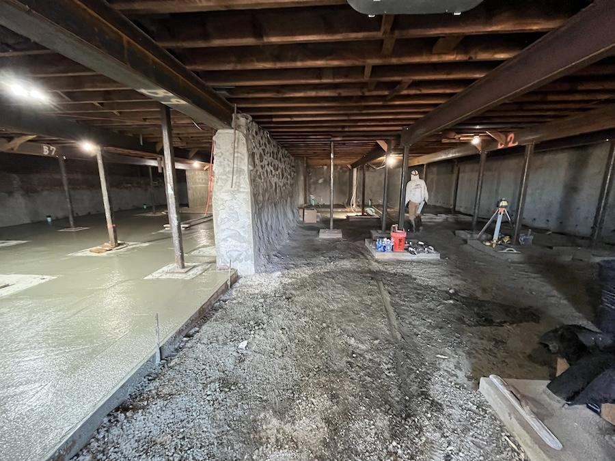

Slide 9
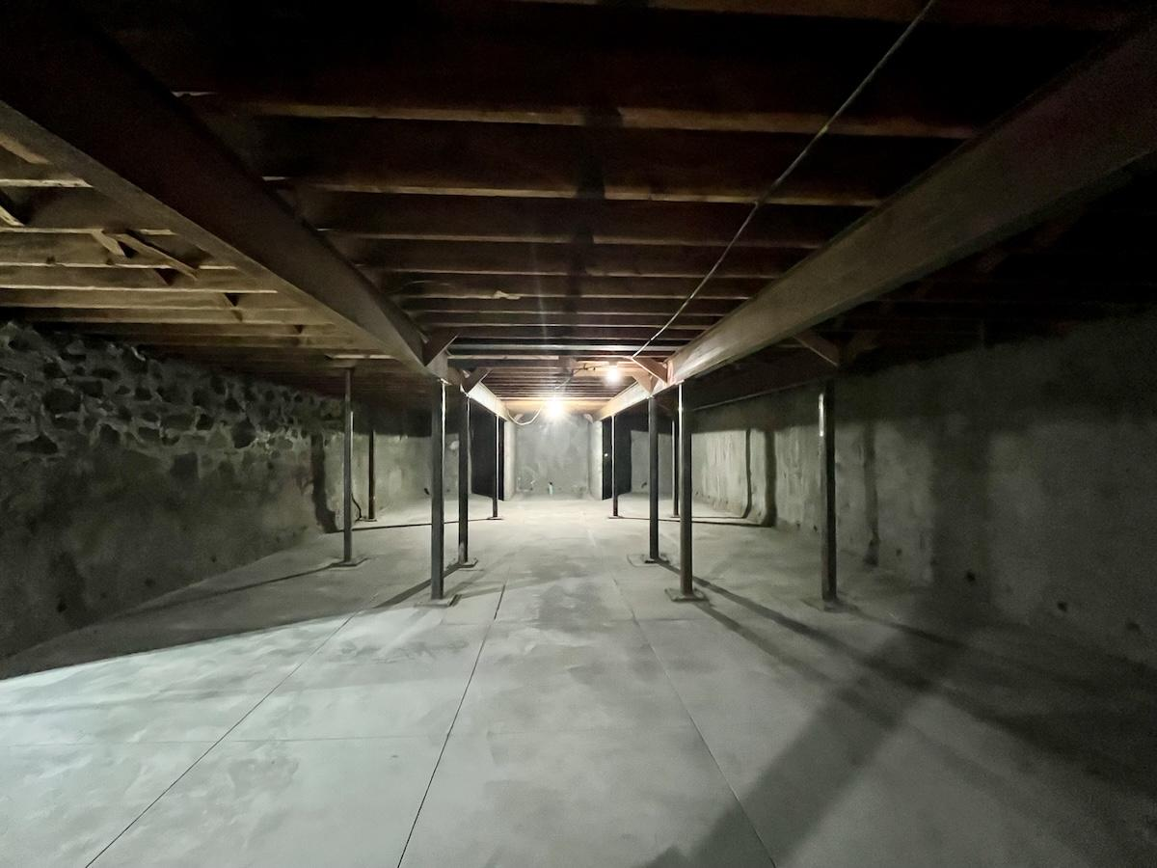

Slide 10
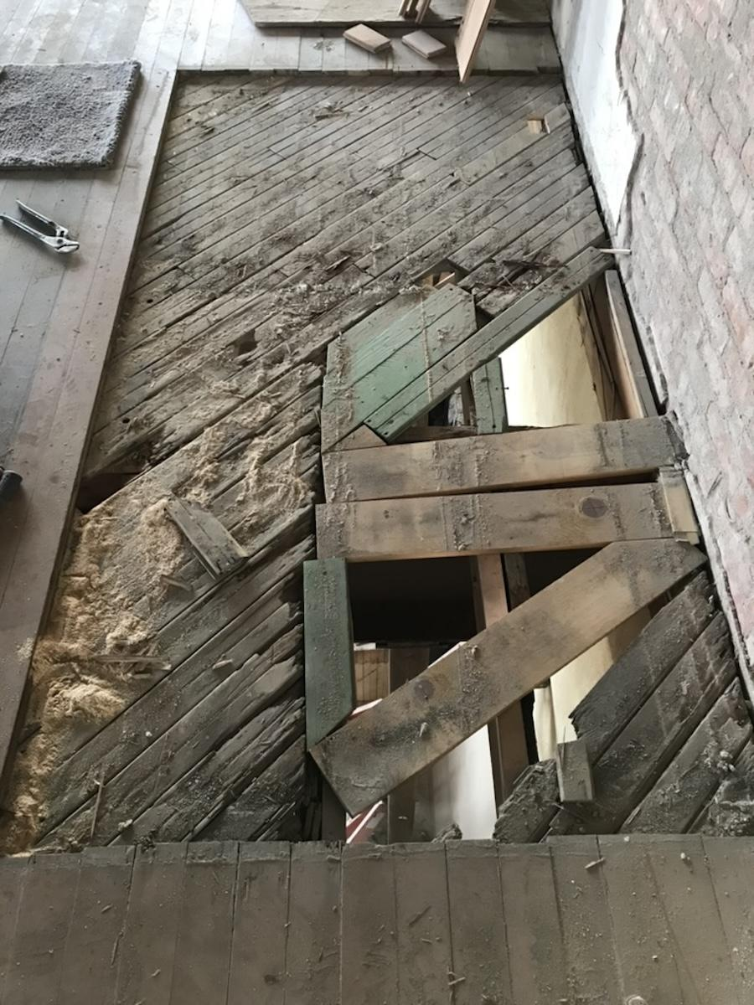

Slide 11
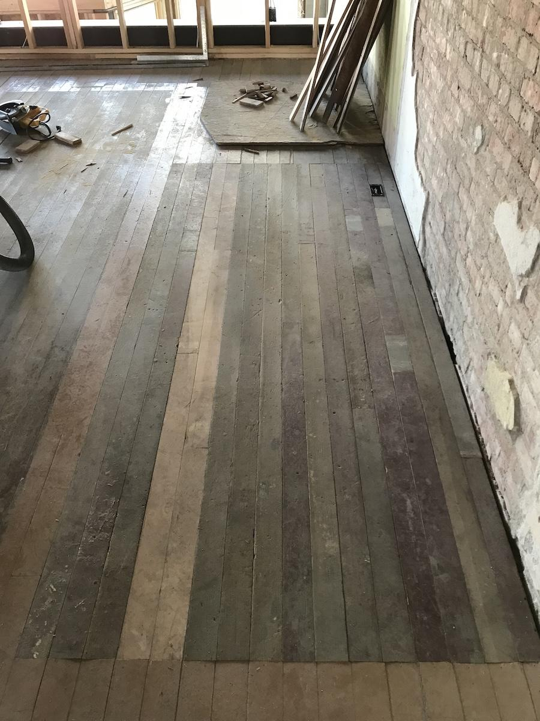

Slide 12
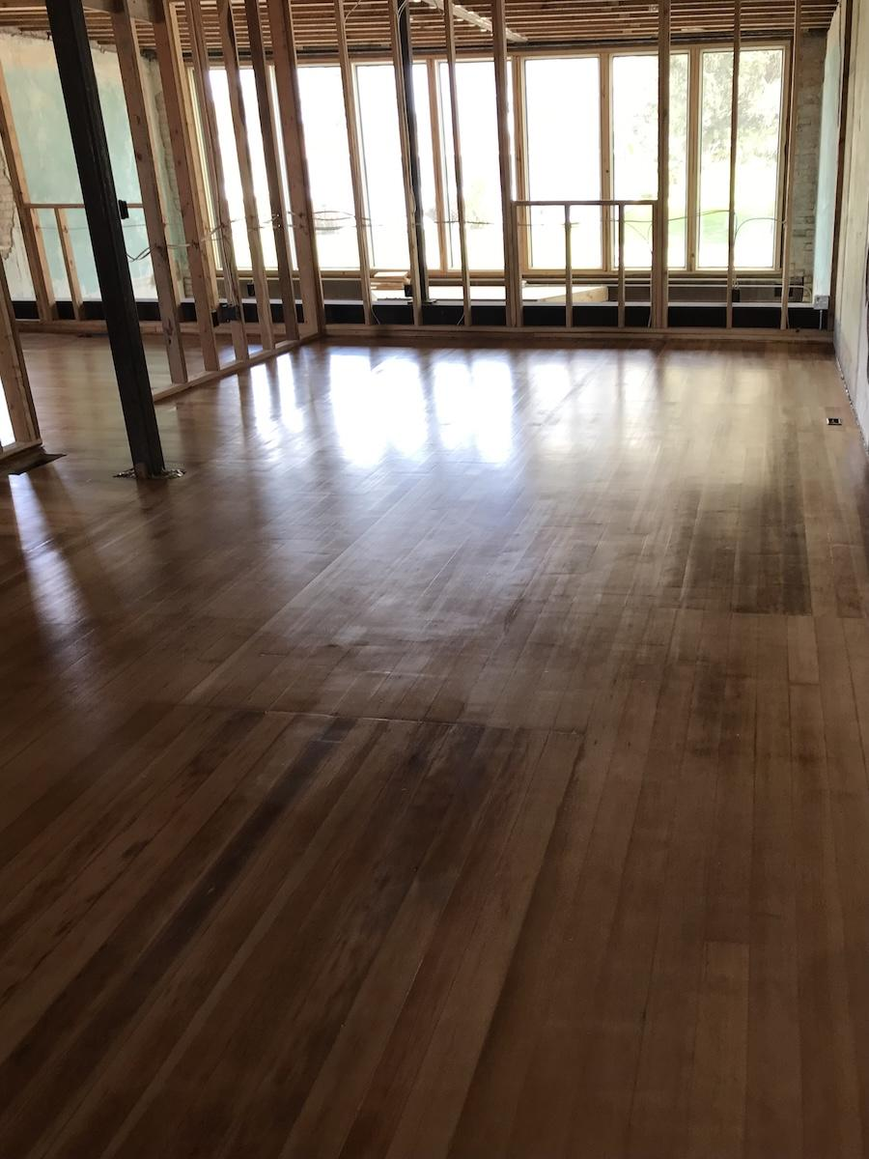

Slide 13
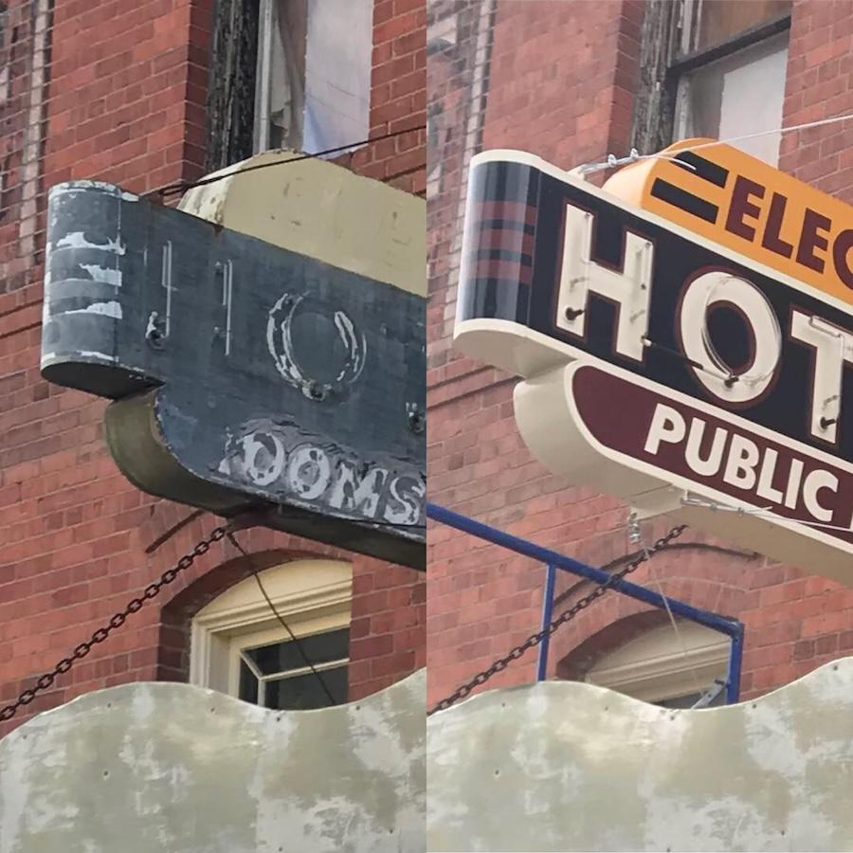
Before and after historic neon sign restoration.

Slide 14
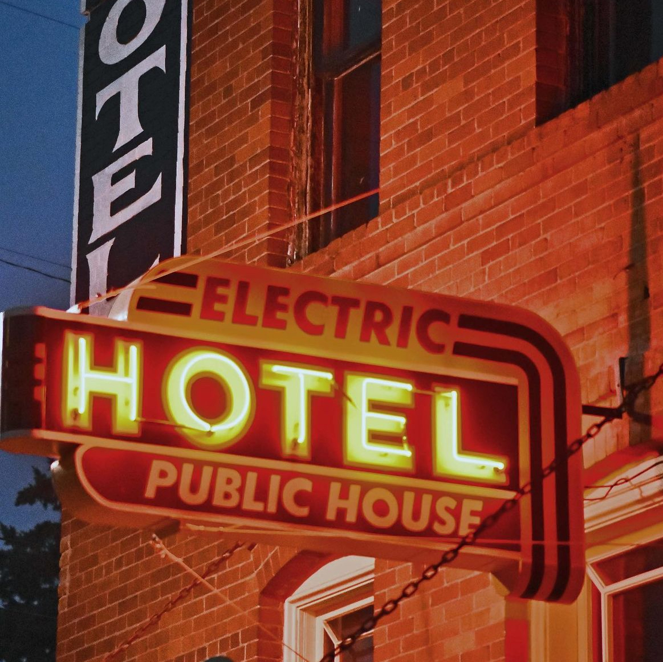

Slide 15
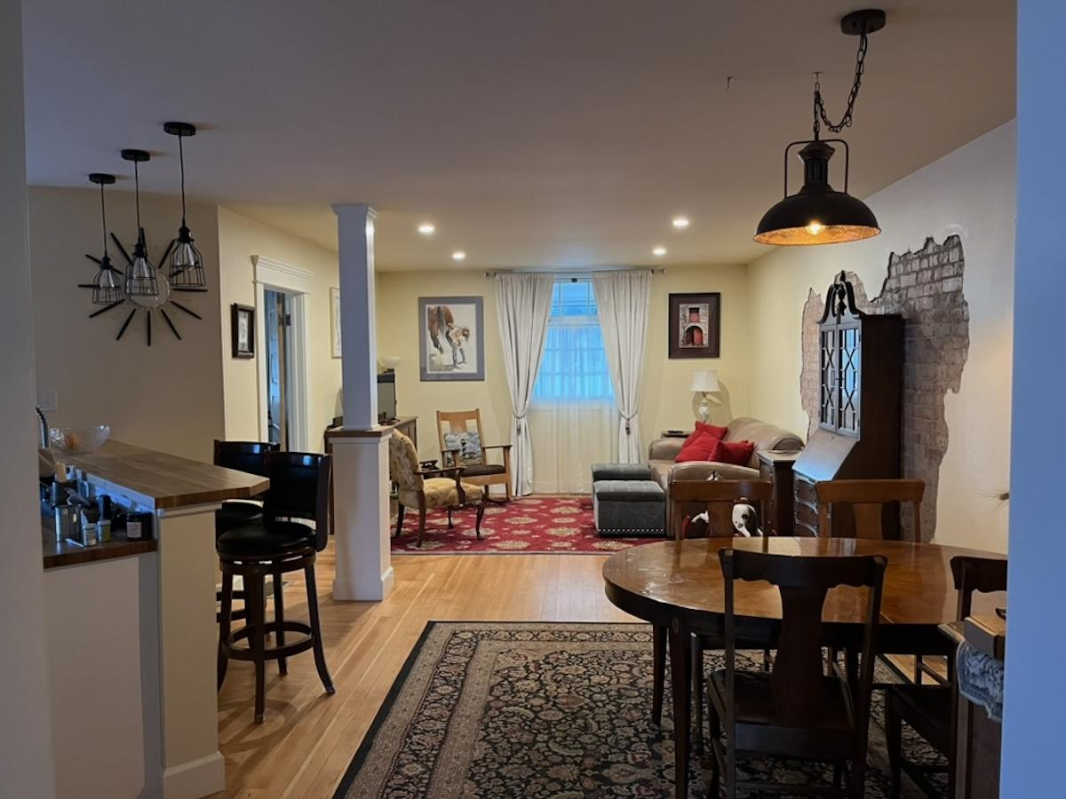
Notes:
Manager suite completed in June of 2023

Slide 16
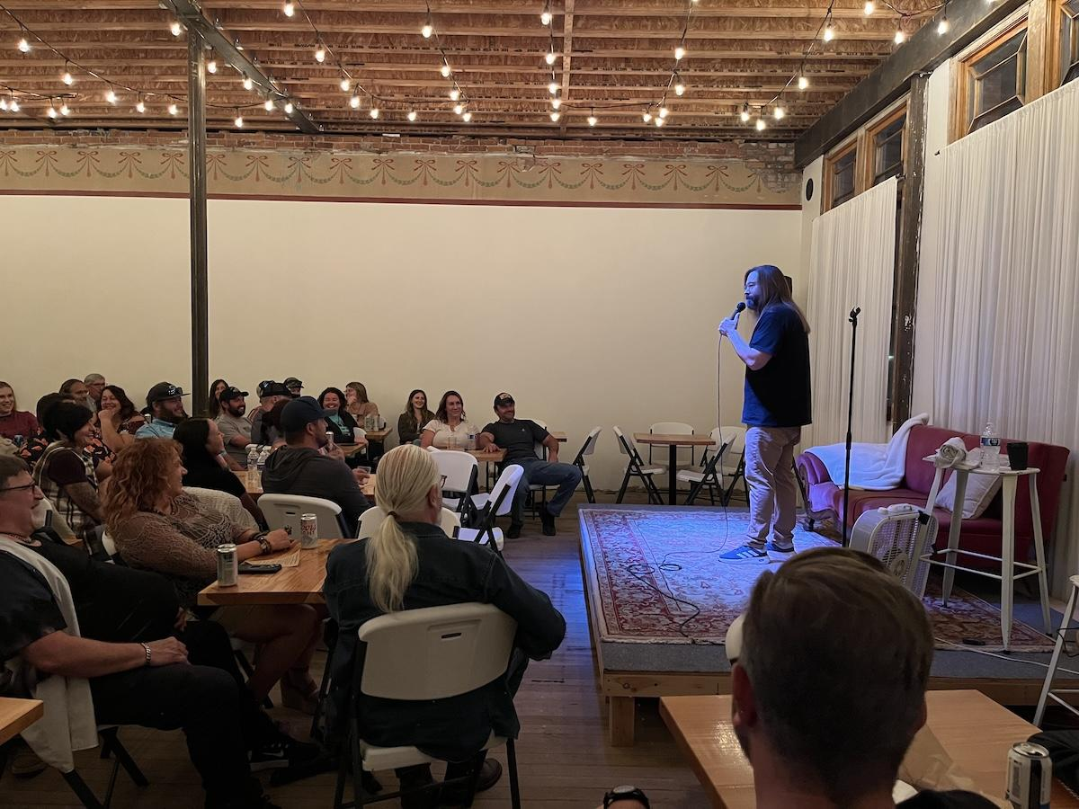
Notes:
Well known comedian, Gabe Rutledge, performs to a full house at the Electric Hotel

Slide 17
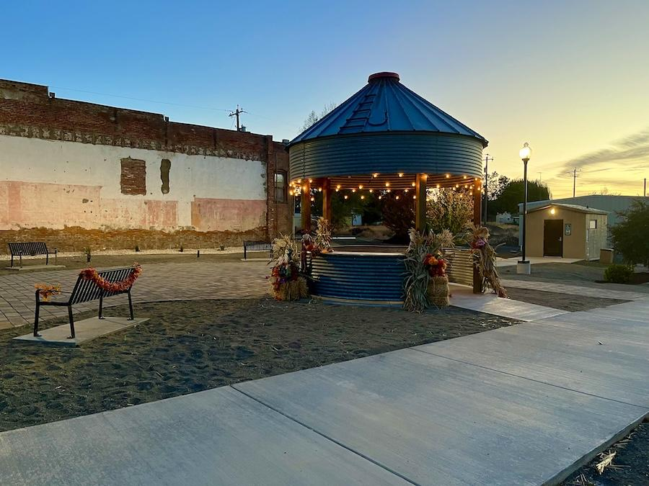
Notes:
Harrington Town Square, formally an vacant lot in the center of town

Slide 18
Notes:
Comedy shows and concerts at the Electric Hotel bolster the downtown economy

Slide 19
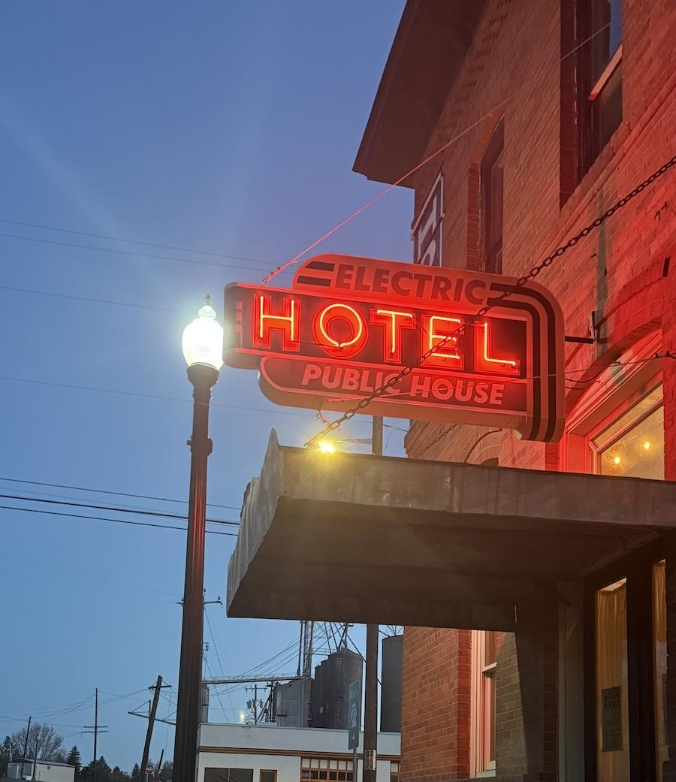

State partnerships
Tapping into expertise, resources, and passion for historic places
Notes:
Karen to share about her experience working with DAHP as a way of transitioning to Michelle
Michelle to intro DAHP and her role

Slide 20
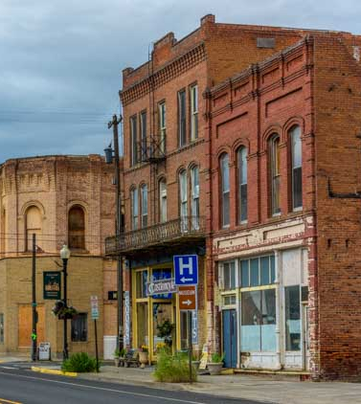
All preservation is local
Certified Local Government = local historic preservation commission
Pomeroy
Downtown Wenatchee
Notes:
Michelle explains CLG

Slide 21
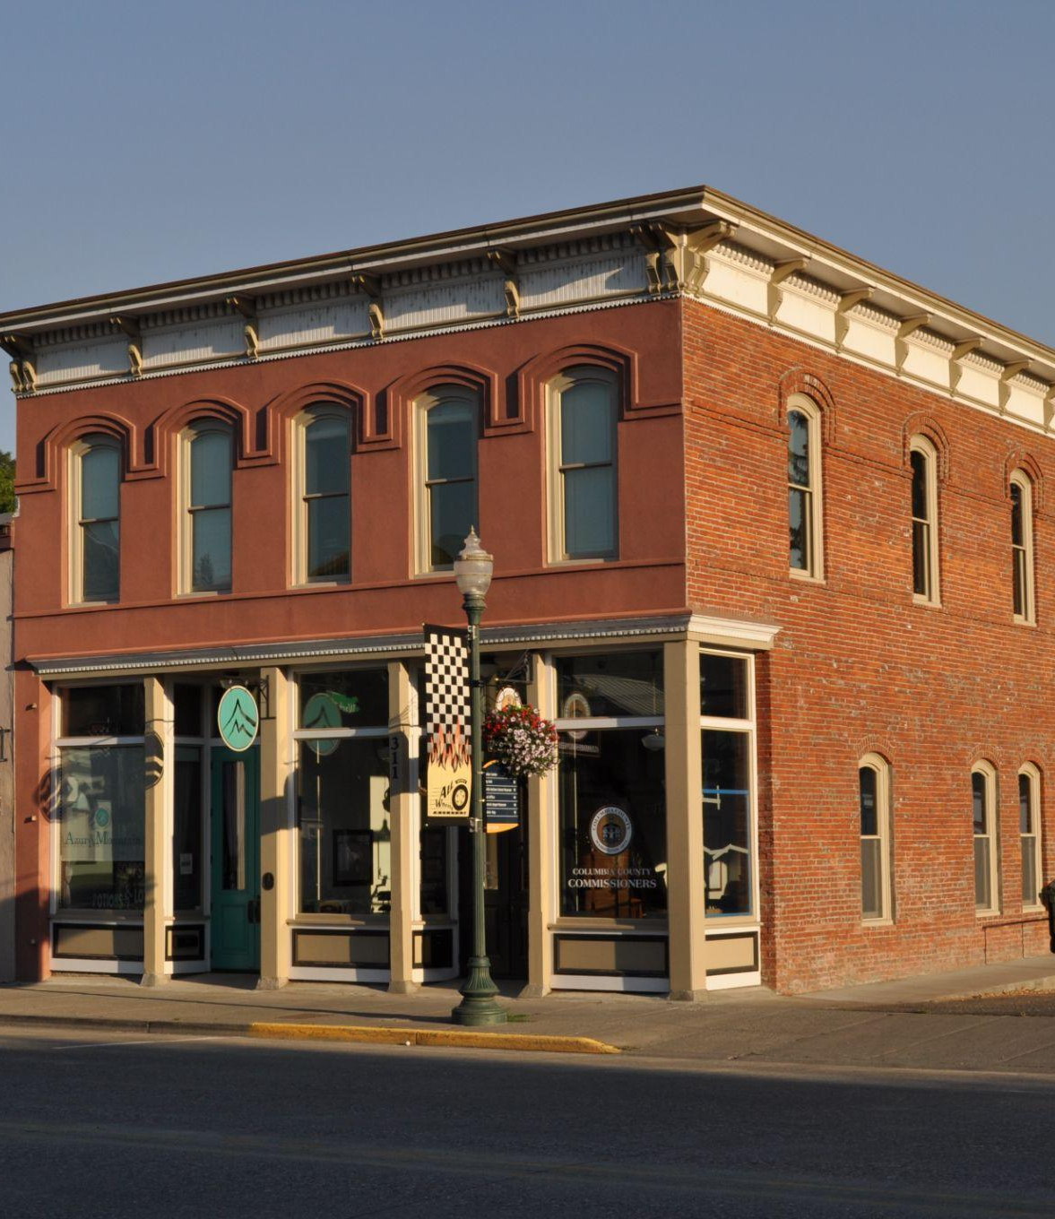
Federal Historic Tax Credits
20% of amount spent on rehabilitation
Income-producing buildings
Listed or eligible for National Register
Dayton
Downtown Wenatchee
Notes:
Michelle

Slide 22
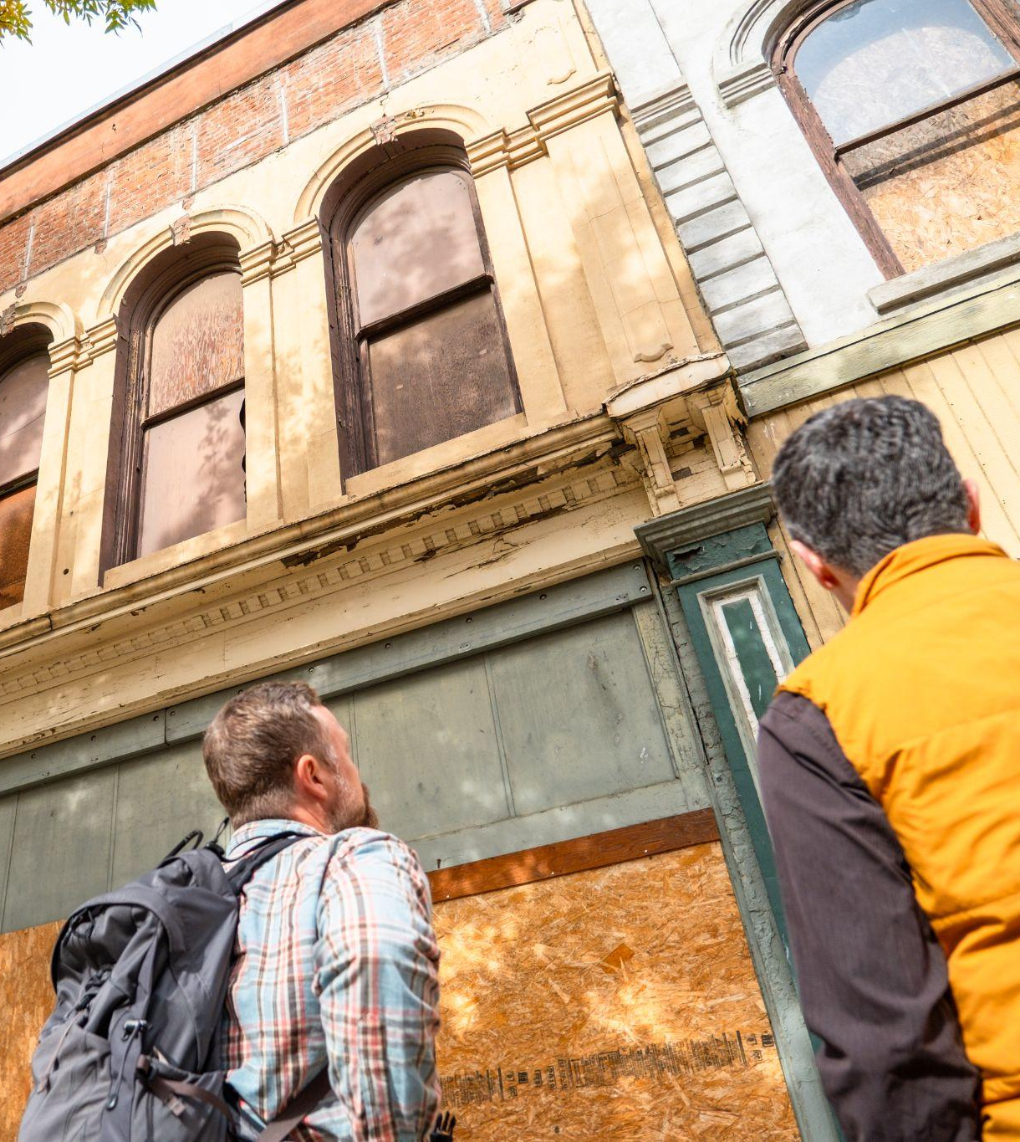
Special Valuation
State tax incentive
Provides a 10-year tax break by reducing property tax liability
Rehab costs need to be 25% of assessed value prior to rehab
Pomeroy
Walla Walla
Downtown Wenatchee
Notes:
Michelle

Slide 23
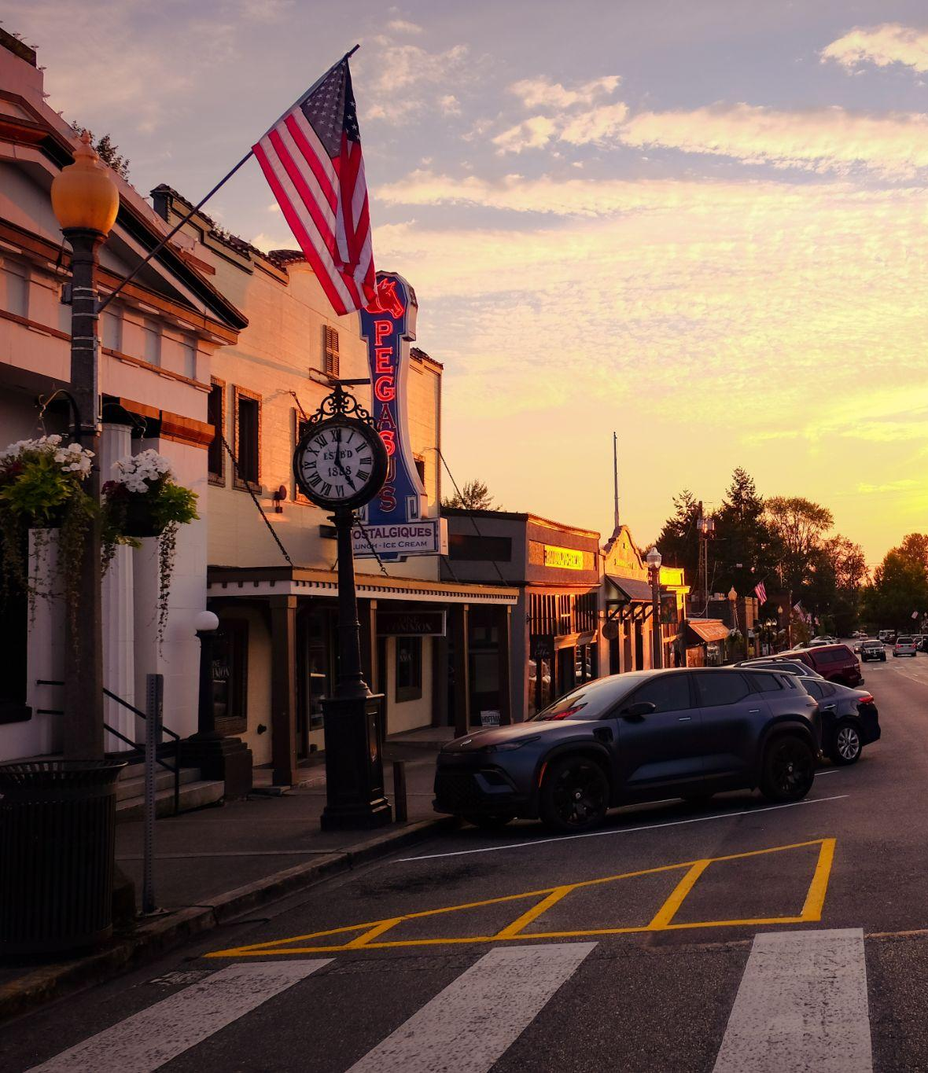
Main Street & Preservation
Momentum & sustainability
Volunteerism
Symbiotic relationship with entrepreneurship
Wenatchee
Snohomish
Notes:
Breanne & Michelle

Slide 24
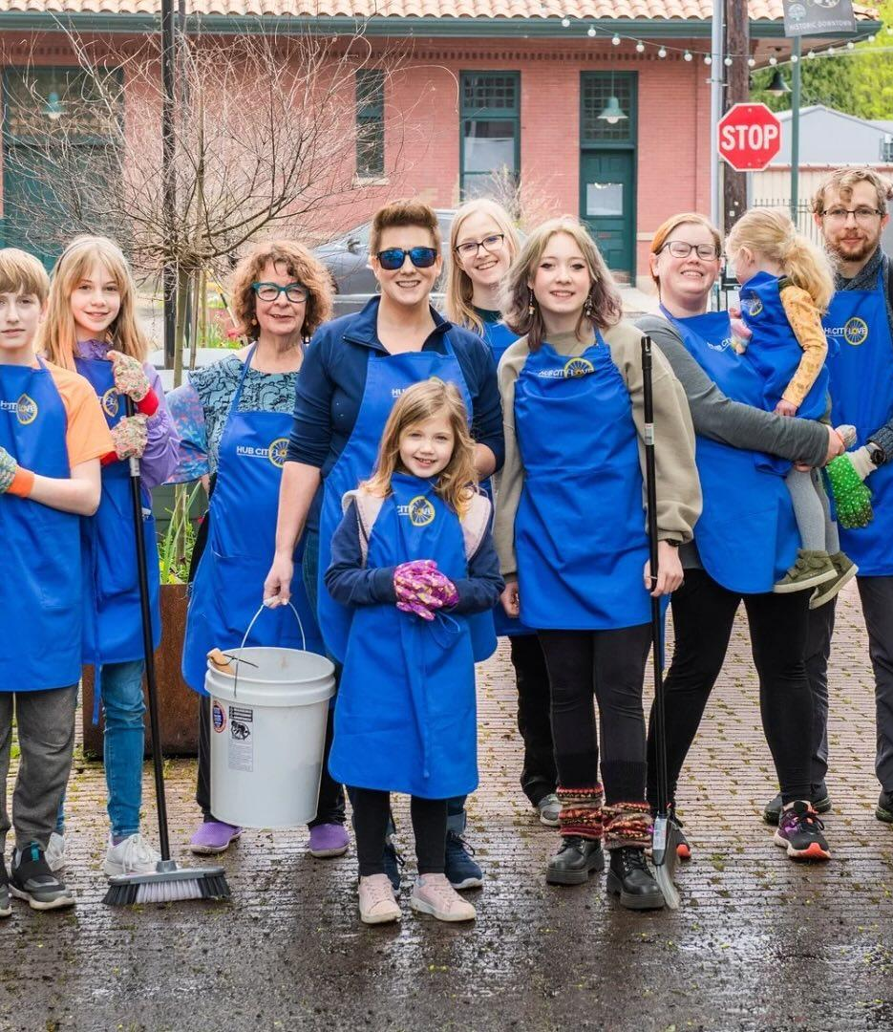
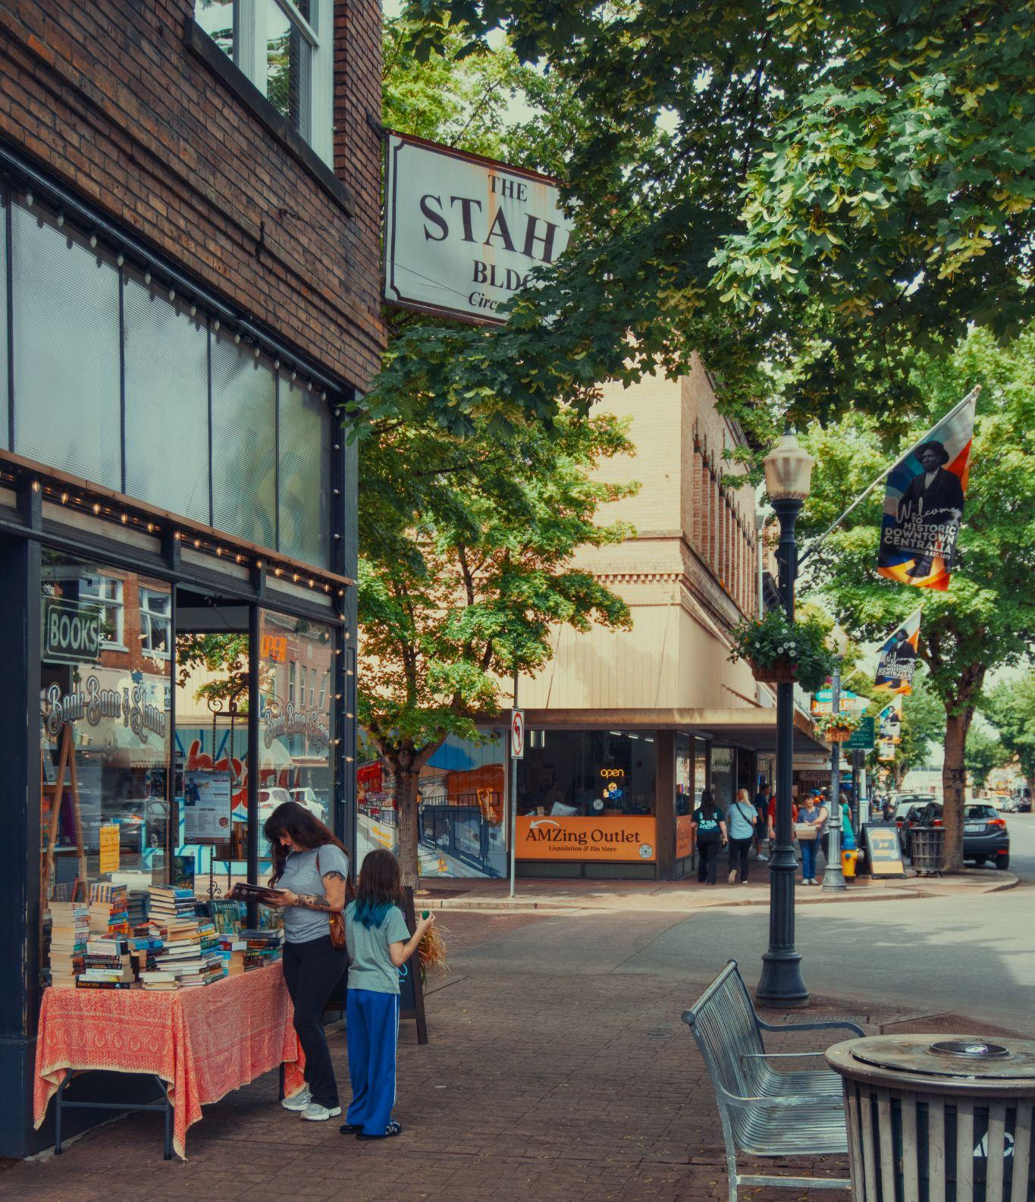
New businesses need old buildings
Small, flexible spaces
Stronger local economy
More creativity, less chains
Centralia
Downtown Wenatchee
Centralia
Notes:
Older, Smaller, Better
Older business districts house a higher density of jobs and businesses per commercial square foot, offering affordable, flexible spaces that fuel entrepreneurship.
These areas contain a higher proportion of non-chain, locally owned businesses, including more women- and minority-owned enterprises.
Cultural outlets and the creative economy thrive in older mixed-use zones.

Slide 25
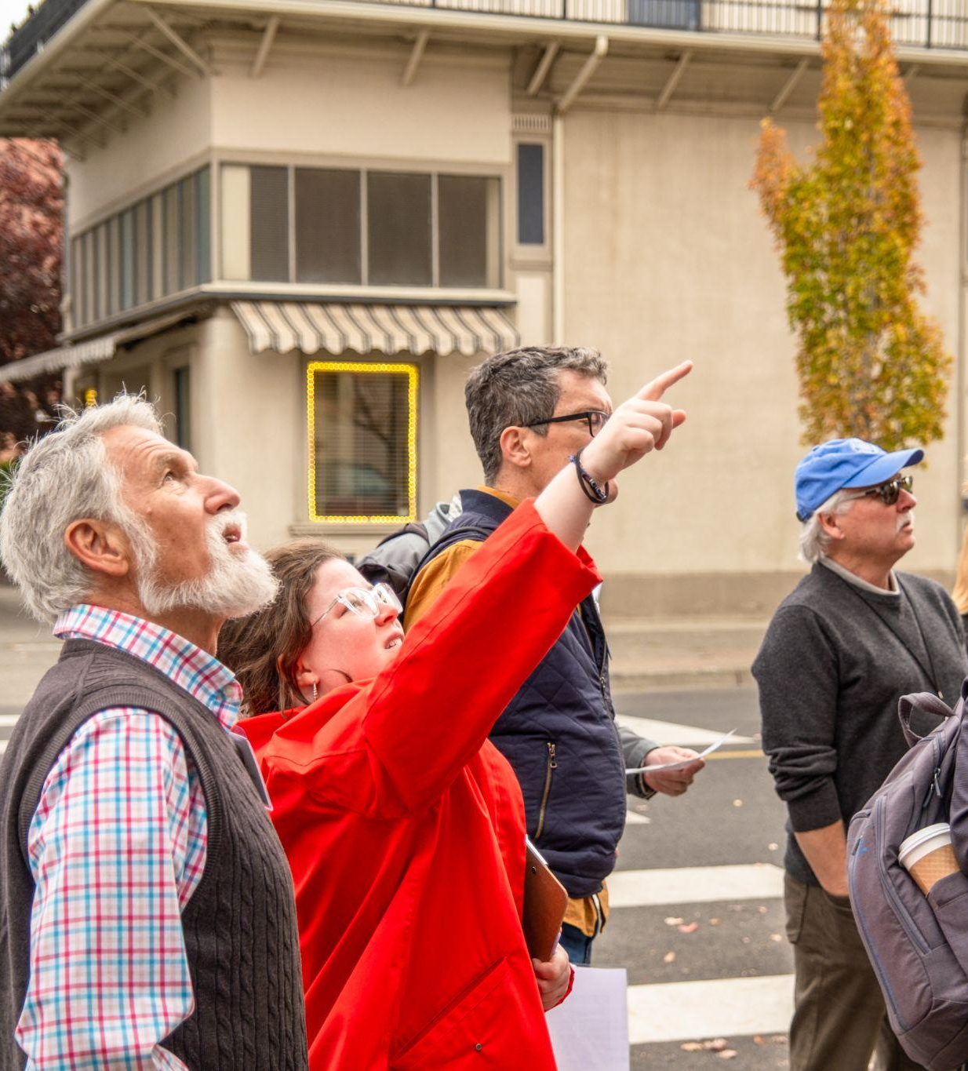
Preservation is about
History & stories
Existing assets & infrastructure
Beauty & craftsmanship
Connecting people to place
Wenatchee

