Slide 1

Social Media- Compliance for Public Entities
Brenda Stav, Operations and Administration Director
Regan Meyer, Communications Director
Port of Whitman County
Notes:
Please refer to your Legal counsel!
If you don’t work for a public agency, you likely work with one! Hopefully, this information can be applied to your work or shine a bit of light on compliance issues that are unique to governments and the challenges they can present.

Slide 2
Social Media and Public Records
"Public record" includes any writing containing information relating to the conduct of government or the performance of any governmental or proprietary function prepared, owned, used, or retained by any state or local agency regardless of physical form or characteristics. - RCW 42.56.010
Notes:
everything is a public record
regardless of physical form or characteristics

Slide 3
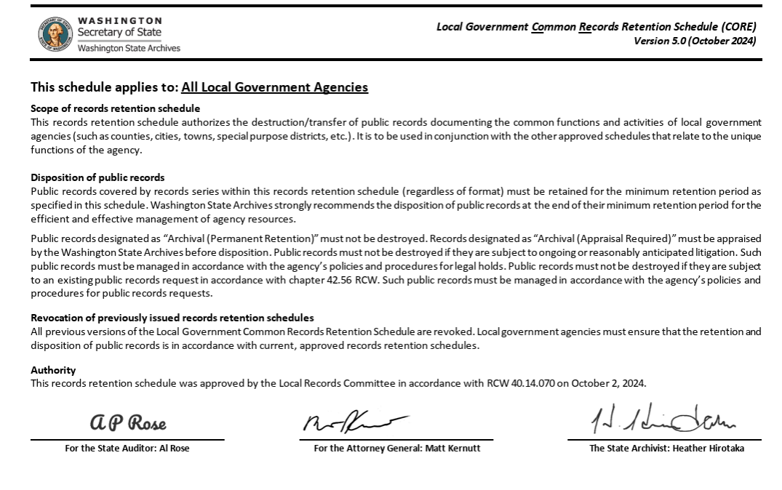
Records Retention
Notes:
determined by its content and function, not simply because it is social media post
The most common retention period in the Local Government Common Records Retention Schedule (CORE) is 6 years.
Pagefreezer
Hootsuite scheduling software

Slide 4
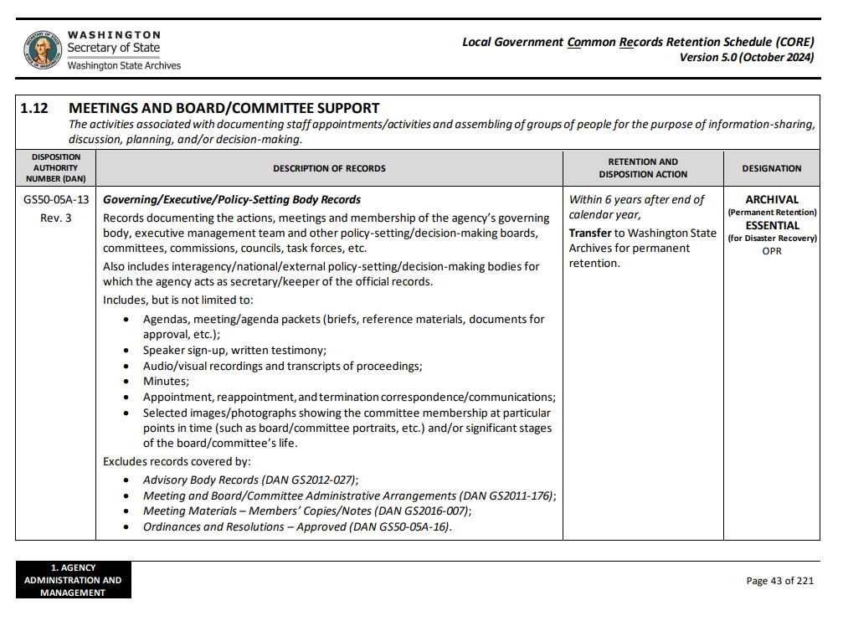
Records Retention
Notes:
Specific instance- livestreaming city council meeting on facebook- public record- Retention period- Within 6 years after end of calendar year, transfer to WA State Archives for perm. Retention. ARCHIVAL and ESSENTIAL

Slide 5
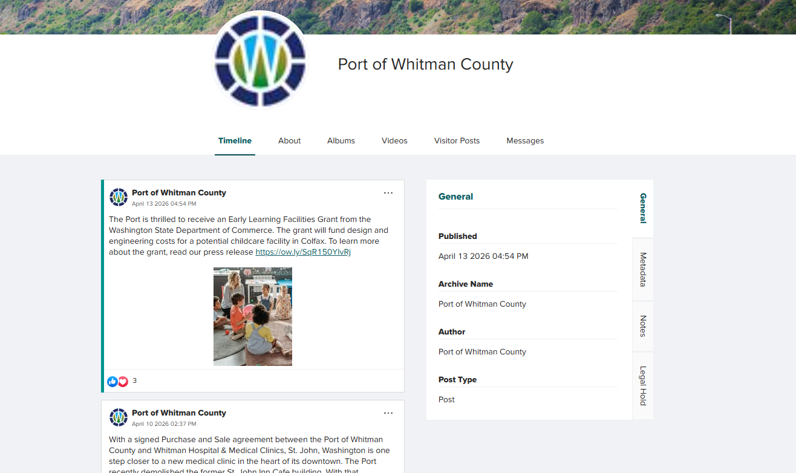
PageFreezer
Notes:
digital archiving and monitoring solution
It automatically captures and preserves websites and social media tools in real-time, creating records for auditing and eDiscovery
Other tools- Smarsh, Archive Social, and Civic Plus

Slide 6
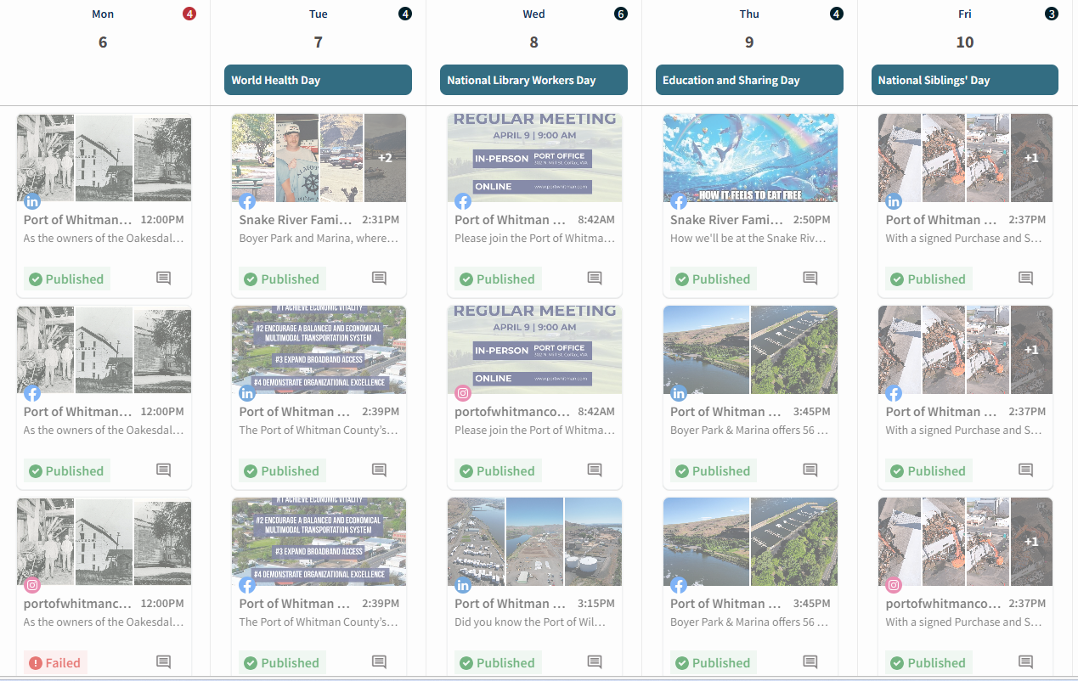
Hootsuite
Notes:
a comprehensive social media management platform that allows us to schedule posts, manage multiple social accounts, monitor conversations, and analyze performance from a single dashboard. It supports major social networks—including Facebook, Instagram, LinkedIn, and TikTok
Other options- Sprout Social, Buffer and Social Pilot
Social media management can be complex without these tools and can make public records requests more difficult- or impossible to fulfill.

Slide 7
Social Media Policy- Employees
“In some cases, the information conveyed through social media has led to legal liability for the person posting the information. In recognition of the large role that social media plays in our society, the Port is providing these guidelines to assist you in utilizing social media in a safe and responsible manner.”
“Use of a social networking site to communicate inappropriately with or about a client or a coworker may lead to the filing of a claim for harassment with the Port or otherwise negatively impact the Port.”
“Through your employment, you may have access to confidential information about clients and coworkers, such as medical conditions, home addresses, and work schedules. Existing Port guidelines that restrict the disclosure of such confidential information apply with equal force to social media postings.”
Notes:
employee posts could be public record
The full statement from the Port’s employee manual is available in our resource link.

Slide 8
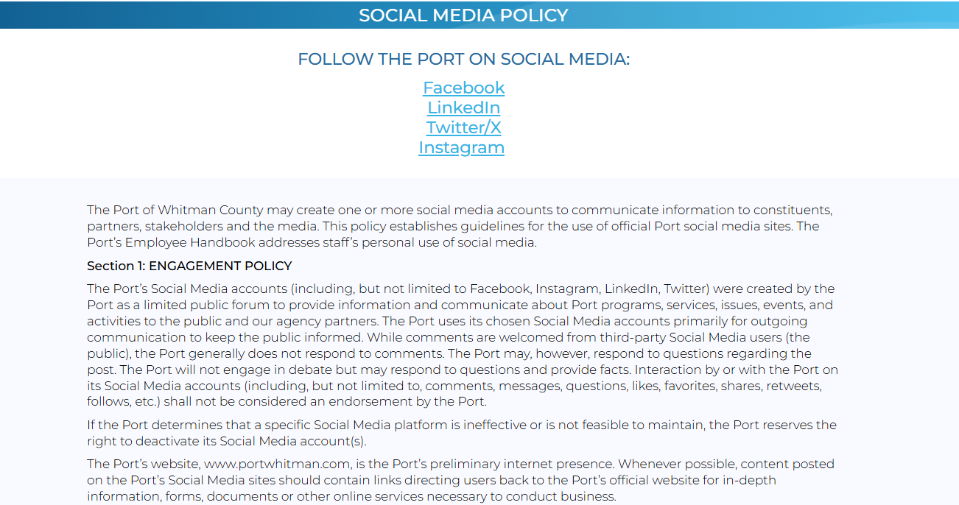
Social Media Policy- Business
Notes:
Posted on the website
Communications between Commissioners via any personal or Port social media/messaging may potentially constitute a “meeting” under the Open Public Meetings Act, RCW 42.30. For this reason, Commissioners are prohibited from posting on social media discussions/threads regarding Port business that involve a quorum of Commissioners, and are strongly discouraged from “following”, “friending” or “liking” other Commissioner-specific posts.

Slide 9
Web Content Accessiblity Guidelines 2.1
50,000 or more persons: April 24, 2026
0 to 49,999 persons: April 26, 2027
Special district governments: April 26, 2027
Applies to websites, applications, and social media accounts
Notes:
Who has heard of the Web Content Accessibility Guidelines or WCAG 2.1?
These guidelines apply to any website, app, or social media account run by a government entity.
Unlike Pirates of the Caribbean, these are more rules than guidelines.
Please check with your legal counsel to ensure you have the correct deadline
If you are not compliant with these rules by the deadline, you can expect someone to take legal action against you.

Slide 10

Notes:
Visually impaired individuals. These individuals use a screen reader to access websites, apps, and social media. I am going to play a quick video that demonstrates how a screen reader works. Once you hear a screen reader, WCAG rules are much easier to understand and put into practice.

Slide 11
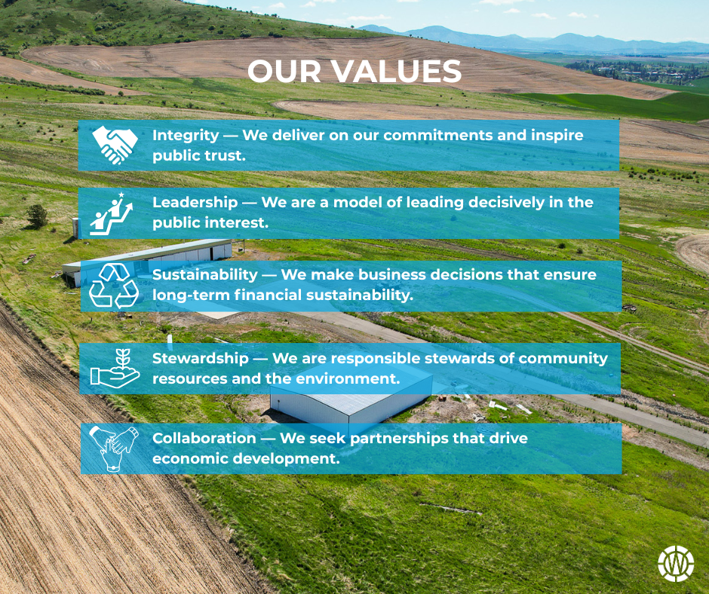
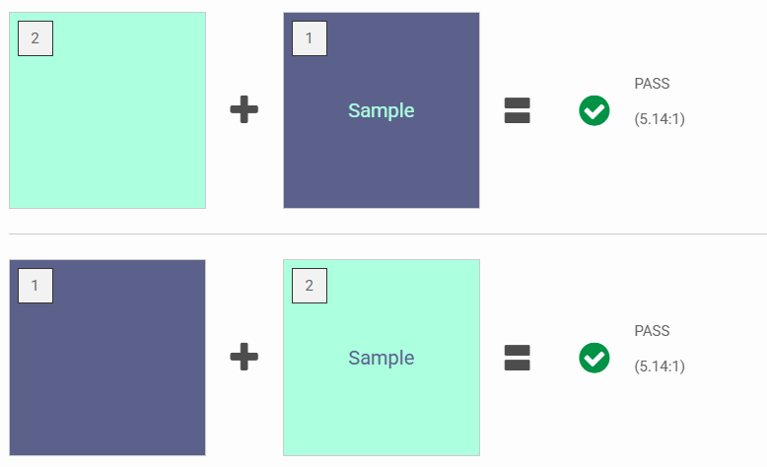
Compliant Images/Graphics
Avoid text on images
Avoid GIFs
Ensure color contrast is compliant
Notes:
Avoid text on images: screen reader can’t read the image. Visually impaired individual will not be able to access the information in your graphic
Avoid GIFs: Hard to explain a GIF with alt text
Ensure compliant color contrast: Ensure easy readability

Slide 12
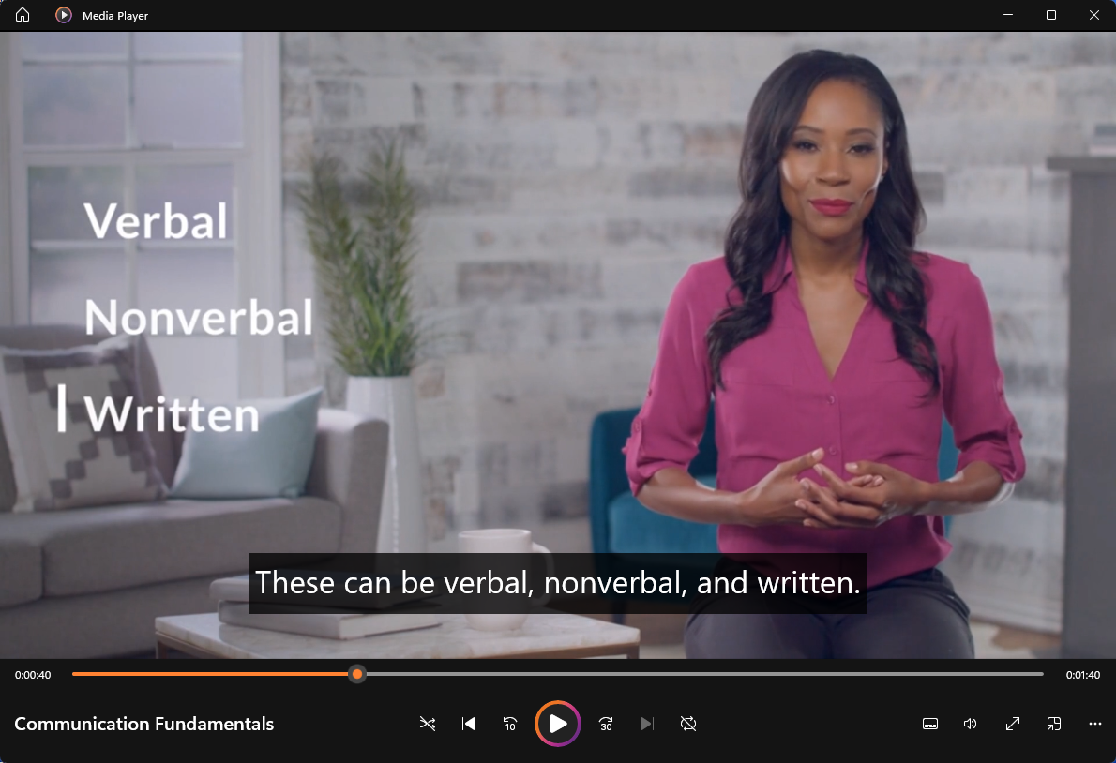
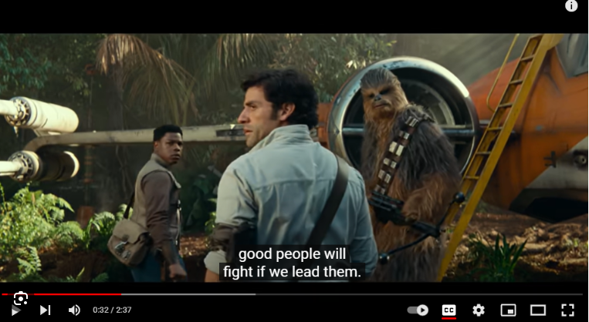
Compliant Video
Remove any flashing content or effects
Provide captions for the video
Ensure captions are readable/have correct color contrast
Notes:
No seizures
Can generate captions on social media but are responsible for their accuracy

Slide 13
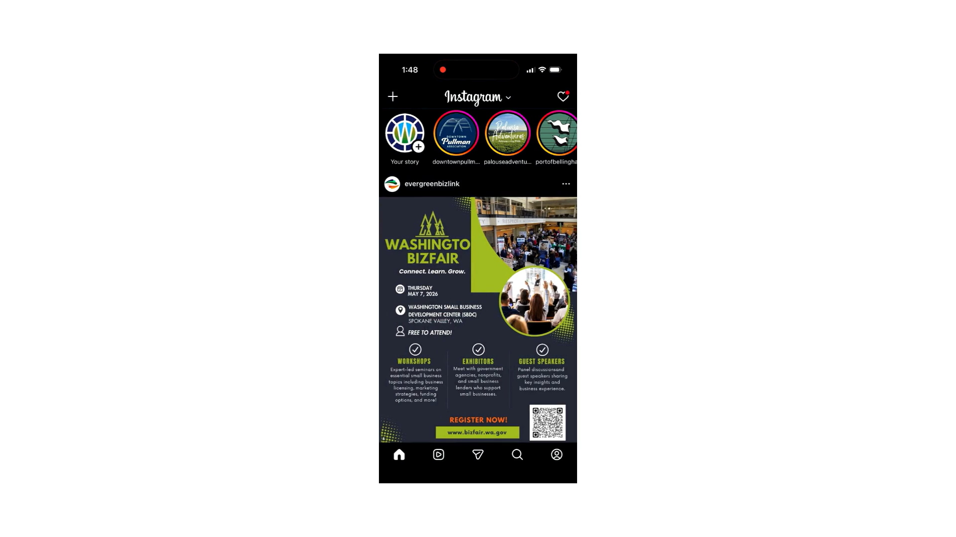
Notes:
Enjoy this awkward video of me

Slide 14
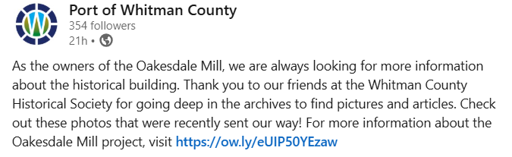
Compliant Captions
Text/Fonts
Avoid unnecessary abbreviation, symbols, special characters
Avoid all caps
Avoid custom fonts
Links
Use only if necessary
Shorten link if able
Notes:
View in context of screenreader

Slide 15
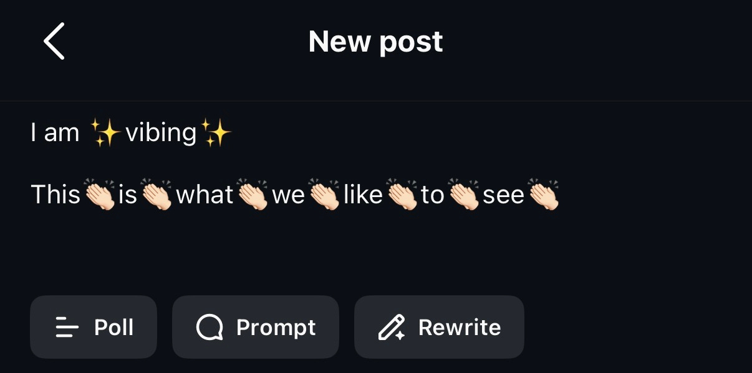
Compliant Captions
Emojis
Avoid emojis
No emojis mid-sentence
Hashtags
Limit hashtag use
Use them at the end of posts
Use Camel Case if using hashtag #InlandNorthwestPartners instead of #inlandnorthwestpartners
Notes:
View in context of screenreader

Slide 16
Alternative Text
Alternative text, or alt text, is descriptive text that conveys the meaning of an image in digital content. It’s designed to make visual content accessible to people with vision disabilities.
Alternative Text 101
1-2 sentences
Consider key elements of the image
Don’t include “image of” or “picture of”
Do include if it’s a logo, illustration, painting, or cartoon
Don’t duplicate text that’s in the caption
End the alt text sentence with a period
Notes:
Instagram adds own alt text but it is often inaccurate. It is your responsibility to ensure your alt text is reflective of the image.

Slide 17
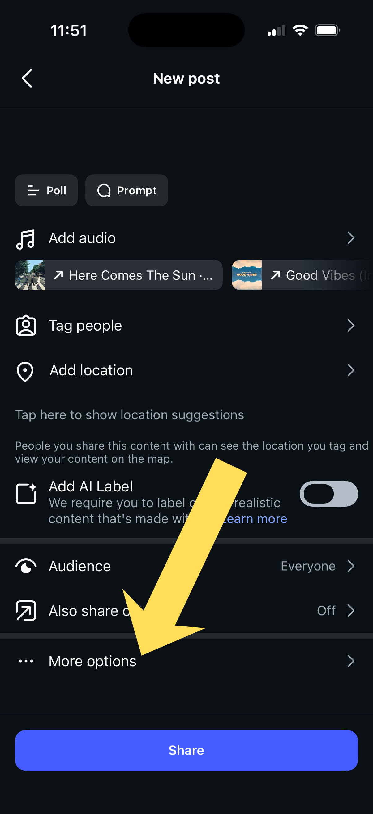
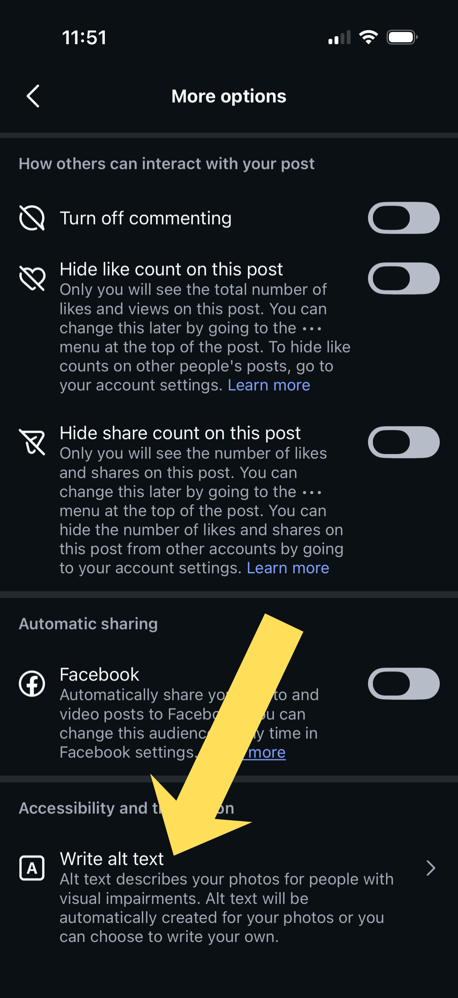
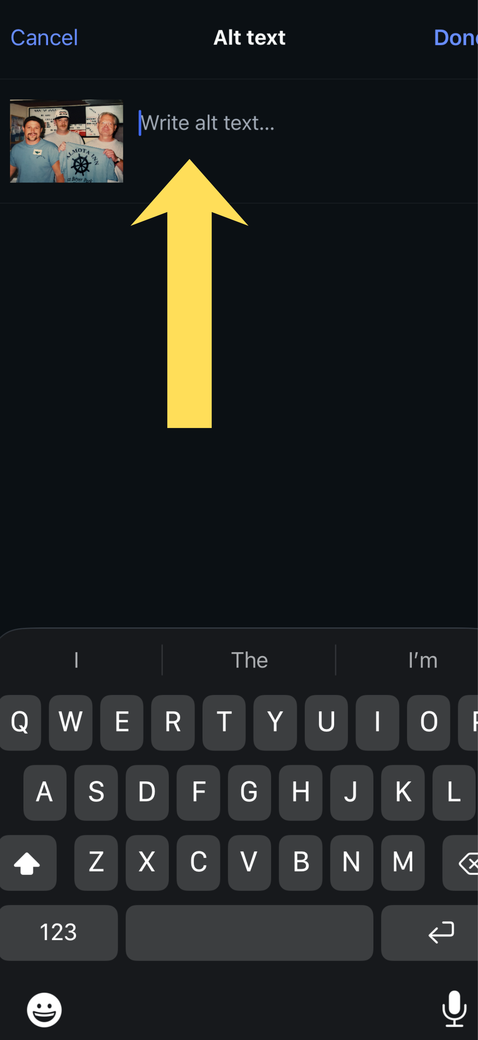
How to Add Alternative Text- Instagram

Slide 18
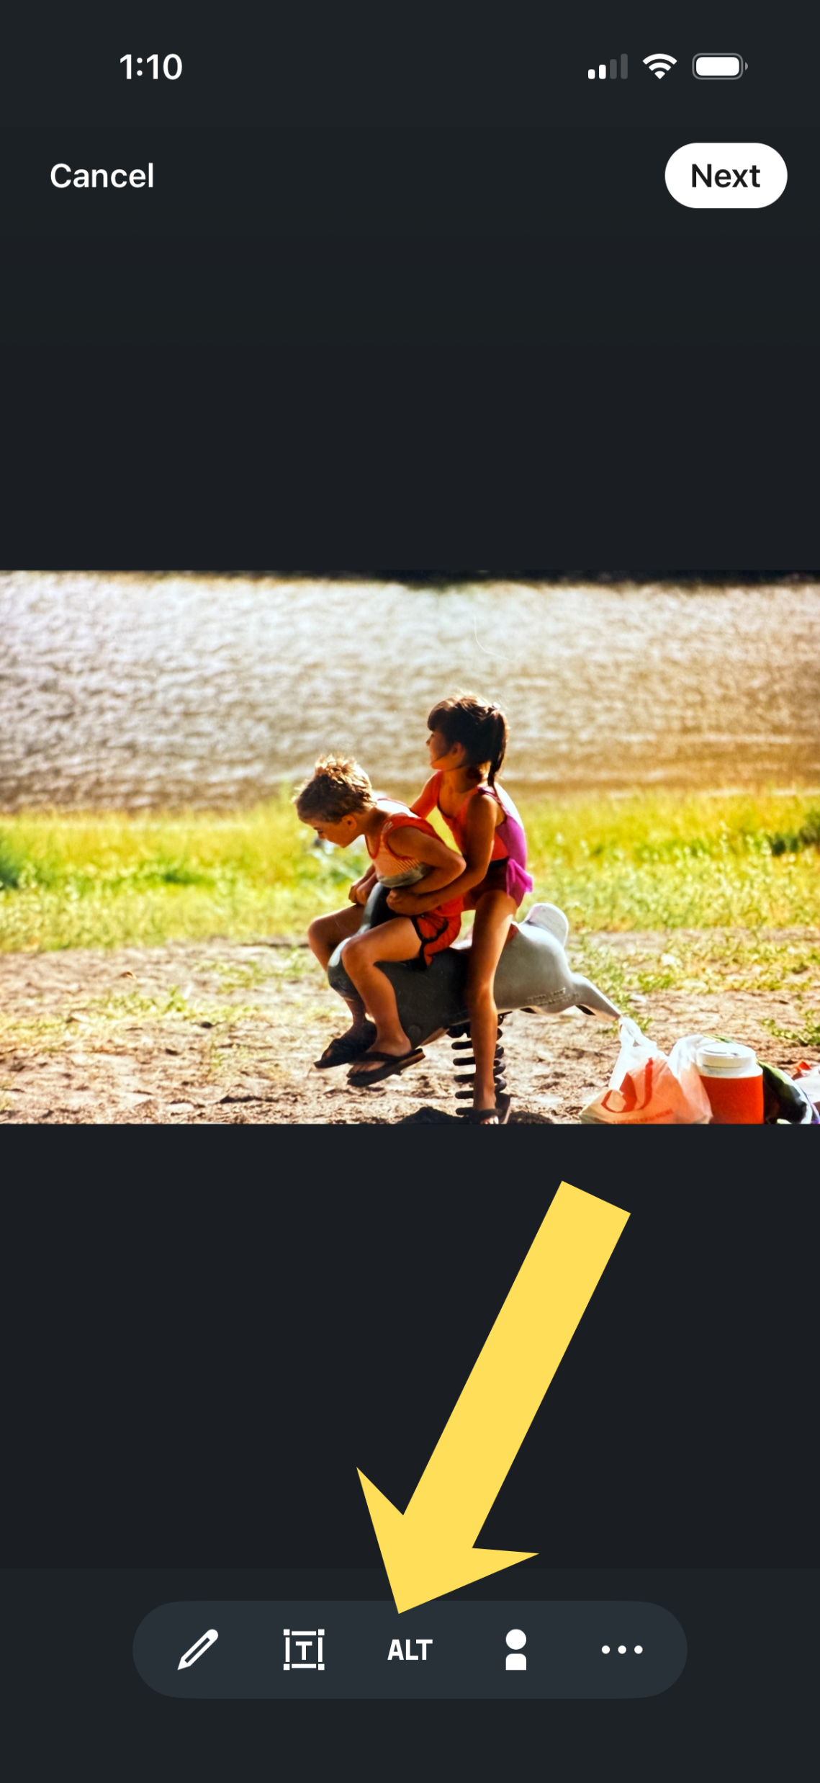
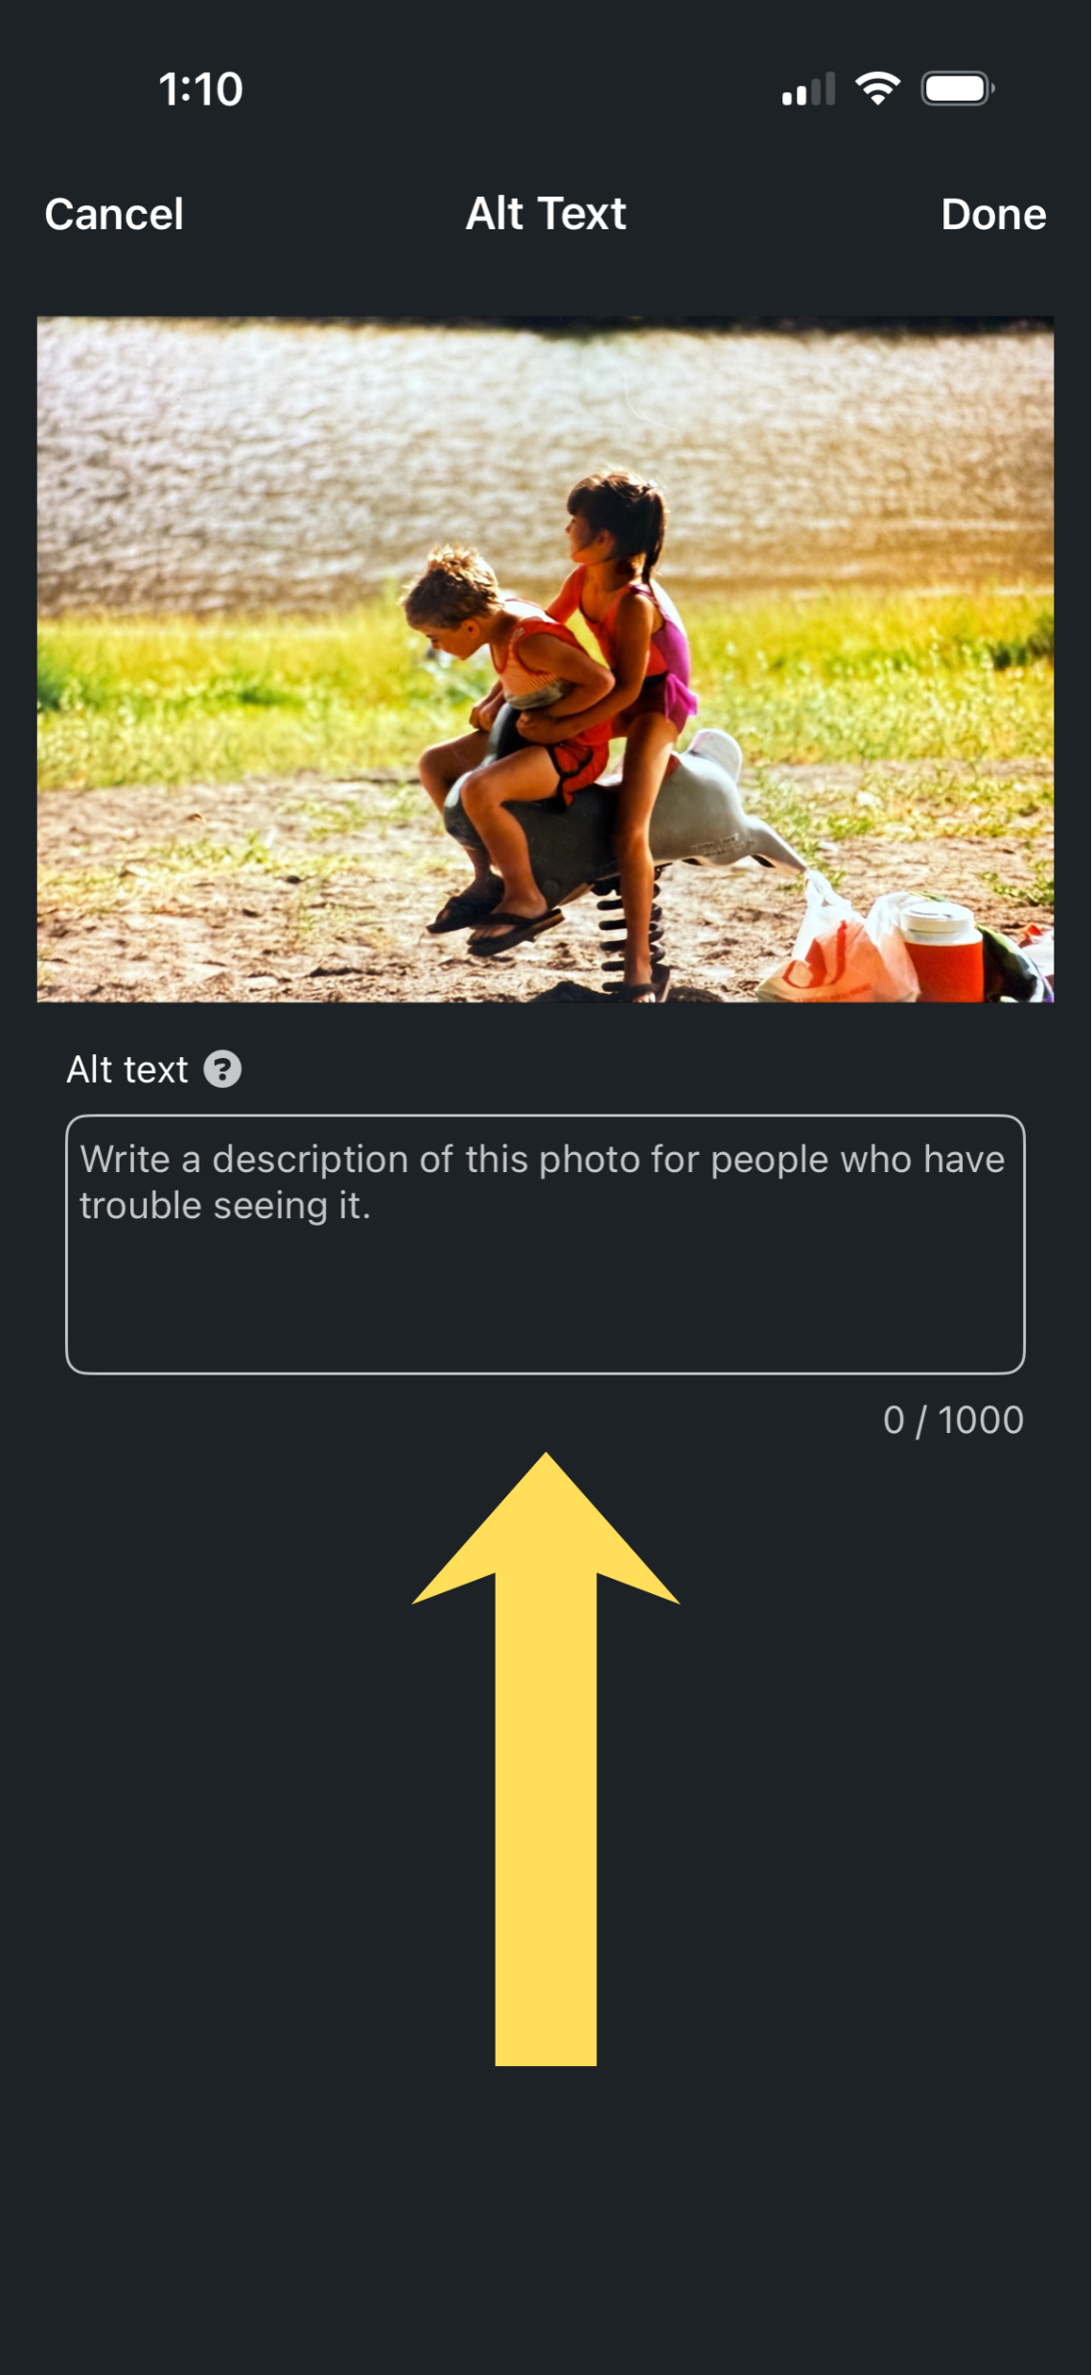
How to Add Alternative Text- LinkedIn

Slide 19
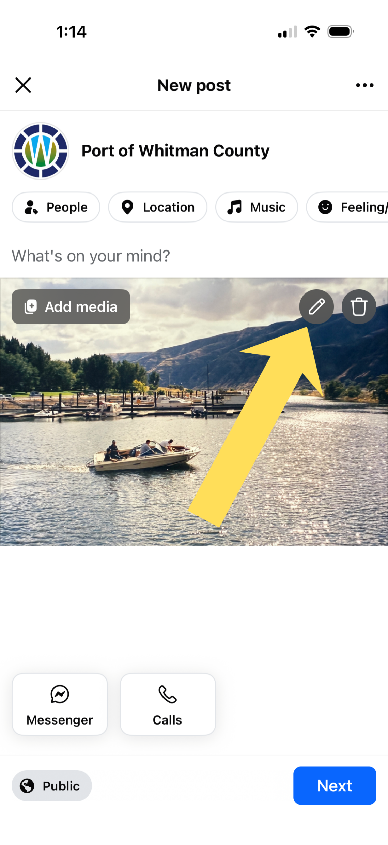
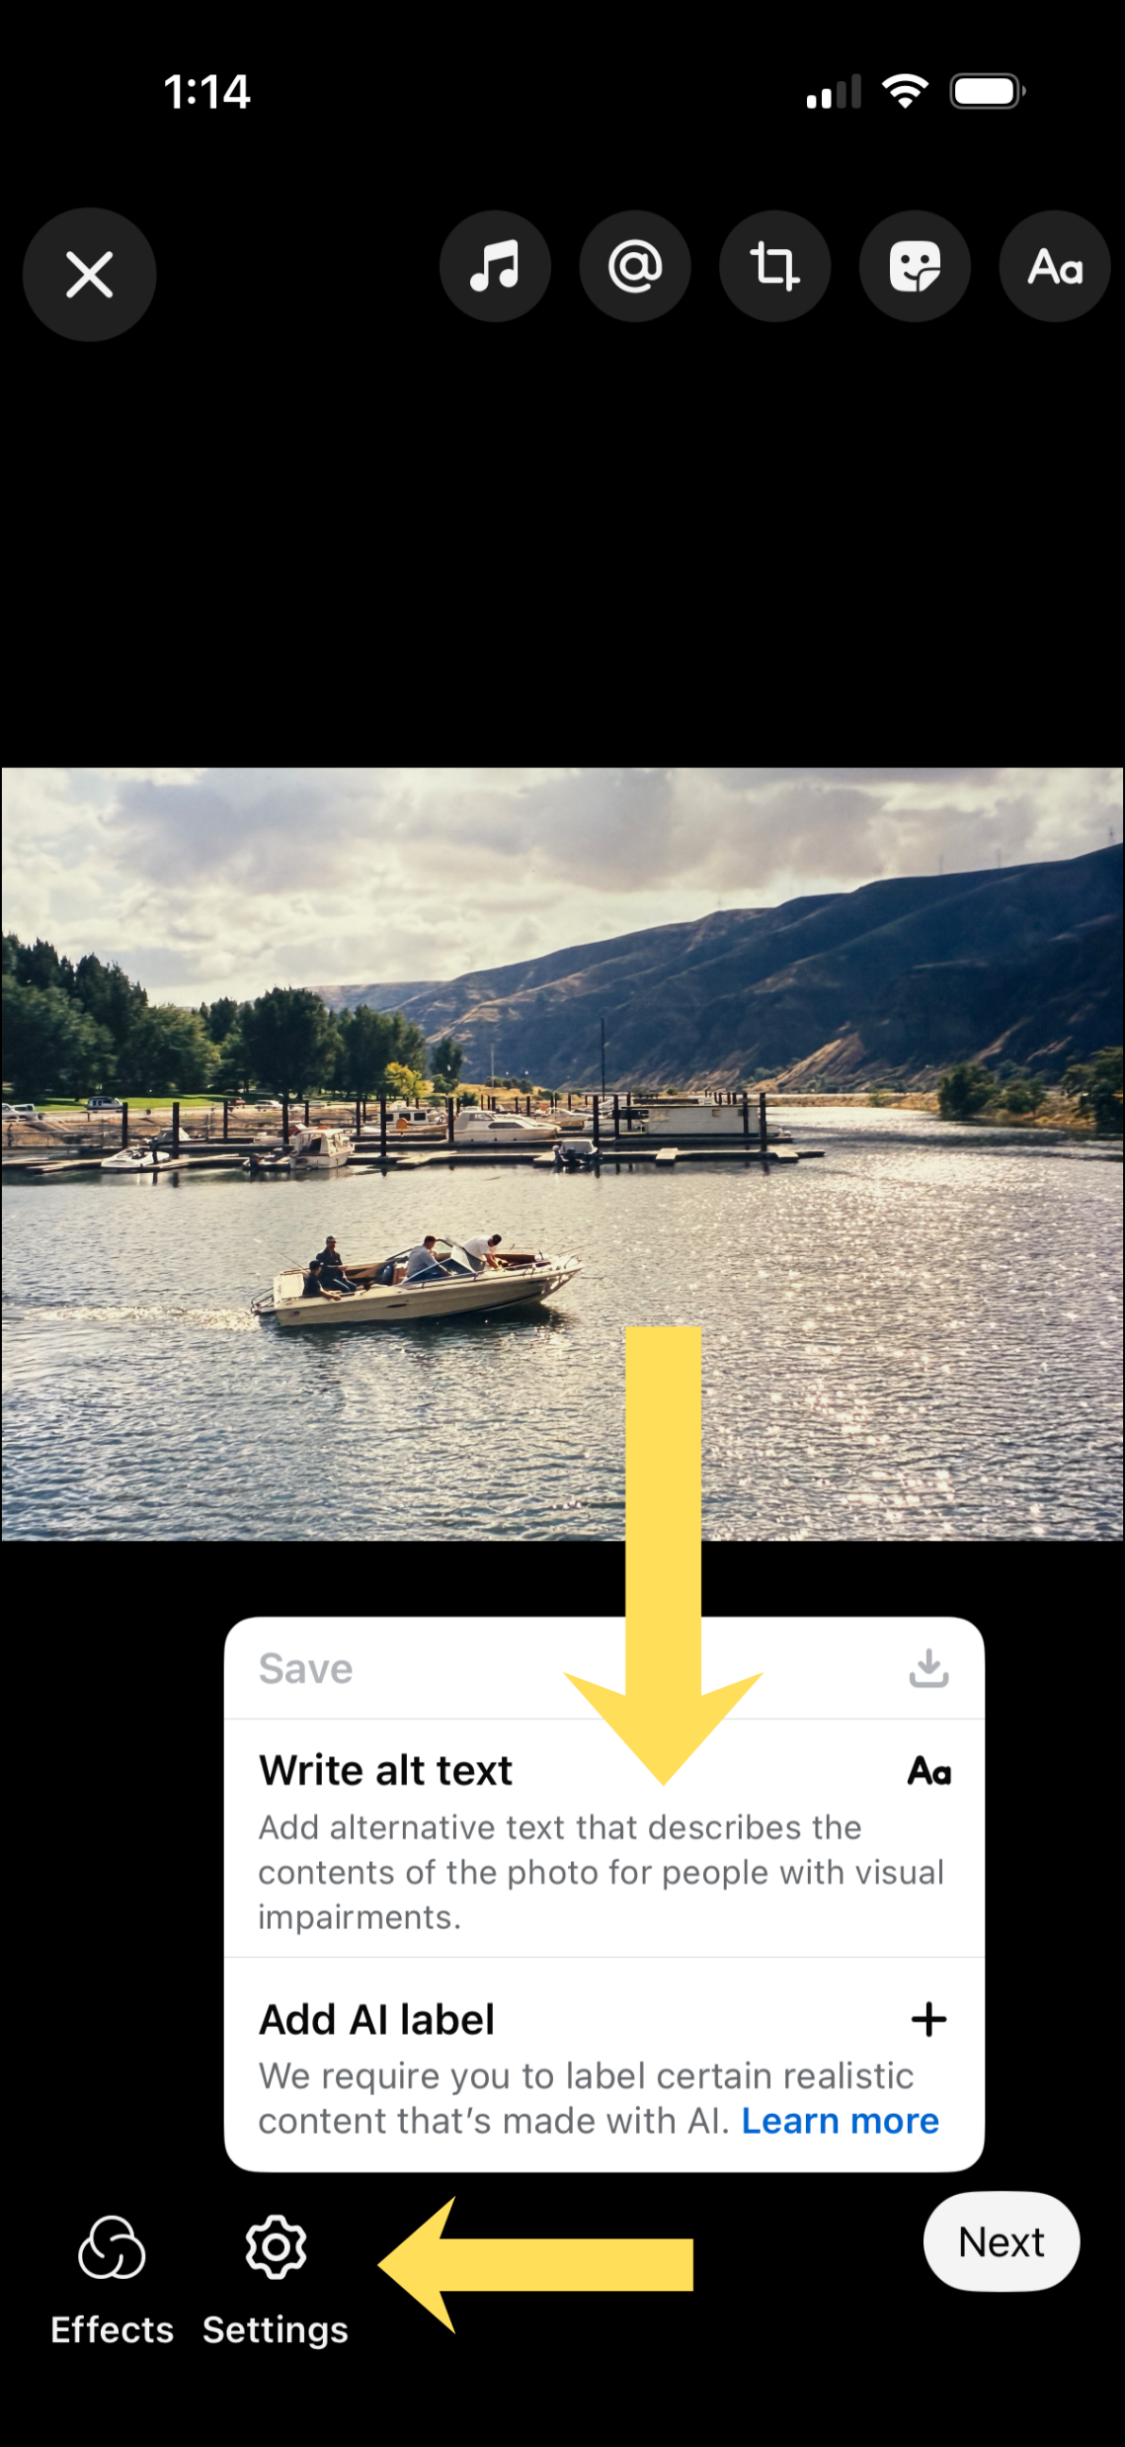
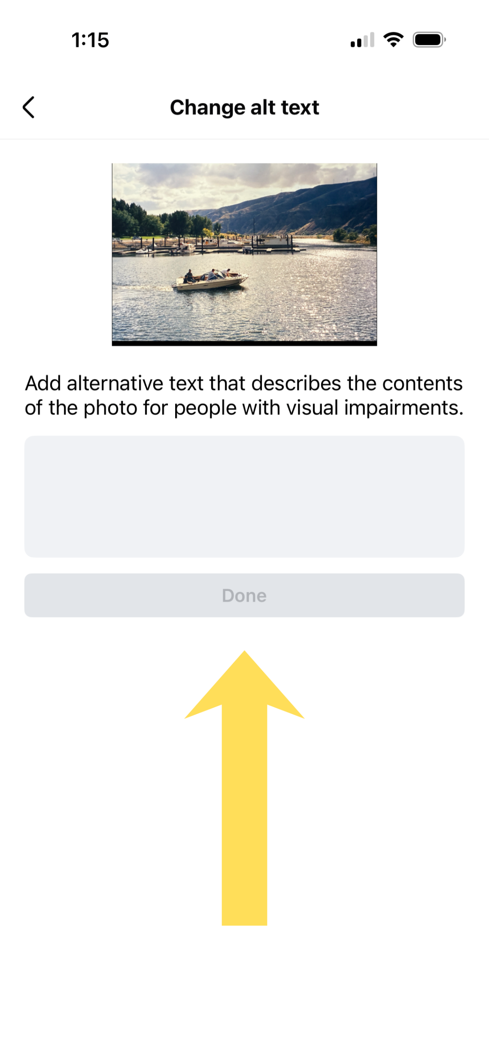
How to Add Alternative Text- Facebook

Slide 20


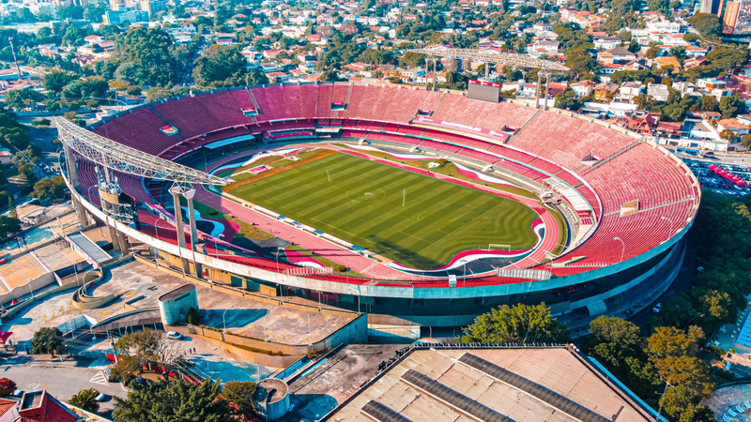
Alternative Text
A golden retriever wearing eyeglasses with brown frames, looking slightly to the left with its tongue out.
A person with white hair wearing oversized sunglasses, a yellow jacket, and colorful beaded necklaces, holding a microphone and singing with their fist raised in the air against an orange background.
An aerial view of a large, circular stadium with a green football field and red seating, surrounded by a city landscape.
Notes:
Canva has alt text generator

Slide 21
Summary
Check with legal counsel for correct deadline
Rules rather than guidelines
Rules apply to website, applications, and social media
Avoid graphics and gifs
Ensure videos are equipped with proper closed captioning
Follow rules for compliant captions
Always use alternative text

Slide 22
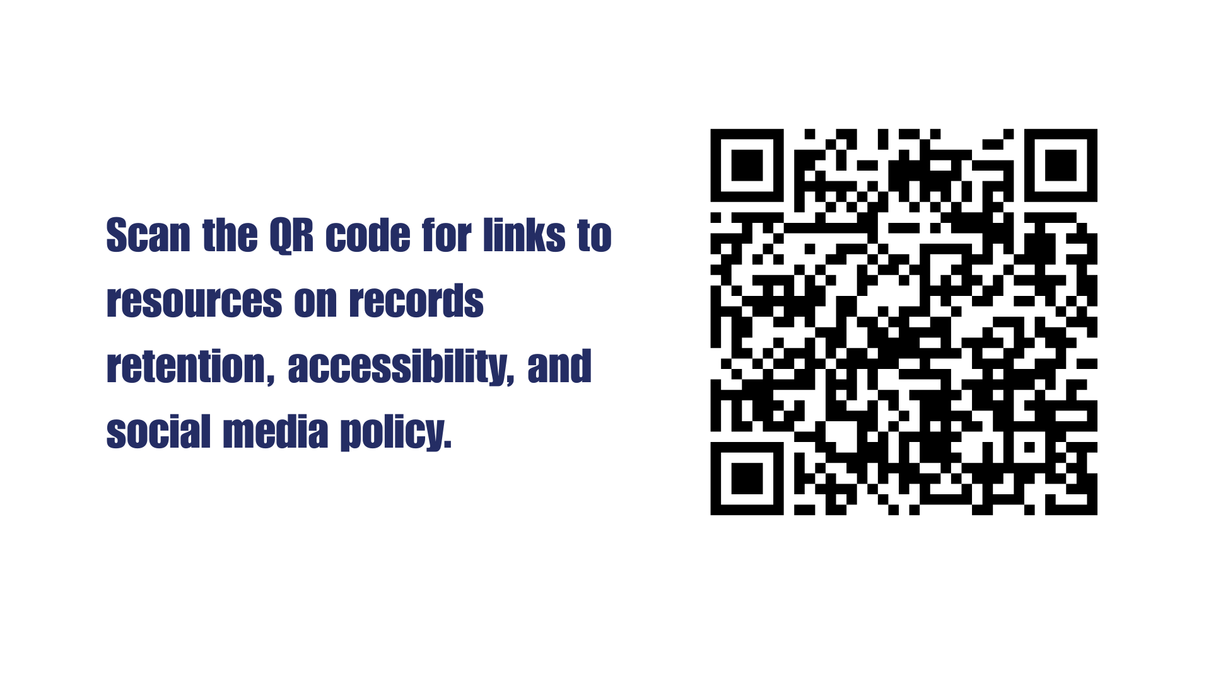

Slide 23
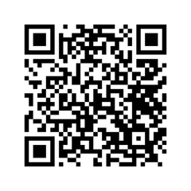
Questions?
Follow the Port on social media!

Slide 24


