Slide 1

IT’S TIME
TO BUILD YOUR INSTAGRAM FRAMEWORK

Slide 2
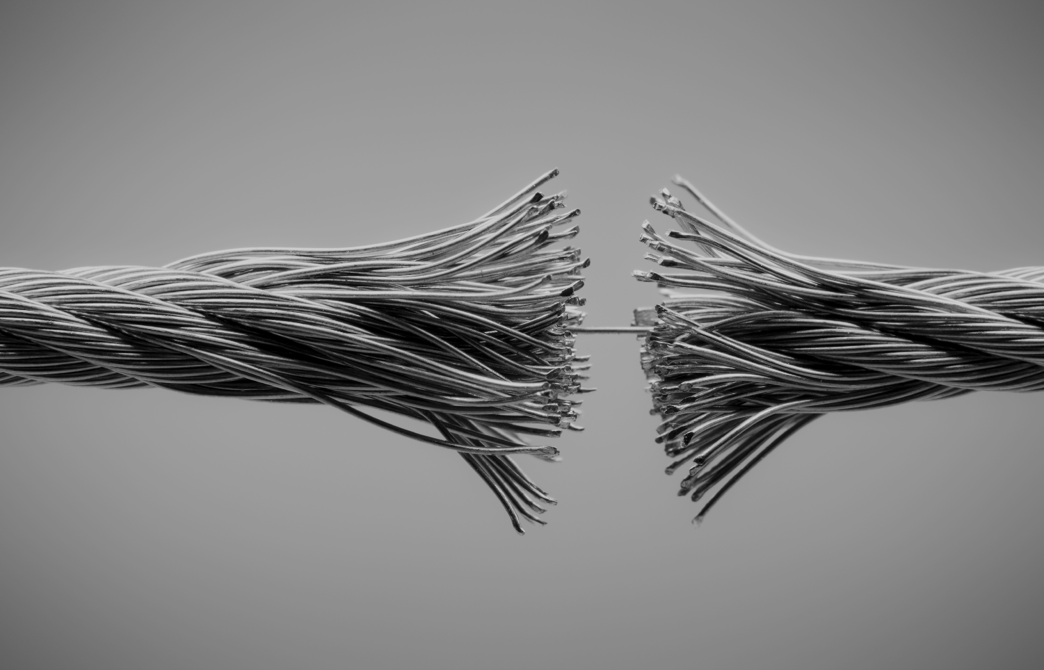
SOCIAL MEDIA IS OVERWHELMING

Slide 3
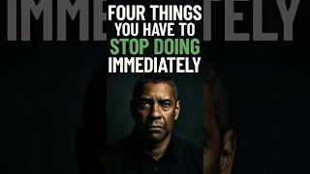

Slide 4


THERE IS HOPE

Slide 5

HEY! I’M JESS!

Slide 6
LET’S GET INTO IT

Slide 8

THE 3 STEPS
market Research
messaging
application

Slide 9

MARKET RESEARCH
demographics
interests/desires

Slide 10

MESSAGING
Phrases they use
Formal? Conversational?
Type of medium

Slide 11
OKAY. NOW WHAT?

Slide 12

CREATING CONTENT
Get inspired
Schedule it
Post it

Slide 13
POST, GATHER DATA, ANALYZE, POST AGAIN

Slide 14

QUESTIONS

Slide 15
