Slide 1

START WHERE YOU ARE:
STORYTELLING FOR CONNECTION
Ariana Lake, M.A.
Avista Senior Communications Manager
@ArianaLake1
ariana.lake@avistacorp.com
Notes:
Hello everyone—thank you so much for being here.
It really is a pleasure to spend time with you today.
My name is Ariana Lake, and I am a professional storyteller.
Now—if you had asked me as a kid what I wanted to be when I grew up, professional storyteller would not have made the list.
But when you understand where I’m from, it starts to make a lot more sense.

Slide 2
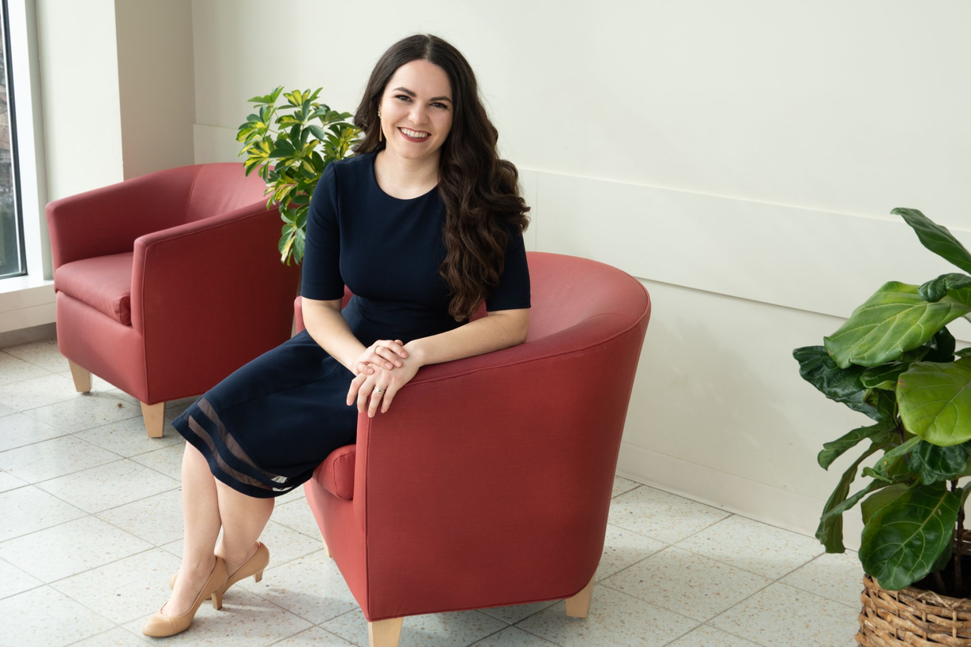
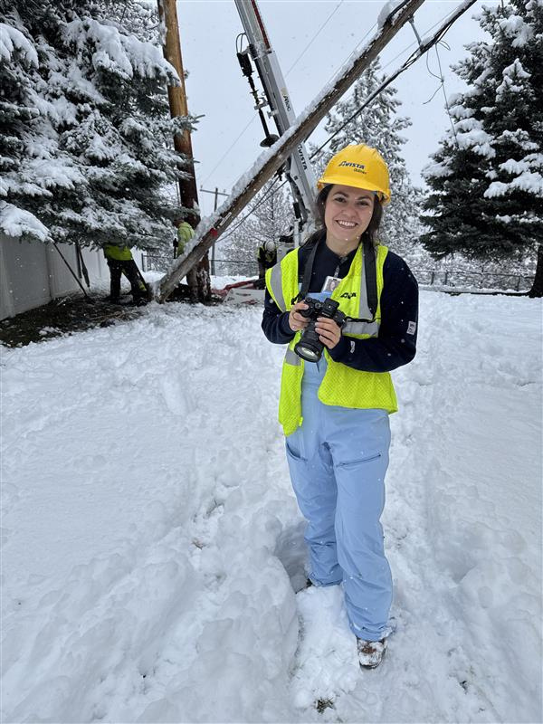
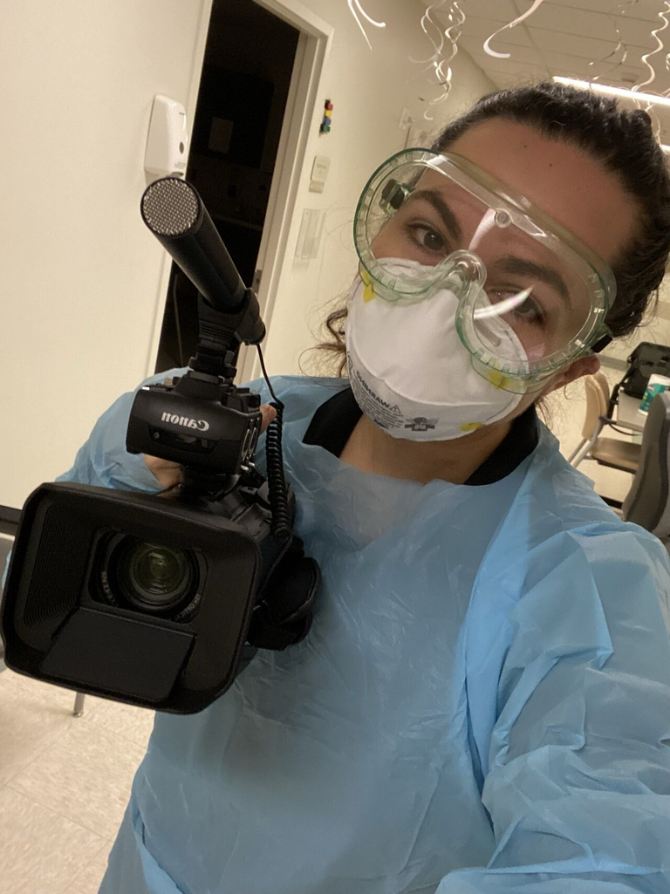
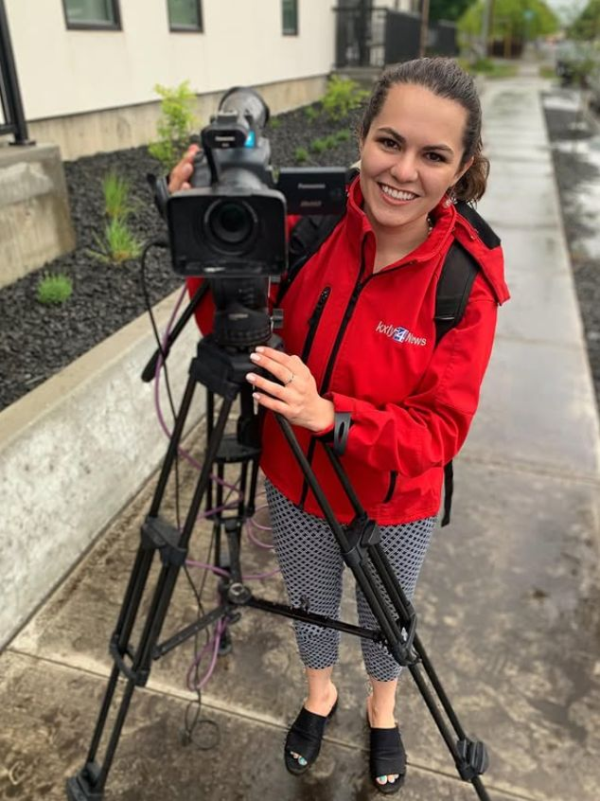
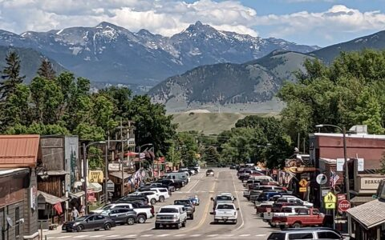
Just a small-town girl...
who was raised in a town with more cows than people and grew up to be an Emmy-nominated professional storyteller.
A few things I’m proud of earning:
Master of Arts in Strategic Communications (Go Cougs!)
Graduate Certificate in Mission Leadership
Bachelor of Arts in Journalism (Go Griz!)
FEMA Certified Advanced Public Information Officer (PIO)
12+ years of professional storytelling & strategic communications experience
Hi! I’m Ariana Lake.
My hometown of Ennis, MT.
Population 917
Notes:
I grew up in a small town in Southwest Montana called Ennis.
Population: just under a thousand people.
And if you like to fly fish—
I apologize in advance… because you may now be extremely jealous.
What makes Ennis special isn’t just the fishing—though it is some of the best in the world.
What makes Ennis special is something that all small towns share:
Stories.
Stories about who’s related to who.
Stories about which business has been there the longest.
Stories about who you can count on—and who knows how to fix just about anything.
So quick show of hands—
If you’re from a small town… or you currently live in one?
Perfect. Then you already understand this part.
When I was growing up, we didn’t need social media.
We had:
• The grocery store checkout line
• The counter at the local café
• The church pews filled on Sunday
That’s where information traveled.
That’s where reputations were built.
That’s where trust lived.
Since then, I’ve been a television news anchor and reporter.
I worked in healthcare communications during the pandemic—yes, that’s me in full PPE, trying to smile with my eyes.
And today, I work at Avista, helping people better understand how utilities work—and more importantly—the people behind keeping the lights on.

Slide 3
If you don’t tell your own story, someone else will.
(And they may not get it right.)
Notes:
Every role I’ve had has reinforced the same lesson:
If you don’t tell your own story, someone else will.
And they probably won’t get it quite right.

Slide 4
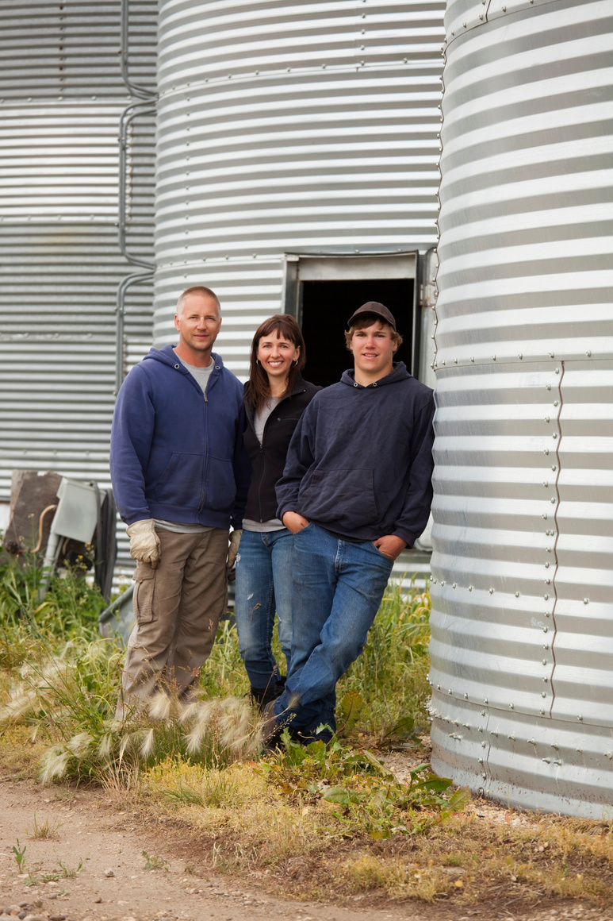
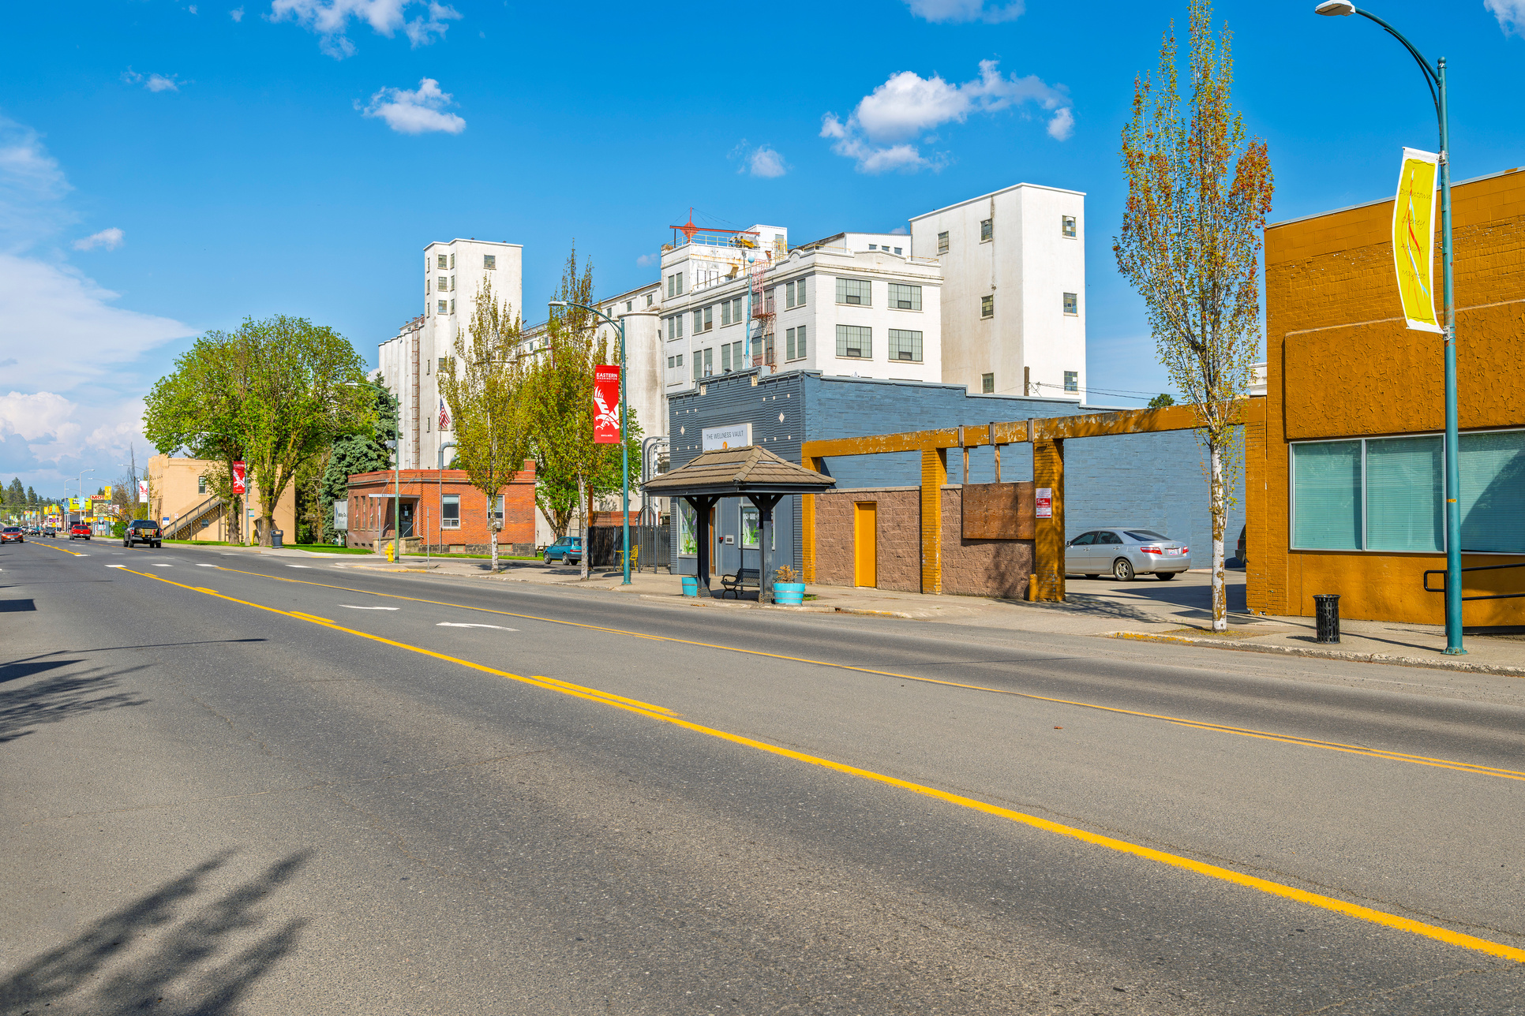
Let’s grow .
Examples
Group sharing
Simple storytelling framework
Notes:
Today, I want to talk about why storytelling matters—especially on social media.
We’ll:
• Look at a few real small town examples
• Walk through a simple storytelling framework
• Do a quick group brainstorming exercise
I will not give you the secret code to go viral—because that doesn’t exist. But I hope that I will help you see social media as something human, doable, and useful.

Slide 5
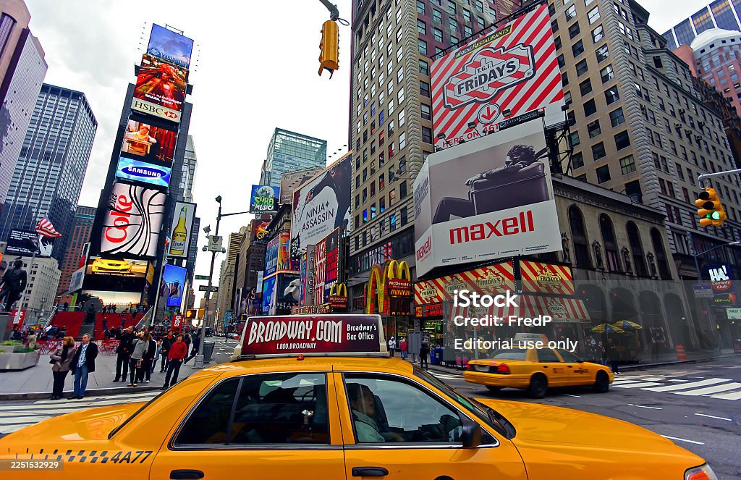
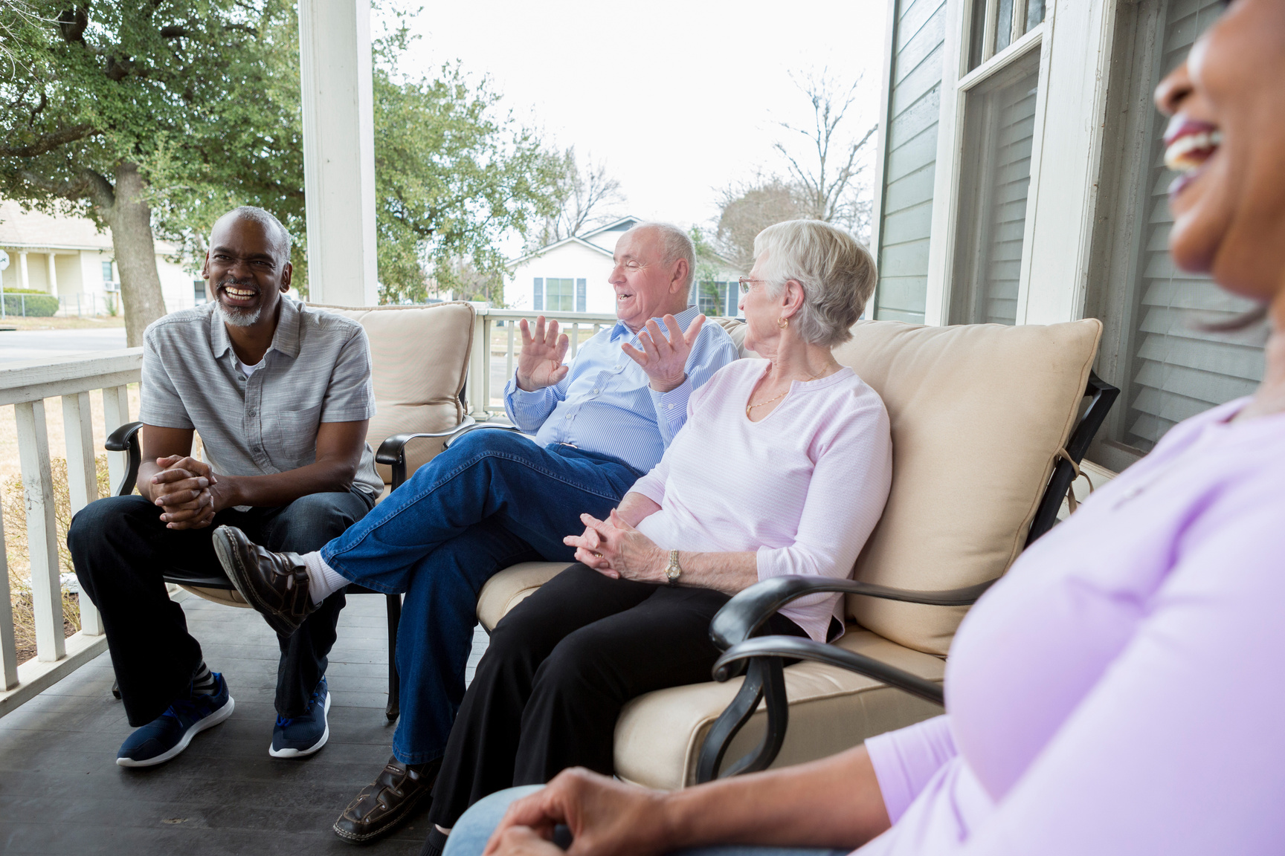
billboard
VS
front porch
Notes:
I want to offer a mindset shift.
I invite you to think of social media less like a billboard… and more like a front porch.
A billboard says:
“LOOK AT ME.”
“BUY THIS.”
“EXIT NOW.”
A front porch says:
“Come on up.”
“Sit for a minute.”
“How have you been?”
In small towns, front porches matter.
And social media—at its best—is simply a digital front porch.

Slide 6
You don’t need a big budget to make a big impact.
Notes:
One of the most common things I hear is:
“We don’t have a big enough budget to make an impact.”
I want to say this clearly:
You absolutely can make a difference—without spending thousands of dollars.
Because when it comes to social media…
Your front porch doesn’t just face your dirt road.
It opens to the entire world.

Slide 7
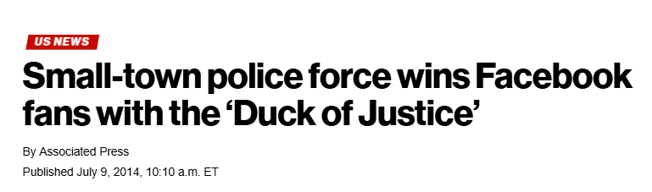
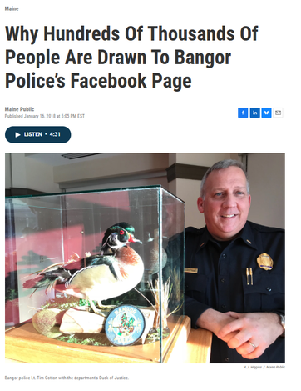
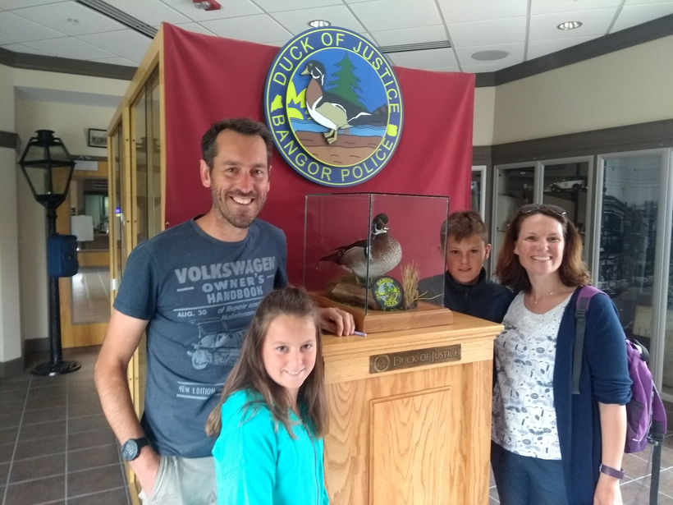
the Duck of Justice &
the Bangor Police Dept.
Let’s be inspired by
Authenticity builds trust and community
Bangor PD’s Facebook page got 300,000+ followers
(over 9 times the city’s population) from around the world.
Their content regularly receives 1,000+ engagements (likes, comments, etc.)
“I think it’s important we try to tell our story with our own words.”
Lieutenant Tim Cotton. Bangor Maine Police Dept. Facebook Page Admin.
Source: Viral Facebook Page Shares 4 Tips For Gaining Followers
Notes:
Let me tell you one of my favorite small town success stories.
In Bangor, Maine, a longtime police lieutenant named Tim Cotton was asked to manage the department’s Facebook page.
No marketing team.
No consultants.
No budget.
Just him—and eventually—a taxidermized duck.
The duck started appearing in photos around town.
No big explanation.
No strategy.
Just personality.
The result?
• Over 300,000 followers
• People traveling from around the world to take photos with the duck
• And one couple—from the UK—who made it a vacation stop
What I love about this story is that they didn’t try to be clever.
They tried to be themselves.
Their posts sounded like Bangor.
Felt like Bangor.
Reflected Bangor’s humor and heart.
And people trusted it—because authenticity builds trust.

Slide 8
By speaking in a genuine, human voice and sharing slice-of-life stories, a small-town built trust and a devoted online community.
Notes:
This storytelling approach even attracted national media; The Washington Post dubbed it “the only police department in America with a funny Facebook page,” highlighting its unique voice.
Bangor’s example shows that authenticity and consistency can beat a big budget – and even generate positive PR far beyond the town’s borders

Slide 9
Storytelling framework
Spot the story.
Shape the message.
Who’s doing something kind, creative, or courageous?
What’s happening that makes you proud to live here?
What’s a tradition, place, or person that makes your town unique?
How will you tell the story?
Photos with caption
A short video
And more...
Share with intention.
Spark engagement.
Choose a posting cadence that works for you
Quality>quantity
Consider blocking your calendar to ‘batch create’ content
Ask a question
Invite people to comment or share
Respond to comments when you can
Notes:
So how do you find your “Duck of Justice”?
Here’s a simple framework I use—with small towns, small businesses, and large organizations alike.
1. Spot the Story
First—find the story.
And here’s the challenge:
You must temporarily forget what you think is ordinary.
Think like a reporter:
• Who’s doing something kind or creative?
• What moment made you proud to live here?
• What tradition would visitors never know without you?
2. Shape the Message
Next—shape the message.
You’re not just posting what happened—you’re deciding:
• What do you want people to understand?
• What feeling should they walk away with?
Photos and short videos work beautifully.
And I mean this sincerely: cell phone photos are more than enough.
Authenticity beats perfection every time.
3. Share With Intention
Now—share with intention.
You do not need to post every day.
For many small towns or local businesses: One good post a week is fantastic.
If time is tight, block 30–45 minutes and batch your content.
Social media is short.
You can create more than you think—faster than you think.
4. Spark Engagement
Finally—invite conversation.
Ask things like:
• “What’s your favorite summer memory here?”
• “Who remembers when this building looked like this?”
When people comment, your message travels further.
And yes—sometimes you’ll get negative comments.
My advice?
• Don’t take it personally
• Don’t engage unless clarification is needed
• Correct misinformation politely—for everyone else reading

Slide 10
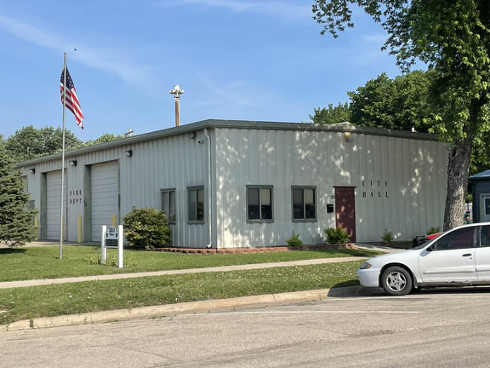
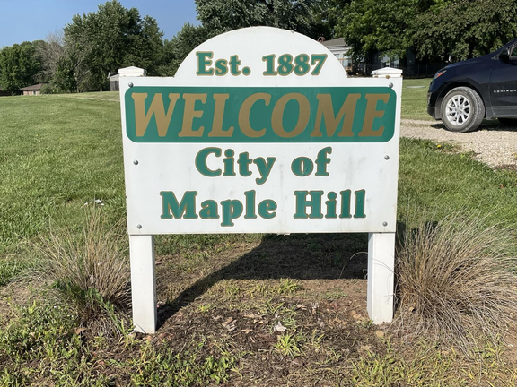
Let’s be inspired by
Maple Hill, Kansas
A simple, low-cost contest turned residents into storytellers—and visitors into future guests.
A rural town of ~600 residents launched a user-generated content campaign to boost off-season tourism. Their “Capture Maple Hill” photo contest invited locals and visitors to share their best images of the town on social media. The prize? A free weekend stay.
Results:
500+ photo submissions in one month
25% increase in hotel bookings during the off-peak season
Boosted community pride and online visibility
Source: SocialTargeter.com
Notes:
In Maple Hill, Kansas—population around 600—they ran a simple photo contest.
Locals and visitors shared their favorite photos of town.
The prize? A free weekend stay.
The results?
• Over 500 photo submissions in one month
• A 25% increase in off season bookings
• And a noticeable boost in community pride
They didn’t hire an agency.
They invited their community to help tell the story.

Slide 11
These towns didn’t try to be something they’re not;
instead, they celebrated exactly what and who they are – and invited the world to joyfully participate.
Notes:
Here’s the secret sauce:
You live in your towns because they’re special.
And right now—there are a lot of people looking for:
• Slower pace
• Real places
• Genuine connection
Your story is the advantage.
Especially for younger travelers and families—small towns feel like the answer they’ve been searching for.

Slide 12
Artifical Intelligence: A word of caution
While AI-driven workflows support effective content and campaigns, consumers crave social content with a human touch.
Findings from Hootsuite 2026 Social Media Trends Report
AI tools can help:
Draft captions or post ideas faster
Generate content calendars
Brainstorm creative angles for story ideas
Hootsuite Social Media Trends 2024
Notes:
AI is everywhere—and yes, it can help.
It’s great for:
• Brainstorming captions
• Organizing ideas
• Understanding posting times
But I urge caution with AI generated images and videos.
They’re increasingly underperforming—and harming trust.
One Montana town shared an AI image of their Main Street.
And people noticed:
• Buildings were wrong
• Signs were off
The backlash was immediate.
Because when people love a place—they want to see the real thing.
Your story is too important to let a robot tell it.

Slide 13
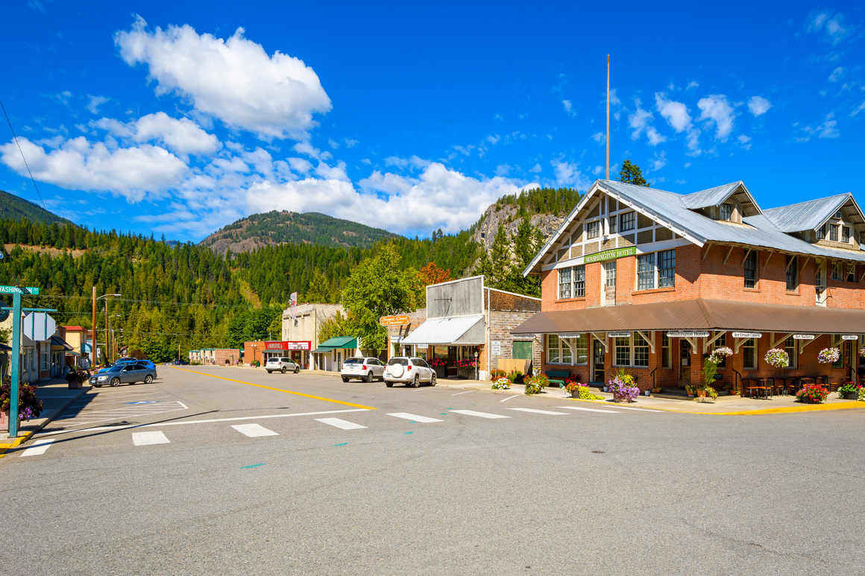
What stories will you tell?
Who is one local person or business who deserves a shoutout—and why?
What’s a photo you could take today that shows off your town’s charm?
What’s a quirky tradition, event, or landmark that only your town has?
What’s a ‘then and now’ photo you could post to show how your town has changed?
What’s a story that would make someone say, ‘I want to visit that place’?
Notes:
Now—I’d love for us to try something together.
You have one minute.
Look at the prompts on the screen—and write down as many story ideas as you can.
We'll share at our table-and then I’ll ask a couple volunteers to share.

Slide 14
Thank you.
Ariana Lake, M.A.
Avista Senior Communications Manager
@ArianaLake1
ariana.lake@avistacorp.com
Notes:
Thank you—for your creativity.
For your openness.
And for caring enough about your communities to show up.
You don’t need to start somewhere perfect.
You just need to start where you are.
Because your front porch is already built.
You just have to open the door.
Thank you.

