Slide 1

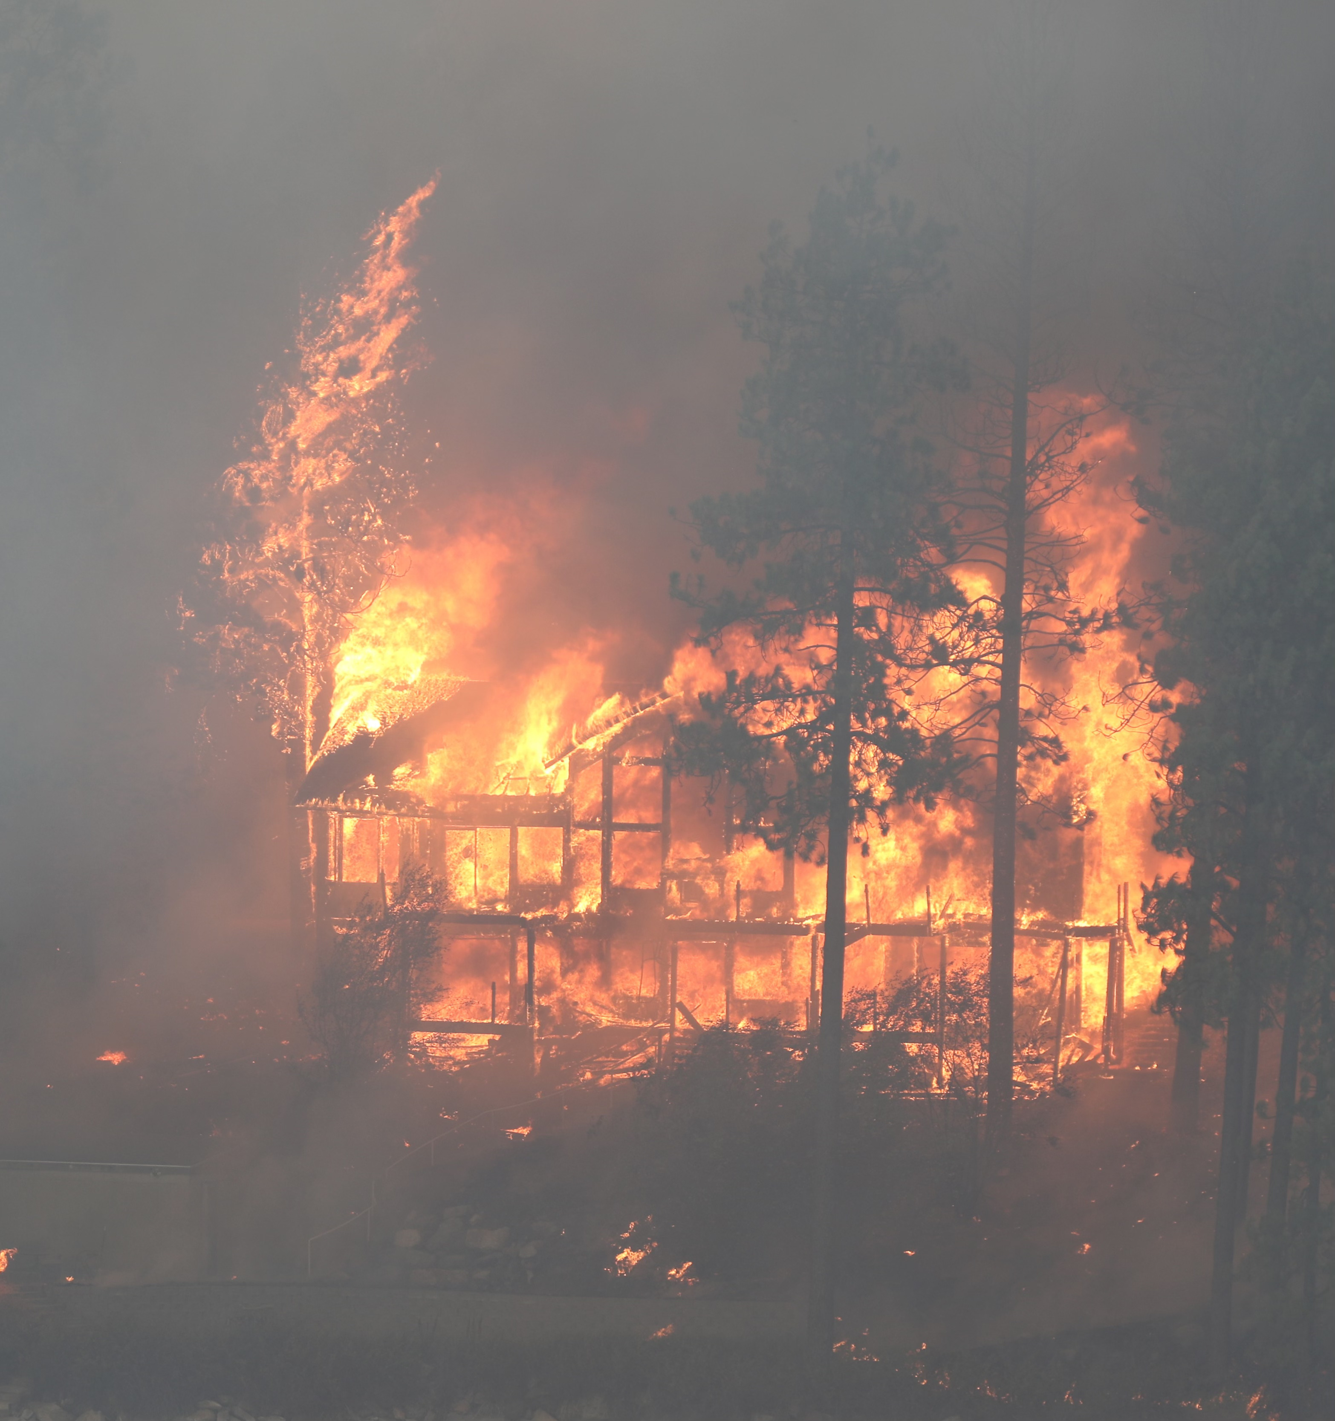
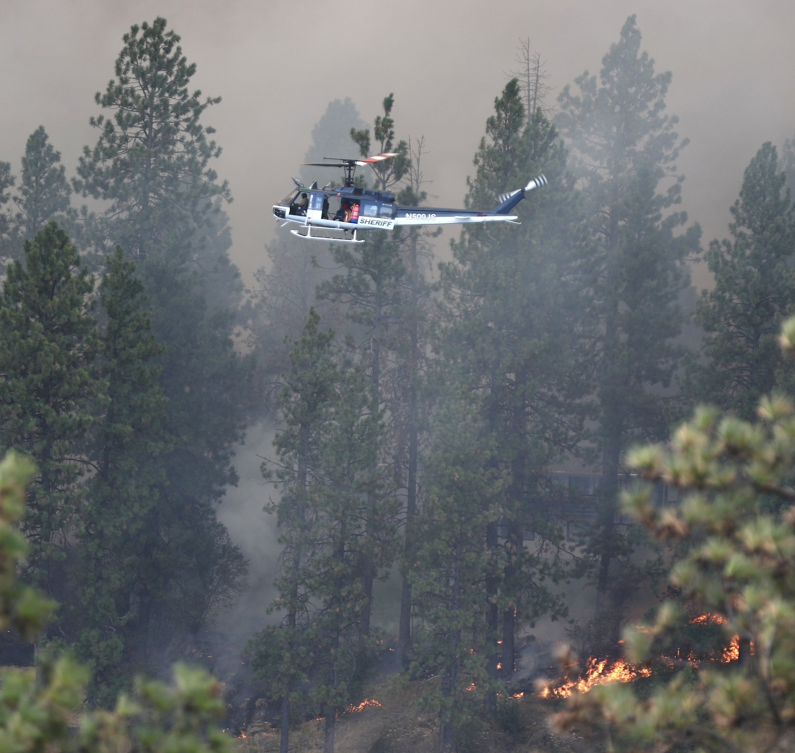
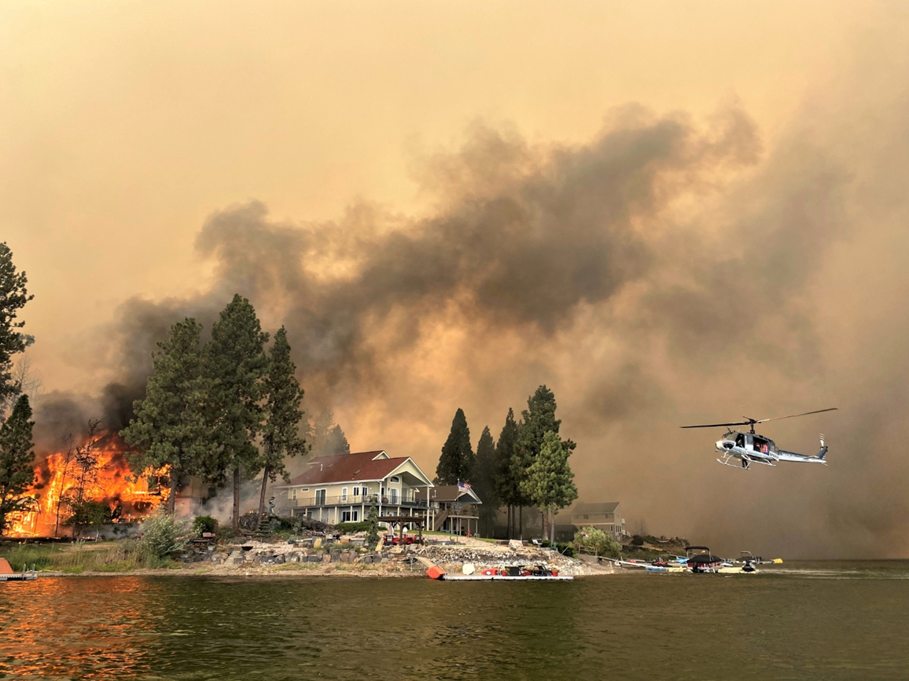
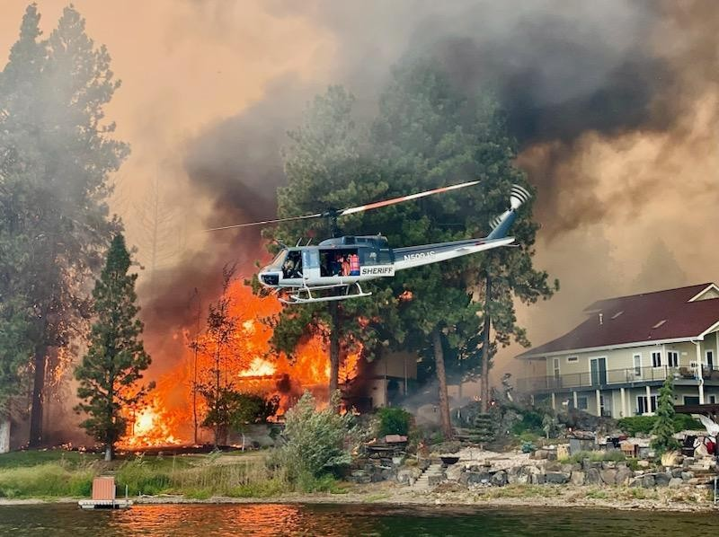
Gray Fire – August 2023

Slide 2
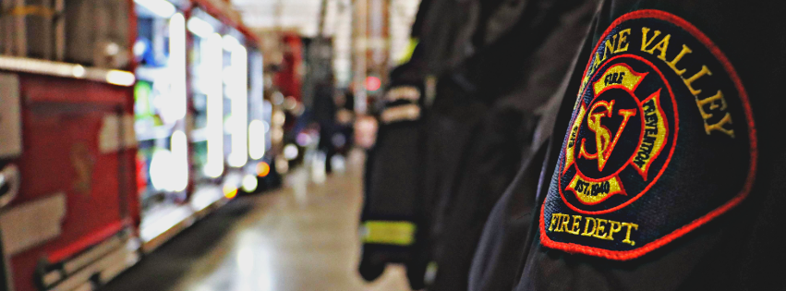
Spokane Valley Fire Department
Crisis Communication & Social Media
Patrick Erickson – Interim Community Affairs Director

Slide 3
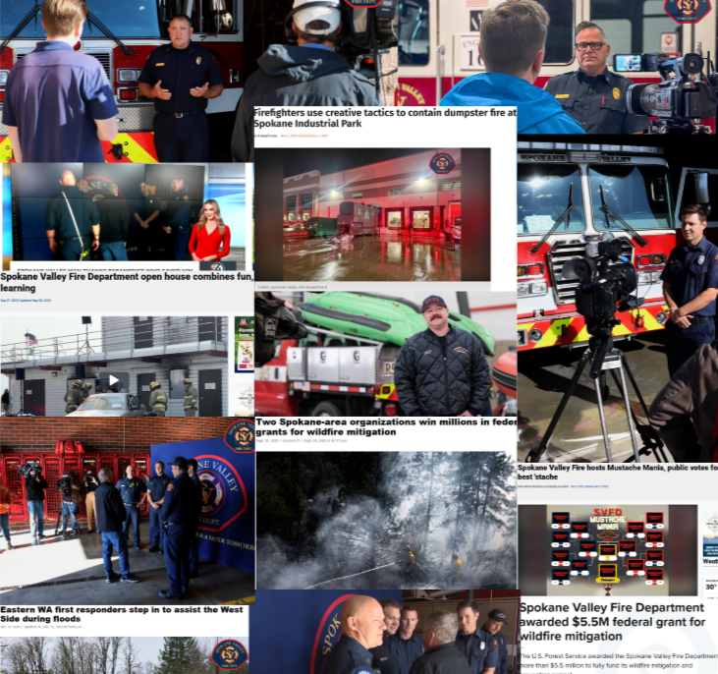
Why Communication Matters
• Public Safety depends on fast, clear and accurate information
• Reduces confusion, panic and misinformation
• Builds lasting trust before, during and after incidents
• Enables people to take immediate protective actions
Poor Communication → Panic → Rumors
vs.
Clear Communication → Action → Safety

Slide 4
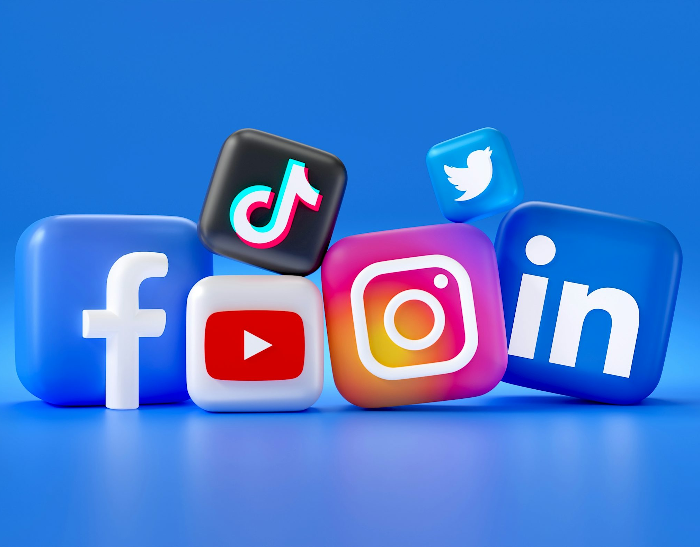
Why Social Media Matters
• Real-time updates reach large audiences instantly
• Wider reach than traditional media
• Two-way communication builds relationship with community
• Builds trust year-round (not just during emergencies)

Slide 5
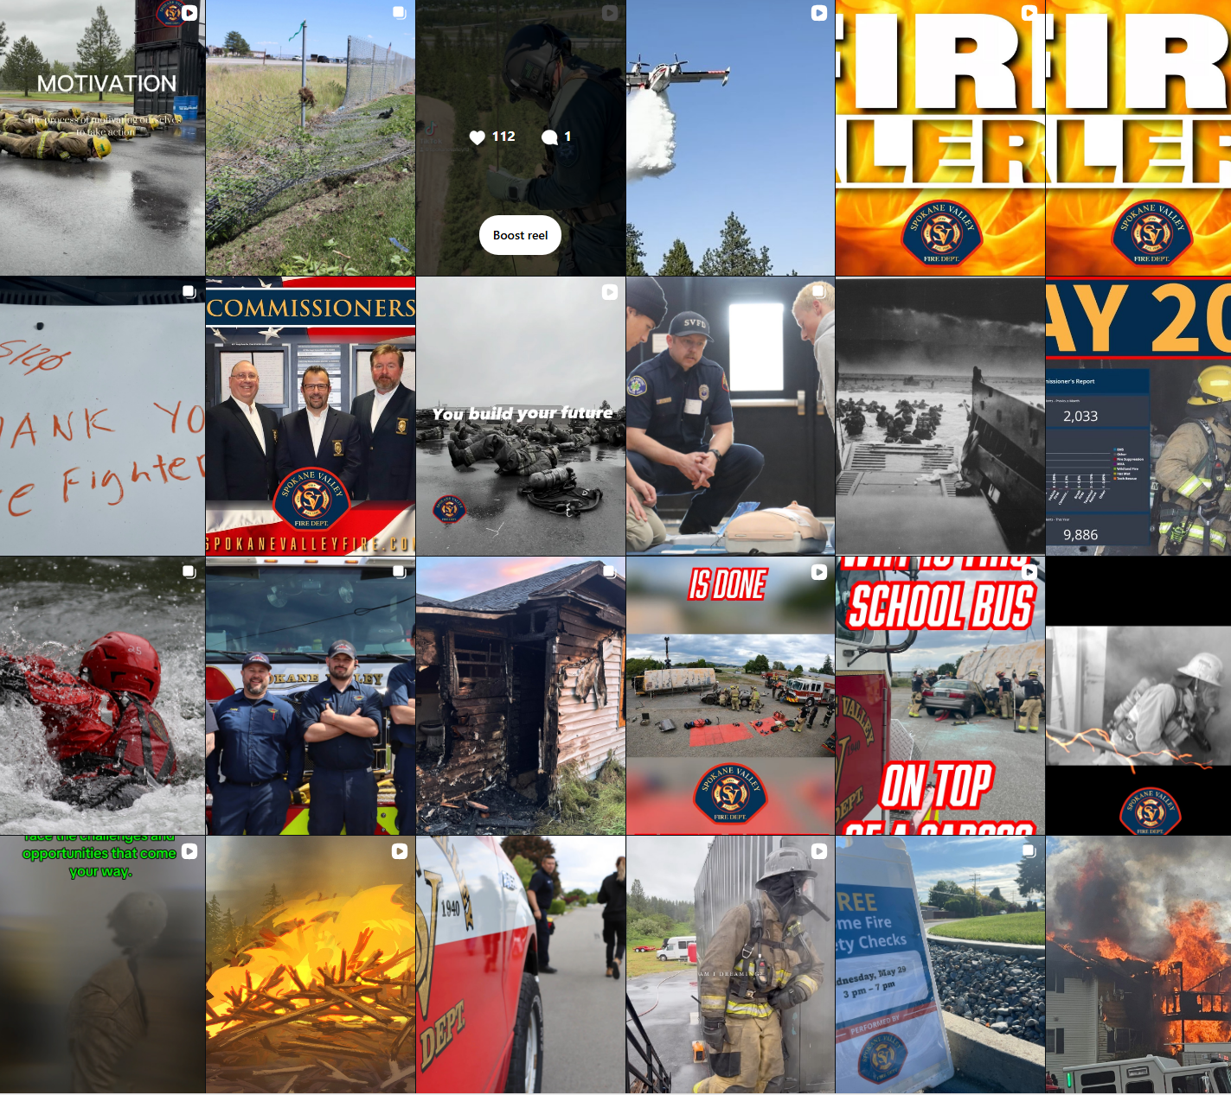
Why Social Media Is Essential In A Crisis
• Public turns to social media first
• Faster than traditional broadcast media
• Allows rapid rumor control
• Helps amplify official messaging
• Improves community preparedness and response

Slide 6
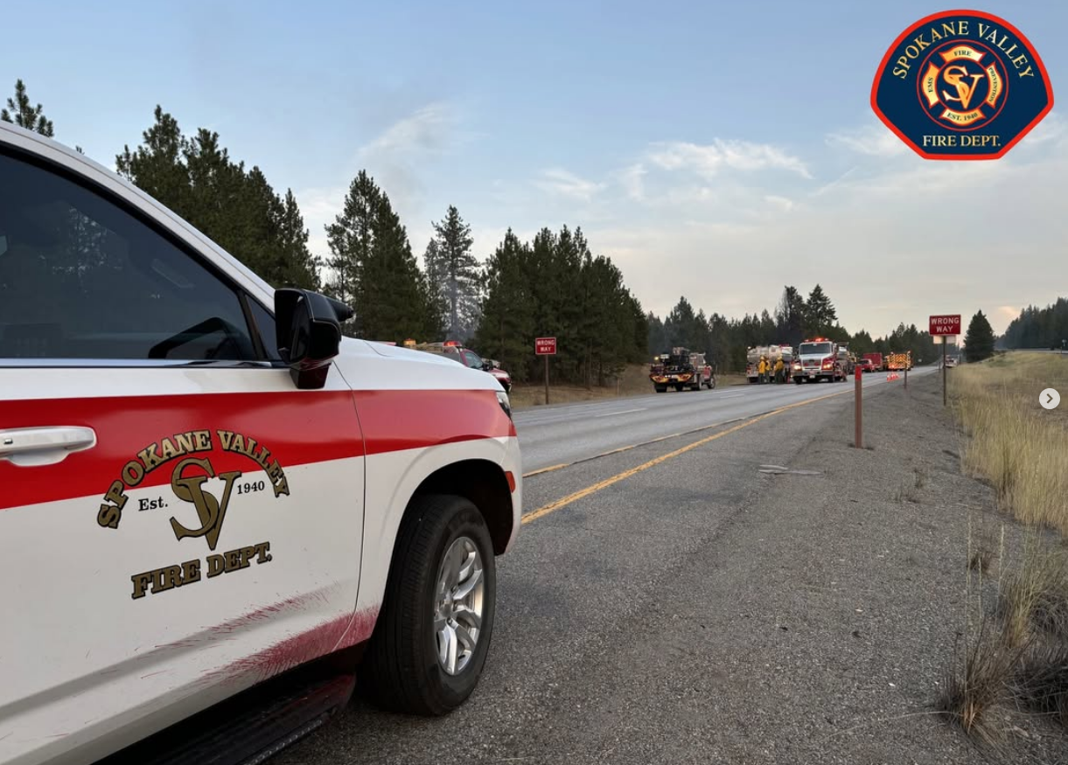
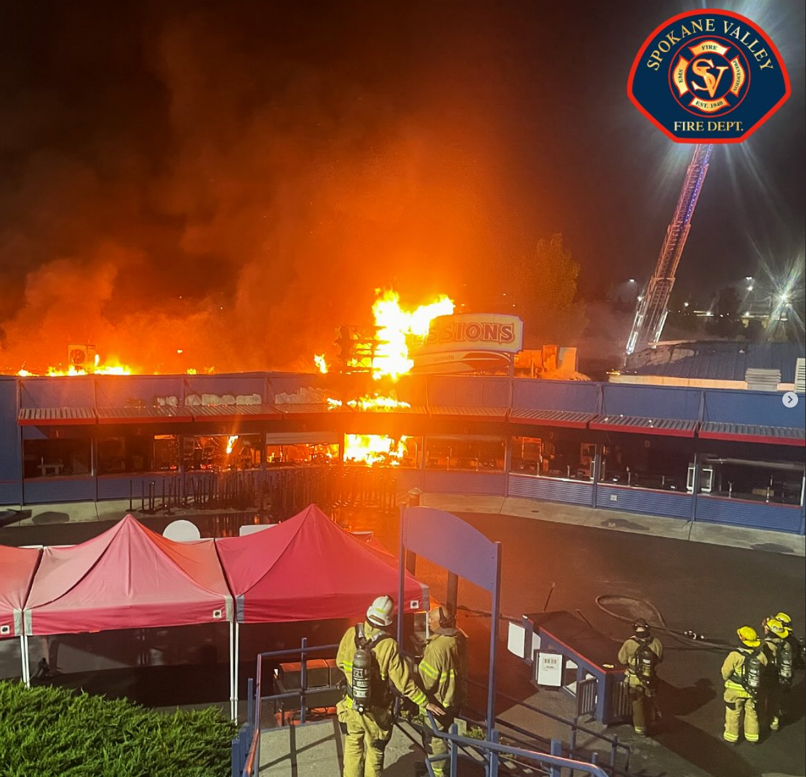
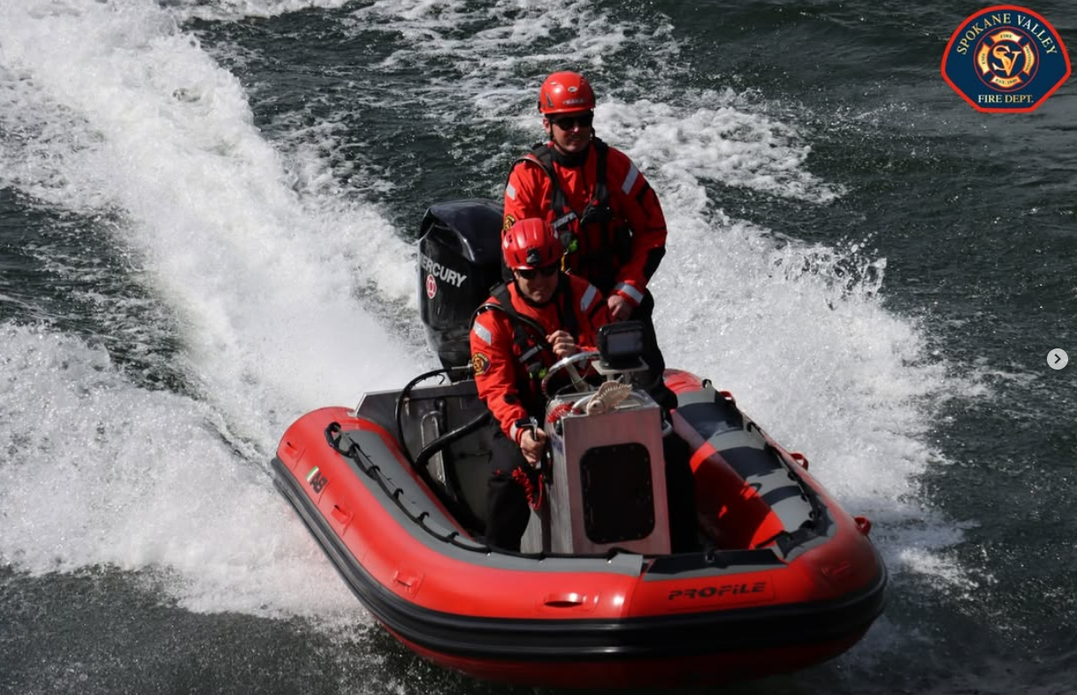
What the Public Expects
• Timely updates (what is happening and where is it happening?)
• Transparency, honesty and empathy
• Clear actionable instructions (what do I do right now?)
• Reassurance (is my family safe?)
• Clear updates on resolution and recovery

Slide 7
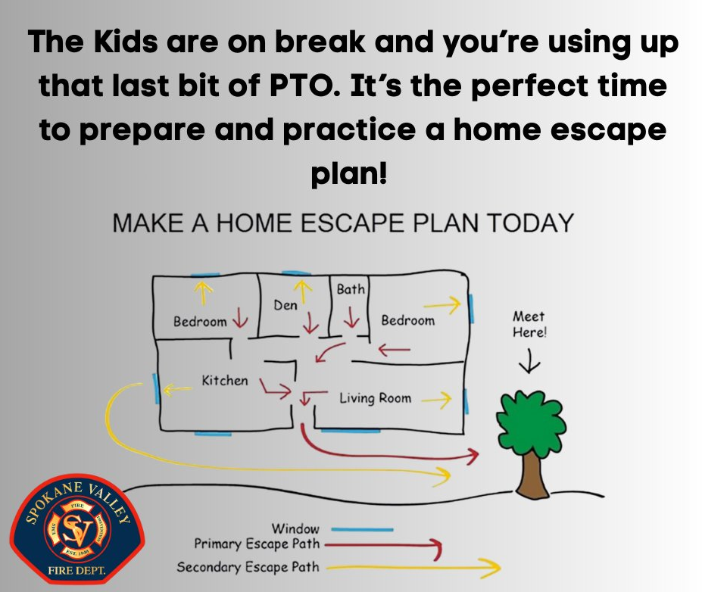
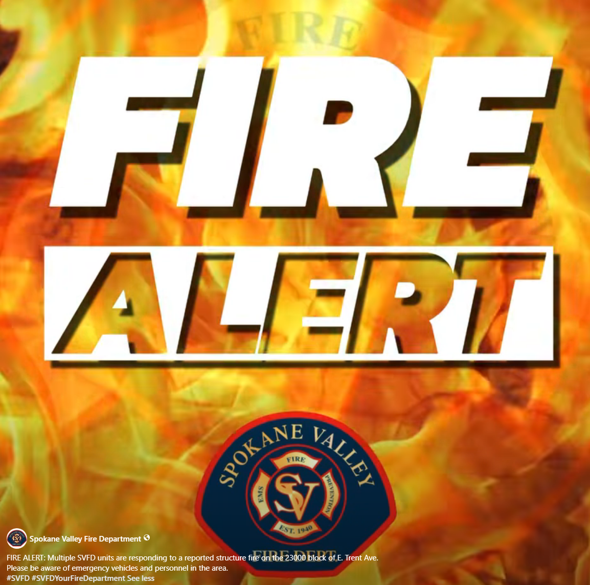
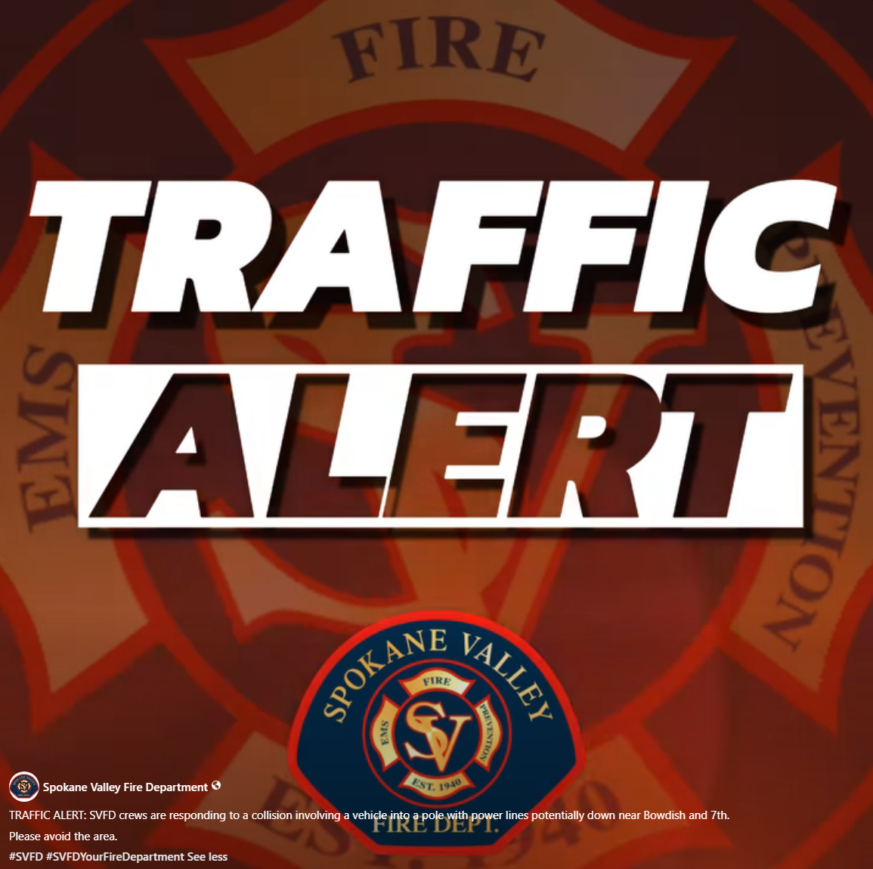
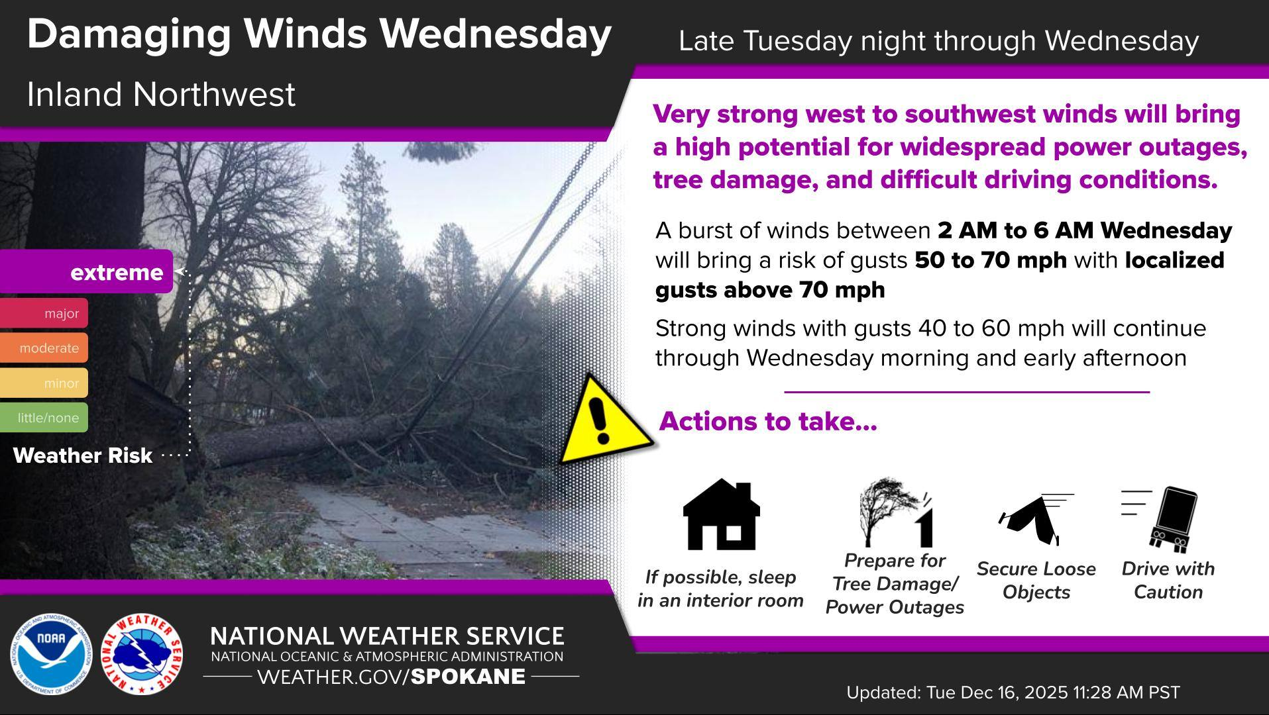
Best Social Media Practices
• Be first, be right, be credible
• Keep messages short and simple
• Use plain language
• Update consistently
• Coordinate unified messaging with partner agencies

Slide 8
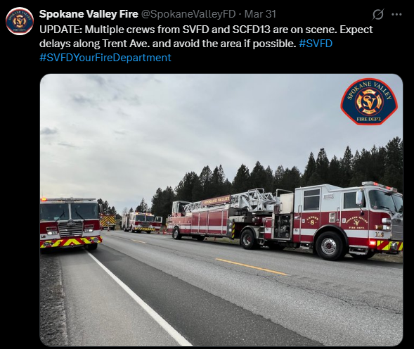
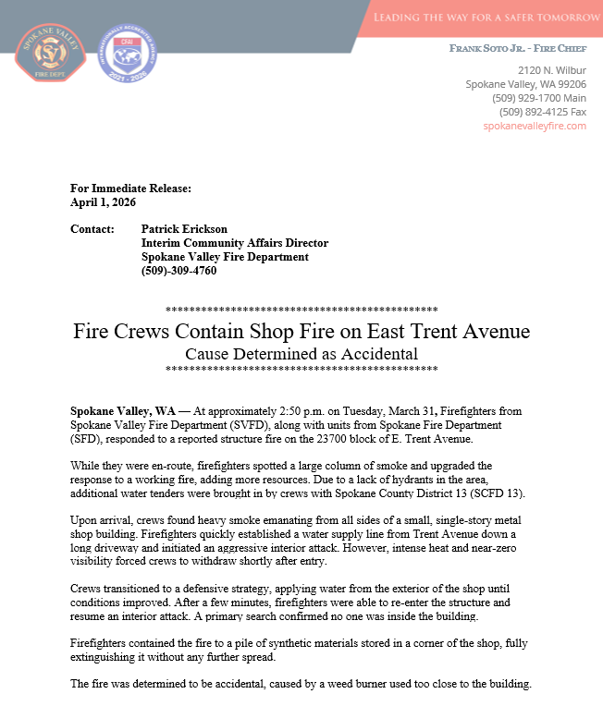
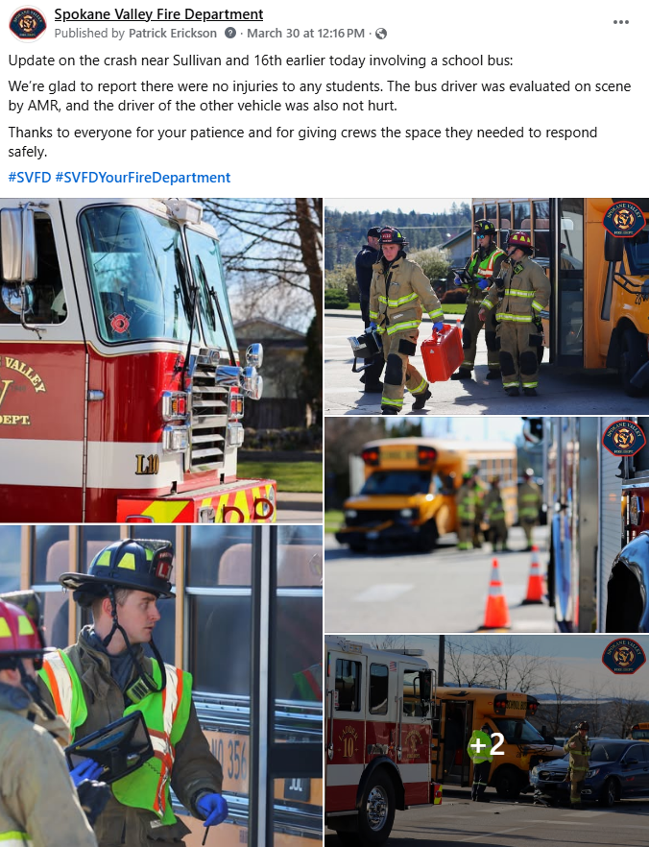
Message Templates
Initial Alert: “SVFD UPDATE: Fire at [location]. Evacuations for [area]. Roads closed at [streets]. Update in 15 min. #SVFD”
Rumor Control: “No evacuation for [area]. Current status: [fact]. Follow @SpokaneValleyFD for updates.”
Action Update: “Smoke advisory: Stay indoors if possible. High winds expected. Check air quality: [link].”

Slide 9
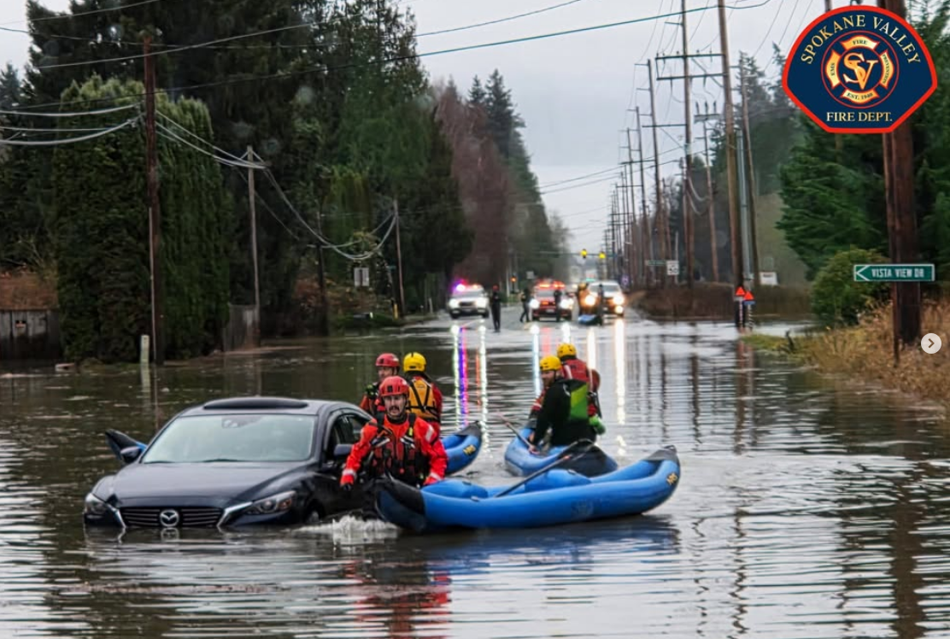
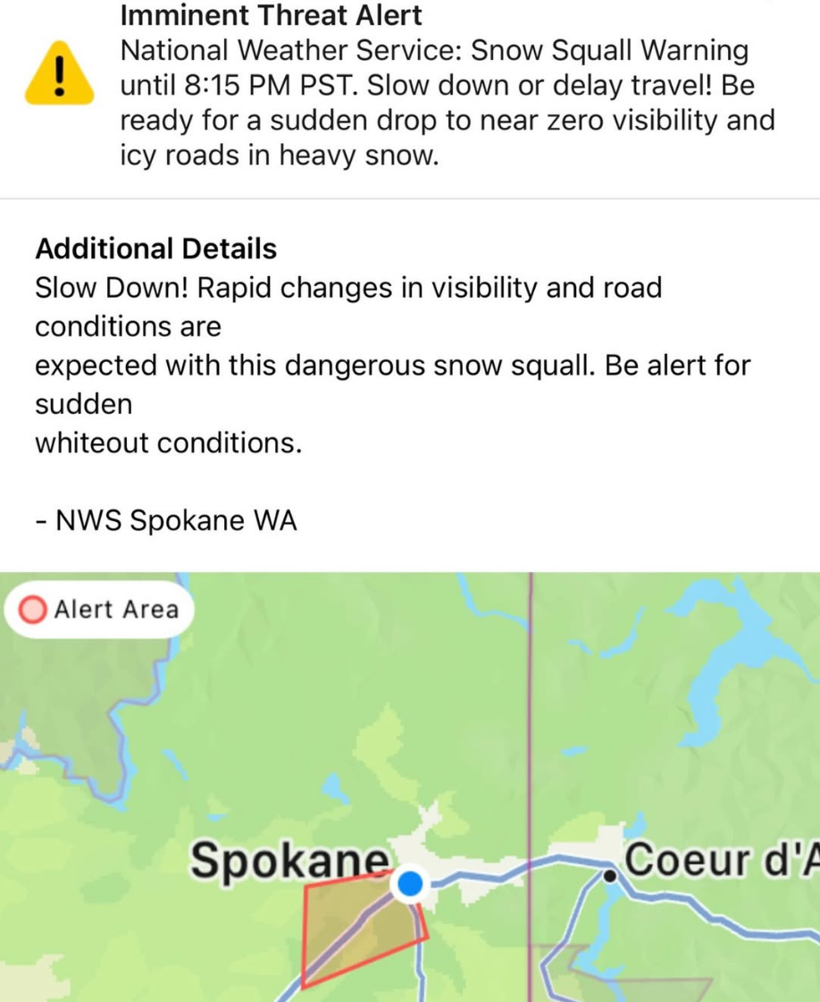
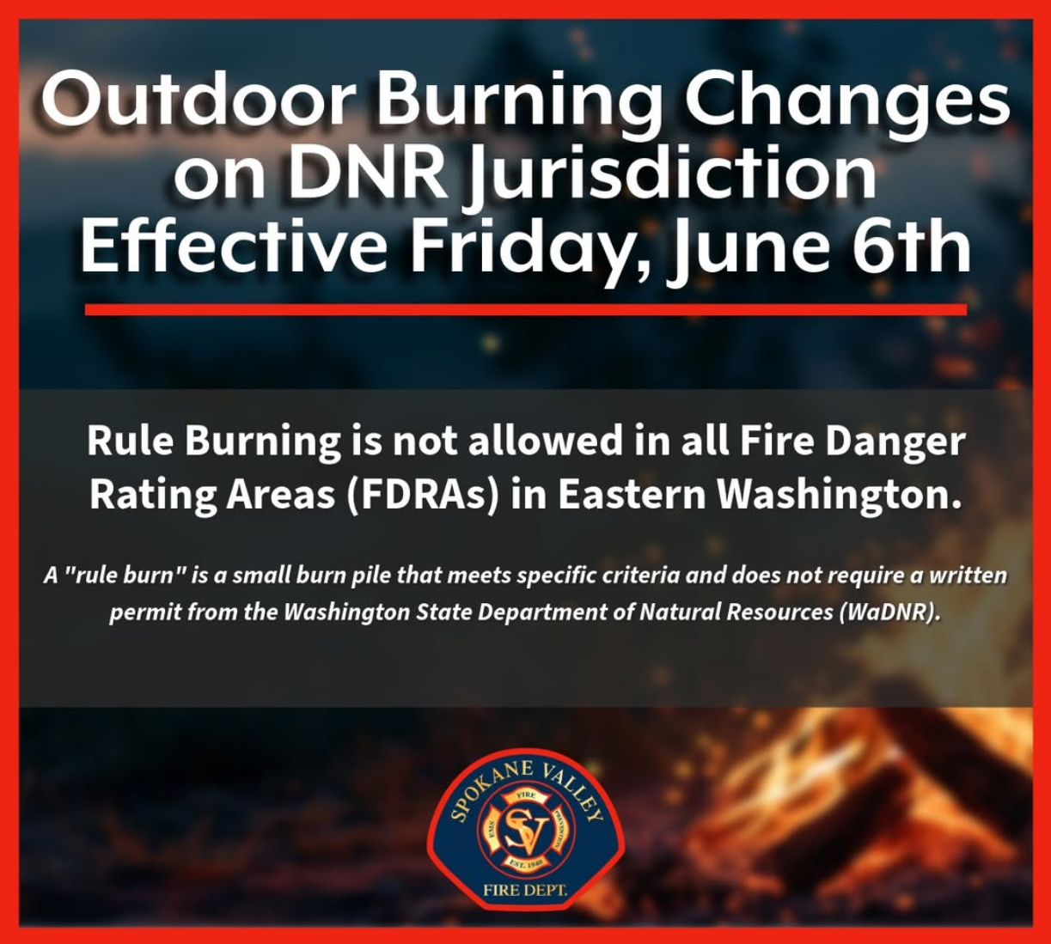
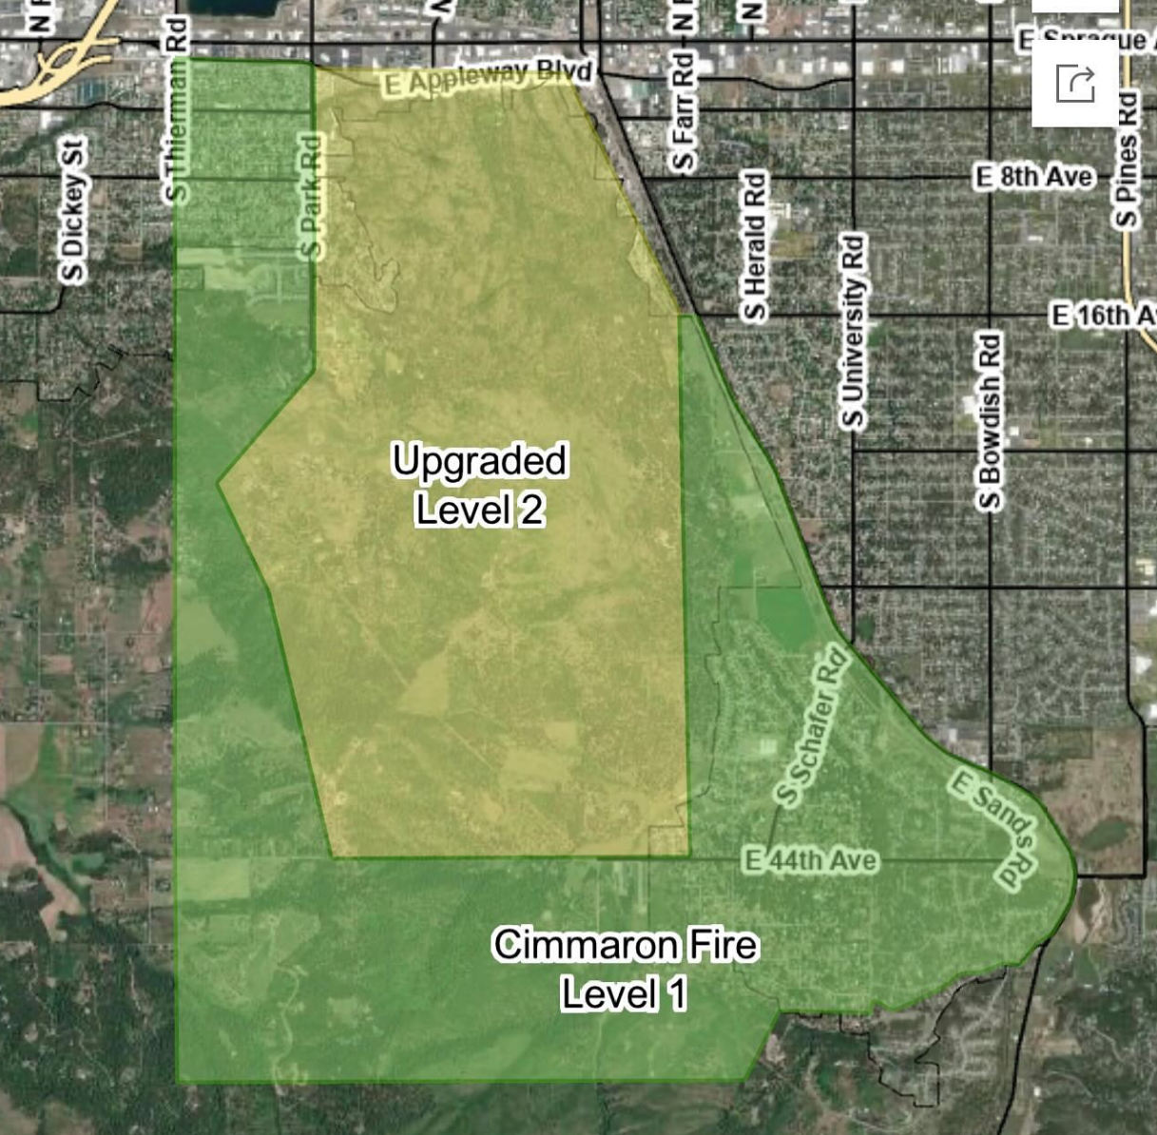
Visual Tips For Effective Posts
• Use photos relevant when appropriate
• Include clear maps/graphics of areas affected
• Keep text minimal on images
• Maintain consistent branding

Slide 10
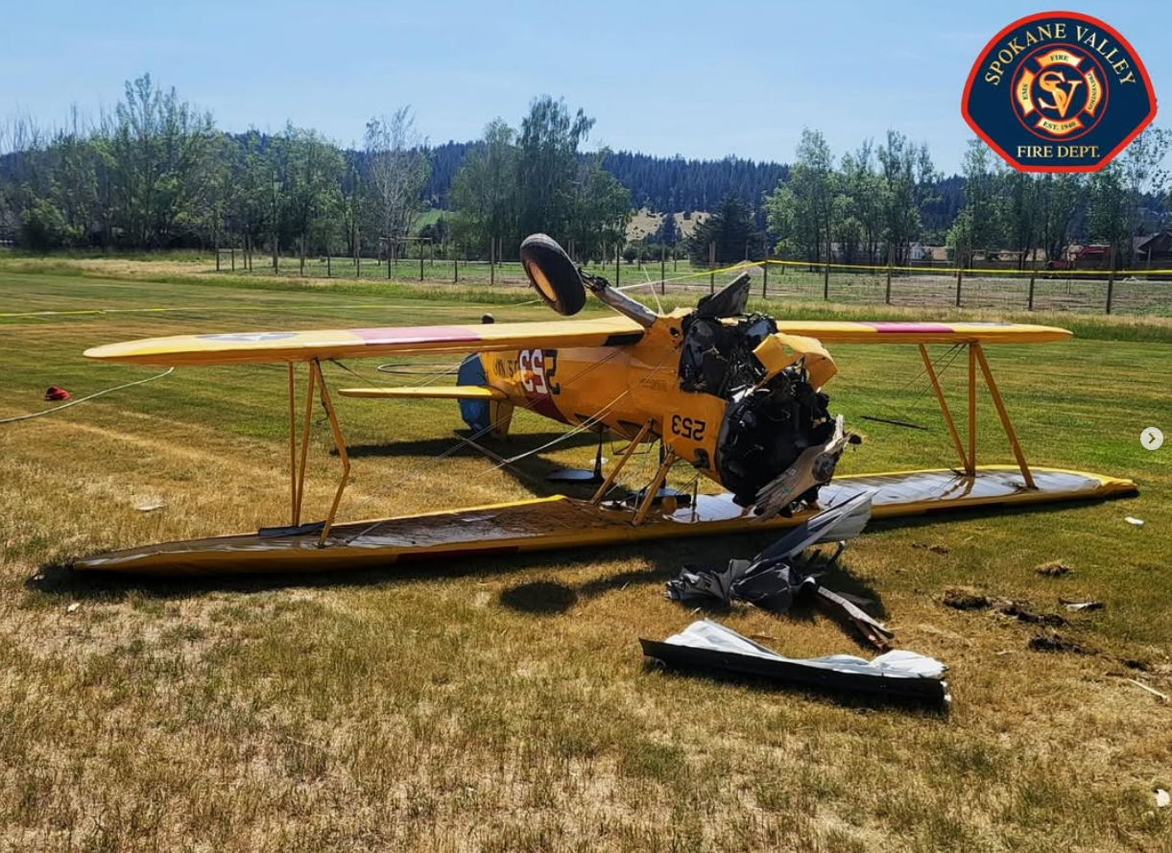
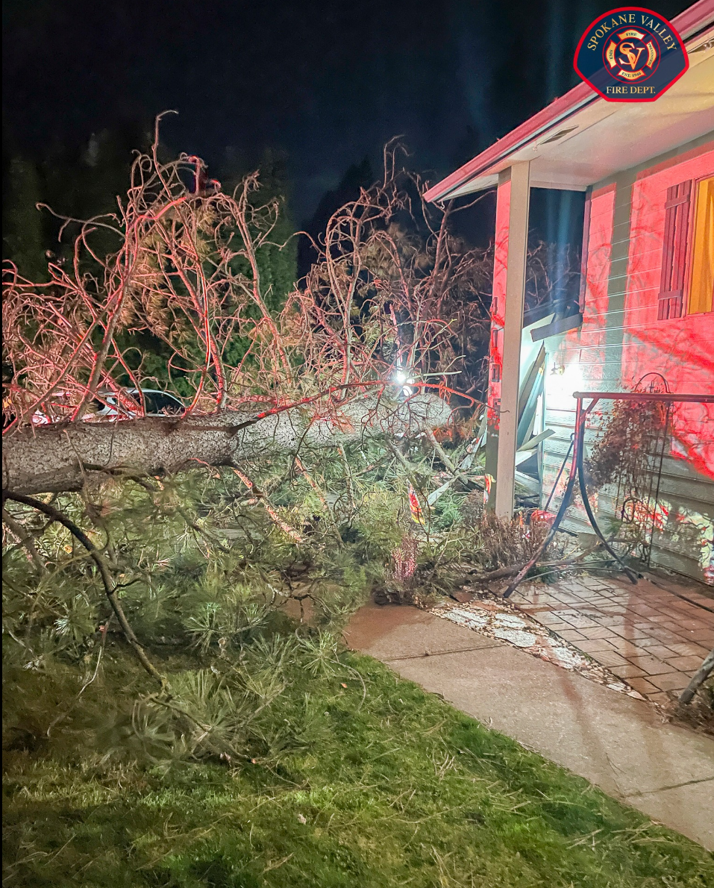
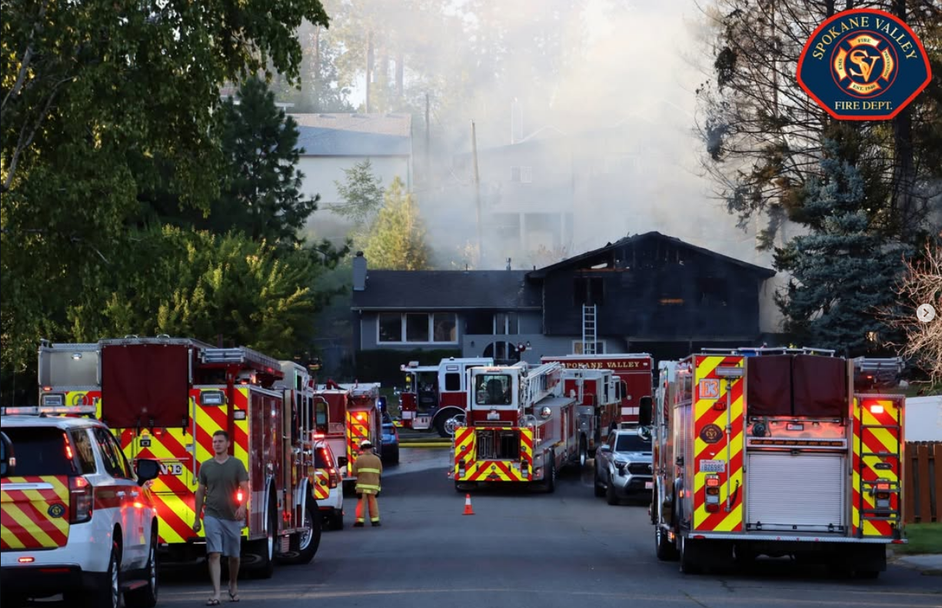
Mistakes That Can Undermine Trust
• Delayed communication
• Too much jargon
• Inconsistent or conflicting updates/information
• Ignoring comments/questions
• Posting unverified details

Slide 11
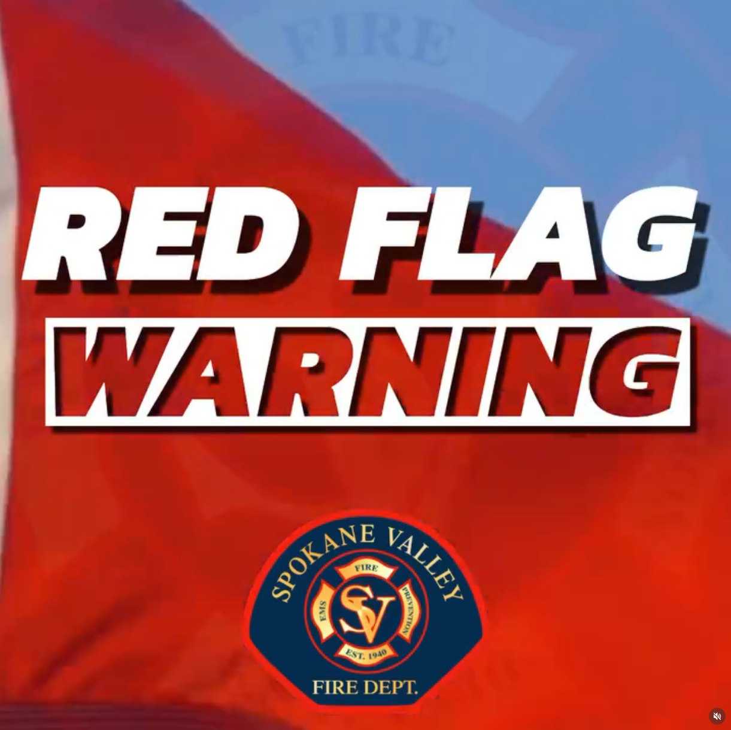
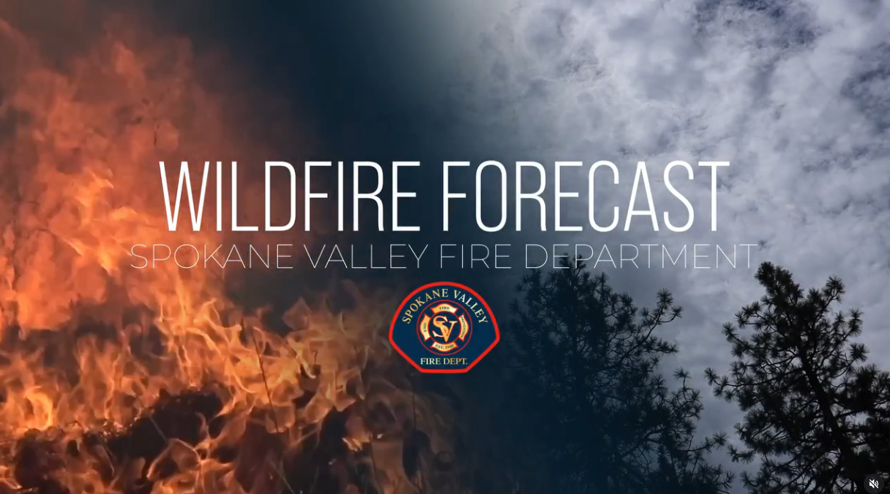
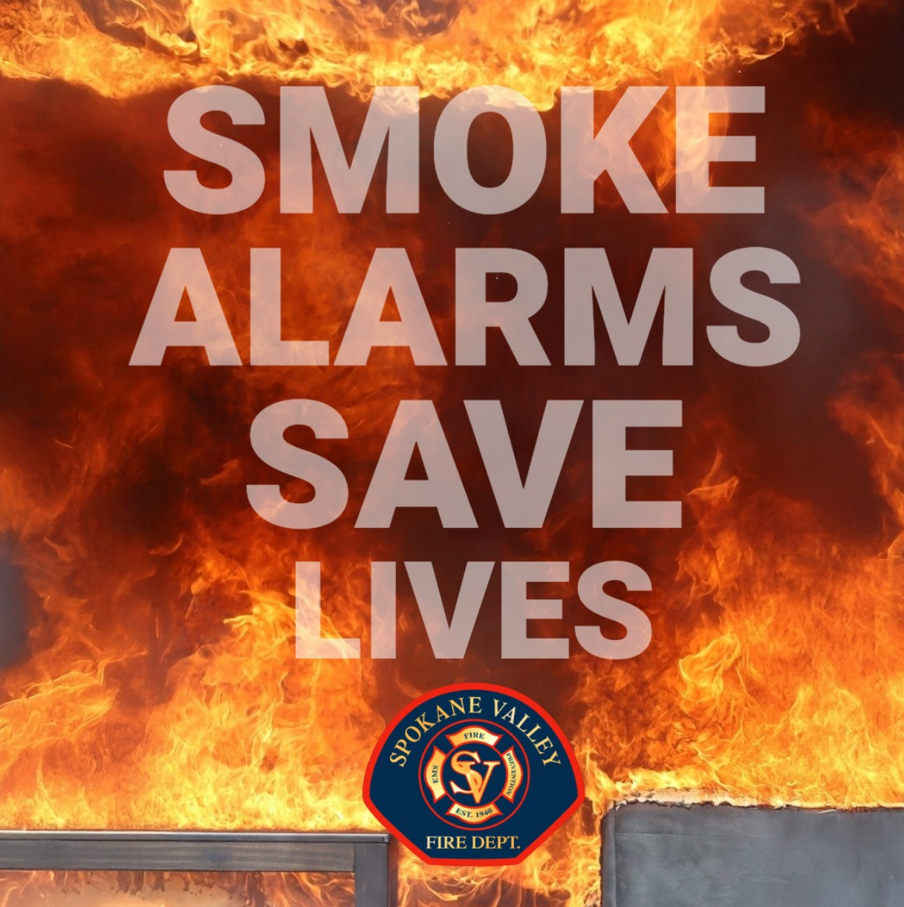
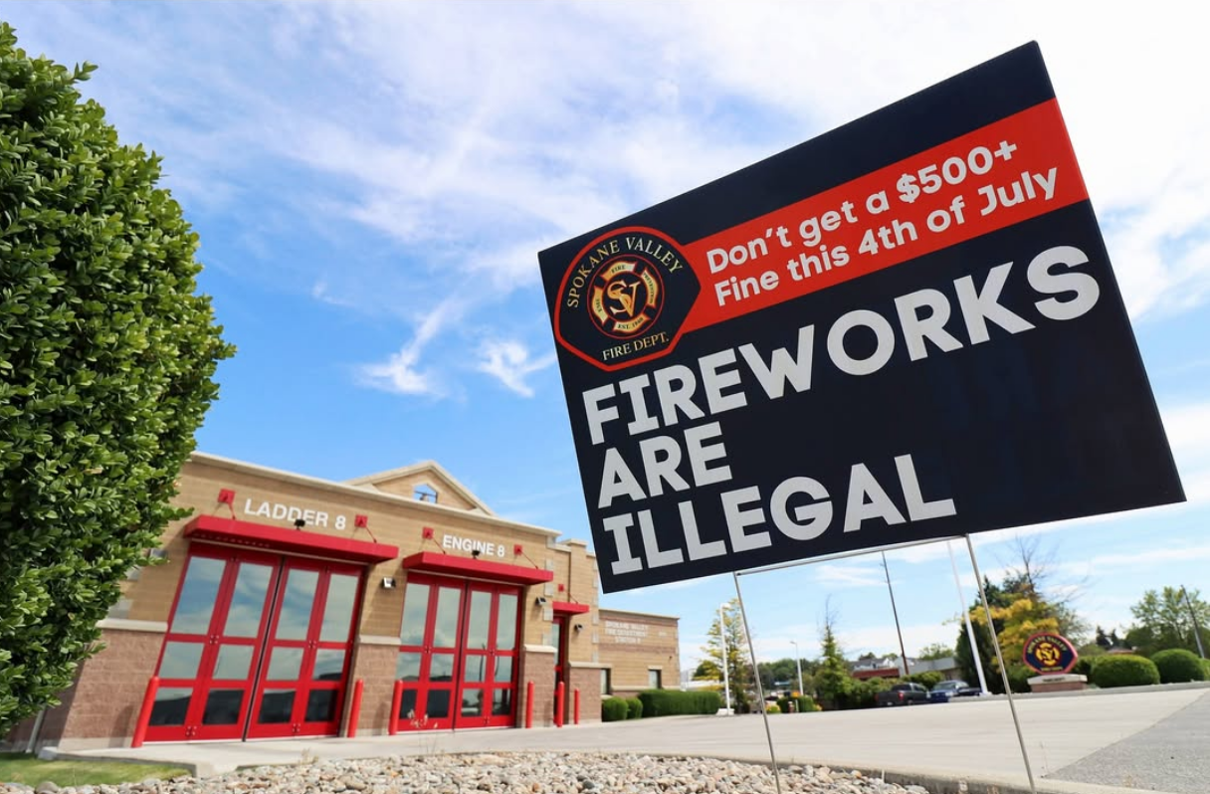
Before The Incident
• Build and test message templates
• Understand roles - designate a Public Information Officer (PIO)
• Establish and streamline approval process
• Monitor social media channels year-round

Slide 12
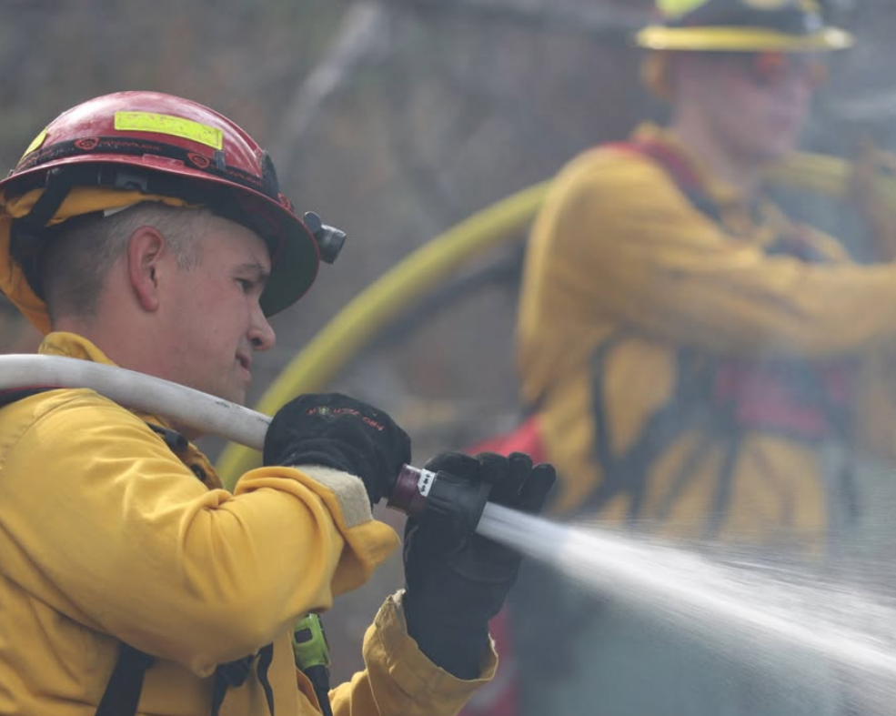
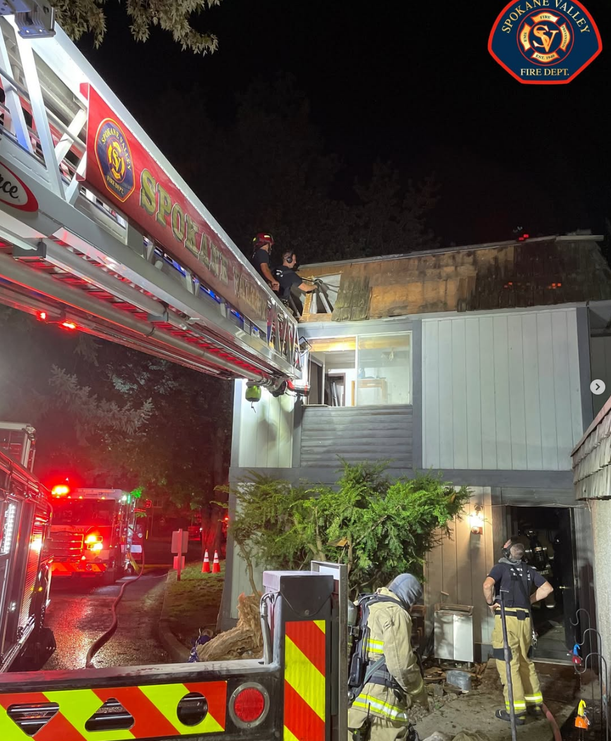
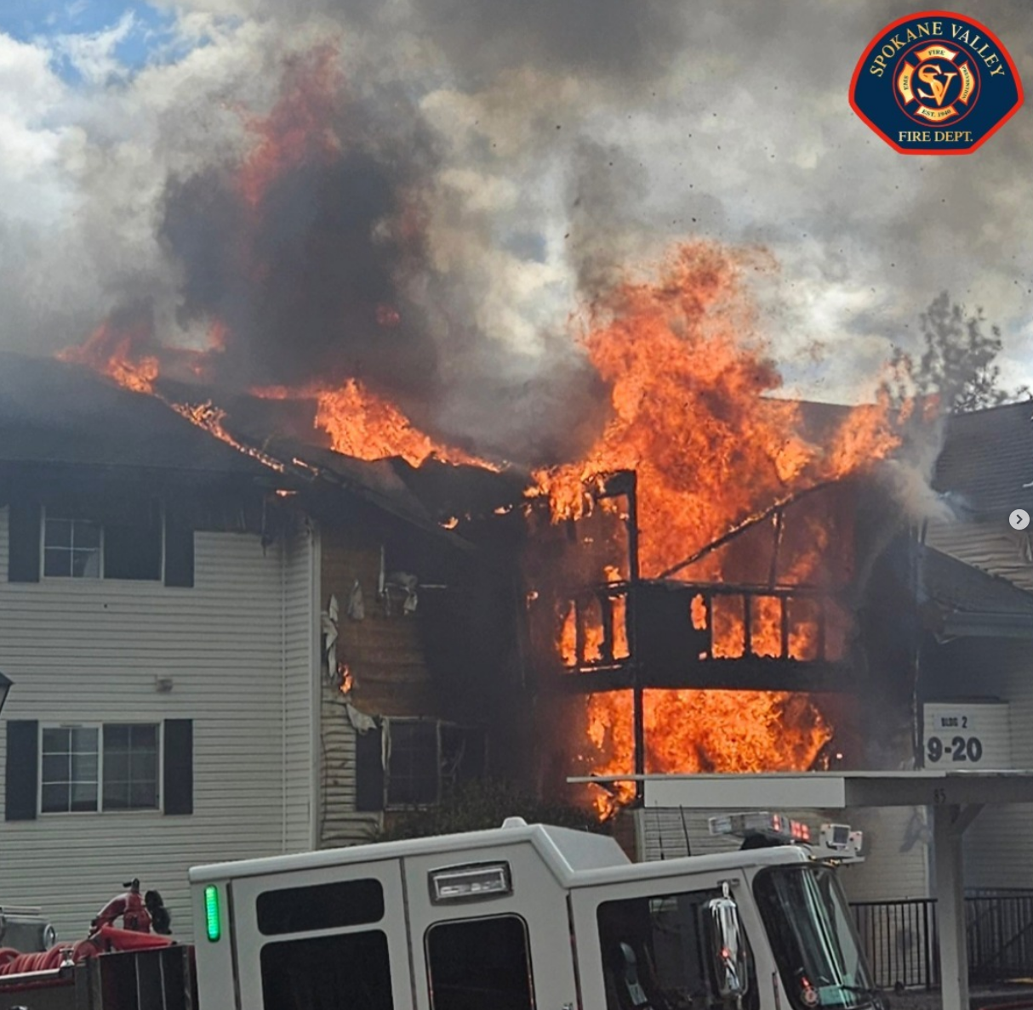
During the Incident
• Post early and often as you receive information
• Provide frequent updates
• Engage with community while staying factual
• Monitor feedback and correct misinformation quickly

Slide 13
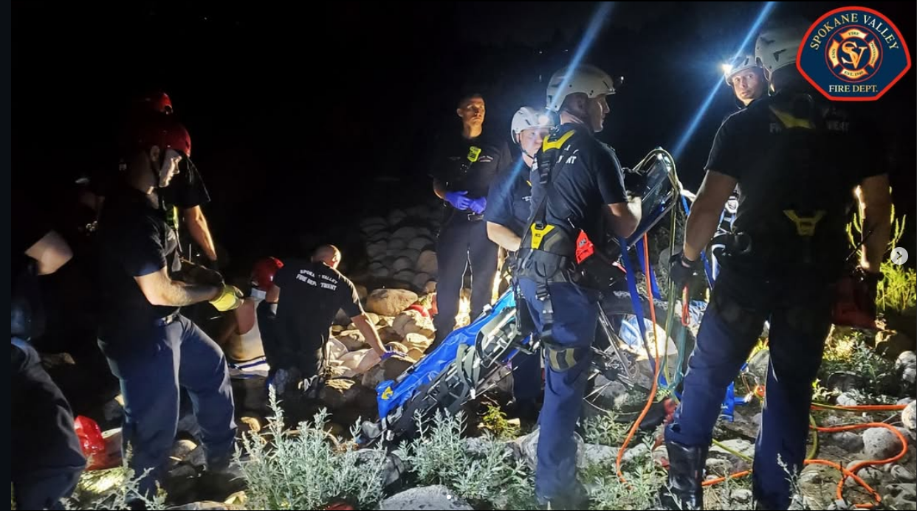
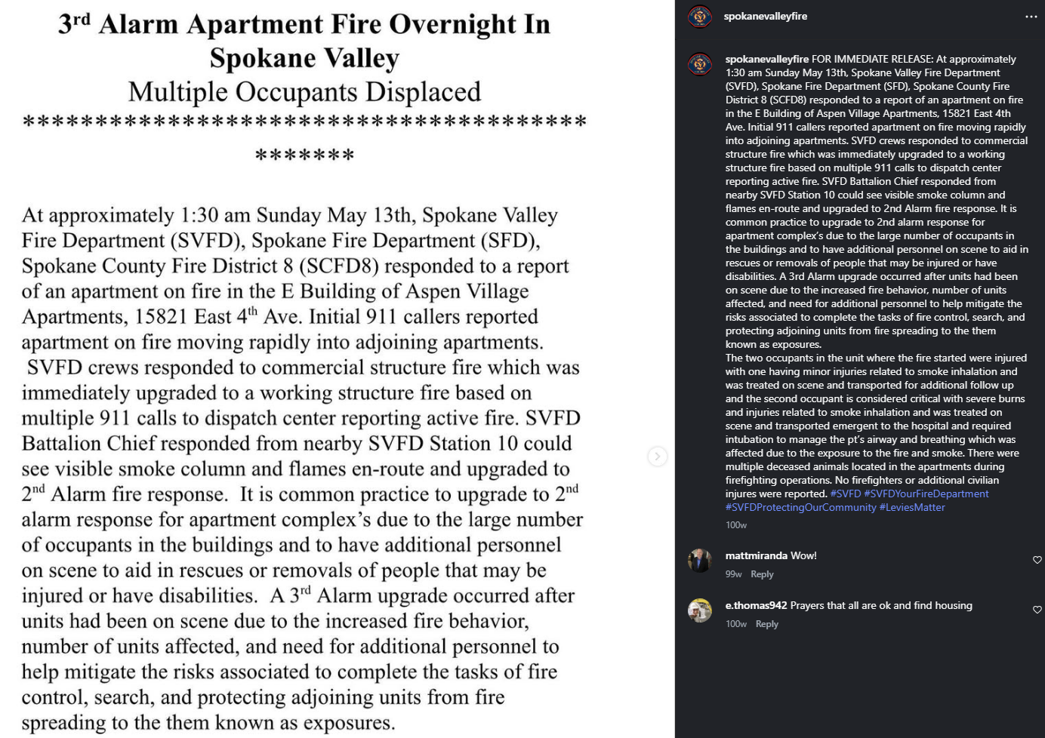
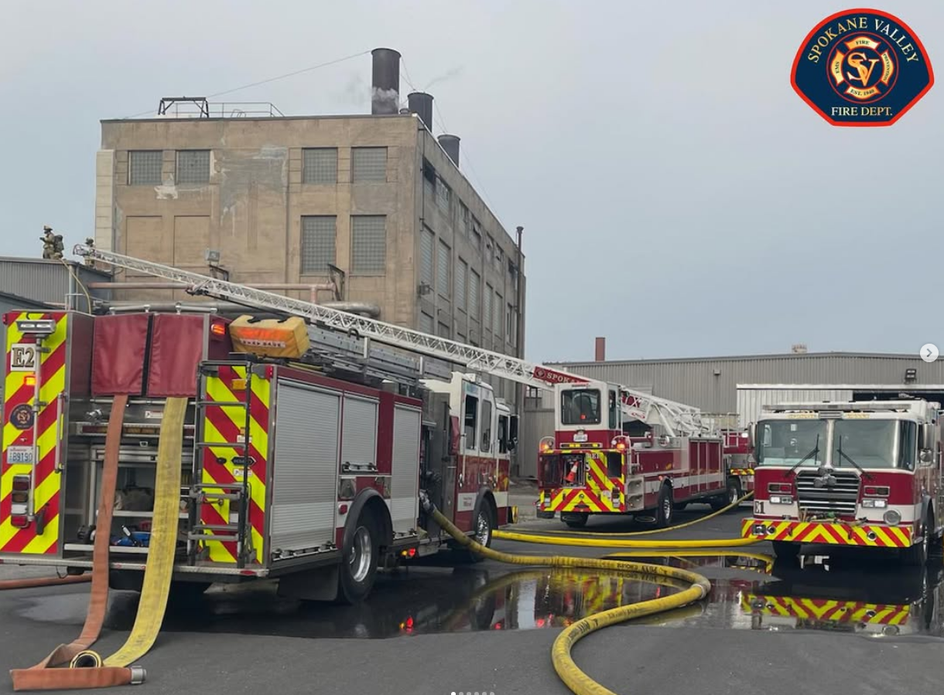
After the Incident
• Share a clear summary/outcome of the incident
• Thank responders, partners and community
• Review performance
• Update plan based on lessons learned

Slide 14
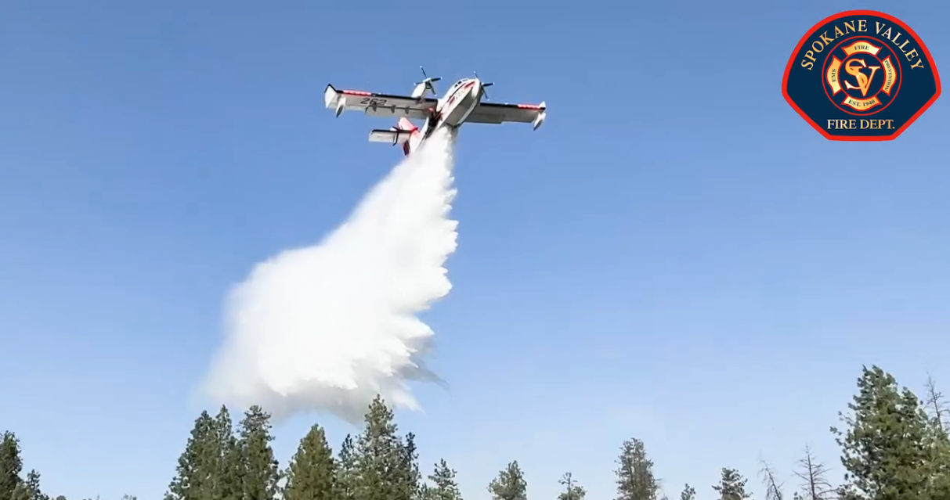
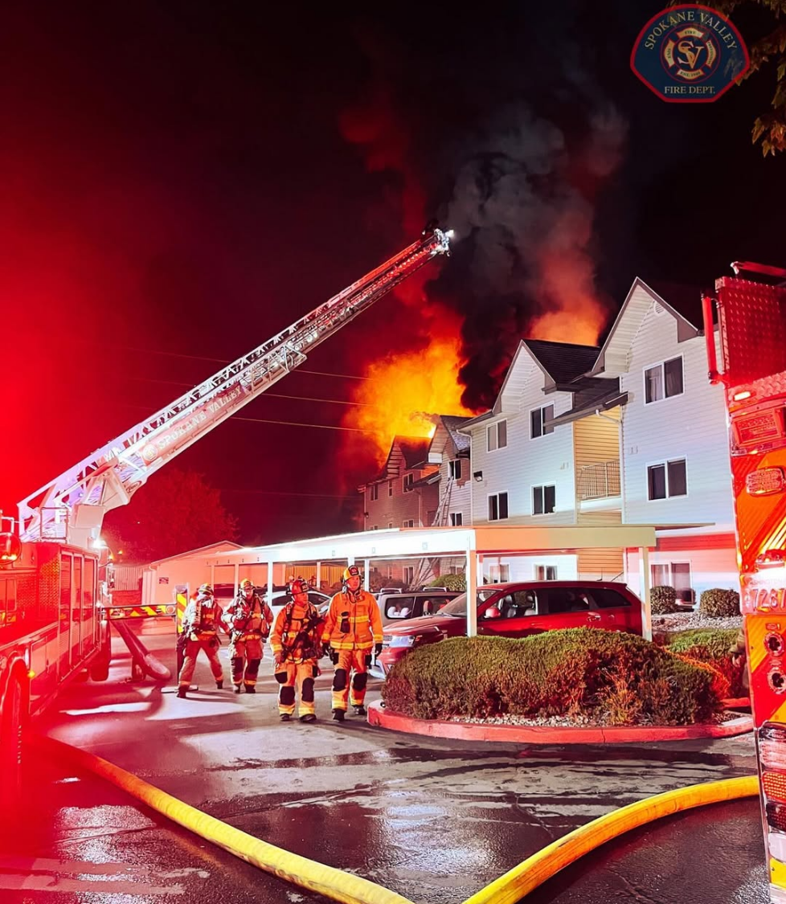
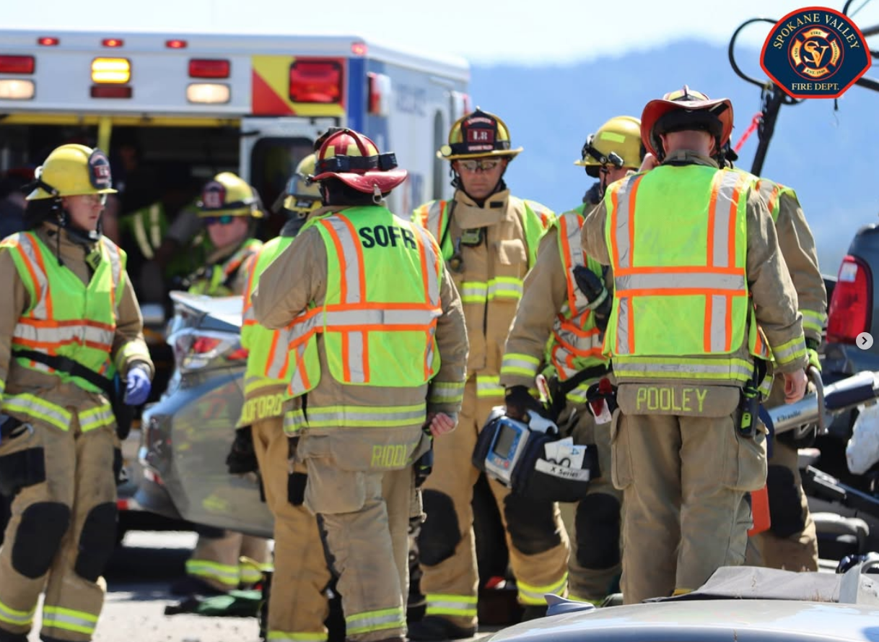
Final Takeaways
• Speed + accuracy = trust and saved lives
• Social media is one of our most powerful tools during an emergency
• Prepared templates and graphics save critical time
• Clear messaging protects our community

Slide 15
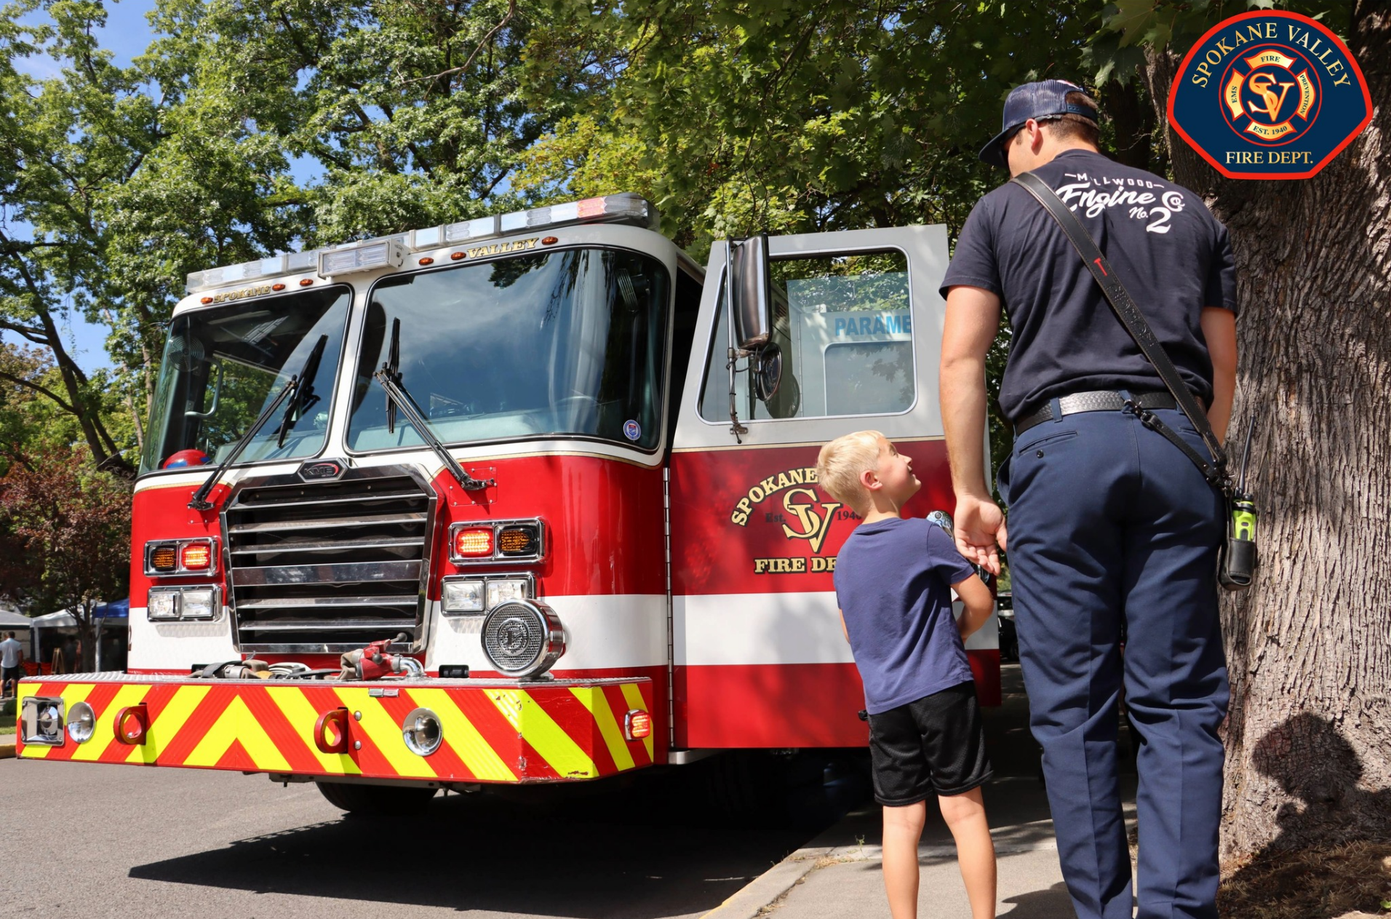
Thank You!

