Slide 1

Social Media
Is Still
Worth It.
PULLMAN
MARKETING
But Only If You Use It Like a Human.
PullmanMarketing.com
Notes:
My Learning Objective for today is that you feel encouraged and emboldened to Make the posts that you have always dreamed about!

Slide 2
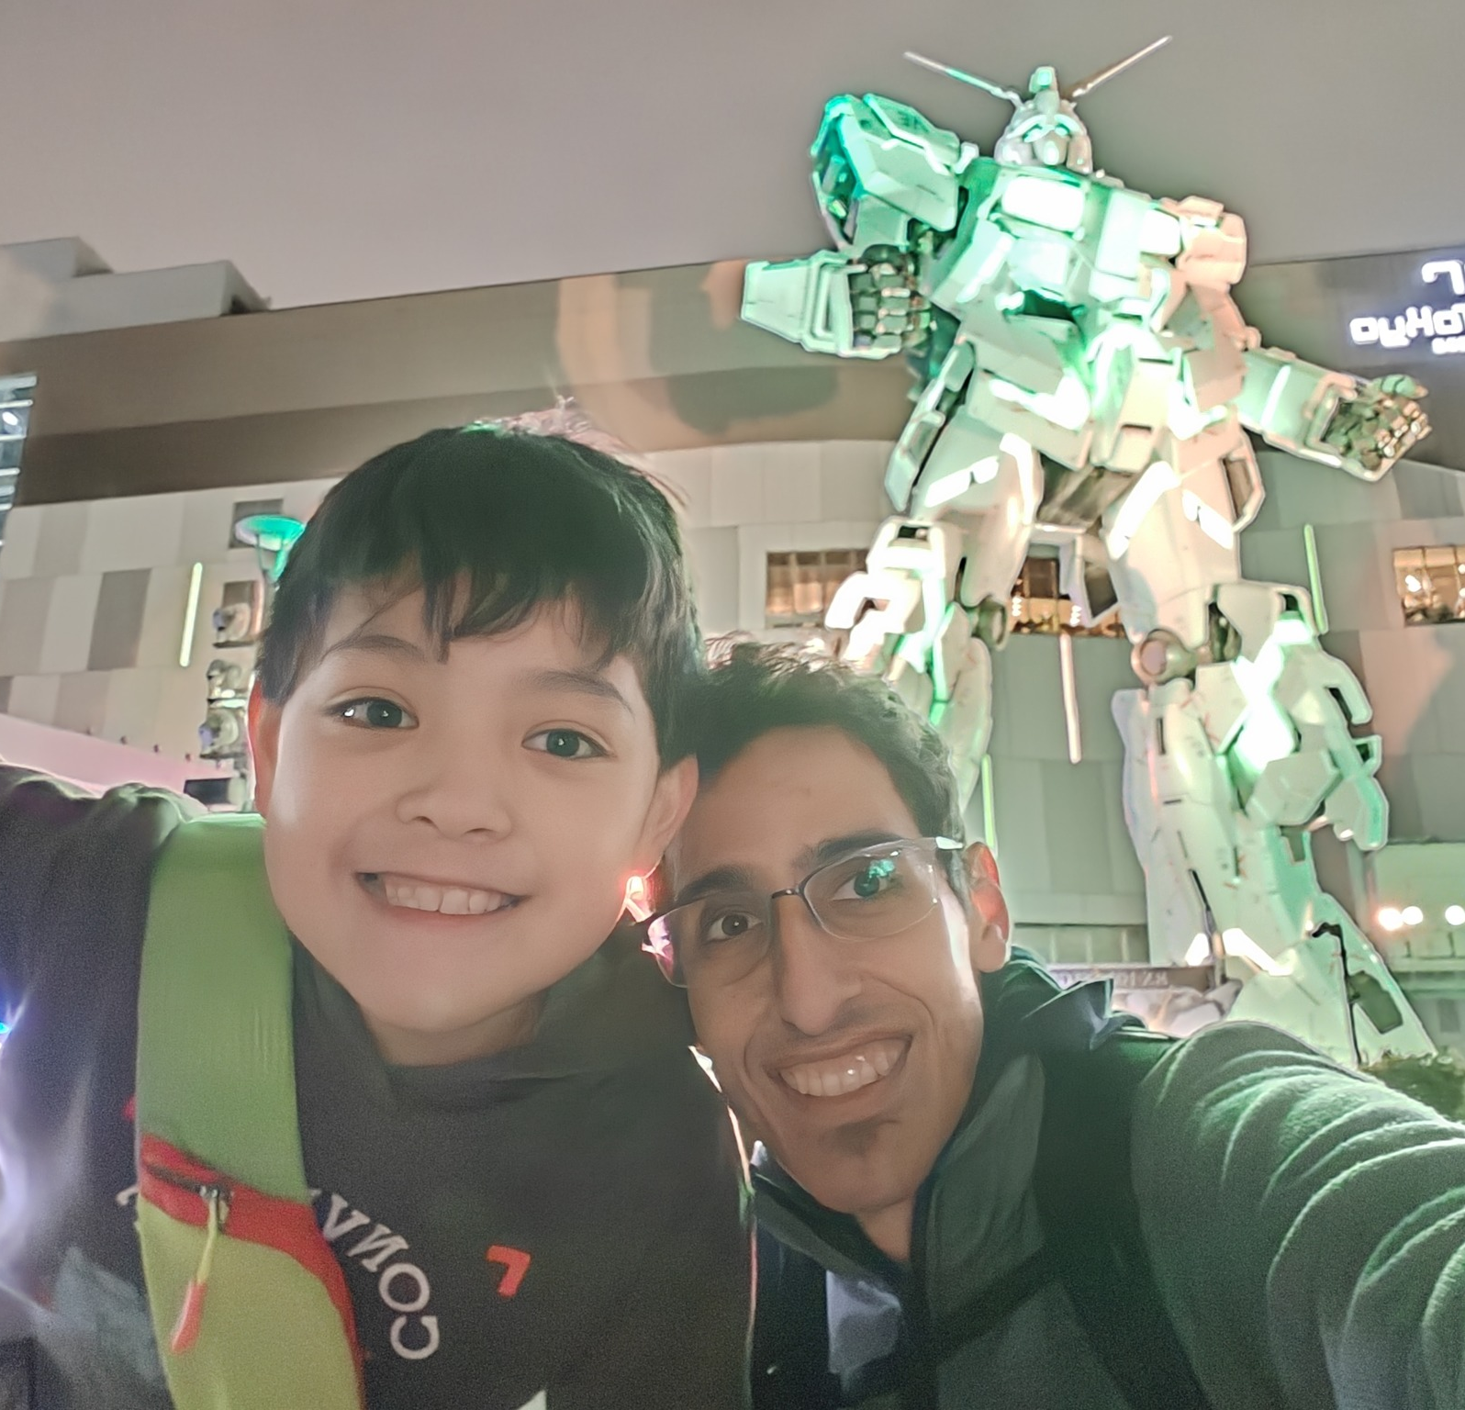
ABOUT THE SPEAKER
Adam Jones
Founder, Pullman Marketing
Experience:
20 Years Experience in WordPress
18 Years Experience in Search Engine Optimization
17 Years Experience in Inbound and Outbound Marketing
Education: Bachelor’s degree in Communication from WSU
Hobby: Volunteer, Mentor, Roasting Coffee, Ukulele,
Past Hobby: Building Longboards, Lawn Care
Me and My Son in Tokyo
Notes:
These are My Stats Like the introduction said:
Private, Public and Non-Profit Sector Experience
My company PM, works across the nation and every market I deal with is radically different from each other.
One thing these things don’t tell you:
Is that I am raise 4th generation eastern Washington family
I have chosen to be a part of my community with volunteering, mentoring and creating a safe work environment to grow in

Slide 3

ABOUT THE SPEAKER
Adam Jones
Founder, Pullman Marketing
Experience:
20 Years Experience in WordPress
18 Years Experience in Search Engine Optimization
17 Years Experience in Inbound and Outbound Marketing
Education: Bachelor’s degree in Communication from WSU
Hobby: Volunteer, Mentor, Roasting Coffee, Ukulele,
Past Hobby: Building Longboards, Lawn Care
Notes:
This is My Extended Family – on our recent trip, you can see how enthused my younger son is to be 17 time zones away, have woken up early, and taken another 3 hour flight to Okinawa The point I am trying to make is, I will choose my family and community first, every time.

Slide 4
Social Media
Is Still
Worth It.
PULLMAN
MARKETING
Really? Are You Sure?
PullmanMarketing.com
Notes:
But you’re here I assume because you are asking the same question everyone else is –
Is social Media Worth?
In my experience, especially as we look at it from a community level is that ---→

Slide 5
"
Most organizations
don't have a
reach problem.
They have a courage problem.
PullmanMarketing.com

Slide 6
"
Please, Go Crazy On Social Media!
Its More Fun, I promise.
PullmanMarketing.com

Slide 7
THE STRATEGY
On A Scale Of 1-10
2
6–7
11
Where most
orgs are now
Where you'll
probably land
What I'm
telling you to try
PullmanMarketing.com
Notes:
"Turn it up to 11. You'll probably land at a 6 or 7. That's still way better than a 2."

Slide 8
THE STRATEGY
Turn It Up to 11.
2
6–7
11
Where most
orgs are now
Where you'll
probably land
What I'm
telling you to try
PullmanMarketing.com

Slide 9
SECTION 01
Is Social Media
Still Worth It?
Let's answer the question directly.

Slide 10
The better question
to ask yourself:
"Who is shaping
the narrative
when you're not?"
PullmanMarketing.com
Notes:
Is The City, Non-Profit Police Department Etc. The ones running the narrative OR IS IT The Self-Appointed Town Crier – Who took an acting class at community college, did the death of a salesman monologue, and POP! Magically became the town’s primary source of news and “investigative journalism” ?

Slide 11
IS SOCIAL MEDIA WORTH IT?
Short answer: Yes.
1
People expect updates where they already spend time
2
Silence creates a vacuum, someone else will fill it, I promise you, they will
3
Social media is the fastest and cheapest way to stay visible
4
When you don't communicate, someone else interprets events for you
PullmanMarketing.com

Slide 12
YOUR
WEBSITE
SOCIAL
MEDIA
HEADQUARTERS
FIELD OFFICE
Your foundation. First impression.
Essential, but static.
Where your community lives.
You need both. You can't replace one with the other.

Slide 13
SECTION 02
The Problem Is Not
Social Media.
Most organizations are just posting at a 2.

Slide 14
THE ANATOMY OF A BORING POST
Stiff & formal
Sounds like a press release nobody asked for
Over-approved
Three rounds of edits, all personality removed
Generic
"We are excited to announce..." Nobody cares.
No personality
No humor, no human moments, no voice
No local hook
Could be any org in any city in America
Posted twice a month
Inconsistent, forgettable, invisible
Notes:
And then they wonder why nobody engages.

Slide 15
THE SNIFF TEST
PullmanMarketing.com

Slide 16
Before you post, ask yourself:
PullmanMarketing.com

Slide 17
THE SNIFF TEST
Before you post, ask yourself:
Would I send this to
my spouse, my group text,
or my staff chat?
If the answer is no, it is not ready to post yet.
PullmanMarketing.com

Slide 18
If the answer is no, it is not ready to post yet.
PullmanMarketing.com

Slide 19
WHAT MAKES CONTENT ACTUALLY WORK
A Stronger Hook
A Surprising Photo
A Local Reference
Make them stop scrolling in the first line. Not "We are pleased to announce..." Try something specific.
Real people, not logos. Faces over flyers. Show behind-the-scenes of the actual work.
Name the street. Name the neighborhood. Generic content is invisible. specific content travels.
A Bit of Personality
A Clear Headline
Real People
A joke. A reaction. A human moment. TSA does it. Your org can too.
Don't make people dig. Lead with the most important thing. Then explain.
Faces and voices build trust faster than anything.
PullmanMarketing.com

Slide 20
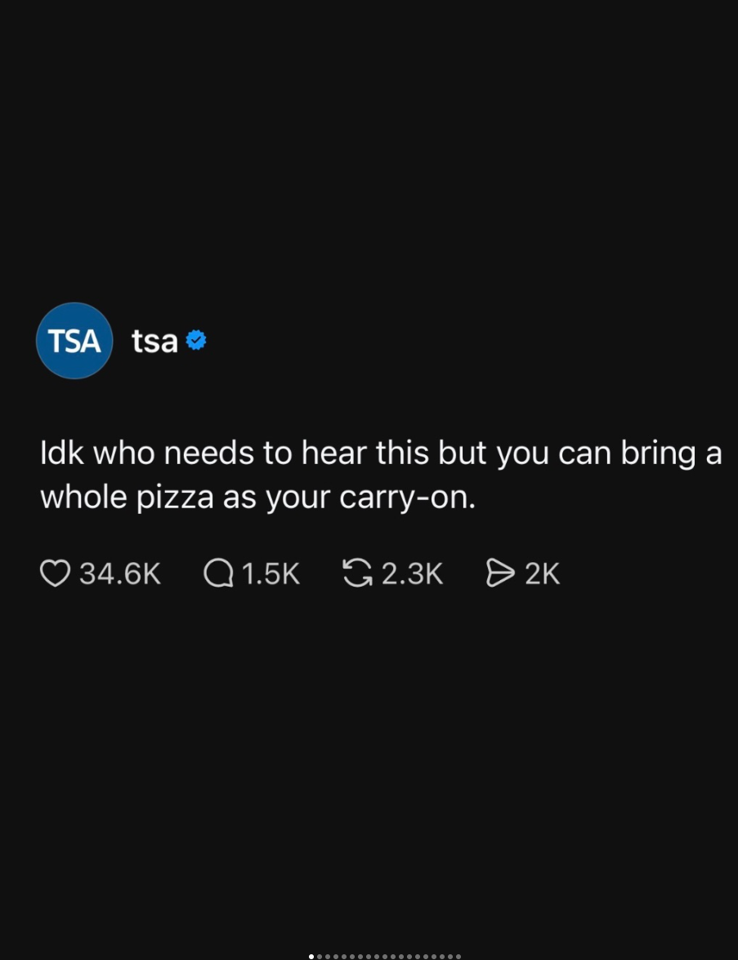
PullmanMarketing.com
Notes:
Caption: Back on the Gram, rehashing this topic for the 420th time. Some thought this would be a sticky subject for us. Weed like to think it’s in our best interest to keep you properly high-drated on the topic.

Slide 21
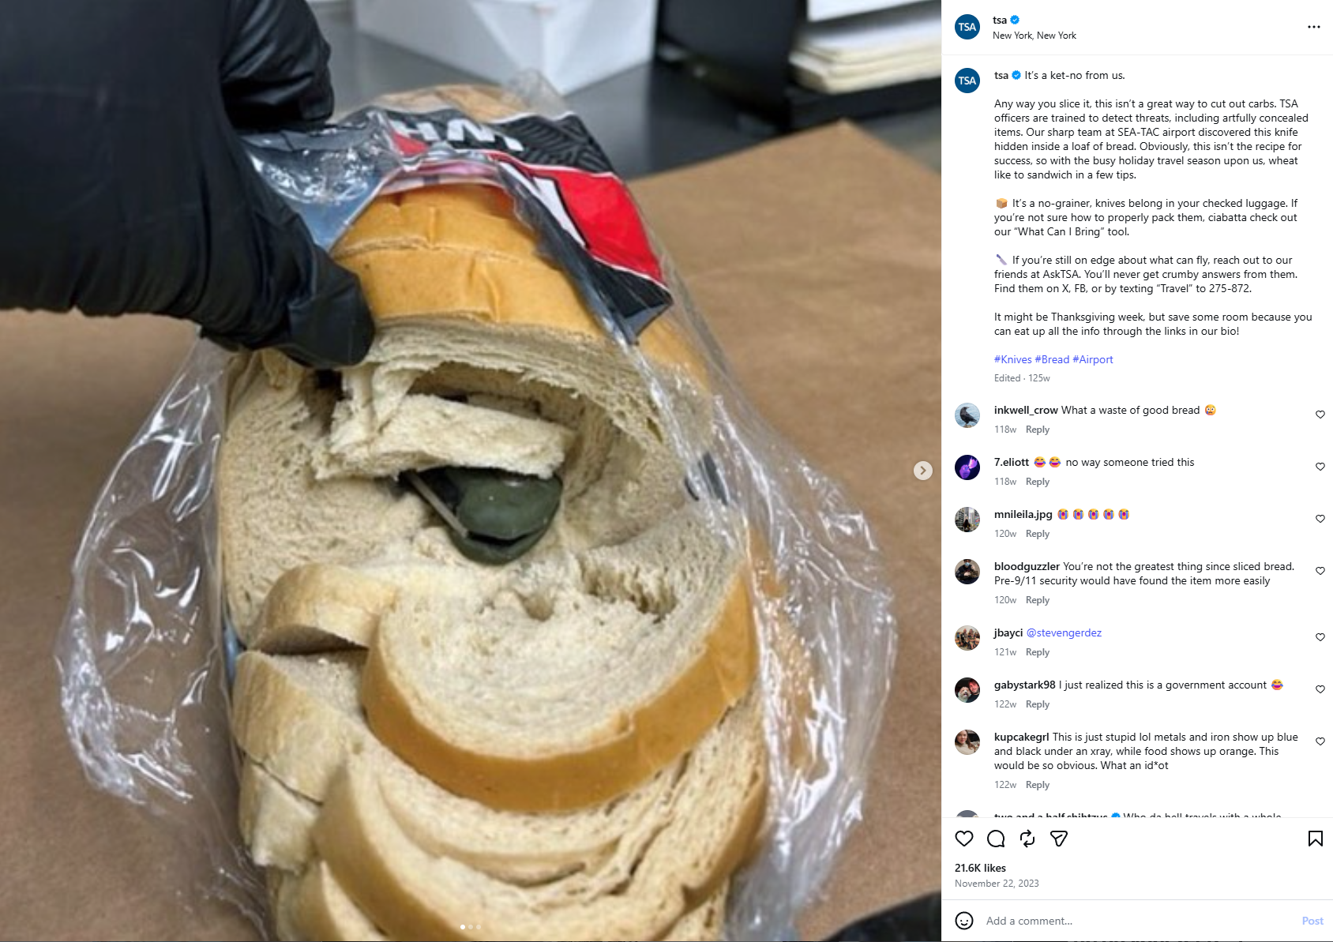
PullmanMarketing.com
Notes:
Caption Any way you slice it, this isn’t a great way to cut out carbs. Our sharp team at SEA-TAC airport discovered this knife hidden inside a loaf of bread. Obviously, this isn’t the recipe for success/

Slide 22
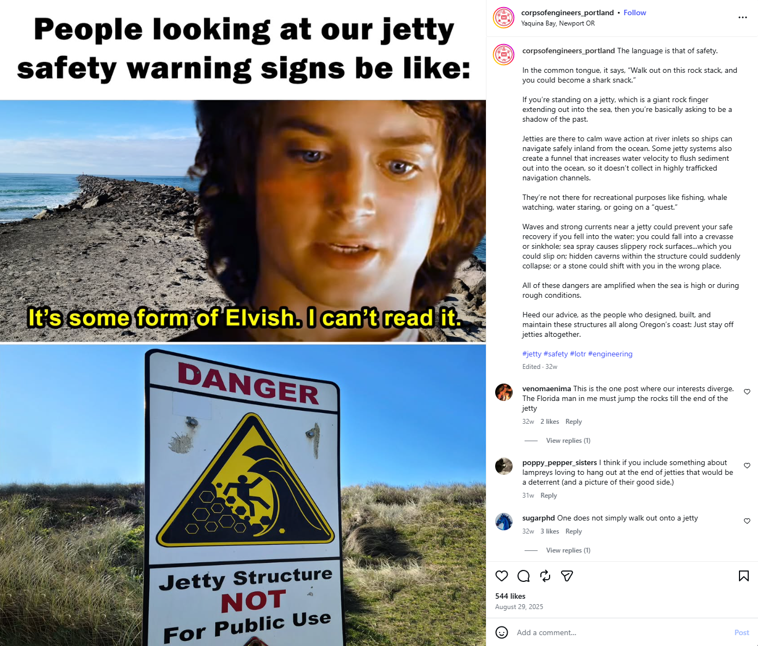
PullmanMarketing.com
Notes:
corpsofengineers_Portland 500+ likes

Slide 23
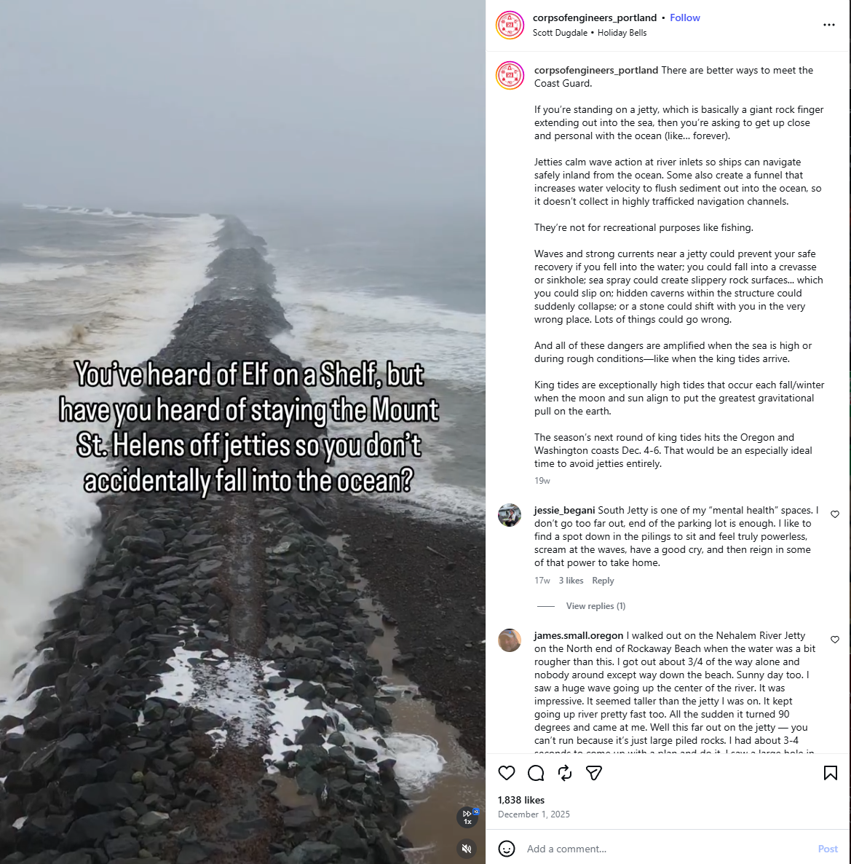
PullmanMarketing.com
Notes:
corpsofengineers_Portland 1800+ Likes

Slide 24
SECTION 03
Fill the Void.
Before the self-appointed town crier
does it for you.

Slide 25
WHAT HAPPENS WHEN YOU GO SILENT
✕
Misinformation fills the gap and it spreads fast
✕
Rumors become the official version by default
✕
Trust erodes slowly, then all at once
✕
Someone else becomes the authority on your own story
✕
When you lose the narrative, getting it back is hard
PullmanMarketing.com

Slide 26
WHAT TO POST INSTEAD
✓
Road closures & delays
Before the complaints start, not after
✓
Policy changes in plain language
Not the legalese version
✓
Behind-the-scenes of your team
The work people never see is exactly what builds trust
✓
Clarifications when rumors circulate
Answer calmly, publicly, and fast
✓
Event updates & quick wins
Share the good stuff. Celebrate the small things.
PullmanMarketing.com
Notes:
Washignton Depart of Transportation has been doing a great job of this recently

Slide 27
"
Even if you do not have all the details, post first, and update as information becomes available.

Slide 28
"
Posting is not just marketing.
It's reputation defense,
expectation setting,
and trust maintenance.
Every post is a claim of: "We are here, we are paying attention, we are working for you."
Notes:
You don’t need the entire story and message and timeline, just start

Slide 29
SECTION 04
A Real
World Example.
Pullman, WA Election Season
Notes:
Pullman’s Election was won and lost on NextDoor – For every loud person, there are a few hundred people lurking and watching. They know the loud person is probably wrong, but they like drama and they don’t want to get sucked into it. The candidates that posted regularly, engaged with the community, and were highly responsive, won handedly, the lowest margin being by 6 points.

Slide 30
SECTION 05
The Bare
Minimum.
You don't need to be everywhere.
You need to be somewhere. consistently.
Notes:
BUT That’s the thing, it was Pullman – In our market for government ongoings, NextDoor is king.
In Albion and Potlatch, Those towns are run entirely by the local Facebook group. Know WHERE you’re your audience is.

Slide 31
HOW TO KEEP IT CIVIL, FACTUAL & TIMELY
01
02
03
Be Faster
Be Factual
Be Human
A decent message today beats a perfect message three days from now. Speed matters more than polish when trust is at stake.
Don't match emotion with emotion. Use calm, clear, direct language. Let facts do the work — let others bring the drama.
Don't sound like a legal disclaimer unless it truly needs to be one. People follow organizations that feel real.
PullmanMarketing.com

Slide 32
THIRD-PARTY ADVOCATES & COMMUNITY CHAMPIONS
Trusted community voices can help reinforce truth.
But your org still needs its own direct voice.
"Advocates can amplify you,
but they should not have to replace you."
PullmanMarketing.com
Notes:
Your organization needs to be the one to set the tone

Slide 33
THIRD-PARTY ADVOCATES & COMMUNITY CHAMPIONS
You cannot completely outsource trust.
PullmanMarketing.com
Notes:
Your organization needs to be the one to set the tone

Slide 34
MY CHALLENGE TO YOU:
Be more present.
Be more human.
Be worth following.
Your community does not need perfection.
They need signs of life and that you are paying attention.

Slide 35
REMEMBER THESE
"Your website is headquarters. Social media is the field office."
"If you wouldn't send it to your spouse or your group chat, it's probably not ready to post."
"Turn it up to 11. You'll probably land at a 7, and that's still way better than a 2."
PullmanMarketing.com

Slide 36
Questions?
Let's Talk.
PULLMAN
MARKETING
Find me on LinkedIn and YouTube <3
Adam Jones adam@pullmanmarketing.com
PullmanMarketing.com

