Slide 1
Social Media Best Practices That Hold Up Across Platforms & Audiences
Desiree Roach, Corporate Communications Specialist

Slide 2
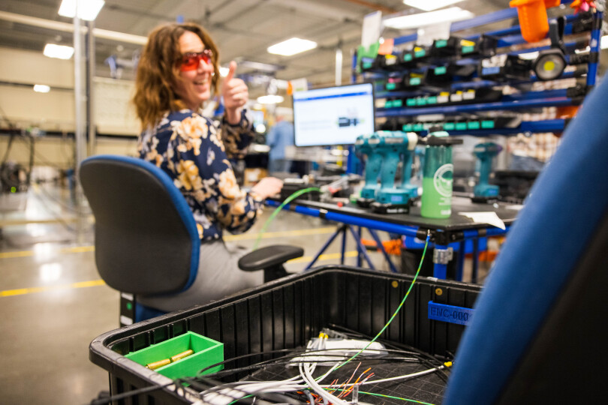
Who am I?
14+ years at SEL
7+ years in digital and social media marketing
Corporate LinkedIn, executive LinkedIn, and Facebook
Corporate and community social media experience
Notes:
Good afternoon. My name is Desiree Roach.
Corporate Communication Specialists at Schweitzer Engineering Laboratories (SEL), headquartered in Pullman, Washington. We engineer, design, and manufacture equipment for the electric power grid.
I have been with SEL over fourteen years, which means I’ve seen how social media expectations have changed — internally and externally.”
What hasn’t changed is that people expect consistency in how organizations show up, regardless of platform.
My background is primarily in digital and social media marketing, where for several years I focused on organic growth and audience engagement.
Over the last year and a half, my role has expanded into corporate communications. Today, I support SEL’s, manage our community‑facing Facebook page, support executive LinkedIn presence with their strategy, and am currently building a Facebook presence for the Schweitzer Wellbeing Center, a community public place
That range has really shaped how I think about social media — not as a channel, but as a relationship.

Slide 3

Social Media is Your Welcome Mat
Social media as a first impression
Serves new audiences and
long‑time followers
Consistency creates trust over time
Best Practice:
Treat social media as an ongoing
relationship, not a campaign
Notes:
I often describe social media as a welcome mat.
It’s the welcome mat for someone just discovering you — and the same welcome mat your most loyal, long‑time followers keep stepping back onto.
What makes a welcome mat effective isn’t how eye‑catching it is — it’s whether it’s consistent.
If the experience changes every time someone shows up, trust breaks. When it’s consistent, relationships form.
When I think about a welcome mat, I’m really thinking about expectations.
Have the audience think about brands and organization they follower
If you walk into a space and it feels completely different every time — different tone, different priorities — it’s disorienting.
That’s exactly what inconsistency feels like on social media.
Consistency is what tells people they’re in the right place — whether they’re visiting for the first time or the hundredth time.

Slide 4
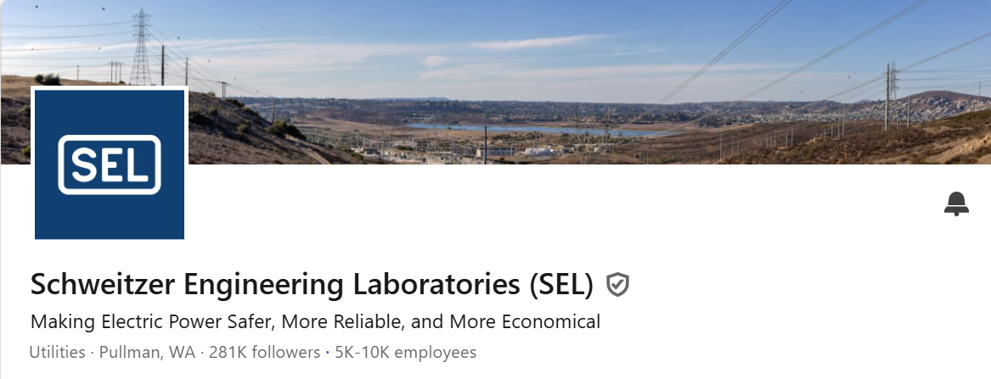
Corporate LinkedIn
Credibility matters on LinkedIn
Technical papers framed as education
Audience expectations
drive engagement
Best Practice:
Lead with value and education,
not promotion
Notes:
I want to pause here and share a personal learning moment.
Early in my career, I thought success on social media meant posting more — more content, more activity.
What I learned is that volume doesn’t fix inconsistency.
In fact, inconsistency makes people work harder to understand who you are — and most audiences won’t do that work.
If people don’t know what to expect from you, even good content gets ignored. Consistency sets expectations — and expectations are what build trust.
That lesson has influenced how I approach corporate LinkedIn, executive presence, Facebook, and even community‑focused pages like the pool.

Slide 5
Lesson Learned: More Isn’t Always Better
More content ≠ clearer message
Inconsistency creates confusion
Consistency builds expectation and trust
Best Practice:
Post consistency matters
more than volume
Notes:
I want to pause here and share a personal learning moment.
Early in my career, I thought success on social media meant posting more — more content, more activity.
What I learned is that volume doesn’t fix inconsistency.
In fact, inconsistency makes people work harder to understand who you are — and most audiences won’t do that work.
If people don’t know what to expect from you, even good content gets ignored. Consistency sets expectations — and expectations are what build trust.
That lesson has influenced how I approach corporate LinkedIn, executive presence, Facebook, and even community‑focused pages like the pool.

Slide 6
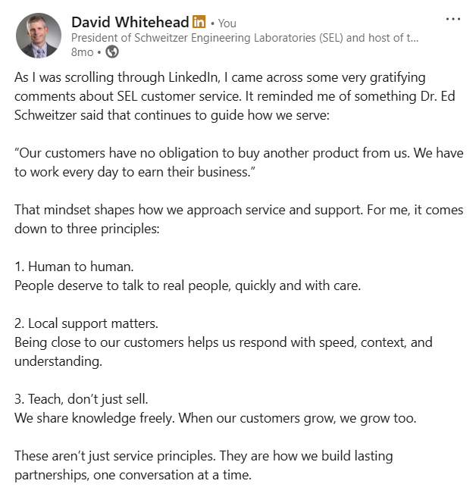
Executive Presence on LinkedIn
Built on perspective, not promotion
Philosophy over announcements
Consistency of voice builds trust
Best Practice:
Be consistent in perspective,
not just presence
Notes:
Executive presence on LinkedIn is also about relationship — but it’s built on perspective.
People follow leaders to understand how they think, not to see announcements.
A strong example was a leadership philosophy post Dave shared. It wasn’t tied to a product or milestone — it was simply how he approaches leadership.
That post resonated because it was consistent with how he shows up over time — thoughtful, values‑driven, and human.
Consistency of voice builds executive trust.
The goal isn’t to make executives visible — it’s to make them recognizable.

Slide 7
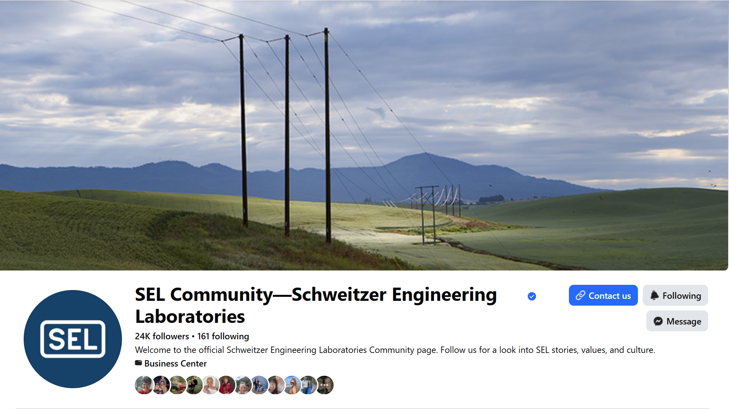
SEL Facebook: How Community Forms
Community‑facing communication
Clarity, responsiveness, tone
Trust leads to participation
Best Practice:
Prioritize clarity and reliability
over promotion
Notes:
Managing SEL’s Facebook page reinforced that while LinkedIn and Facebook are both about relationships, expectations differ.
On Facebook, especially for a community‑facing organization, people aren’t looking for perspective or thought leadership — they’re looking for clarity they can rely on.
This page isn’t campaign‑driven — it’s community‑facing.
People come here to understand what’s happening, what’s changing, and what they can reliably expect.
When that information shows up consistently and respectfully, people begin to engage in ways that align with the space —acknowledging updates, adding helpful context, and interacting appropriately.
That’s how a Facebook page shifts from simply sharing information to functioning as a community.
Consistency in communication makes the brand feel dependable — and dependable spaces invite participation.

Slide 8

Schweitzer Wellbeing Center Facebook
Social media as public service
Reliability builds confidence & participation
Simple information matters
Best Practice:
Consistency builds confidence
in community spaces
Notes:
What you see on the SEL Facebook page is how community forms when information is reliable and expectations are clear.
The community pool uses that same model — consistency first, trust second — but applies it in a space where the need for information is immediate.
That’s where community becomes visible very quickly.
People aren’t looking for inspiration — they want answers
Is the pool open today?
Did the hours change?
Is this information accurate
Consistency is what removes that uncertainty
Here, social media isn’t marketing — it’s communication. And consistent updates and follow‑through are what build confidence and trust.

Slide 9
Consistency is Key!
Match the message to the audience
Choose platforms intentionally
Stay consistent, even when engagement fluctuates
If someone encountered your organization on social media for the first time today, what would they learn about you?
Notes:
Across corporate, executive, and community spaces, these best practices hold true.
Match the message to the audience.
Choose platforms intentionally.
And stay consistent, even when engagement fluctuates.
I’ll leave you with this question:
If someone encountered your organization on social media for the first time today, what would they learn about you?
And would that experience feel the same for someone who’s followed you for years?
Because social media isn’t just content — it’s a relationship over time.
And great relationships start with a welcome mat people trust.

Slide 10


