Slide 1
Disrupting, Relearning and Reshaping in an Aging Upturn
INP Fall Conference
October 15, 2025
Spokane Valley, Washington
John W. Mitchell

Slide 2
October 2025
(Written as of 10/13/25!)
Year 6 of Upturn
Global Trade Upheaval
Mercurial Policy Environment
Weakening Labor Market
Inflation Above Fed Target
Emergence of State Capitalism
Financial Markets Flirting with Record Highs-Net Worth Up $7.1 Trillion in Q2
Flying Blind in Shutdown

Slide 3
From The Dustbin of History
Socialism-government ownership and direction of firms-Intel, Golden share of US Steel, Mayoral Candidate in NYC
Trade Wars-Ghosts of Smoot Hawley from the 1930s
Independent Monetary Authority Under Attack Reminiscent of Johnson and Nixon

Slide 4
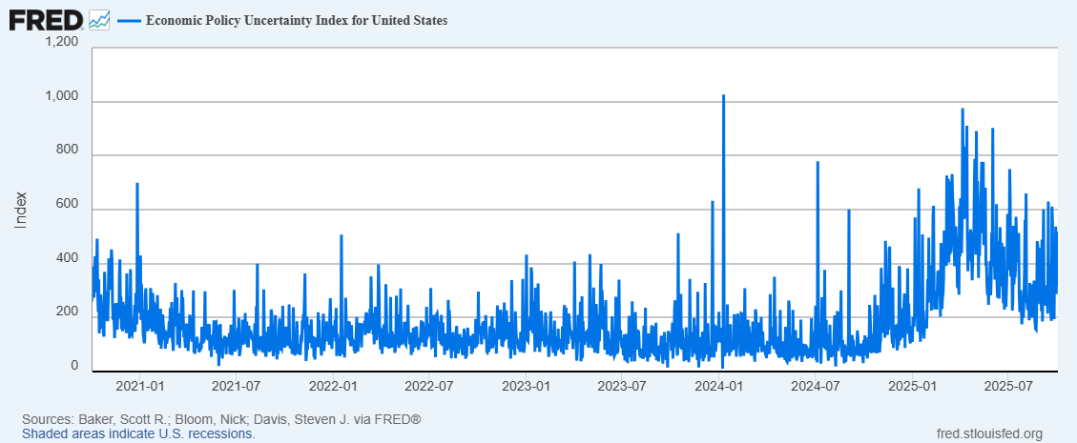
Policy Uncertainty
Baker, Bloom and Davis

Slide 5
GDP
In Q2 Huge Swing in Imports-Subtracted 4.7 % Pts in Q1 added 5.03% Pts in Q2-Beat Tariffs
Consumption 1.68% Pts in Q2
Housing Weak-Residential -.2% Pts. Q2 down 4 of last 5 quarters

Slide 6
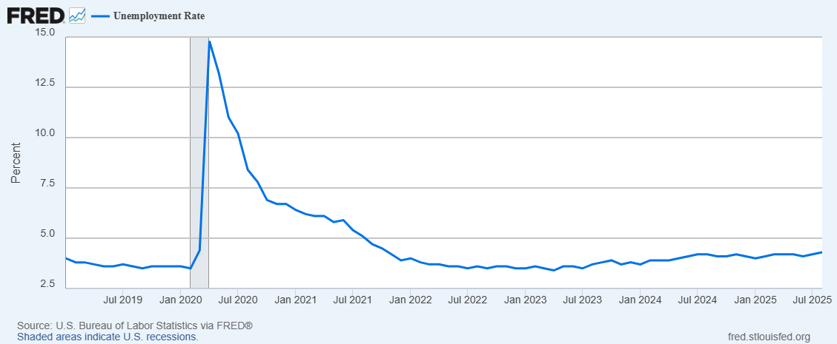
Employment and Unemployment Rate Now 4.3% (62 Months Up and 2 Down Since May 2020)

Slide 7
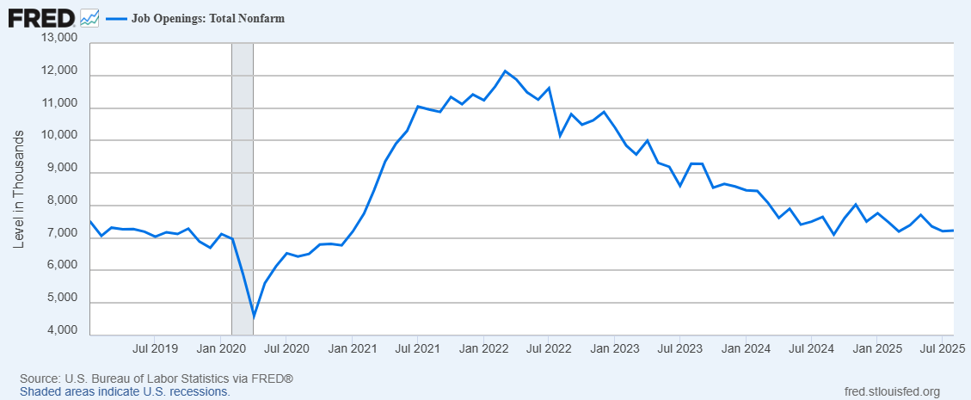
Miscellaneous Labor Market
Job Openings
30 States 4% or Less August Un. Rates SD Lowest 1.9% CA Highest at 5.5%
BLS Director Fired, Nominee Withdrawn
JOLTS Openings Per Unemployed .98 had been over 2 back in 2022
No Hire and No Fire
Immigration/Deportation Policies-Impacting Supply

Slide 8
Year to
August .8%

Slide 9
Inflation
CPI August 2025 2.90% Core 3.1% Annual Average 2024 2.9%
PCE August 2.7% Core 2.9%
On going Increase in General Price Level
Over the Month Change 2024-25
Annual Average CPI

Slide 10
Confluence
Covid Response-Fiscal-Cares Act 2020, Omnibus 2020, American Rescue Plan 2021, Infrastructure Bill (2021), Chips and Science Act (2021), Inflation Reduction Act (2022)
Monetary Policy Funds to 0-.25% in March 2020, Quantitative Easing Buying Securities
Covid Supply Chain Disruptions
War in Ukraine
Response to Inflation-Fed began to tighten in 2022- March of 2022 until July 2023 0-.25% to 5.25-5.5%

Slide 11
Tariffs
Tariffs-A Tax on Imports-paid by Importers-Attempt to Raise Prices
Who ultimately bares the burden? Exporter Lower Prices, Reduced Margin of Importer-Lower Earnings –Passed on to Ultimate User?
One Off or ?
April 2,2025 Liberation Day Announcement Tariffs based on Merchandise Trade Deficits- Backed Off
Deals-Exceptions- Examples Reciprocal Tariffs- UK 10%, Switzerland 39%, South Korea 15%, Vietnam 20%, India 25%
Less Competition Directly, Inputs Increase Costs –Some Job Gains and Some Losses
Lobbying for Protection or Exemption
Consumer Goods-Appliance, Apparel, Coffee, Sporting Goods, Tires, Beef—have all jumped- Metals working Through
Comparative Advantage, Gains From Trade, Safeway/Albertsons/Super One/Freddys and Trade Deficits

Slide 12
Endgame?
Long Period of Falling Trade Barriers and Globalization of Production
Now More Protectionist-Higher Costs
Defense Argument
Court Decisions
Role of the Dollar as the dominant Reserve Currency
Rest of World-Agreements Excluding US

Slide 13
The Fed
Waiting While Under Attack
FED Charge-Maximum Employment and Stable Prices
Powell at Jackson Hole- “Effect of tariff on consumer price clearly visible.”
“risks to inflation tilted to the upside and risks to employment to the downside”
“Nonetheless with policy in restrictive territory, the baseline outlook and the shifting balance of risks may warrant adjusting our policy stance.”
September cut target .25%- with 1 Dissent Miran
High Level of Uncertainty
Attempt to Fire Governor Cook-Blocked by Court
Public Criticism and Insults
Indicate More Cuts to Come
Powell’s Term as Chair ends in the Spring
s

Slide 14
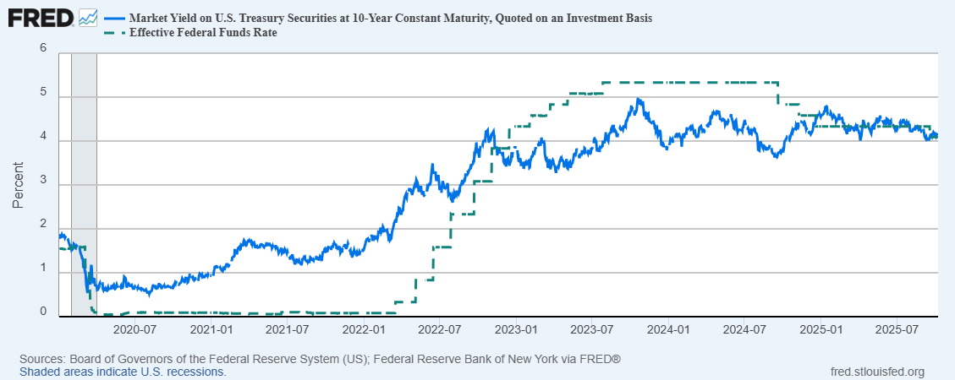
10 Year and Funds Rate

Slide 15
Independent Monetary Authority-lessons from 1970s
Inflation Risks-lower rates-rapid increases in money supply
Inflation Expectations-New York Fed Survey-1 year Inflation Expectations rose to 3.4% from 3.2%-Expected weakening in Labor Market
Dilemma for Policy Makers-Labor Market calls for lower and Inflation for higher or no Change

Slide 16
Role of Government
Post Covid World
Intel, Golden Share of US Steel, Rare Earth Investments, Share of Export Revenue, Lithium Mine Investment, Directing Investment from Overseas, Pharmaceutical Deals
Ownership/Control
Lobby or Innovate
State Capitalism-Giving up our Strength/Advantage?

Slide 17
Fiscal Policy
2025 BBB
Extended TCJA Cuts that were to Expire
Tips and Overtime Provisions
SALT Cap Raised
$5 Trillion Debt Ceiling Jump
SNAP and Medicaid Changes
Business Incentives
Energy Policy-Reduction in Green Subsidies
Border Wall and ICE Expansion and Enforcement
Larger Debt $4-5Trillion

Slide 18
Deficits
Spending in Fiscal 2025 $7.03 Trillion
Interest $1.03 Trillion
Social Security $1.57 Trillion
Defense $.87 Trillion

Slide 19
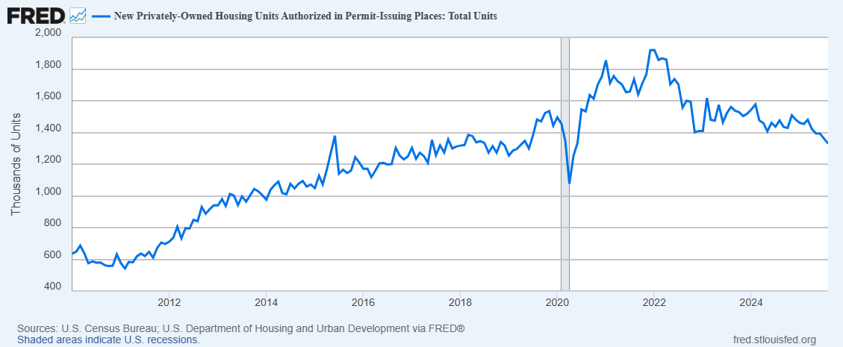
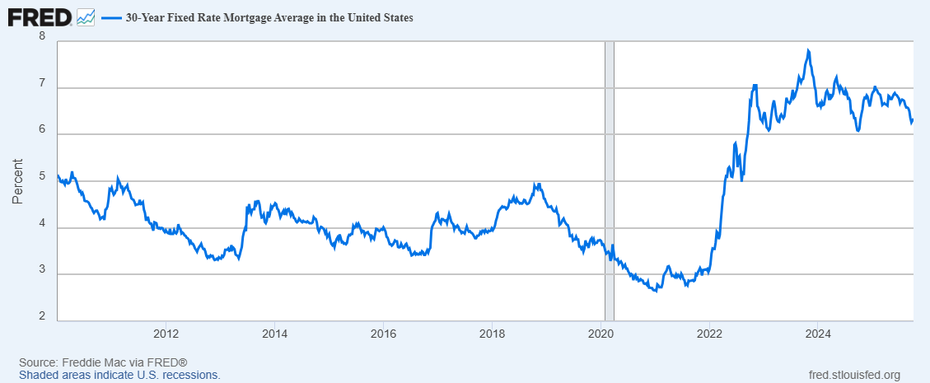
Building Permits and Mortgage Rates
2020 to 2025

Slide 20
Housing Conundrum
Case Shiller Cotality July Data Year over Year down to 1.7% was 4.1% start of year-slowing for 6 Months-Leading Cities-New York, Chicago and Cleveland
Falling Prices over the Month-Lead by San Francisco, Seattle, Phoenix and Miami- 4 of 20 Cities had Increases-Cleveland, Chicago, Minneapolis and Detroit
Resales in August were 38% below the levels of late 21- early 22 (NAR)
Rising Inventories-Annual Gains-Monthly Declines In Prices
Affordability-Leveled out Started To Increase -Mortgage rates Off Highs, Incomes Rising, Prices Moderating in Many Areas
Construction and Immigration Policy
Tariff Implications for Costs-Steel, Copper, Wood, Cabinets, Trucks -AGC

Slide 21
Housing Affordability
(30% Affordable)
Area | % Median Income for Mort., Taxes, Ins.
Boise | 51
CDA | 64
Lewiston | 42
Moses Lake | 40
Othello | 32
Richland-P-K | 52
Sandpoint | 73
San Francisco | 77
Area | %Median Income for Mort., Taxes, Ins.
Seattle | 57
Spokane | 51
Wenatchee | 62
Yakima | 50
Atlanta Fed | July

Slide 22
Housing Considerations
FHFA Q2 2025 New York 8.03% 1 Florida -1.39% 50
Idaho 21st 4.27%, Washington 38th 2.23% Q2 PO
Most Depreciation PO Sarasota, Cape Coral, Lakeland FL, Stockton, Tucson, Saint Petersburg, San Jose, Austin
Most Appreciation Rochester, Hartford, New York, Lakewood NJ, Buffalo, Elgin Illinois ( How The World Turns!)
Getting on the Ladder-Age at First Purchase
Long term Rates; Deficit Angst, Inflation Fears, Control of Fed, Reserve Currency Status of Dollar-What Does $4000 Gold Tells Us?
Housing as Collateral Damage

Slide 23
Uncertain Outlook
Labor Market Weakening-Demand & Supply
Inflation Still above Target
Shutdown-Temporary-How long to catch up?
Policy? Trade-Monetary-Fiscal- Energy Policy
AI Investment Boom-Data Centers-Power Supplies

Slide 24
A Possible Scenario
2.8% GDP Growth in 2024 1 to 2% in 2025-SImilar in 2026
CPI 2.9% in 2024 2.6-3.4% in 2025 and 2026-wide range NABE October
Fed Says Two more Cuts in 2025 Data Dependent- Response to Weakness in Labor Market with Inflation Above Target?
Idaho Employment 2-2.5% in 2025 and 1.3- 2.5% in 2026
Washington .5 -1.2% in 2025 and .4 to 1.8% in 2026
Risks Have Grown on Downside-Confidence in Outlook Diminished
Decimal Points?

Slide 25
A New Environment
Known Unknowns (Rumsfeld)
This is an experience that none of us have seen before in terms of magnitude. One thinks about June,1930 Smoot Hawley Tariff in US helped spark large decline in trade. Daily Change
Response from Rest of World-Retaliate –Deal
Changed the Signals to Billions of People-How will they and their institutions respond?
Price Pressures after an Inflation Episode
Deficit/Debt Burden Implications
Aging Population –Oldest Baby Boomers about to Turn 80-Youngest about to turn 62

Slide 26
Animal Spirits in 2025
“Most, probably, of our decisions to do something positive, the full consequences of which will be drawn out over many days to come, can only be taken as a result of animal spirits-of a spontaneous urge to action rather than inaction , and not as the outcome of a weighted average of quantitative benefits multiplied by quantitative probabilities.” JMK 1930
Tariff Changes, Rules and Regulations No Stability
Project Funding Gone
Stay Put-Delay

Slide 27
THANK YOU
Lessons-Considerations
  Time to See impacts
  How do things work?
  Interdependence-Global
  Baby and Bathwater Risk “Poorer, Smaller and Less Innovative”-Economist 10/9/25
  The Excitement Continues

