Slide 1



Lightcast powers strategic decisions that drive clarity and impact
Trusted by:
of Fortune 100 Companies
67
Founded over 20 years ago, Lightcast created the category of labor market intelligence to help companies, educators, and governments make strategic decisions about their people.
1,000+
Educational
Institutions
When building a skill-based, future-ready workforce, start with Lightcast.
775
Government Organizations
Notes:
Elena to introduce Lightcast

Slide 2
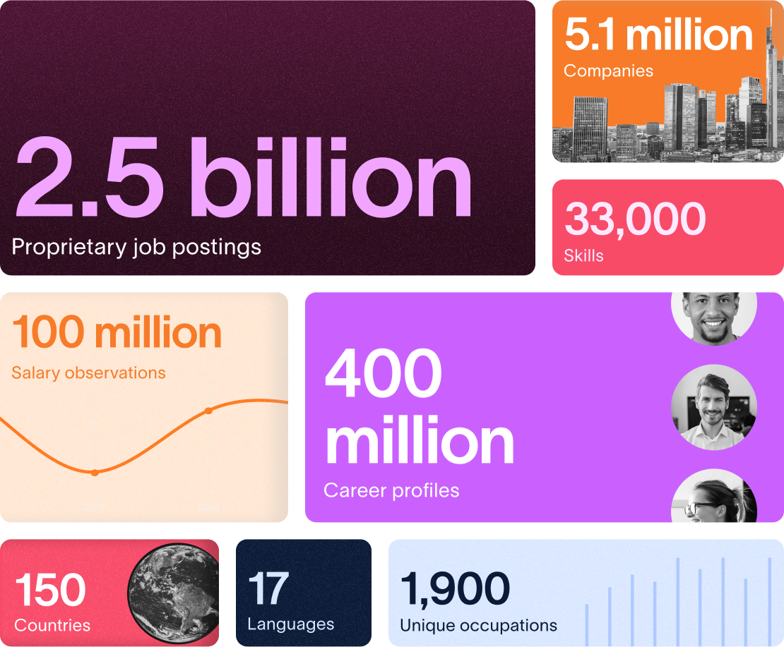
Lightcast Data Comprehensive, Contextualized, Actionable.
Lightcast combines 18B+ data points from job postings, profiles, and pay into clear labor market insights - powered by 25 years of expertise, machine learning, and skills taxonomies.
Cuts through fragmented data to give clear signals
Helps employers build workforce strategies
Supports educators design future-ready programs
Informs policymakers on economic and skills trends

Slide 3
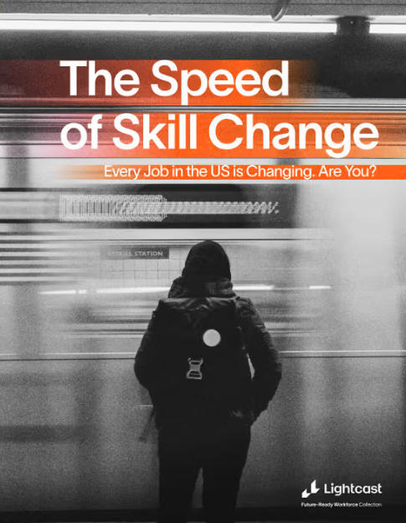

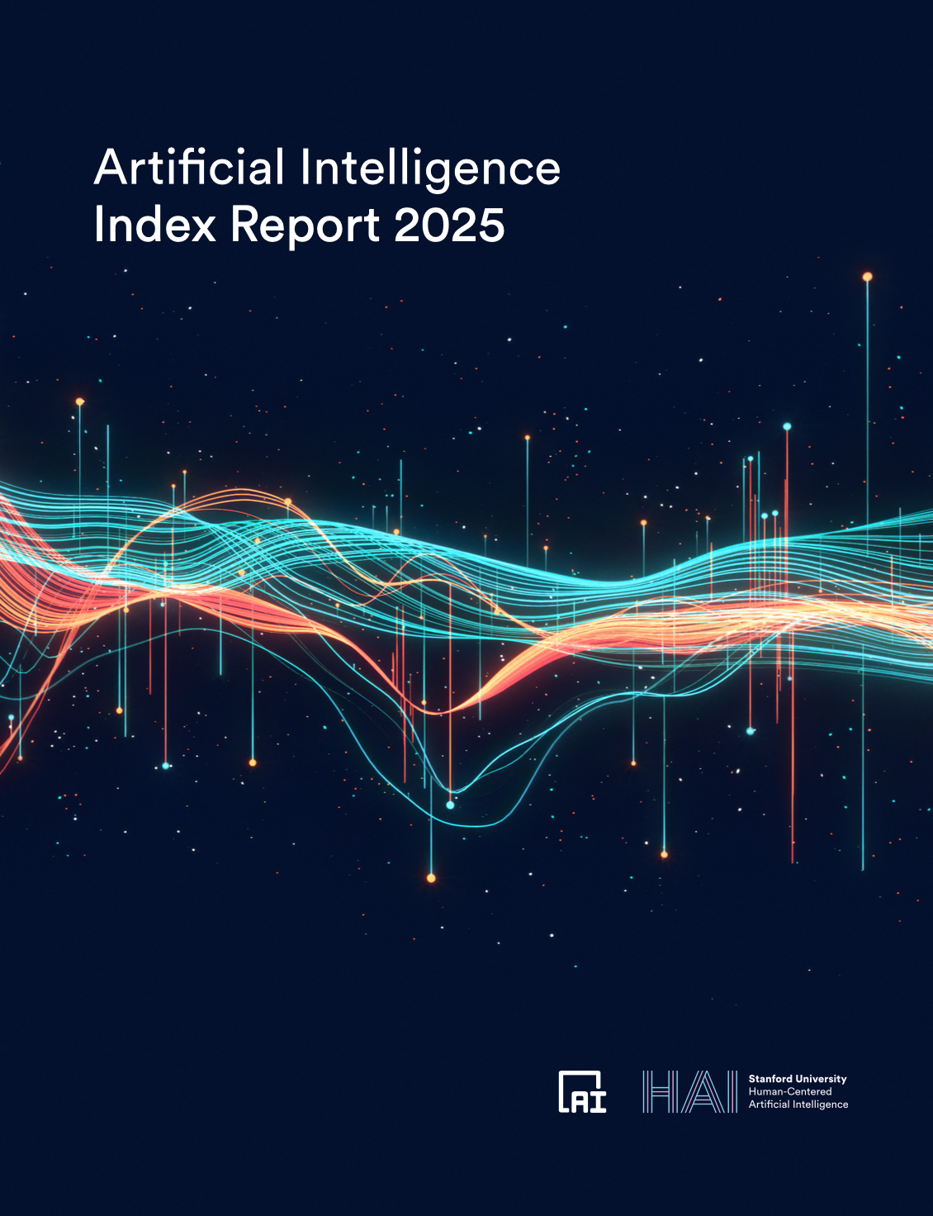


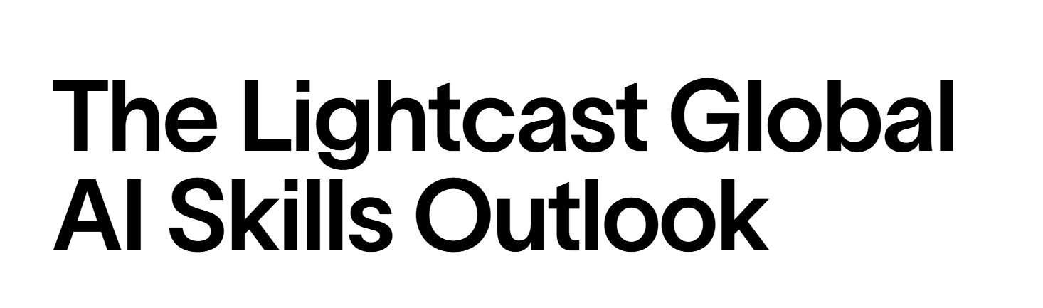


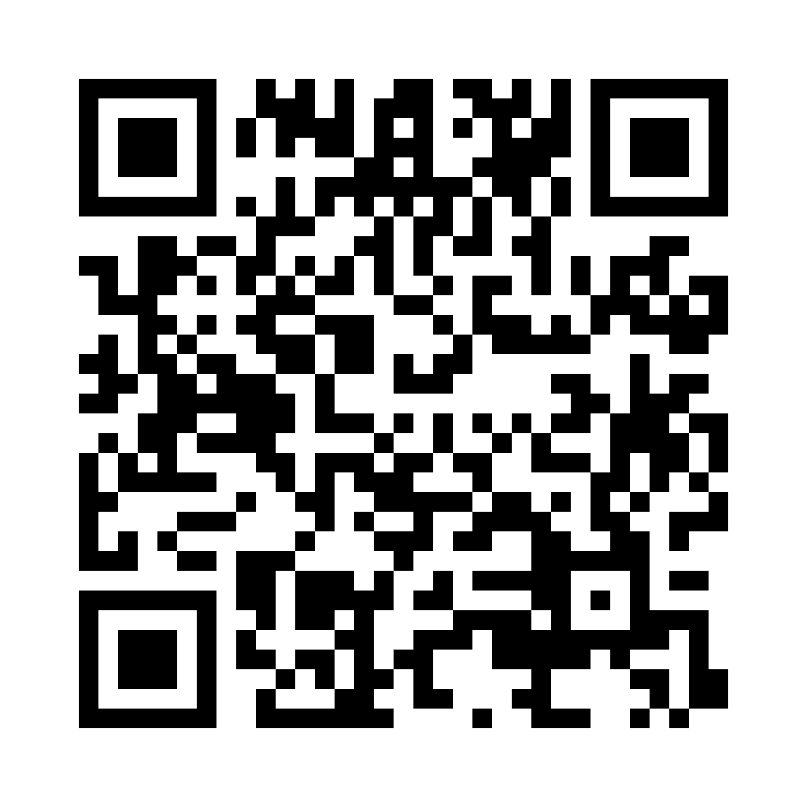


Lightcast Research on Artificial Intelligence in 2025
IMPACT ON SKILLS
GLOBAL TRENDS
US INSIGHTS
AI SKILLS TO CULTIVATE

Slide 4
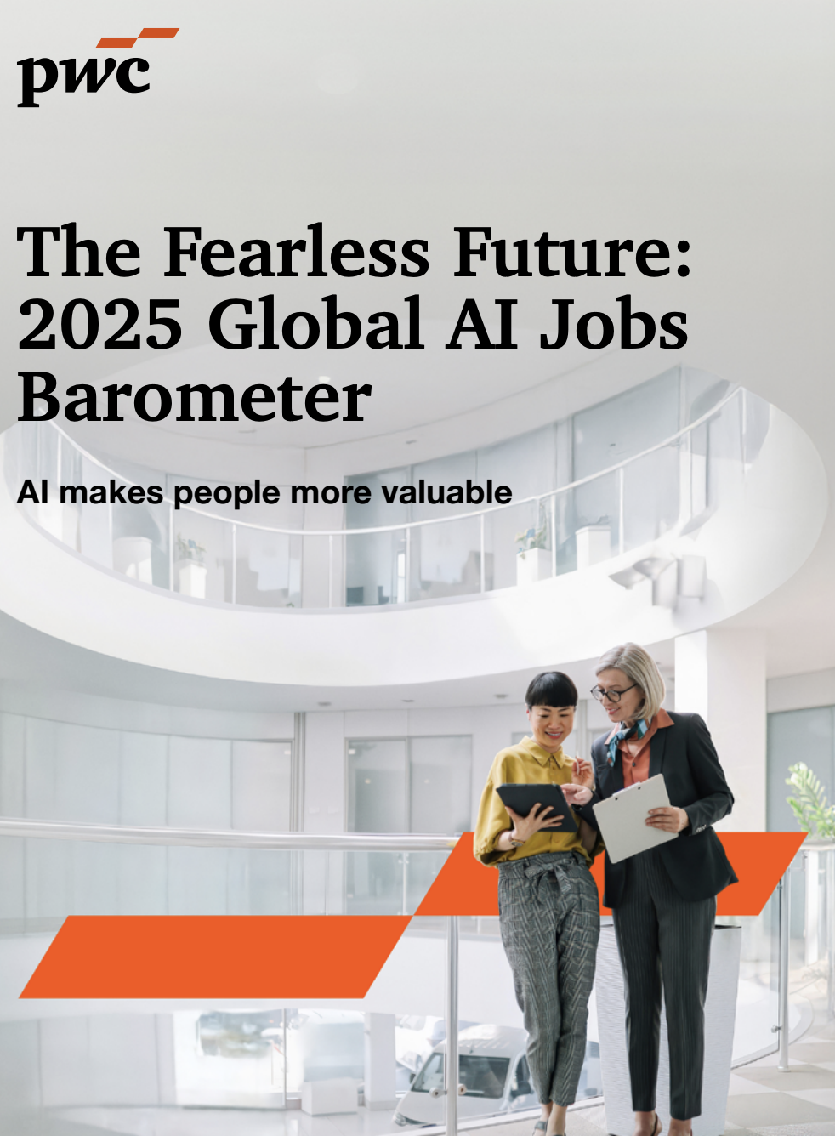
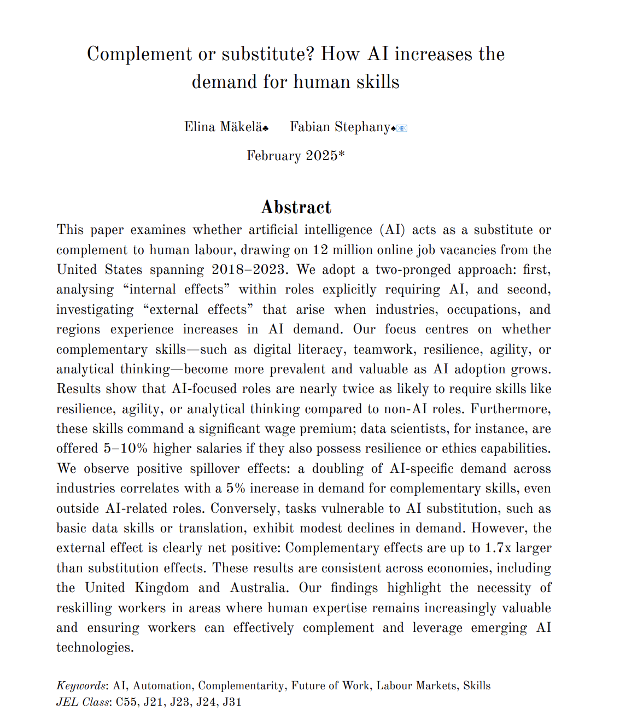
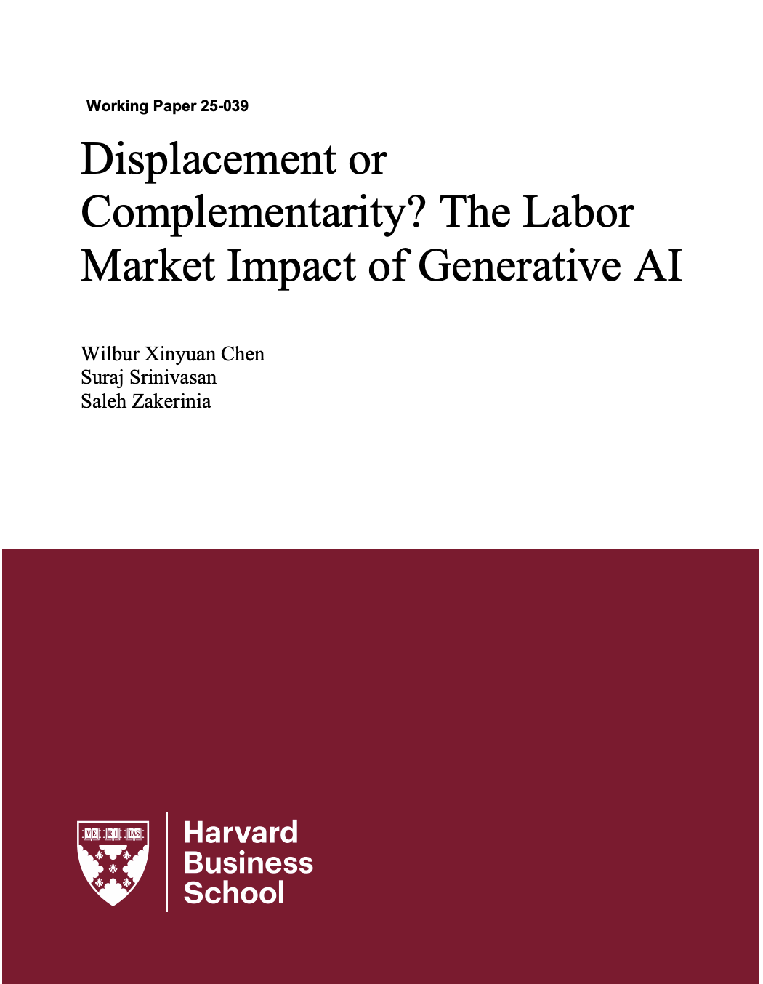
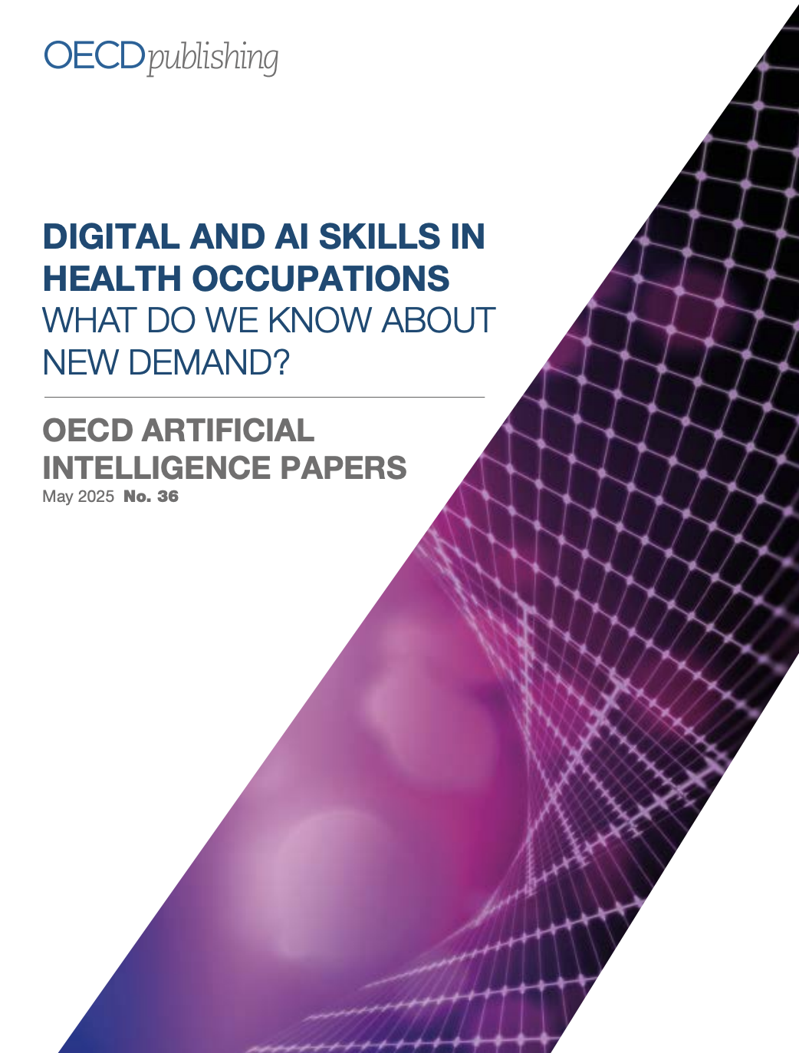
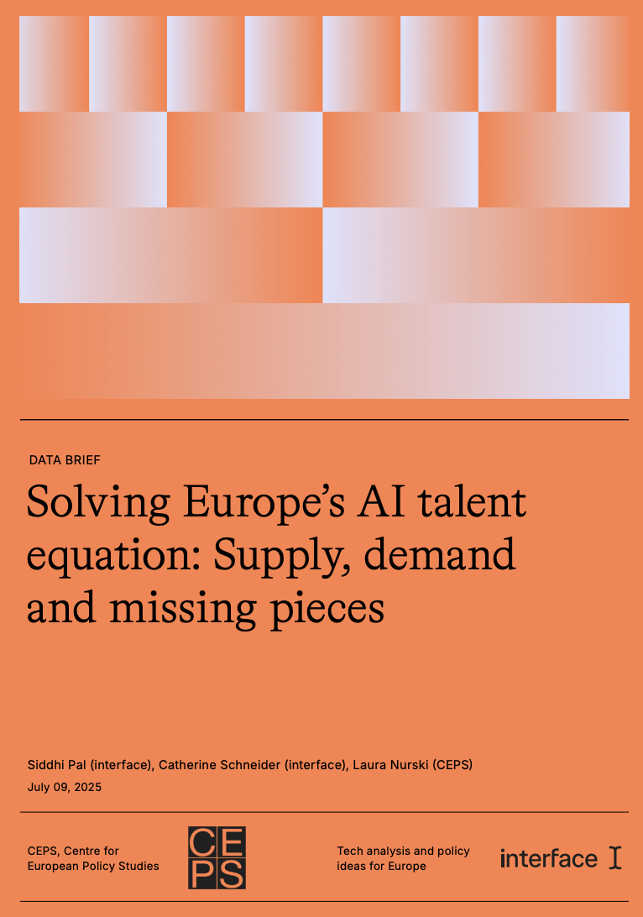
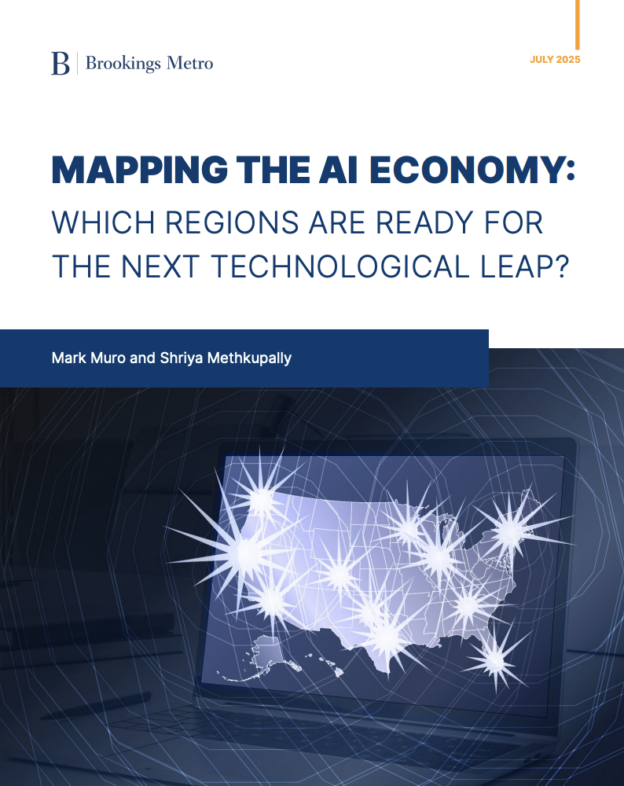
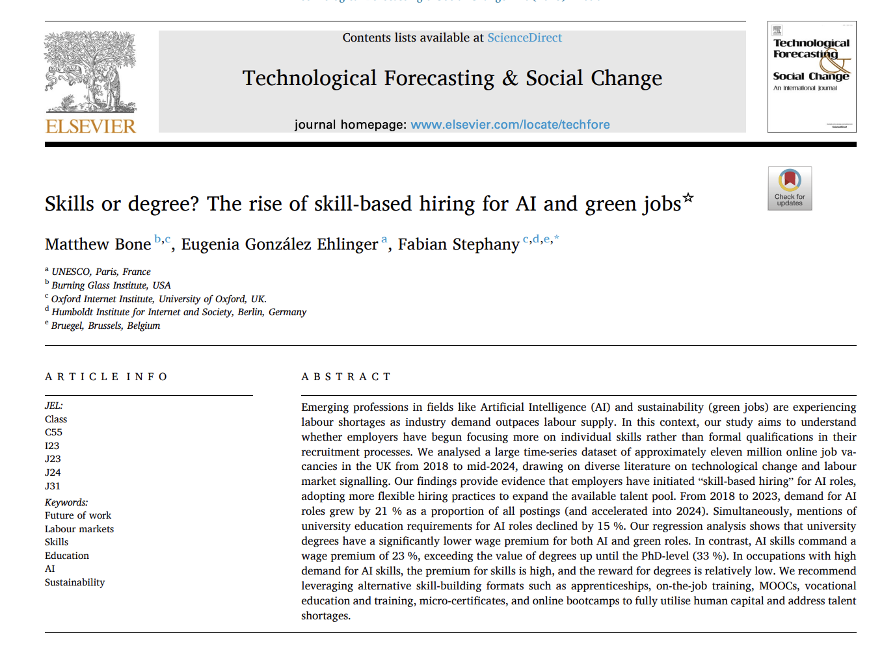
Also - Academics, Think Tanks, and Policymakers use Lightcast data to track AI trends and their impact
Our 2025 partner releases so far
The Lightcast AI methodology sets the standard and is used in academia and policy

Slide 5

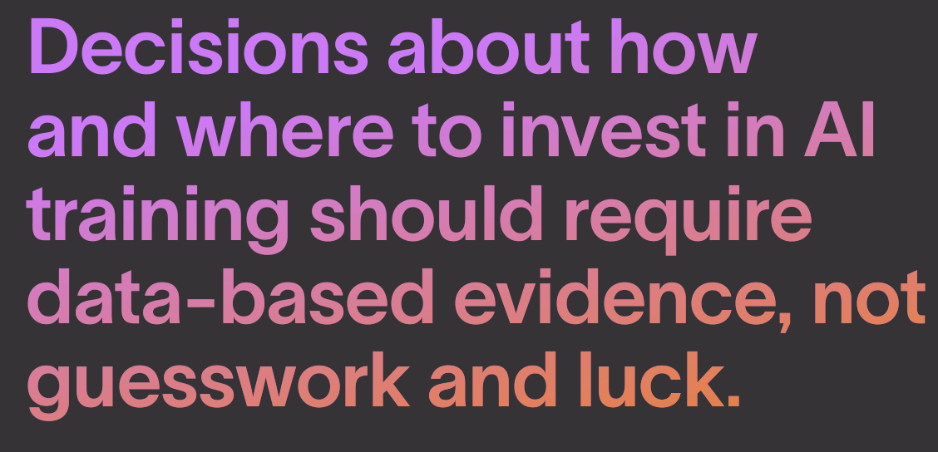

Beyond The Buzz

Slide 6
Beyond The Buzz
We have the answers.

Slide 7



Beyond The Buzz - Three Key Findings:
“AI job” does not mean “tech job”

Slide 8

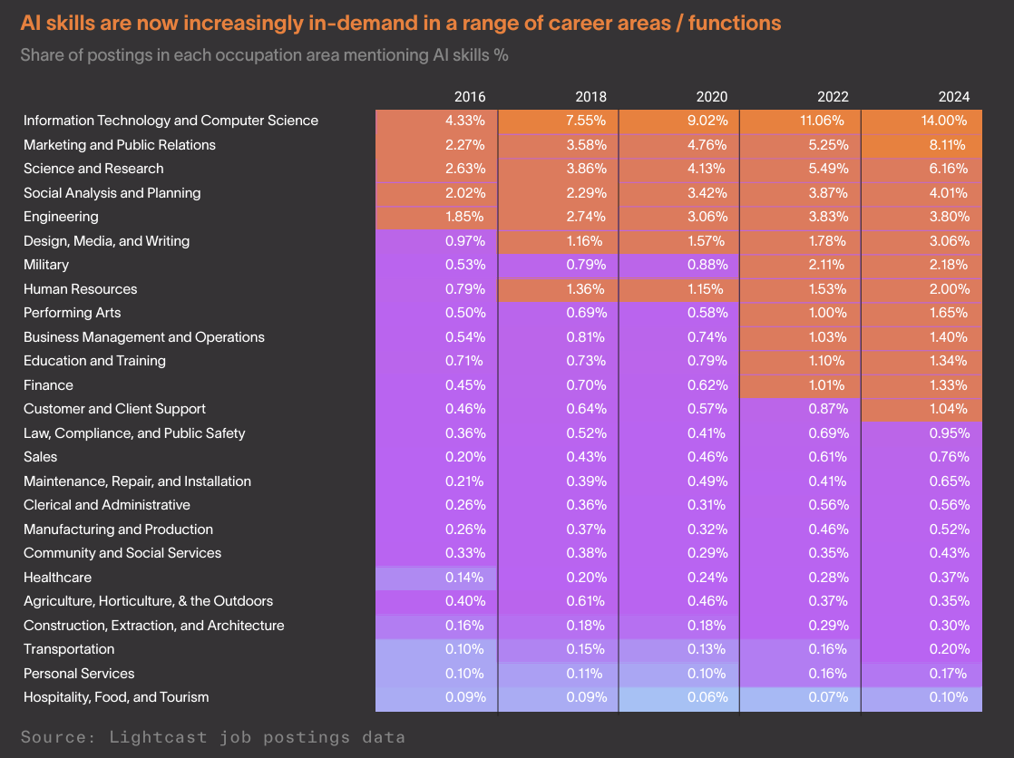
AI is no longer just a “tech thing”
Demand for AI is growing across all career areas
2024: 51%
of AI job postings were outside IT & computer science
2019: 39%
of AI job postings were outside IT & computer science

Slide 9
Beyond The Buzz - Three Key Findings:
“AI job” does not mean “tech job”
AI skills mean higher salaries

Slide 10
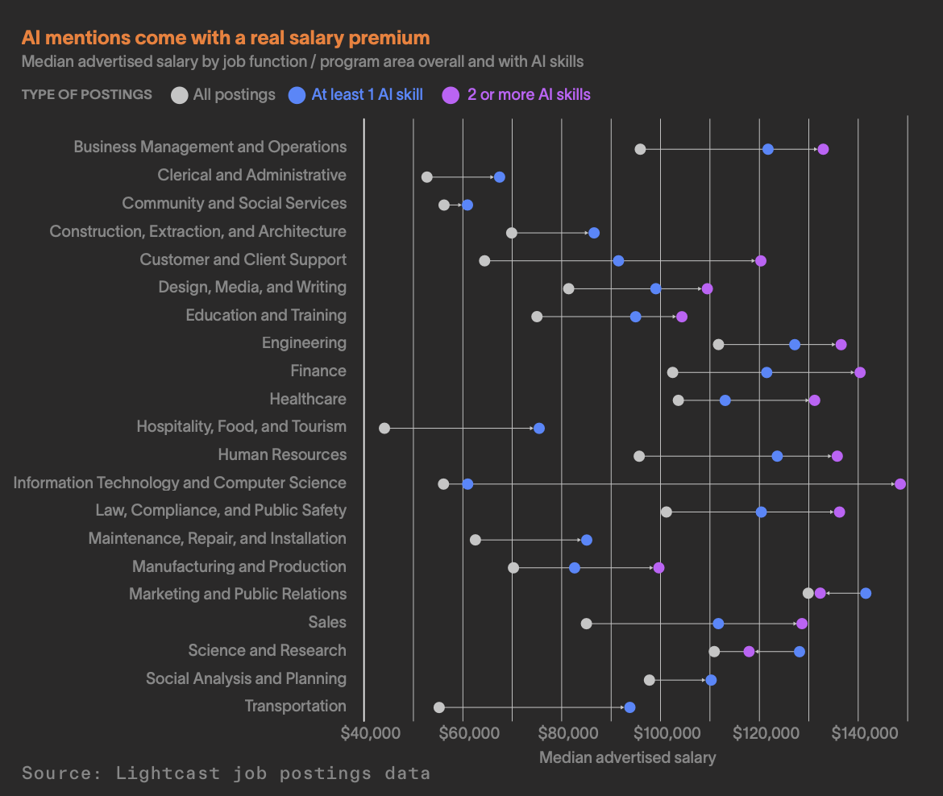
AI skills carry a real salary premium
Across job functions / program areas
28% salary premium
In median advertised salary in job postings with at least one AI skill compared to similar roles w/out AI.

Slide 11
Beyond The Buzz - Three Key Findings:
“AI job” does not mean “tech job”
AI skills mean higher salaries
Every career area is at a different stage on its AI adoption journey

Slide 12
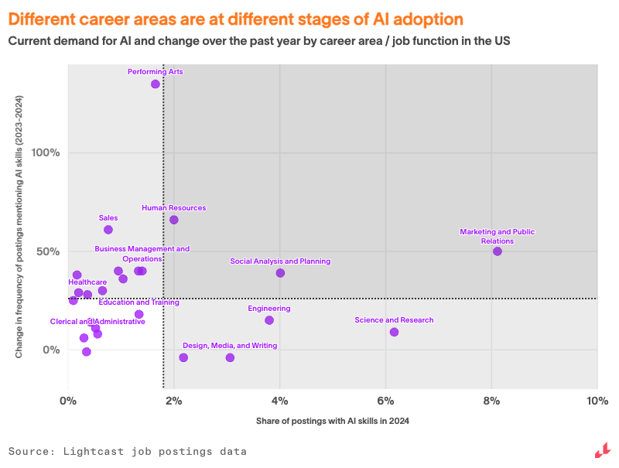
But… different jobs = different journeys with AI
And therefore, different strategies are required.
Let’s zoom in:
IT and computer science
Emerging frontiers
AI hotspots
AI Hotspots demand immediate, comprehensive action.
Emerging Frontiers represent the highest-opportunity investments.
Established AI Hubs need evolution, not revolution.
AI Cold Zones are in a position to respond proactively.
AI cold zones
Established AI hubs

Slide 13

Which skills should you teach right now?
Introducing the AI Skill Disruption Matrix
Notes:
Elena

Slide 14
The Common Foundation
Skill name | Description
Communication | Communication is the ability to effectively interact, convey information, and collaborate with others in a clear and understandable manner.
Artificial Intelligence | This skill encompasses the development of algorithms and models that enable machines to perform tasks such as learning, reasoning, problem-solving, and understanding natural language.
Management | Management is a set of skills that involve a variety of tasks, such as planning, organizing, leading, and controlling resources to achieve specific goals.
Operations | Operations is a fundamental skill that involves managing and overseeing the day-to-day activities of a business or organization.
Leadership | Leadership is a skill that involves the ability to motivate and guide a team towards achieving common goals.
Research | Research is a skill that involves gathering and analyzing information to answer questions or solve problems. It involves identifying reliable sources of information, evaluating the credibility of those sources, and synthesizing the information to draw meaningful conclusions.
Machine Learning | Machine Learning is a subset of artificial intelligence that involves the development of algorithms and statistical models that enable systems to perform tasks without explicit instructions.
Customer Service | Customer service is a necessary and common skill in almost every field and industry. It involves effectively communicating with customers to understand their needs,answering their questions or concerns, and providing them with excellent support and service.
Writing | Writing is a skill that involves putting thoughts and ideas into words through the use of language. It is an essential communication tool used to convey messages, express thoughts and emotions, and share information.
Problem Solving | Problem solving is the process of identifying, analyzing and resolving problems that can arise in any situation. It involves identifying the root cause of a problem, generating possible solutions, evaluating those solutions and implementing the best one.
A number of skills are essential to AI jobs, across career areas
Some, like communication, management and leadership are highly demanded across all jobs, not just AI jobs
Others, like research, are more likely to be among the top mentioned skills in AI job postings across functions vs. other job postings

Slide 15

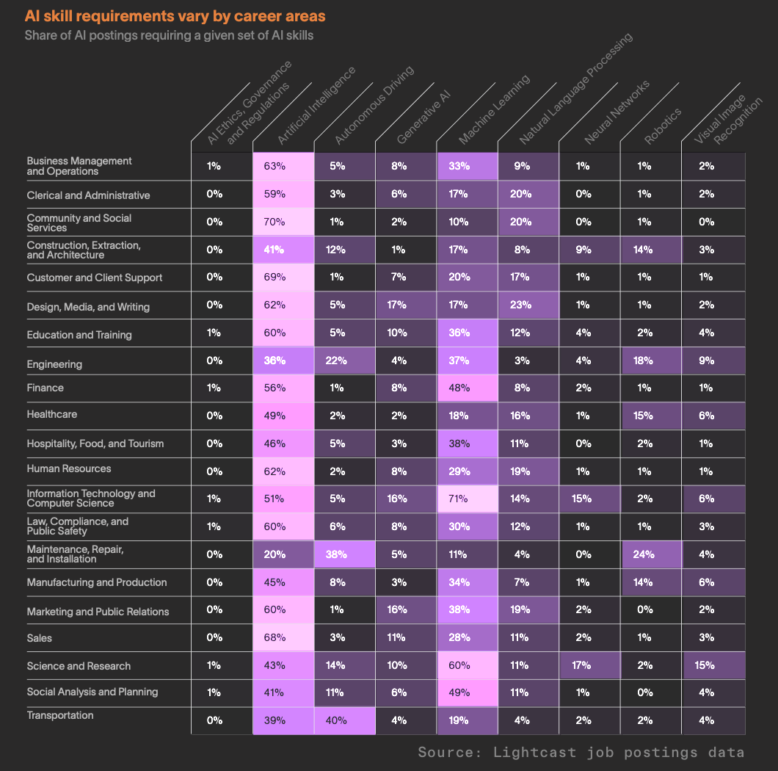
Specific AI skills needed vary
While some skills are needed across the board, AI skills training needs to be tailored to the requirements of each specific role

Slide 16

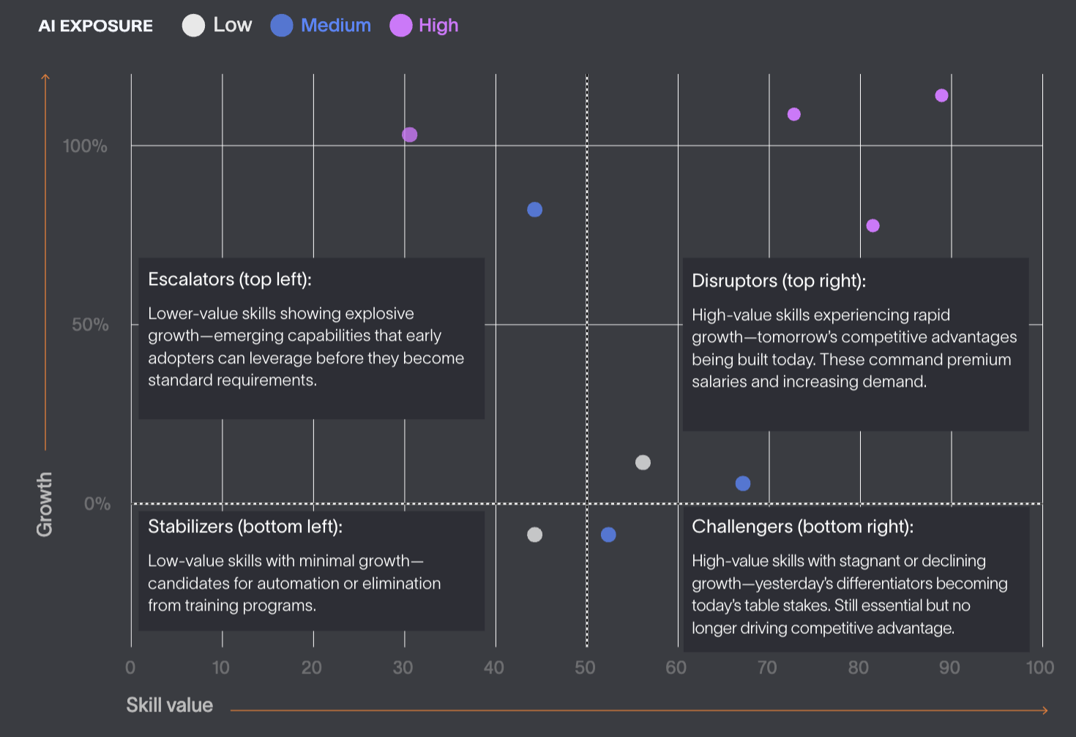
Zooming in for practical insights: The AI Skill Disruption Matrix:
Notes:
Elena

Slide 17
The AI Skill Disruption Matrix:
A Deep Dive into 5 Career Areas
Marketing & PR
Human Resources
Finance
Science & Research
Education & Training
Notes:
Elena

Slide 18
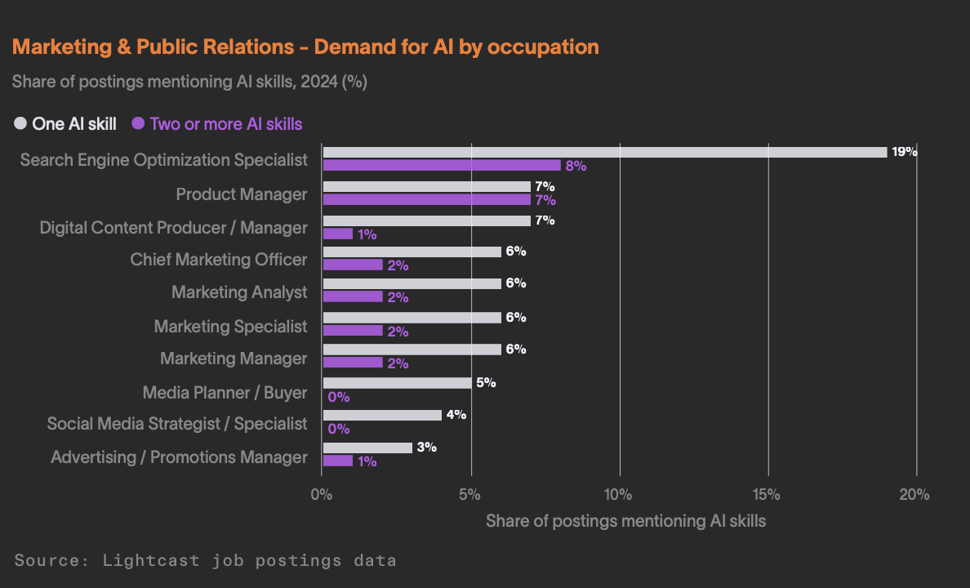
Zooming in for practical insights
Marketing and PR
Examples of AI applications:
Automating campaign optimization
Content creation
Predicting customer lifetime value
Audience segmentation

Slide 19
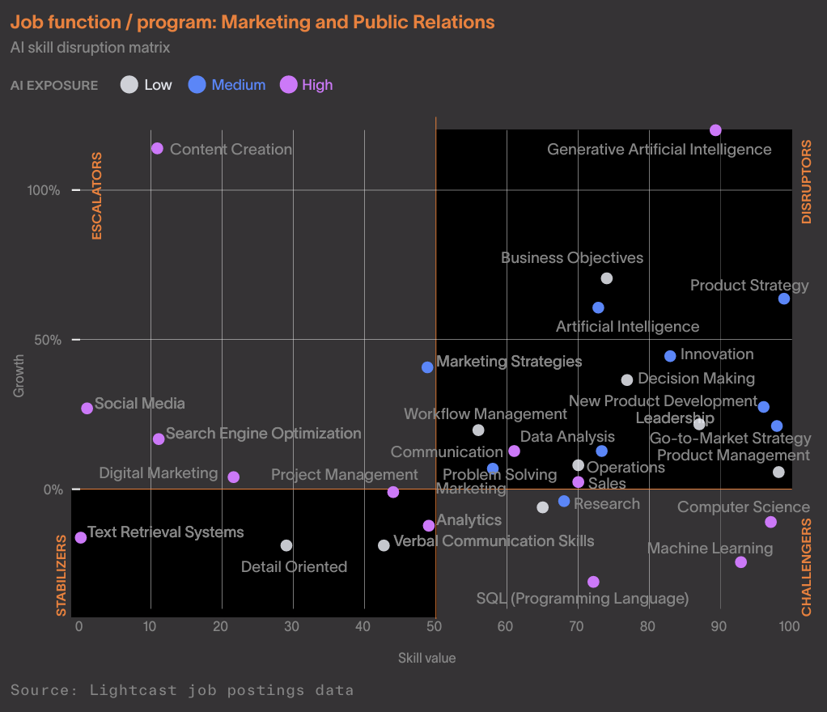
Zooming in for practical insights
The AI skill disruption matrix for Marketing and PR
Immediate focus: Comprehensive AI training for SEO specialists and product managers.
Universal requirement: Generative AI literacy for all marketing roles.
Strategic balance: Combine AI technical training with enhanced human capabilities like communication, leadership, and decision-making that maintain high salary value but low AI exposure

Slide 20

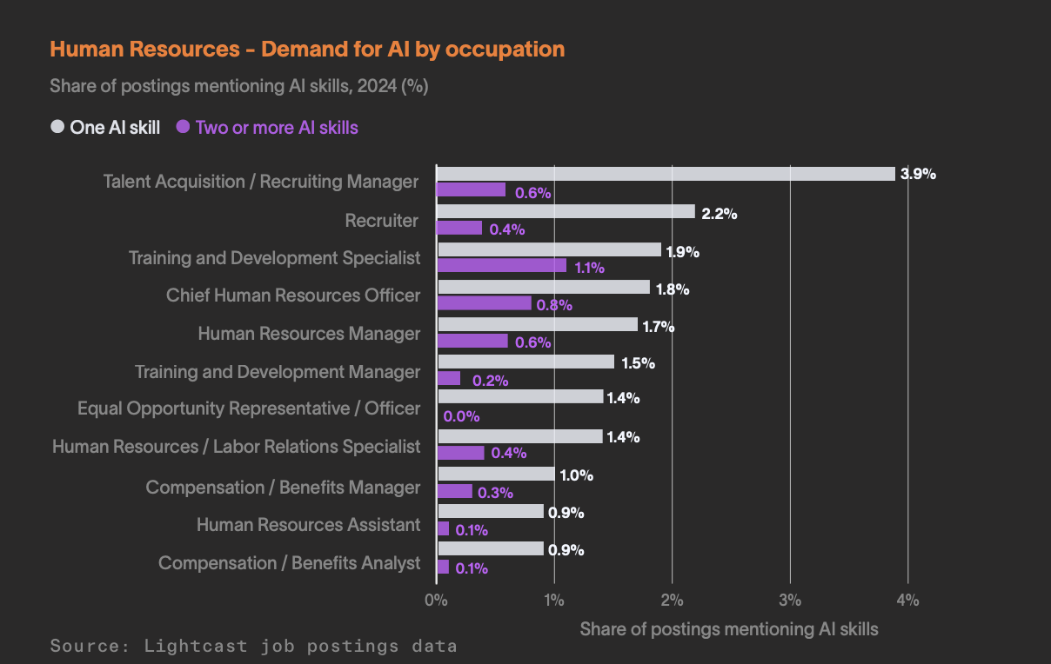
Zooming in for practical insights
Human Resources
Examples of AI applications:
Automate resume screening
Conduct initial candidate assessments
Provide employees with self-service chatbots
Identify high potential candidates
Predictive analytics on employee retention.

Slide 21
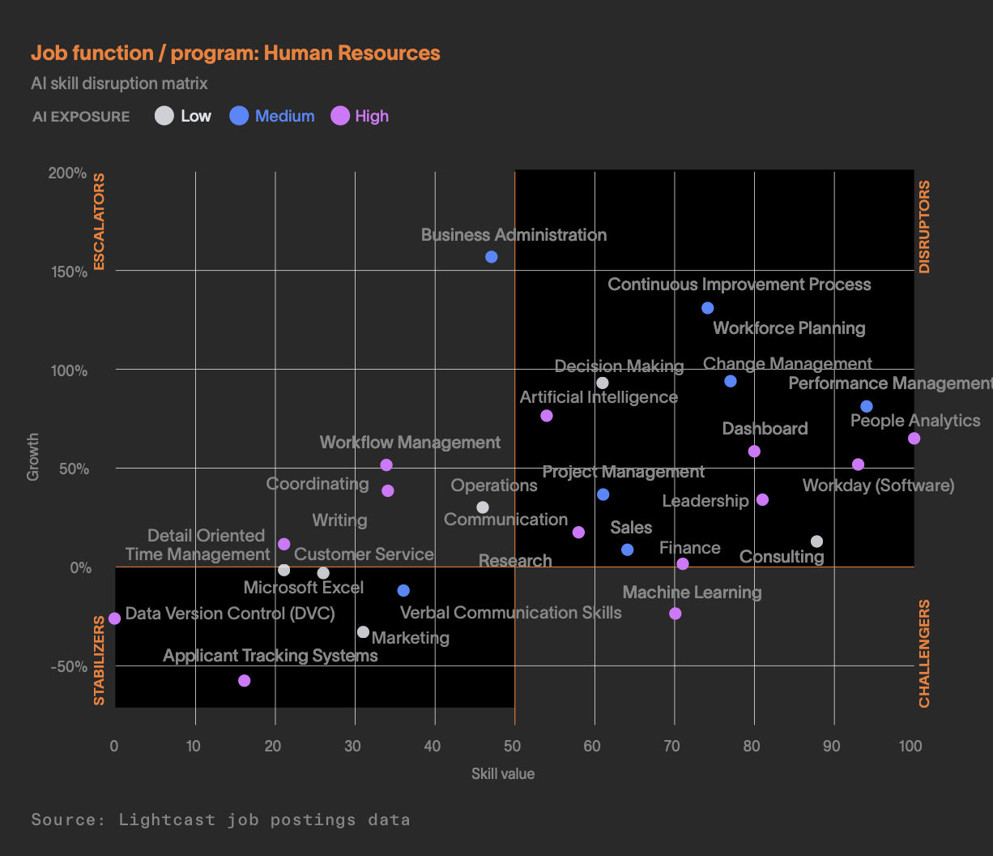
Zooming in for practical insights
The AI skill disruption matrix for Human Resources
Immediate focus: Comprehensive AI training for talent acquisition and training specialists.
Universal requirement: Build AI literacy around candidate screening, employee analytics, and workflow automation for frontline HR roles.
Strategic balance: Combine AI technical capabilities with enhanced human skills like decision-making and change management.

Slide 22
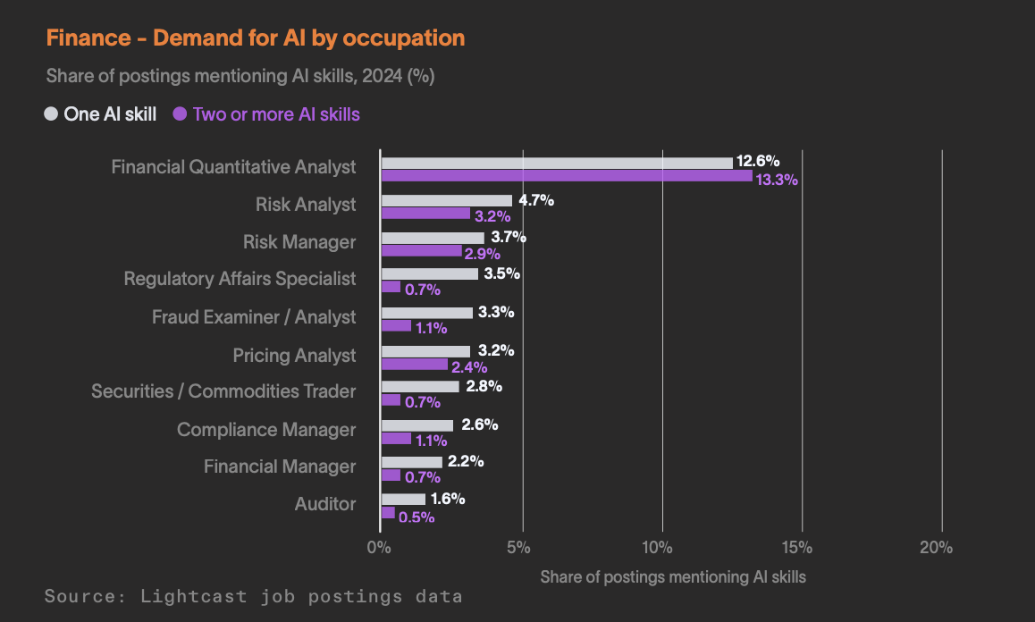
Zooming in for practical insights
Finance
Examples of AI applications:
Automated financial reporting
Regulatory compliance monitoring
Credit default predictions
Real-time transaction processing
Algorithmic trading strategies

Slide 23
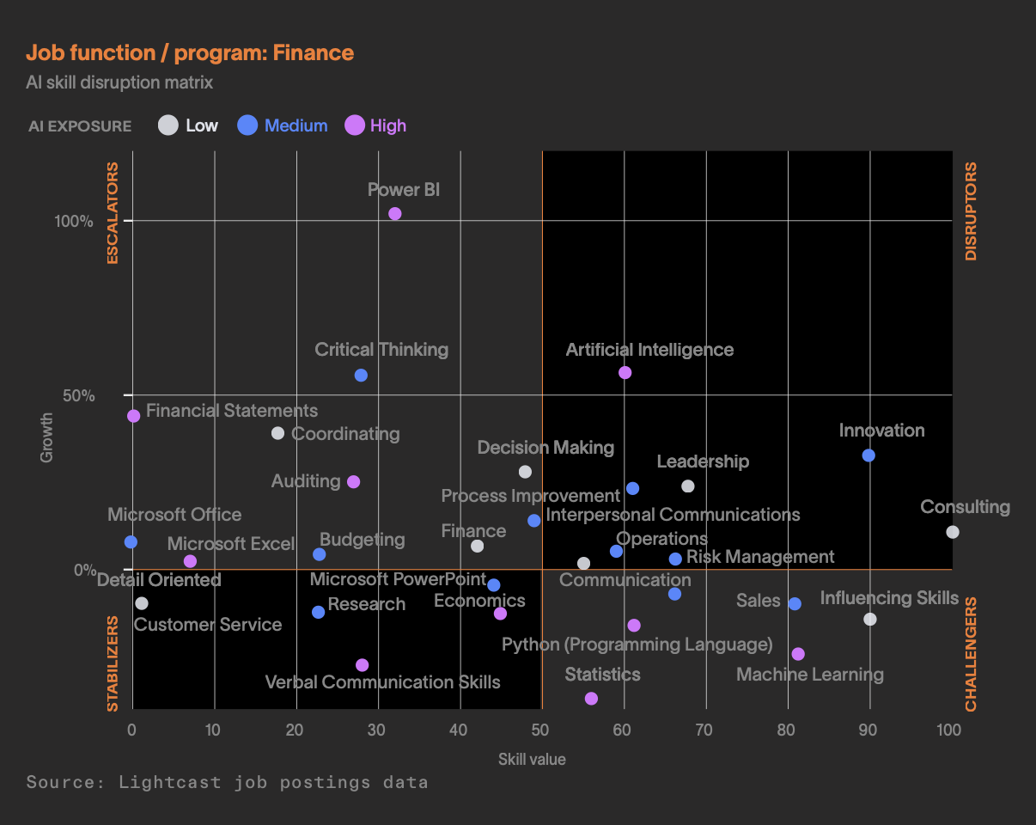
Zooming in for practical insights
The AI skill disruption matrix for Finance
Immediate focus: Financial analysts and risk managers need comprehensive AI training in machine learning and predictive modeling.
Universal requirement: Build foundational AI literacy across analytical roles.
Strategic balance: Combine technical AI capabilities with high-value consulting and governance skills that maintain low AI exposure.

Slide 24
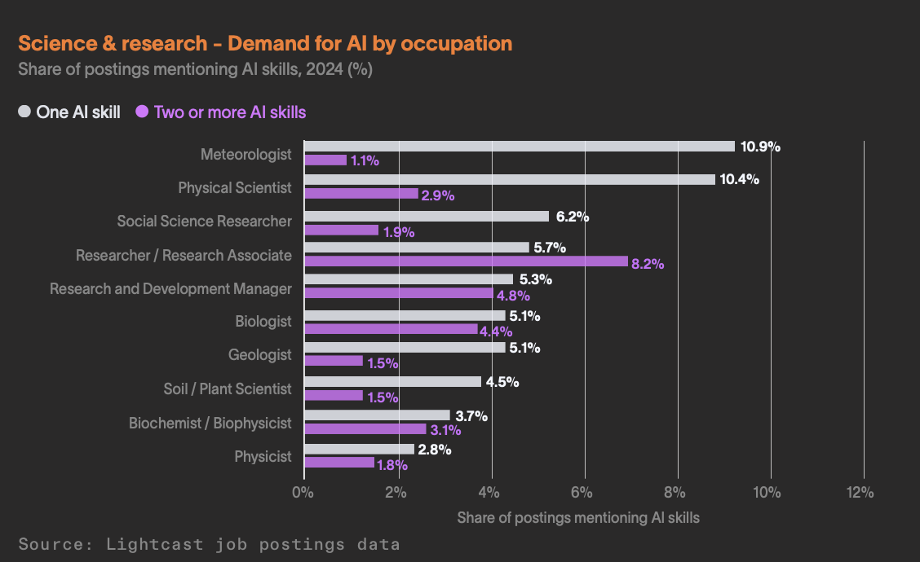
Zooming in for practical insights
Science and research
Examples of AI applications:
Pattern recognition in large datasets
Research proposal optimization
Image analysis in medical research
Experimental model prototyping
Survey automation

Slide 25
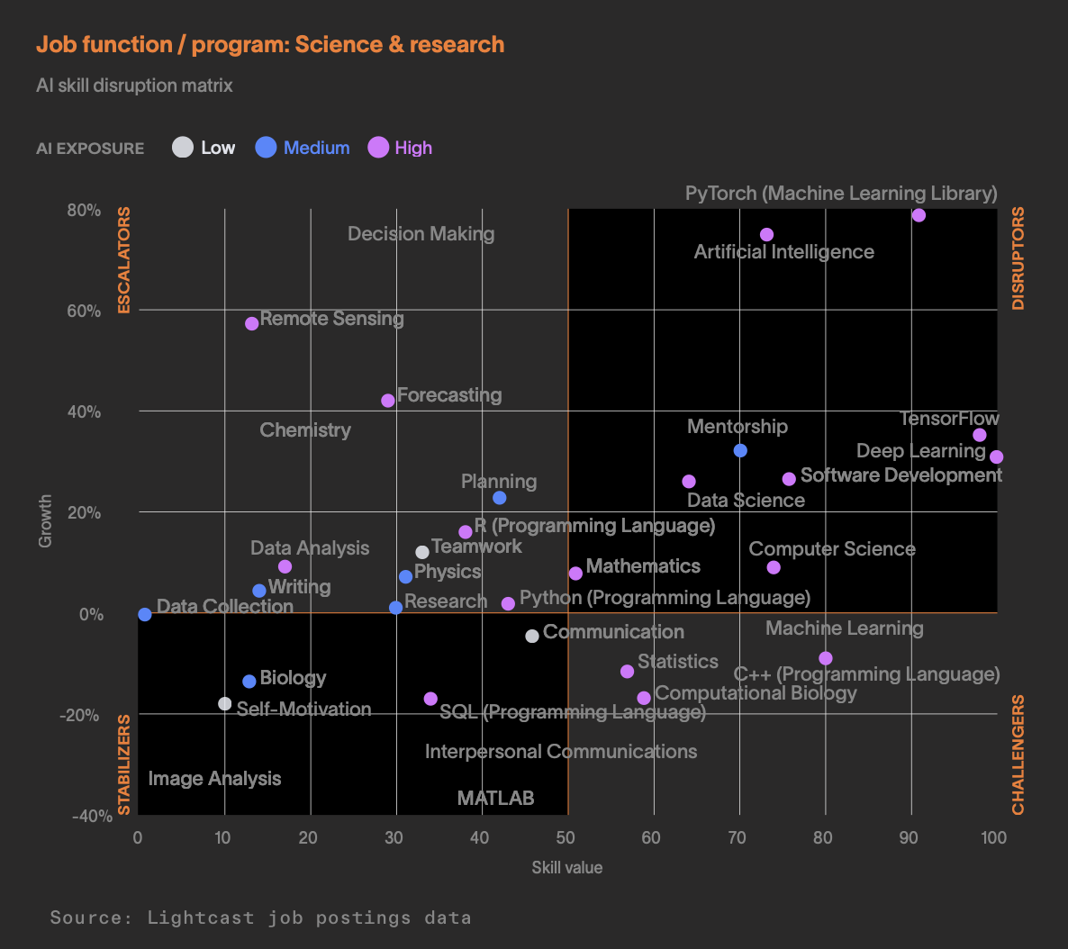
Zooming in for practical insights
The AI skill disruption matrix for Science and research
Immediate focus: Researchers need deep competency in machine learning libraries like PyTorch and TensorFlow.
Universal requirement: Build specialized AI training around domain expertise.
Strategic balance: Combine cutting-edge AI capabilities with enhanced leadership and decision-making skills for research direction and team management.

Slide 26
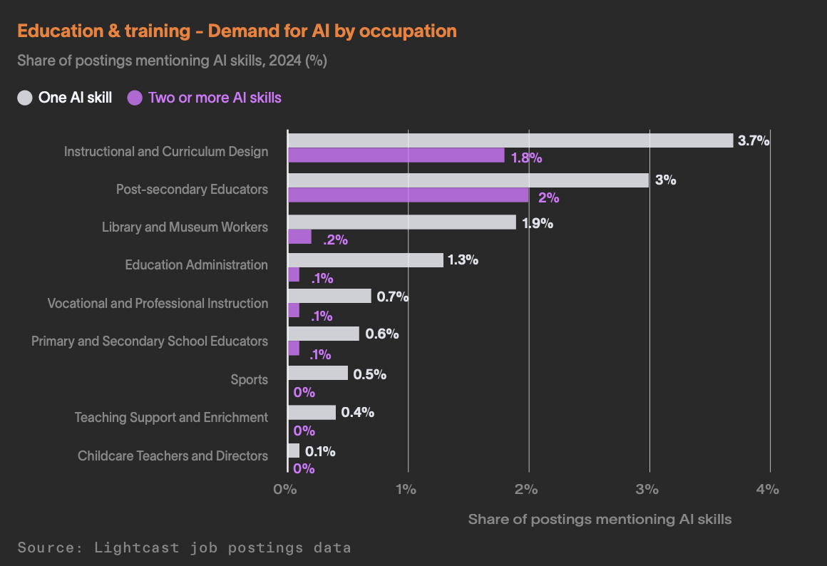
Zooming in for practical insights
Education and training
Examples of AI applications:
Personalized learning path creation
Adaptive curriculum design
Educational material creation
Lesson plan creation
Automated assessment feedback

Slide 27
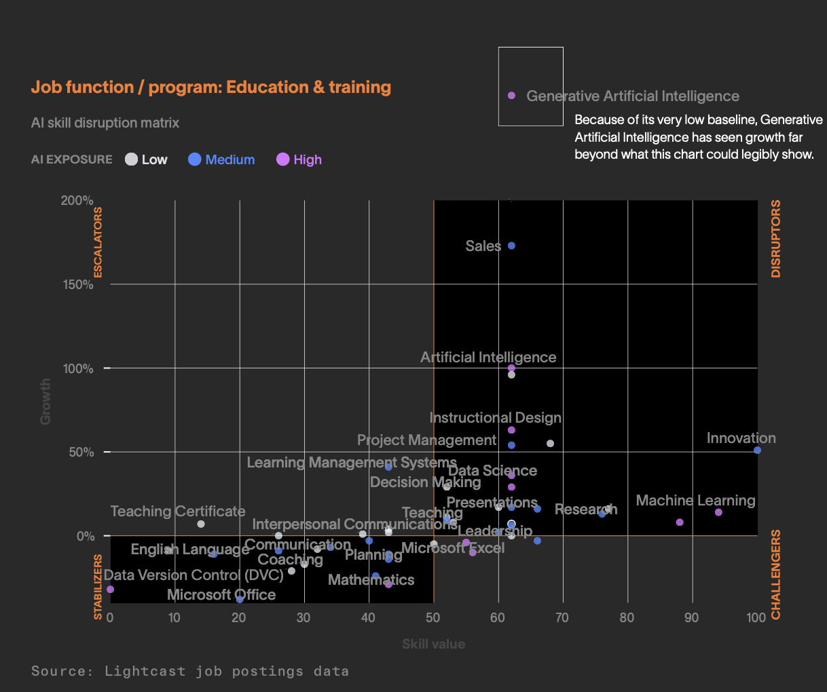
Zooming in for practical insights
The AI skill disruption matrix for Education and training
Immediate focus: Prioritize AI training for curriculum developers and instructional designers who can integrate AI into educational delivery systems.
Universal requirement: Build comprehensive generative AI capabilities for content creation, assessment development, and personalized learning materials
Strategic balance: Strengthen pedagogical and mentorship capabilities that maintain high value despite low AI exposure.

Slide 28
Now what?
Moving from research to impacting outcomes

Slide 29




What does this all mean in practice?
Decisions about how and where to invest in AI training should require data-based evidence, not guesswork and luck.
PRIVATE
SECTOR
PUBLIC
SECTOR
EDUCATION
SECTOR
The global leader in linking skills supply and demand to help organizations thrive in rapidly changing labor-market conditions
Analyze workforce to understand skills needed to drive business.
Support targeted recruiting, reskill, upskill, and retention efforts to meet the current and future needs of businesses in the state.
Take broad view across the continuum of skills supply and demand to drive an economic development strategy for the state.
Use appropriator power to leverage higher education apparatus to address skills gaps.
Map current programs to specific in-demand skills in the labor market, and design programs to address the skills gap.
Deploy degrees and reskilling programs that align with growth sectors in the economy.

Slide 30


This is not just another ‘interesting’ report
We have already collaborated with, and continue assisting, real customers better understand what AI means for their work
Leveraging labor market data for strategic AI workforce planning
A deep dive into cybersecurity roles.
Driving value by identifying which skills matter
Assessing AI demand in education programs.

Slide 31
How Lightcast can help
Three ways:
Lightcast Skillabi™
Lightcast Talent Transform™
Professional Services
Measure how well an institution’s academic programs map to labor market realities
Identify training priorities and ways to update programs
Create a dynamic skill architecture to navigate disruption
New Skill Agent™ automatically updates skill demand for roles
Tailored insights on the AI Skill Disruption Matrix for specific occupations and roles
Further intelligence into risk and AI adoption

Slide 32
Three Takeaways:
Broadband Access
Track Your Skills
Talk to Each Other

Slide 33
Thank you.
Beyond The Buzz: Translating AI trends in the labor market into actionable training and strategy
← View the Report

