Slide 1
The Human Side of Economic Development

Slide 2
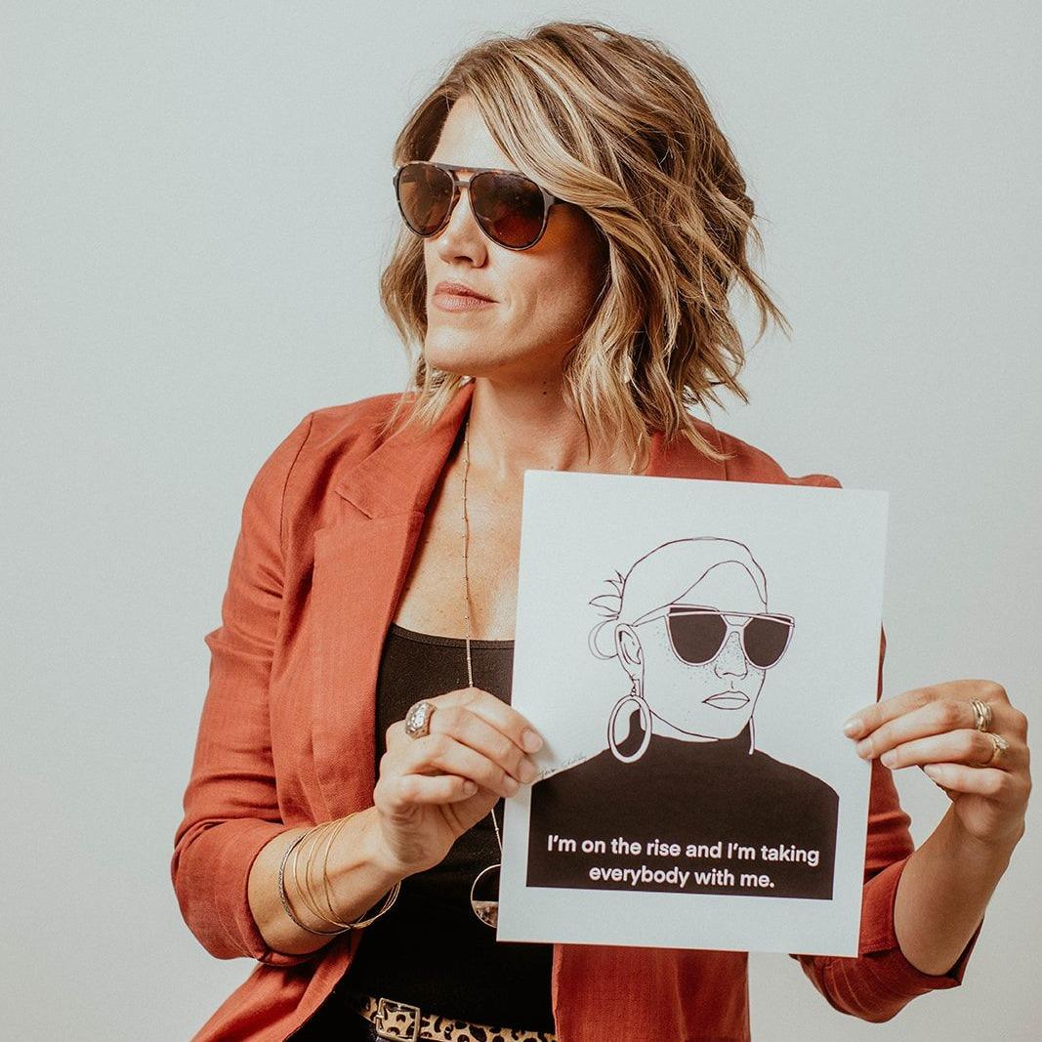
Hi!
I’m Rebecca.
You are different
We need each other
Humans are worth investing in
The future of ED work needs you
Hope over fear
Notes:
Tell the EDND story.
We are more connected in many ways than ever before. And sadly, also more disconnected. I’m going to kick this off encouraging you to set your phones aside. (Pump up the summit on socials, of course, but seriously, BE HERE.)
My background is in org dev and in starting my nonpforit, it’s translated to ec dev; I started my organization with the core belief that when humans get better, everything gets better. You are here not just for your ommunities and your work. You’re here for YOU. Everything you pick up at this Summit will go with you. Allow yourselves to be transformed.
The needs of communities are changing; we’re going to talk a bit about the shifts that we’re seeing and what that means for you in this work
You can have a little fear and still operate from a place of hope, but hope dies when fear reigns. Let’s sink into hope.

Slide 3
What if our role was to facilitate more love between people and our communities?
Notes:
Sign me

Slide 4
Experience
Thoughts + Feelings
Beliefs
Behavior
Results
Framework for Change
Notes:
Walk through the model, explaining that in this situation, we’re looking at it from the standpoint that we are driving the results we want. For me, it was that laundry list of things I wanted. That’s the change I wanted to bring about.

Slide 5
Experience
Thoughts + Feelings
Beliefs
Behavior
Results
Individual Changemaking
Notes:
When we’re driving the change ourselves, most of the model includes facets that are within our control. The only that’s not? The experiences we encounter, i.e. the people, events, and situations that happen TO us. Everything else could be summarized as our response to that stimulus.

Slide 6
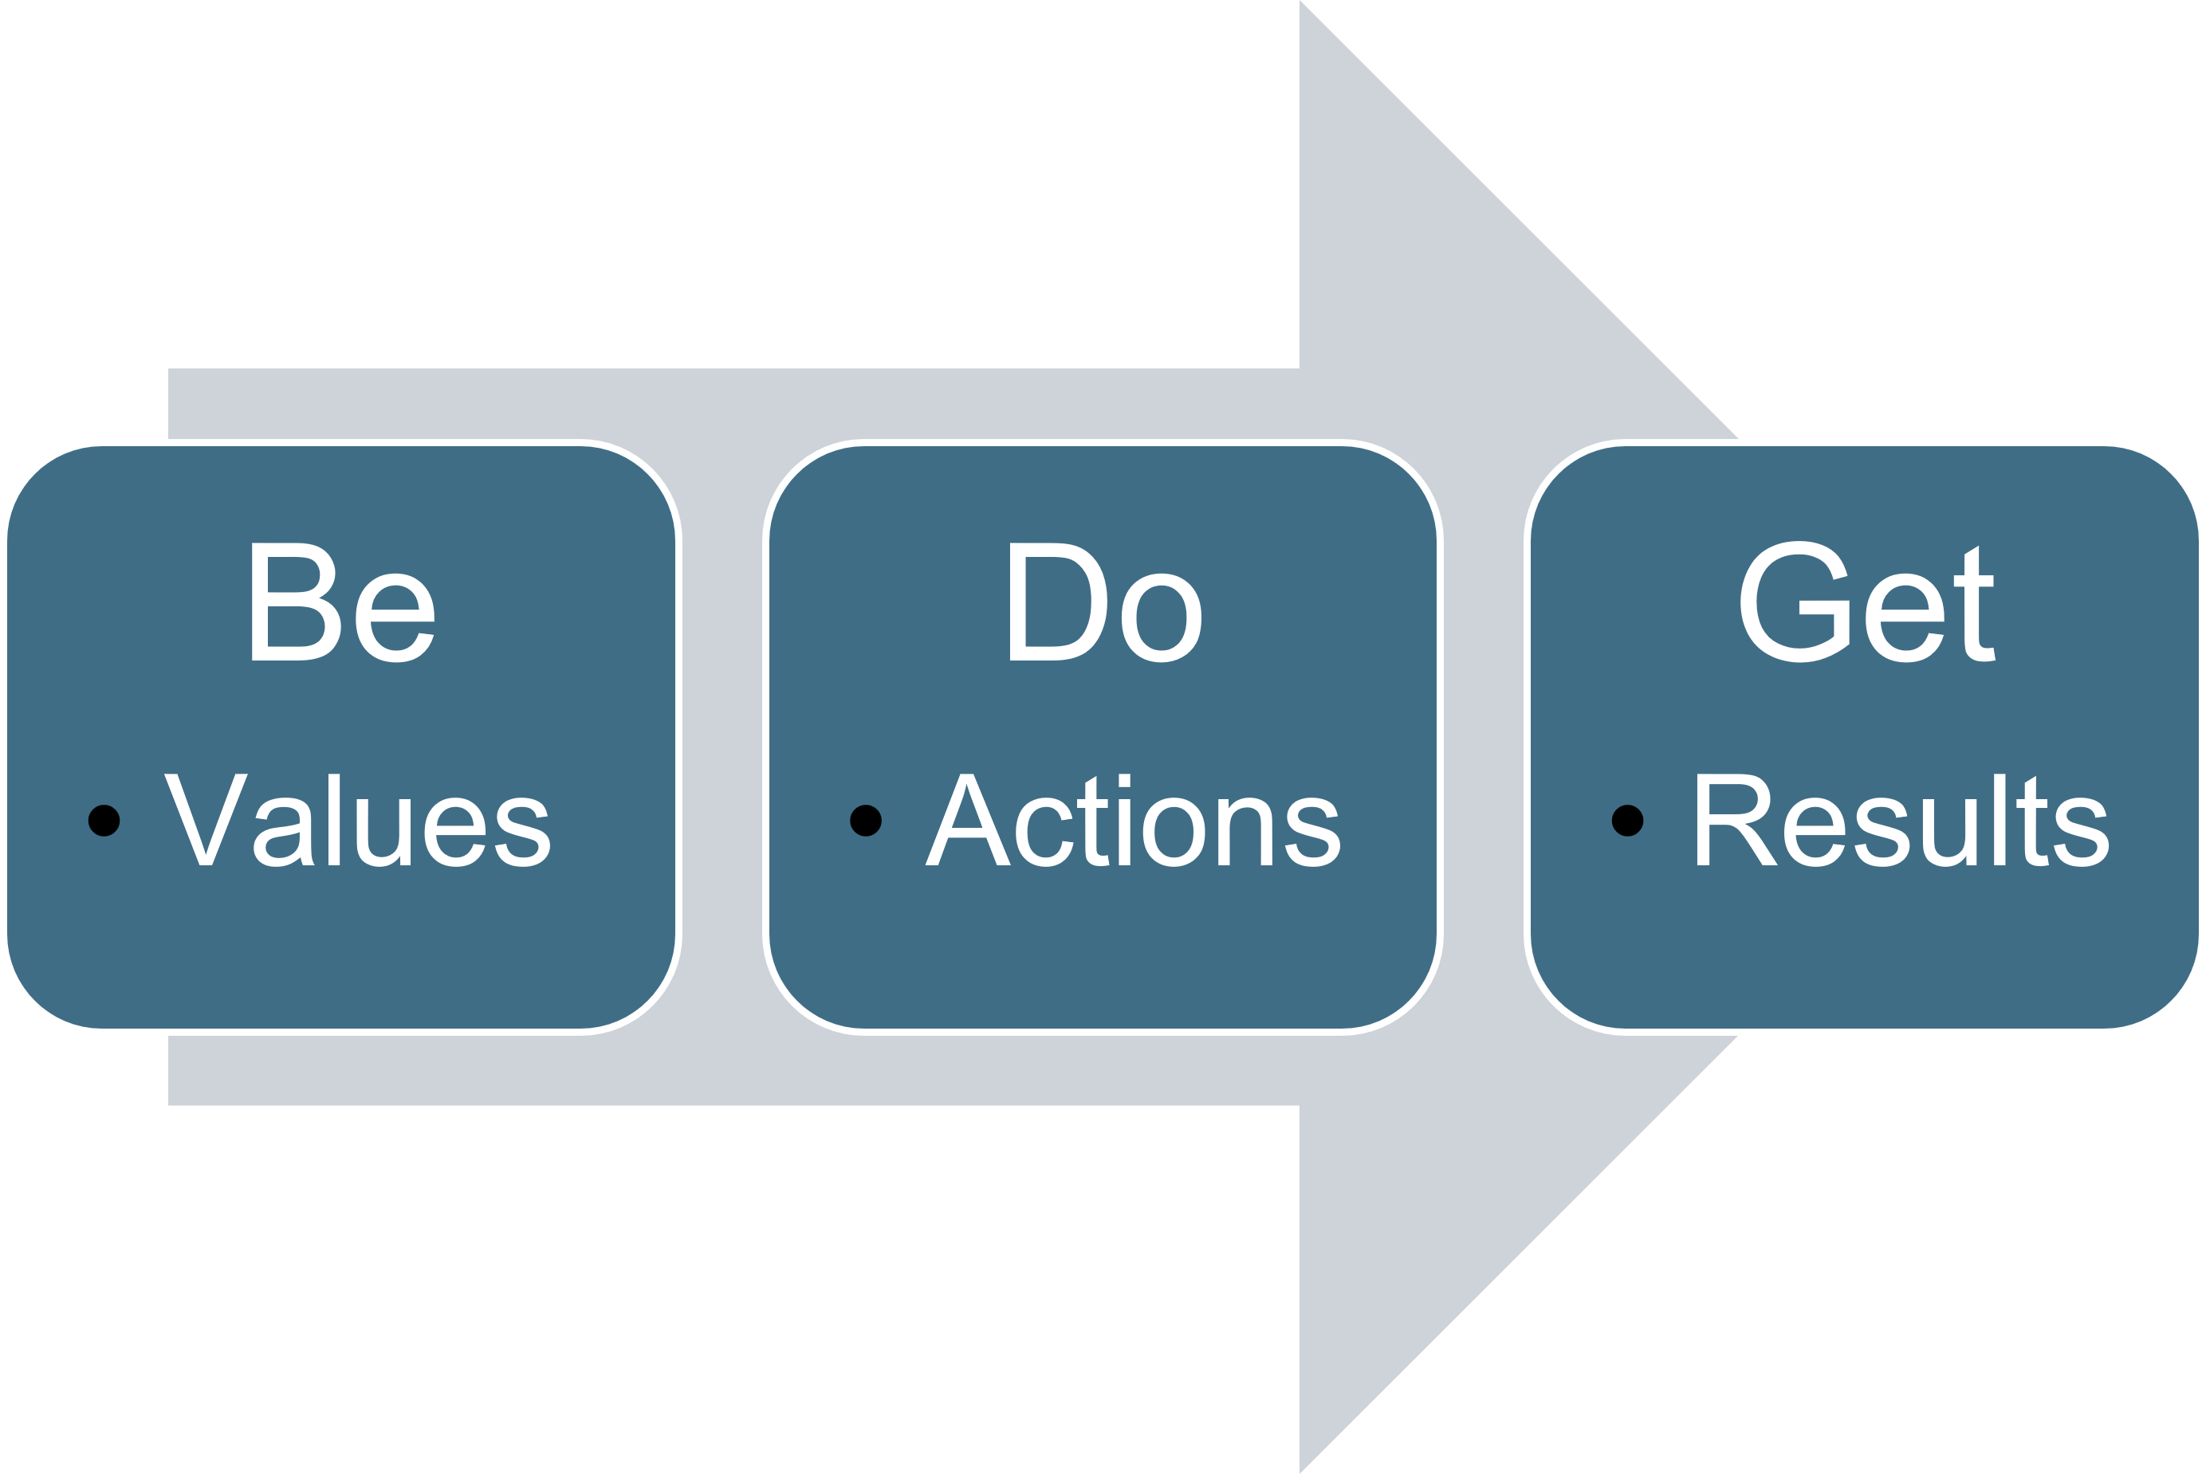
Notes:
This is a simplified way to think about our own personal ability to create change. It’s never just about doing the “right” things; in fact, when you’re not getting the results you want (in ANY area of life) rather than asking yourself what you need to do differently, more than likely, at its heart, there’s a misalignment between your actions and who you say you are; your actions always flow from your being; check your values before you commit to new behavior. There has to be alignment to get a good result.

Slide 7
Experience
Thoughts + Feelings
Beliefs
Behavior
Results
Influence-Driven Changemaking
Notes:
Basically, when we’re influencing change, the model flips entirely. The ONLY element we control is the experience, because the rest of the model is owned by the person we’re influencing to change.
We can’t MAKE people believe, think or feel things any more than we can make them do things; our only opportunity for shaping the behavior of other people is by thoughtfully designing their experiences, whether that’s a single interaction or a marketing campaign
The entirety of our work is this process. We are influencing people to make an enormous decision. Moving to a new place and even choosing a new job is a monumental effort. And this framework helps us design experiences in a human-centered way.

Slide 8
How do we create experiences that generate the thoughts and feelings that lead a person to adopt the beliefs they’d need to hold to take the actions we want them to take?
Notes:
I started my career working for Dale Carnegie Training. He famously wrote the book “How to Win Friends and Influence People”. It never failed that in training that content for over a decade, people would suggest the Human Relations principles in the book were manipulation.
Rather than thinking about it as manipulation, I like to think of it as mindful, intentional, human-centered design. Every interation, whether IRL or online can be designed to bring about a specific result.

Slide 9
Example: Resident Recruitment + Retention

Slide 10
Begin with the end in mind…
Not just MORE…
The right people to help shape us into who we want to be
Notes:
Would I be a keynote speaker if I didn’t randomly quote or pull quips from famous authors? Stephen Covey wrote this book so if you’re filling our your keynote speaker Bingo card, mark that one.

Slide 11
“Saying all growth is positive is like saying all diets are healthy.”
- Jeff Siegler, Revitalize or Die
Notes:
That’s the biggest challenge in community development and while I’m not going to say there’s a magic bullet, I do believe this to be true.

Slide 12
Community Culture: What if we acted like a business?
What do we care about?
Who are we recruiting?
Who do we want to be?
What skills/talents do we need?
Notes:
Culture can be simply thought of as “the way we do things around here”; communities have a culture whether they’ve ever given this a second thought or not.
The people you’re recruiting aren’t just filling jobs; they’re adding to the fabric of the culture of your community. They’re shaping you.
Get clear about what you actually need/want.

Slide 13
“Our people are our greatest asset.”
Basically, every town or company, ever.

Slide 14
4.5 Generations?
 | Traditionalists | Baby Boomers | Generation X | Millennials | Generation Z
Birth Dates | 1928-1945 | 1946-1964 | 1965-1980 | 1981-1996 | 1997-2012
Youngest today | 78 | 59 | 43 | 27 | 11

Slide 15
 | Traditionalist | Baby Boomers | Generation X | Millennials | Generation Z
Adult | 16 | 18 | 21 | 30 | 30+
Time | Company owns it | Company owns it | Mine, will rent | Let’s trade | Let’s trade
Loyalty | Company | Company | Leader | Team | Own growth
Career goals | Legacy | Stellar career | Portable career | Parallel careers | Personalized career
Feedback | No news is good news. | Yearly; in writing. | Will ask, “How am I doing?” | On demand. | Constant.
Training | Learn the hard way. | Risky. | The more, the better. | Continuous learning. | Real-time.
Rewards | Job well done. | Money, title, corner office. | Freedom | Meaningful work. | Purpose, then $$.
Titles | Respected. | Impressive. | Empty. | Irrelevant. | Constraining.

Slide 16
Which creates the most challenge for you?
Baby Boomers
Generation X
Generation Y
Generation Z

Slide 17
WHAT DO THEY NEED TO EXPERIENCE?
About themselves, the job + place
“I will it here”
They Move Here
The Specific Humans You Want Live in Your Community
Recruitment
Notes:
Thoughts + Feelings: as you consider this model while you’re developing tactics, get SUPER clear: What do they need to think. What do they need to feel? Write them down and embody this person.

Slide 18
Other Framework Factors
Know your prospects
Unknown v. poorly perceived
Pull humanity through the work
Notes:
If you can’t relate to the ideal prospect you’re trying to recruit: find someone who does and ask them questions about what motivated them to move to you.
Flint as an example. I don’t know if Bree and her team used this model intentionally, but to overcome a challenging public perception is a huge task. In that case, you’re actually influencing people to change their beliefs; in most cases, we are simply unknown, so the design is less about changing or updating their beliefs and more about planting them to begin with.
Taking the time to sit down and design the interaction, pulling humanity through the work, is the only way to ensure people fall in love with your town.

Slide 19
Communication Fundamentals
7%
How We Look
What We Say
38%
55%
How We Say It
What We Do
Notes:
Digital tactics allow us to communicate in ways we never could; but we can’t deny the art that’s missing; anything done in a digital context needs to reflect what they’d experience in person. In fact, start there and build back.

Slide 20
Experiences
Your website
The people they meet
Your social media ads
Print materials

Slide 21
Review your touchpoints. Do they generate the kinds of thoughts/feelings/beliefs needed to activate humans?

Slide 22
You can’t fake your way into a real relationship with someone.
Notes:
We can’t tell them we’re something we’re not; we might get them, but we’ll never keep them. Segue to retention.

Slide 23
WHAT DO THEY NEED TO EXPERIENCE?
About themselves, the job + place
“I love it here”
Contribute, volunteer, get involved
They STAY
Retention
Notes:
Thoughts + Feelings: as you consider this model while you’re developing tactics, get SUPER clear: What do they need to think. What do they need to feel? Write them down and embody this person.

Slide 24
What is Employee Engagement?
A total-person (intellectual and emotional, not just physical) commitment to the success of the organization and doing one’s part to achieve it.
Engagement = spending discretionary effort to get things done
Notes:
Wouldn’t it be amazing to have more of our employees that act like this? We’ll never win them all…but the goal is to increase engagement levels, if possible AND be the kind of workplace that highly motivated and engaged people are attracted to

Slide 25
Why Should Businesses Care?
According to Gallup, the total cost of a disengaged employee is 34% of their annual salary.
Notes:
It’s not enough to GET them; we have to consider how we KEEP them.
Did I throw this in there because most of my material seems anecdotal and I know we have some data folks in the room? Yes. Am I honest about this? Also, yes.

Slide 26
Drivers of Employee Engagement
Pride in the Organization
Belief in Senior Leadership
A great relationship with their direct supervisor
Notes:
Now, if your employers want to be great places to work…they ought to take note. A big part of my work is helping them creatively consider how to develop a culture that fosters these actions. (Yes, I’d use the exact model I’ve shared.)

Slide 27
Ultimately? Engagement is a FEELING!
ENTHUSIASTIC
EMPOWERED
INSPIRED
CONFIDENT
Notes:
Yes. I said FEELINGS. And since engagement is a feeling, that means we need to embrace the feelings in our employees a bit more. But what does that mean? And how do we influence the feelings of other people?
We can’t MAKE them feel anything. Telling them to won’t work.
Hmm…if only we had a framework.

Slide 28
Resident Engagement?
A total-person (intellectual and emotional, not just physical) commitment to the success of the COMMUNITY and doing one’s part to achieve it.
Engagement = spending discretionary effort to get things done
Notes:
I mean…OK. Why wouldn’t we pursue this?

Slide 29
Drivers of Resident Engagement
Pride in Your Town
Accessible Leadership
Seen as unique individuals who can contribute

Slide 30
Fostering Engagement…
Model it
Help them connect to people + stuff
Invite them
Appreciate them
Make room
Notes:
Model it: be engaged yourself: Pour into people. Ensure that somewhere in the community or their workplace, they are being shepherded, guided, and supported.

Slide 31
BE this.
ENTHUSIASTIC
EMPOWERED
INSPIRED
CONFIDENT

Slide 32
Fears + Challenges
No “boss”
Too vulnerable
Question the ROI
Silos
Seems too granular
Notes:
This is the big difference in this work when we translate it to communities. In companies, this kind of work can be catalyzed a bit more effectively; you can see where there are subcultures being developed. In a community, you can’t control how everyone acts; your community is home to the proud card-carrying members of the WBC; let them. Be better. You don’t need a “boss” to lead the way. Be the change you want to see. (I did it again)
YUP. But the core root of all true connection starts with vulnerability. You and your town don’t have to be perfect to be worthy of love. You just have be authentic and honest. Just like love between people.
Continue to pull Gallup quotes. I heard that works. And hey, this does take effort, but not necessarily more money than you’re already spending on this work.
Silos will continue to exist; invite them; keep that invite open; then work with the willing and love the rest.
It IS granular; but every single human you attract with love will shape the future of your community for the better.
What if I pour into them and they still leave? What if you don’t and they stay? Be the kind of place that even if they do leave, they’ll still speak fondly of their time in your community.
Improve from the inside out; no marketing campaign can undo the impacts of negative, vocal locals.
It IS granular. But it’s the only work that ever mattered. You are trying to get and keep HUMANS.

Slide 33
Traditional v. Modern Leadership
Hierarchical structure
Cares about results above all
Directive
Instructive
Figure-head driven
“Need to know” basis
Encourages compliance
Flattened structure
Cares about people above all
Visionary
Empowering
Shared exposure and credit
Open, honest communication
Encourages commitment
Notes:
This kind of works requires different leadership. This is exactly the shift taking place in companies; it holds for communities, too.
You ARE this kind of leader; you’re showing it by being here.

Slide 34
Traditional v. Modern Economic Development
Prioritizes industry
Cares about tax base above all
Driven by incentives (rational)
Power + resource-driven
Tribal knowledge
Competitive in nature
Prioritizes humans
Cares about people above all
Driven by love (emotional)
Creativity + human-driven
Shared exposure and credit
Collaborative in nature
Notes:
If THIS is the future? Sign me up.

Slide 35
What if LOVE is the strategy?
It’s magnetic.
It’s undeniable.
It feels destined and meant to be.
Notes:
Think back to that person you conjured up in your brain at the start of this session. Get that person in your mind. Embody those feelings.

Slide 36
Home isn’t where you’re from. Home is where you belong.
Notes:
We want people to call our places home.
Love is the greatest motivator that ever existed. It causes rational people to behave in irrational ways. Let love guide this work. And because I care about you as people and not just the jobs that brought you here, I hope you’ll let love guide your life. You deserve to feel like you’re home.

