Slide 1
Carbon-Free Electricity Policies Impacts & Perspectives
Fall Economic Forecast Meeting
Rick Dunn, General Manager/CEO
October 29, 2024
Your Trusted Energy Partner

Slide 2
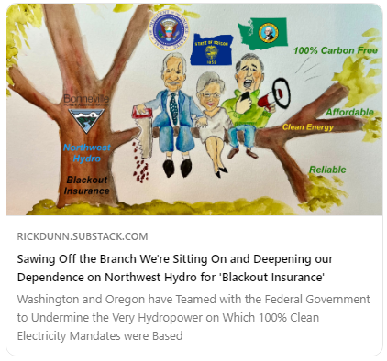
rickdunn.substack.com
Began Publishing November 2023
Optional & Free to Subscribe
Artistic Collaboration: Marjean Allen-Dunn
https://rickdunn.substack.com/

Slide 3
Agenda
Northwest Close to Blackouts – How did we get here?
WA & OR Clean Energy Policies – Global & U.S. Perspectives
WA Energy Strategy – We’re Coming for Your Wind MT & WY!
Where Do We Go from Here? – Near and Long Term

Slide 4
Northwest Close to Blackouts
Northwest Imported Electricity for all 120 Hours of Cold Snap
Hydro short on water, natural gas maxed out & wind power collapsed to zero
+2,000 MW of coal retirements so far
Demand grew 2% to 6% since December 2022 winter event
Northwest electric grid & natural gas pipeline systems are at immediate risk with no margin for the unexpected
Multiple Utilities Declared Energy Emergencies
No Net Energy from California Generation
Nuclear, Natural Gas & Coal Imports
January 12 – 16, 2024

Slide 5
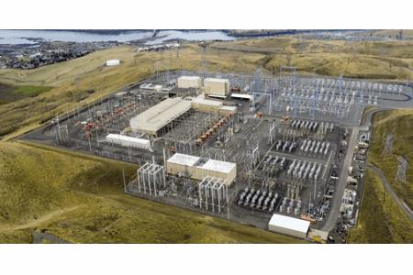
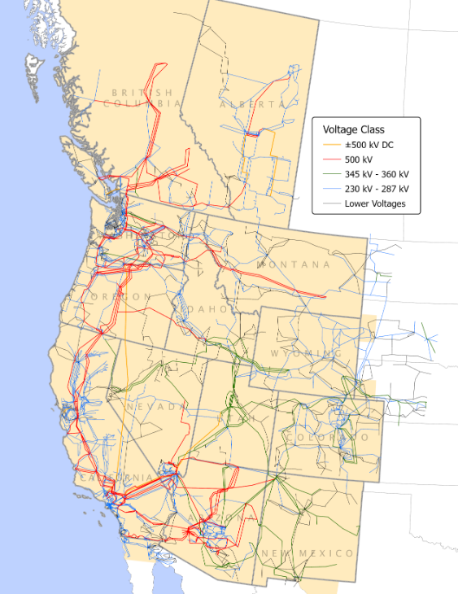
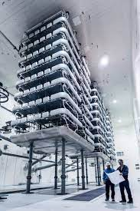
Northwest has Long Exported Electricity to California
Pacific HVDC North Terminal near The Dalles
Western Interconnection
Transmission Lines
Pacific Interties went into service 1968 - 1970
Path for Hydropower surpluses in the Northwest to flow to California
High Voltage Direct Current (DC) allows more precise control of power flow and lower losses; but more complicated
Canada & Montana Interconnections becoming more important
U.S. – Canada Interconnections
Pacific
DC & AC Interties
8,000 MW
Montana – Colstrip
Pacific HVDC South Terminal near Los Angeles

Slide 6
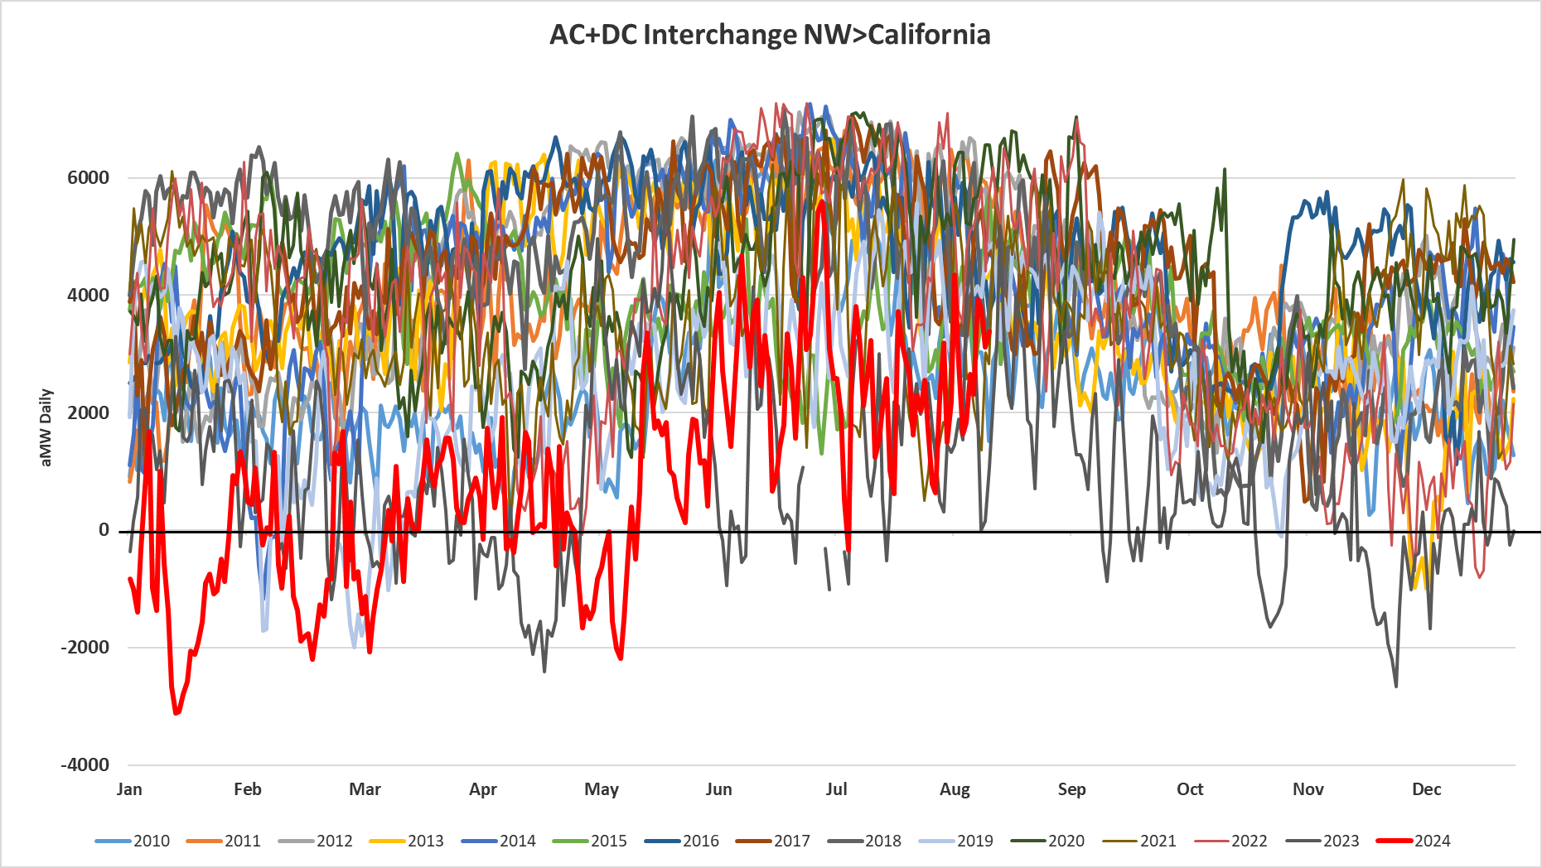
Northwest Beginning to Import Electricity via CA
DC Line Outage for Maintenance
Graphs below zero indicate flows from CA to NW
January 2024 Cold Weather Event

Slide 7
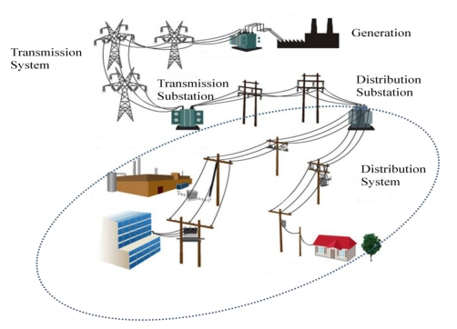
Power Grid Basics: A Service Like No Other!
Electricity is simultaneously:
Produced
Delivered
Consumed

Slide 8
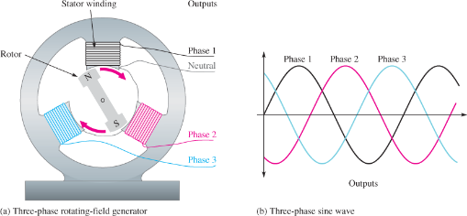
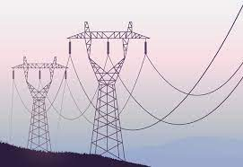
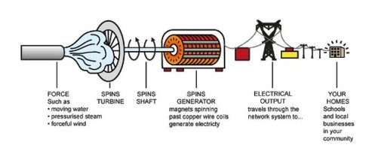
Alternating Current (AC) Electricity
Three-Phase Requires 3 Wires
60 cycles per second sine waves
N
S
Rotating Magnetic Field
Speed of rotation precisely controlled
All Generators must be Synchronized
Increasing Demand Tends to Decrease Speed of Rotation
Decreasing Demand tends to Increase Speed of Rotation

Slide 9
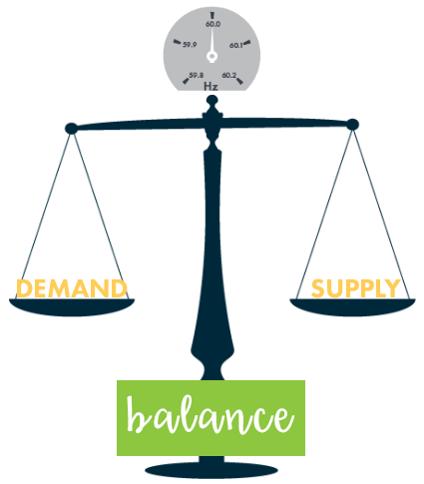
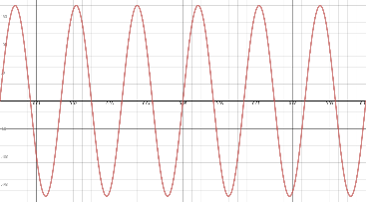
Demand/Supply Balancing: Physics
Electrical Demand and Supply Must Be Equal at All Times
‘Cruise Control’ set at 60
No over supply
No under supply
The Laws of Power Grid Physics are Unforgiving
Consequences of not maintaining supply & demand balance are blackouts
60 cycles per second
Notes:
4,000 MW OF FIRM GENERATION IS BEING RETIRED IN THE NWPP. THERE IS NO ORGANIZATION IN THE NORTHWESTERN UNITED STATES RESPONSIBLE FOR RESOURCE ADEQUACY PLANNING
ONLY RELIABILITY REQUIREMENTS ARE OPERATIONAL
ANTI FOSSIL FUEL AND ANTI NUCLEAR SENTIMENT COMBINED WITH STRONG WIND AND SOLAR POWER ADVOCACY HAS PUSHED UTILITIES INTO A GAME OF CHICKEN.

Slide 10
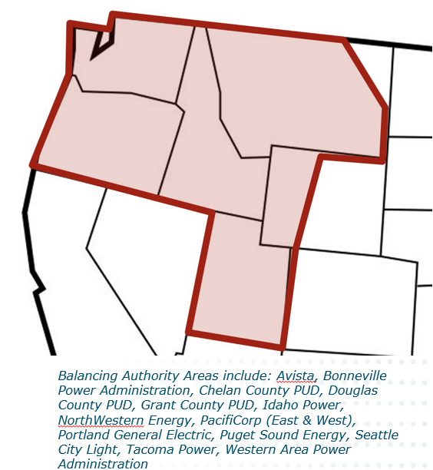
Controllable Supply: Blackout Insurance
Effective Capacity = % of Installed Nameplate Generation that can be Counted on During Hours of Maximum Demand
Controllable
High
Effective Capacity
Uncontrollable Low
Effective Capacity
Coal & Natural Gas
50% of Effective Capacity
Hydro
40% of Effective Capacity

Slide 11
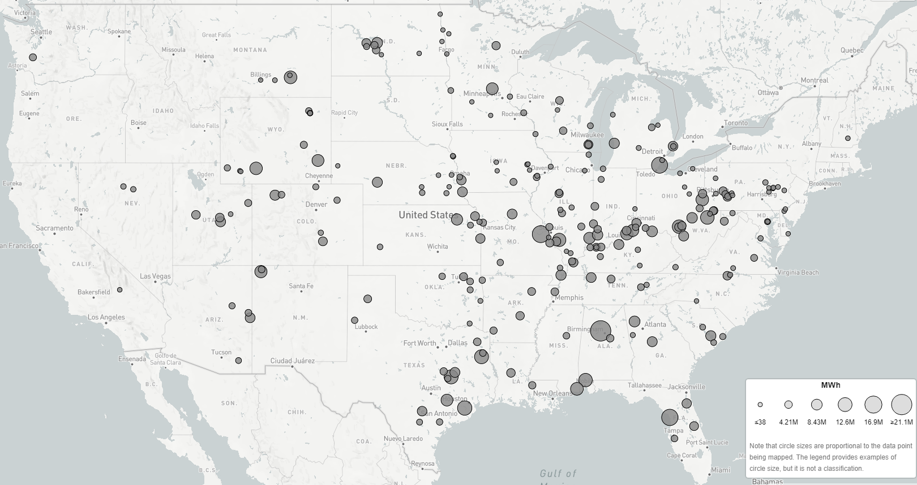
Coal = 16% of U.S. Electricity
NW Coal Plant Closures
Colstrip(1) 716 MW in 2019
Centralia(1) 730 MW in 2020
Boardman 600 MW in 2020
Centralia(2) 730 MW in 2025
2,776 MW by 2025
+3,000 MW more in ?
Coal =12% of PNW
Total generation (MWh)
by plant
Source: epa.gov/egrid/data-explorer

Slide 12
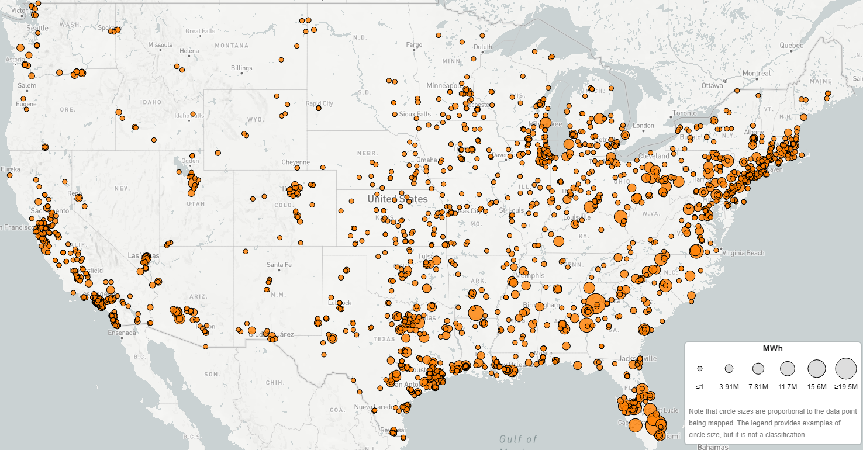
Natural Gas = 43% of U.S. Electricity
5,000 MW
Interstate-5
Population Centers
100% CO₂-Free Policy Impacts?
Natural Gas 23% of PNW
Controllable
&
Power/Energy
Dense
High MW/MWh
Per Acre
Total generation (MWh)
by plant
Source: epa.gov/egrid/data-explorer

Slide 13
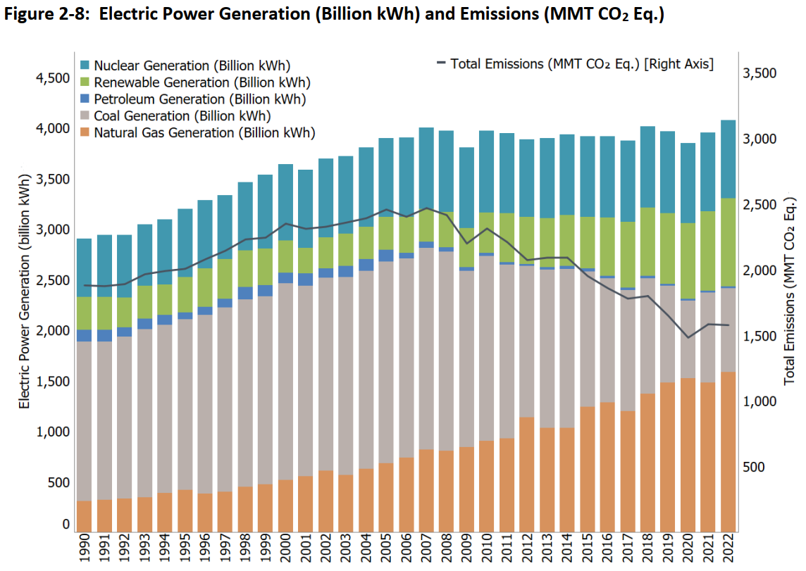
U.S. Electricity: Coal to Natural Gas Fuel Switching
Electricity Generation Flattened
36% CO₂ Reduction
Down 869 MMT since 2005
Natural Gas
50 to 60% less CO₂ than Coal
Plus, Wind & Solar
Emissions Trending Downward
https://www.epa.gov/ghgemissions/inventory-us-greenhouse-gas-emissions-and-sinks-1990-2022

Slide 14
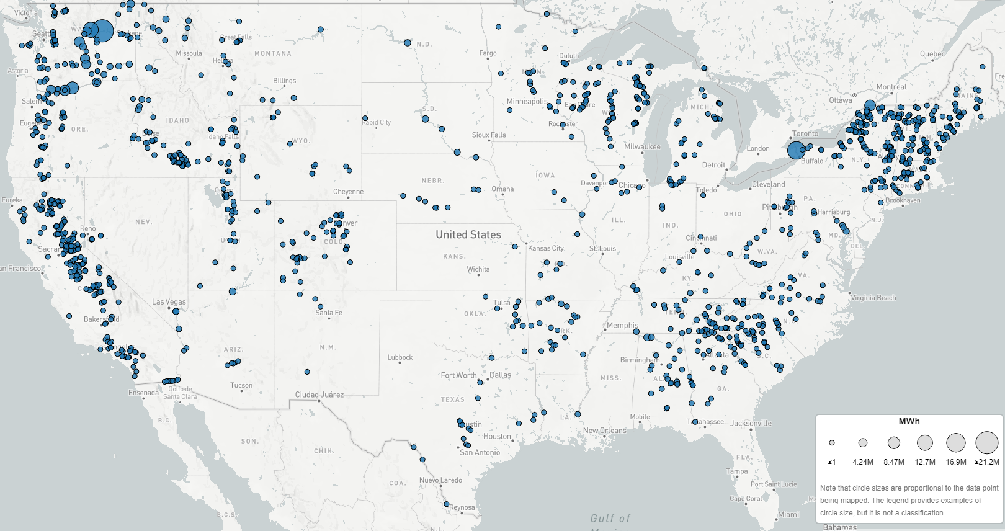
Hydropower = 5.7% of U.S. Electricity
Northwest Hydropower Like Nowhere Else:
Electricity Provided
50% of PNW Region
60% of Washington
Hydro-Based
100% CO₂-Free Electricity does not scale to the rest of the U.S.
Total generation (MWh)
by plant
Source: epa.gov/egrid/data-explorer

Slide 15
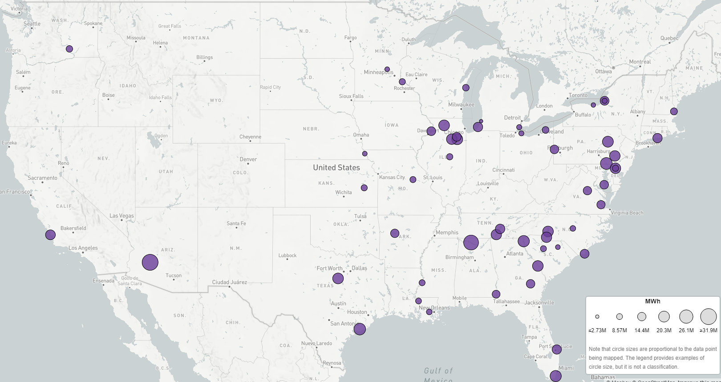
Nuclear = 18.6% of U.S. Electricity
Nuclear
3% of PNW
Controllable
&
Power/Energy
Dense
High MW/MWh
Per Acre
Total generation (MWh)
by plant, 2022
Total generation (MWh)
by plant
Source: epa.gov/egrid/data-explorer

Slide 16
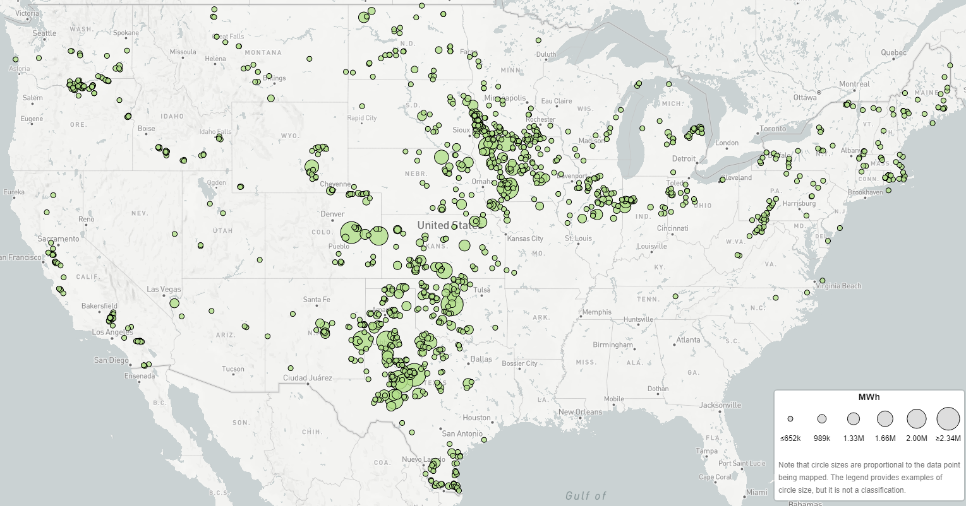
Wind = 10.2% of U.S. Electricity
Wind
10.5% of PNW
Uncontrollable
&
Power/Energy
Dilute
Low MW/MWh
Per Acre
Total generation (MWh)
by plant
Source: epa.gov/egrid/data-explorer

Slide 17
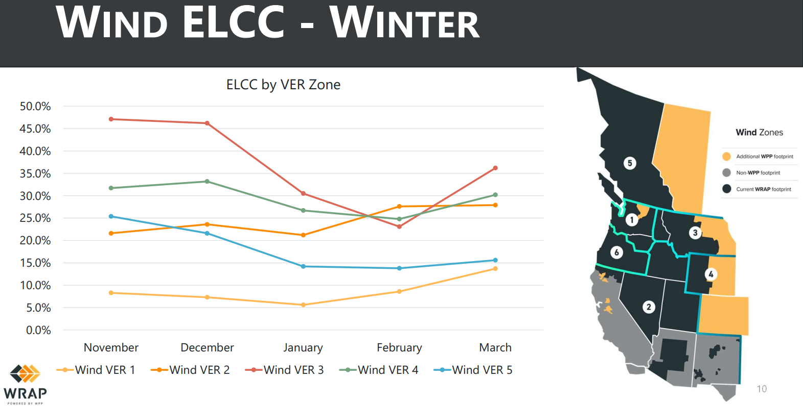
Northwest Wind Power Effective Capacity
Overbuild Factor
+18,000 MW
of Washington Wind
Replaces only
1,000 MW
of January
100% Effective Capacity
Montana
30%
5.5%
ELCC = Effective Load Carrying Capability

Slide 18
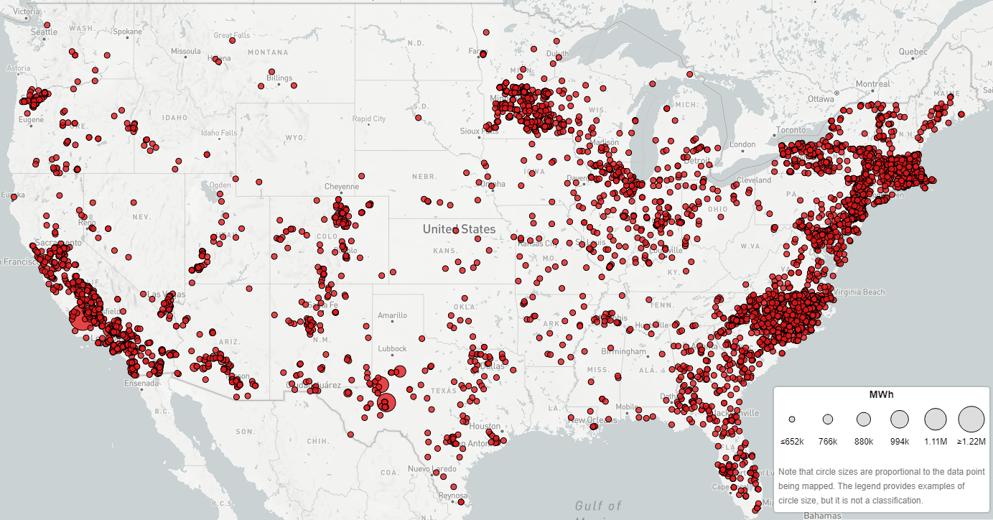
Solar = 3.9% of U.S. Electricity
Solar
0.9% of PNW
Uncontrollable
&
Power/Energy
Dilute
Low MW/MWh
Per Acre
Total generation (MWh)
by plant
Source: epa.gov/egrid/data-explorer

Slide 19
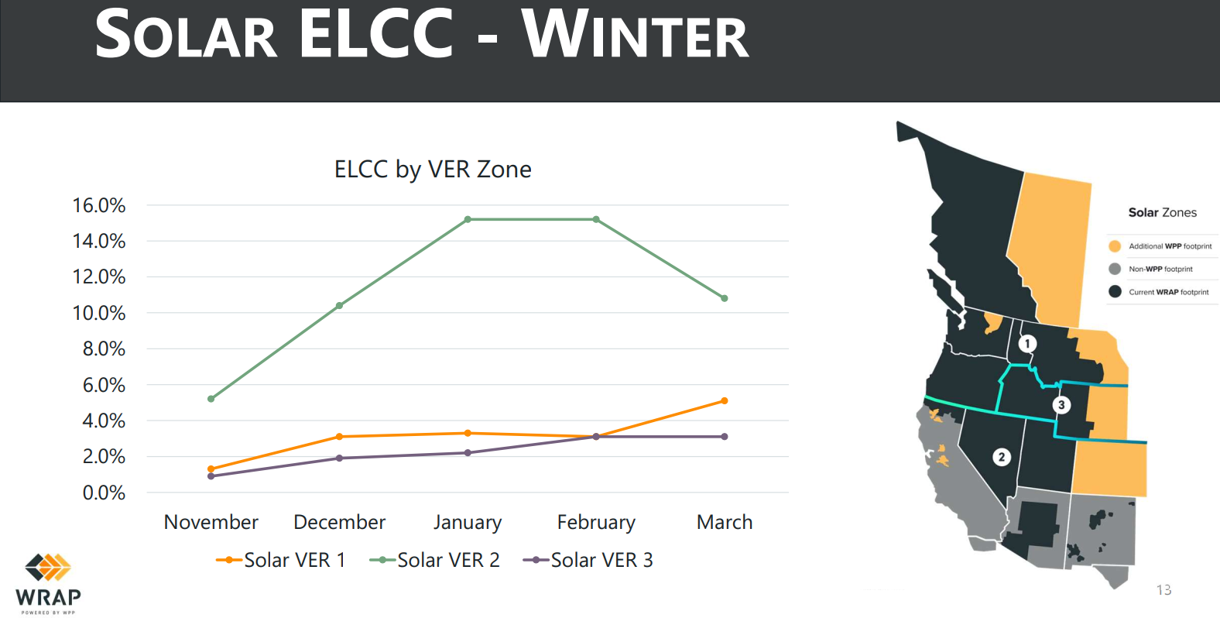
Northwest Solar Power Effective Capacity
Northwest Solar Extremely Low Effective Capacity in Winter
2% to 3%
ELCC = Effective Load Carrying Capability

Slide 20
NW Supply & Demand Balancing: January 2024 Cold Snap
38 Balancing Area Authorities in Western Power Grid
Maintain supply & demand balance including scheduled generation imports and exports
Expanded “Northwest” Footprint

Slide 21
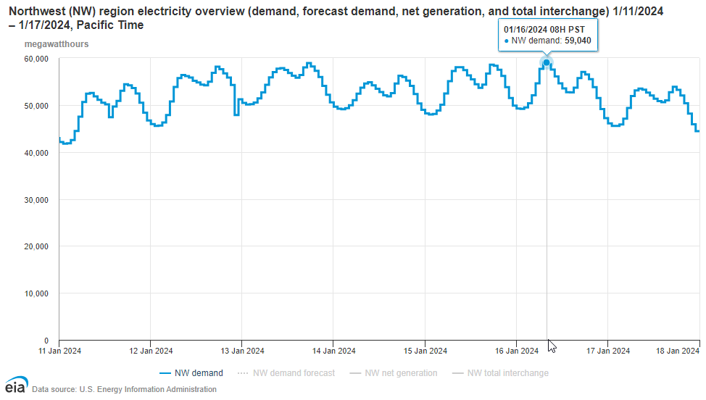
NW Electricity Demand: January 2024 Cold Snap
Demand Curve is Power & Must be Precisely Matched
Controllable Effective Capacity
Area Under Curve is Energy
Electricity Demand Cold Winter Days January 2024
Daily Rhythm of Life
Note: y-axis is megawatt-hours (energy) per hour or average megawatts (power)

Slide 22
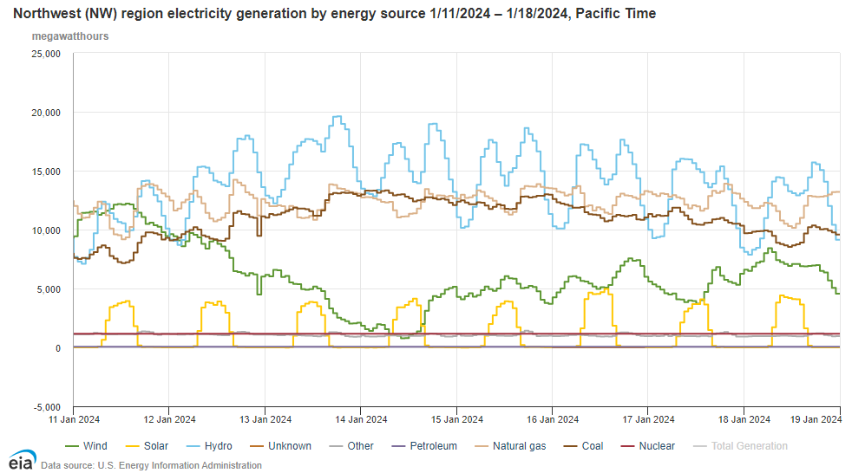
NW Electricity Supply: January 2024 Cold Snap
Future Concerns with Shutting Down Coal & No New Natural Gas
More Dependence on Drought Susceptible Hydropower
Ecological & Financial Costs to Overbuild Wind & Solar
Increasingly Risky & Costly Probability Game
Wind & Solar are parasitic to the “reliable grid” – effectively negative demand
“Averages are the enemy of reliability planning” Randy Hardy
Wind Energy Drops by 94%
Solar 0% during hours of darkness
Note: y-axis is megawatt-hours (energy) per hour or average megawatts (power)

Slide 23
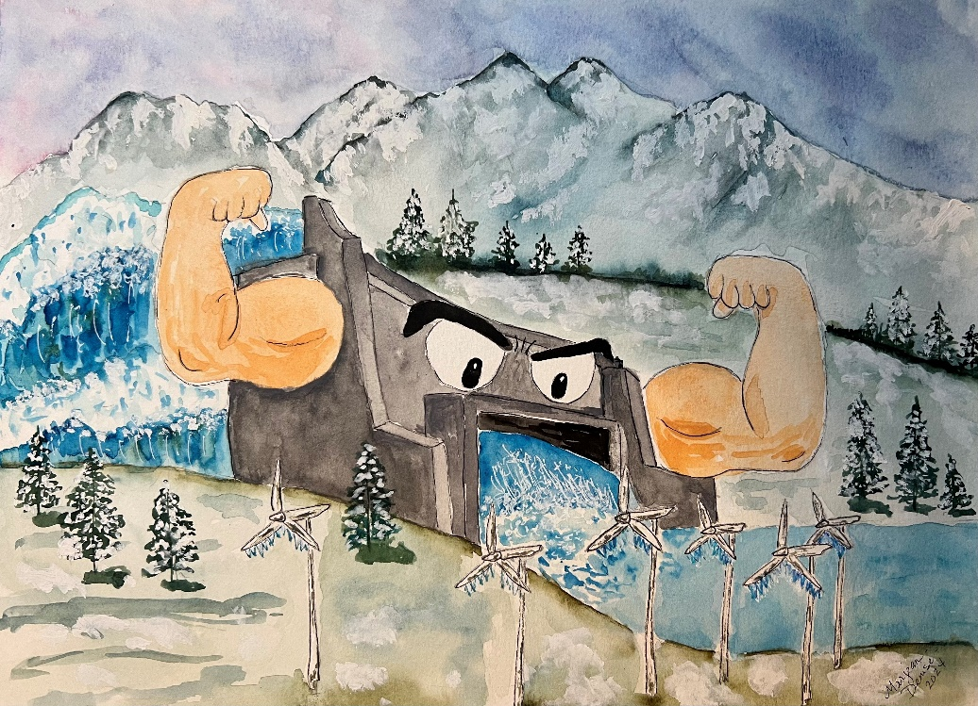
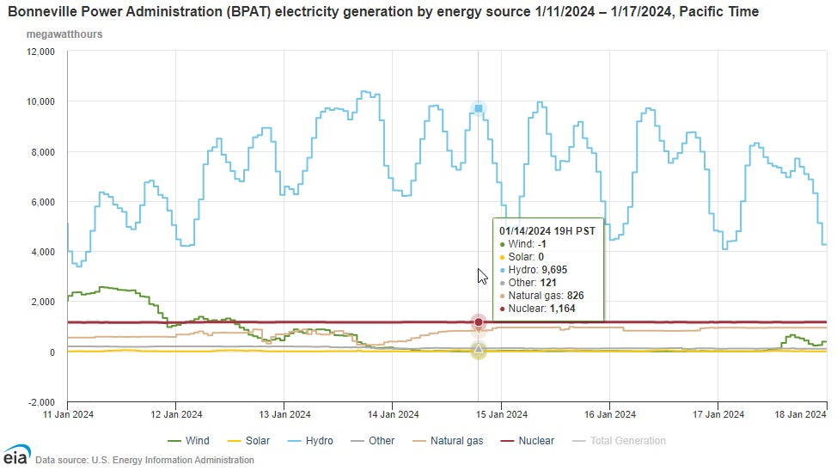
NW Hydro: Flexes Polar Vortex Muscle
https://rickdunn.substack.com/p/northwest-hydro-flexes-its-polar
WA & OR Wind Power at Zero or Less During Coldest Temperatures

Slide 24
Agenda
Northwest Close to Blackouts – How did we get here?
WA & OR Clean Energy Policies – Global & U.S. Perspectives
WA Energy Strategy – We’re Coming for Your Wind MT &WY!
Where Do We Go from Here? – Near and Long Term

Slide 25
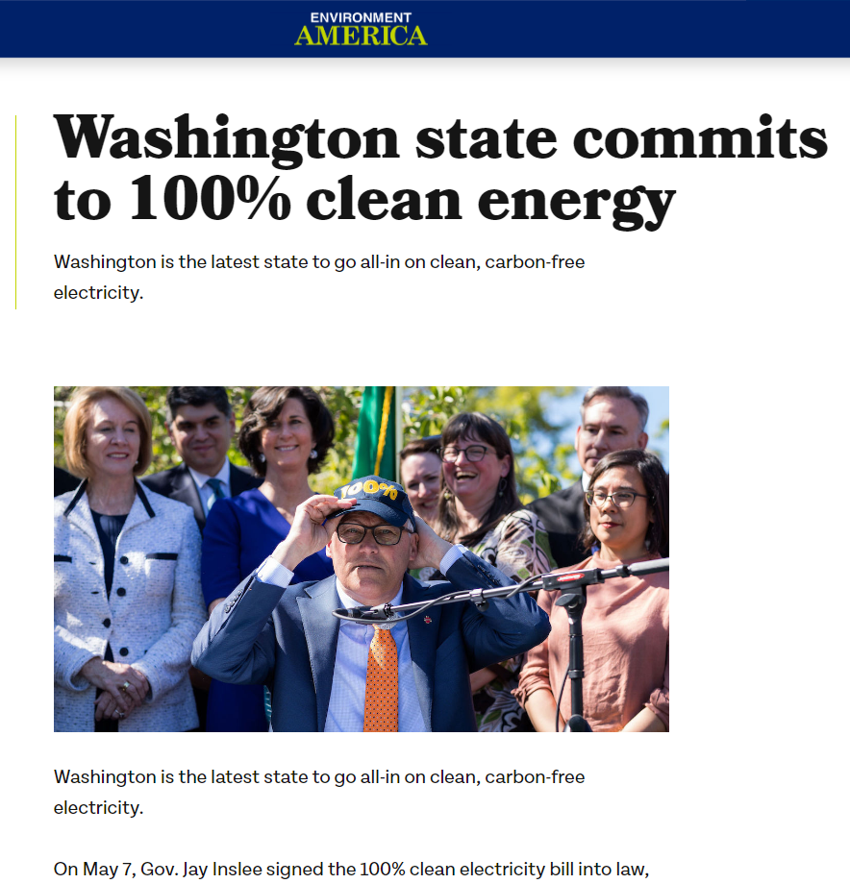
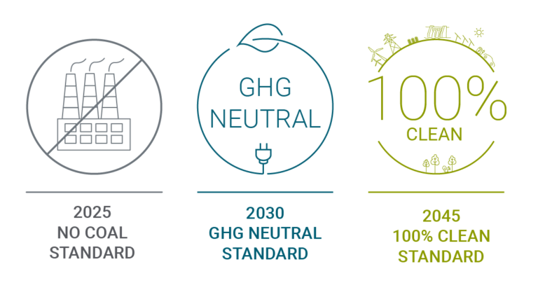
WA Clean Energy Transformation Act (CETA)
CETA Requirements
20% of utility portfolio can be CO₂ emitting generation with offsets
Has effectively eliminated investment in new natural gas generation so far

Slide 26
Oregon Clean Energy Bill
Directs two largest utilities to deliver 100% clean electricity to customers by 2040
Stairstep from 80% clean electricity by 2030, to 90% percent by 2035 and 100% by 2040
Prohibits new or expanded natural gas-fired power plants in the state (also illegal to build nuclear plants)
Most ambitious timetable in the nation

Slide 27
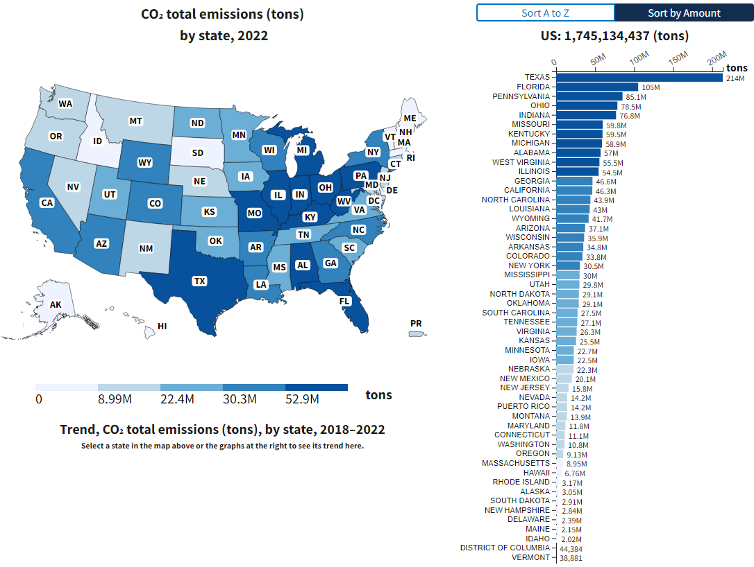
Washington & Oregon: What Dirty Energy Problem?
Hydropower Like Nowhere Else
% of U.S. Total (1,745 MMT)
WA = 10.8 MMT (0.62%)
OR = 9.13 MMT (0.52%)
Idaho = 2 MMT (0.1%)
Source: https://www.epa.gov/egrid/data-explorer

Slide 28
CO₂ Reductions: Local versus Global
“…cuts are necessary to prevent the worst effects of climate change on our state’s coastlines, water supplies, forests, environment, and economy.”
Poor Hydro Year & Includes “Other”
What the rest of the world is doing matters & says something
Extent & rate of CO₂ reductions
Virtue signaling vs. global impacts
Bending the Curve vs. Going Over a Cliff
Grid Reliability Risk
Increasing Energy Rates
Land-use Impacts
Total Energy ≈ 74 MMT
US EIA 2021 Data
Electricity ≈ 11 MMT
https://ecology.wa.gov/air-climate/reducing-greenhouse-gas-emissions/tracking-greenhouse-gases/ghg-inventories

Slide 29
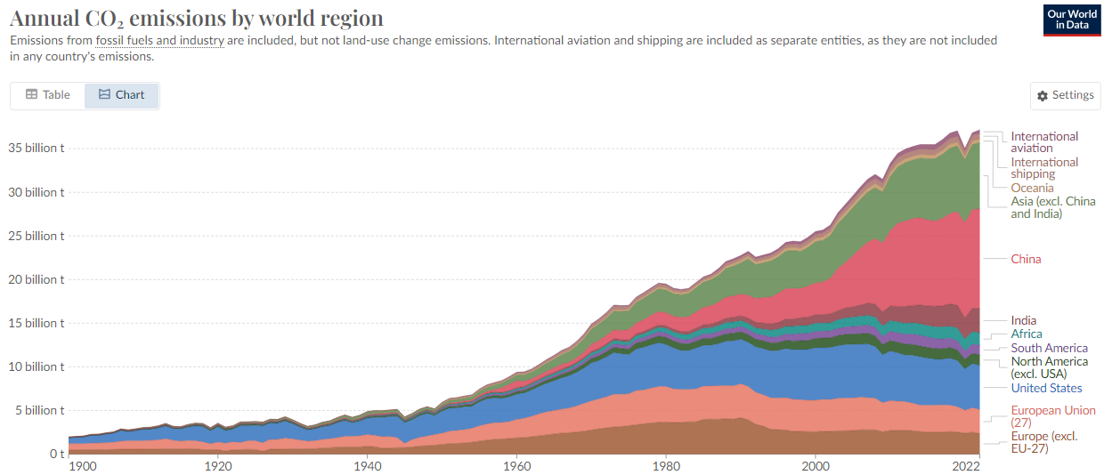
As We Push Grid to Blackout: Global CO₂ Emissions Rise
Atmospheric CO₂
420 ppm today (0.04%)
280 ppm pre-industry
<200 ppm some plants die
<150 ppm all plants die
Since 2007
U.S. decreased by 1,070 MMT
China increased by 4,420 MMT
China
2 new coal plants per week in 2022
In 2023, new coal plant construction hit an eight-year high.
+37,000 MMT per Year
11,400 MMT
5,060 MMT

Slide 30
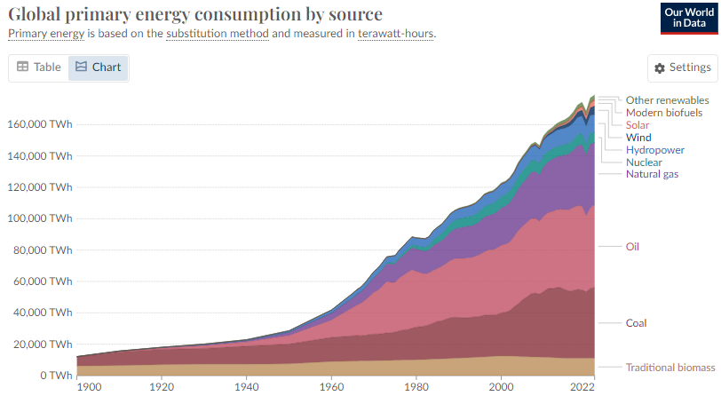
Rapid Global “Energy Transition” ?
5% Wind and solar
6.3% Hydro
3.8% Nuclear
83% Fossil Fuels & Biomass
Electricity is 16% of Global Energy Consumed
Source: https://ourworldindata.org/energy-production-consumption

Slide 31
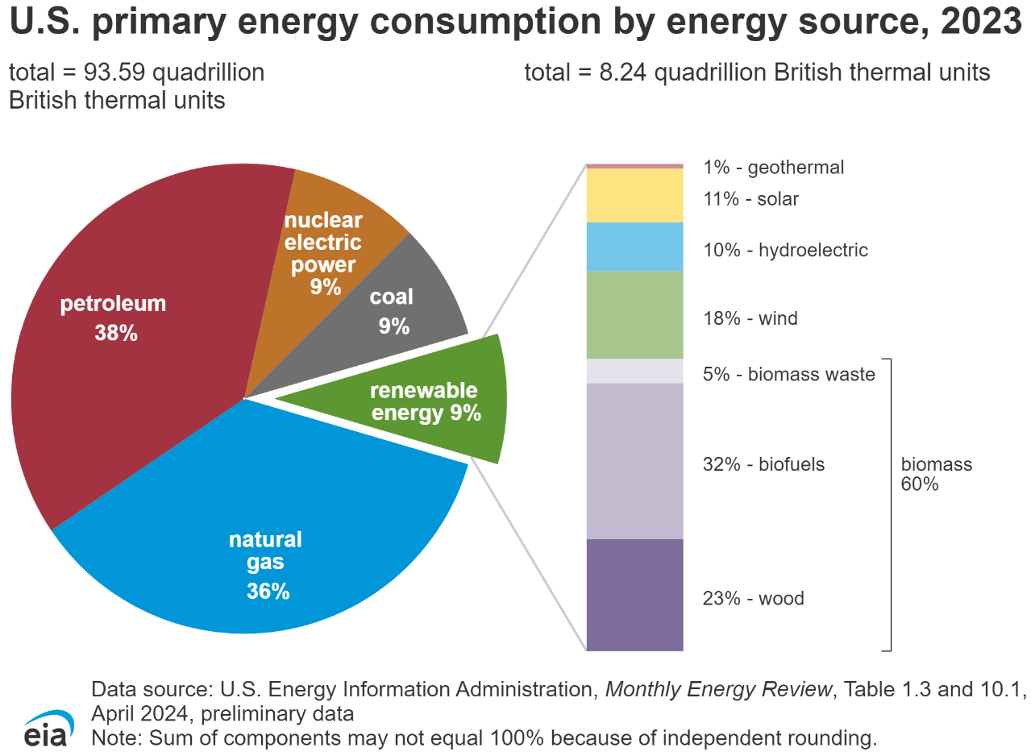
U.S. Total Energy Consumption in 2023
Fossil fuels = 83%
Wind & Solar = 2.6%
Hydro = 0.9%
Total Renewables = 9%
Nuclear = 9%
Electricity Represents 34% of total U.S. Energy
Wind was 18%x 9% =1.62% & Solar was 11%x9%=0.99%
Wind & Solar combined were 2.6% of U.S. primary energy consumption in 2023

Slide 32
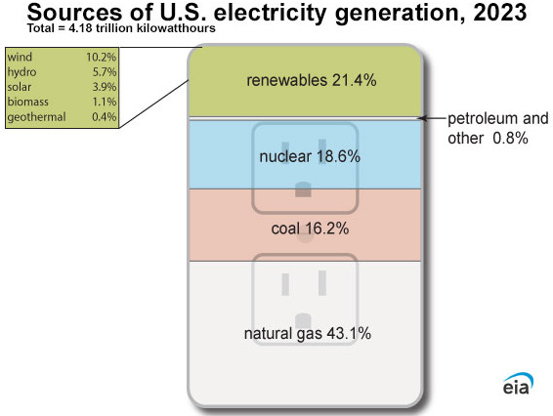
U.S. Electricity Generation
Fossil Fuels = 60%
Renewables = 21.4%
Wind & Solar = 14.1%
Hydro = 5.7%
Nuclear = 18.6%
39% Non-CO₂ Emitting
84%
New Generation Under Development
Source: https://www.eia.gov/energyexplained/electricity/

Slide 33
Agenda
Northwest Close to Blackouts – How did we get here?
WA & OR Clean Energy Policies – Global & U.S. Perspectives
WA Energy Strategy – We’re Coming for Your Wind MT & WY!
Where Do We Go from Here? – Near and Long Term

Slide 34
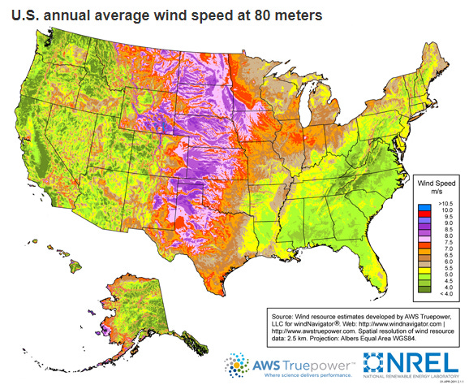
We’re Coming for Your Wind MT & WY!
Washington State Energy Strategy
+10,000 aMW = 10 x Columbia Generating Station Nuclear Plant

Slide 35
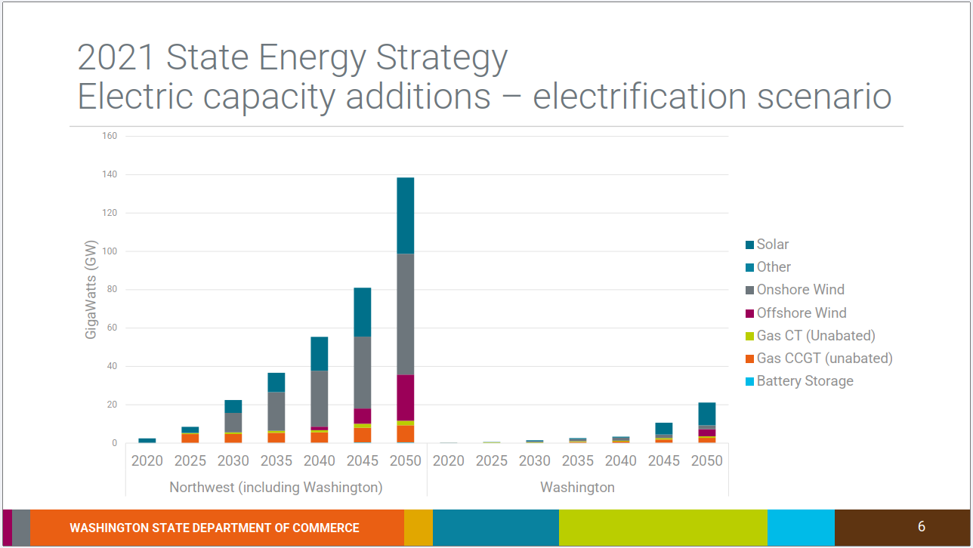
WA Energy Strategy: Everywhere but Here
38,000 MW solar
+116 million panels
63,000 MW onshore wind
+100 Seattle-sized farms
WA Wind = 2,000 MW

Slide 36
Washington’s Vision for the Northwest
WA Vision for NW
+63,000 MW
Southwest Power Pool
+31,000 MW
Texas
+37,000 MW
Total generation (MWh)
by plant
Source: epa.gov/egrid/data-explorer

Slide 37
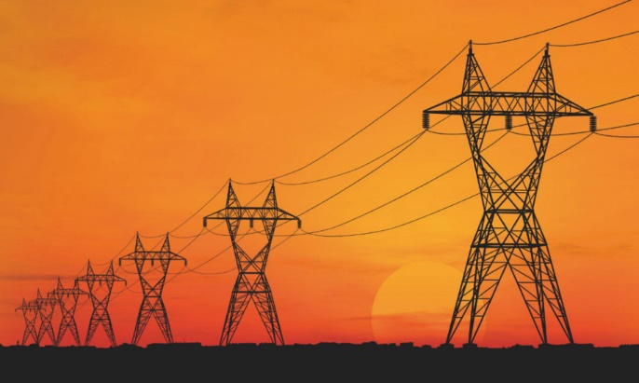
Wind & Solar: Land Use Impacts
Transmission Lines Needed to Bring
Wind and Solar Power to Population Centers
Assumes 100% of Existing Hydropower stays in Place
Source: Public Generating Pool study by E3 Consulting submitted to WA State Legislature prior to passage of CETA

Slide 38
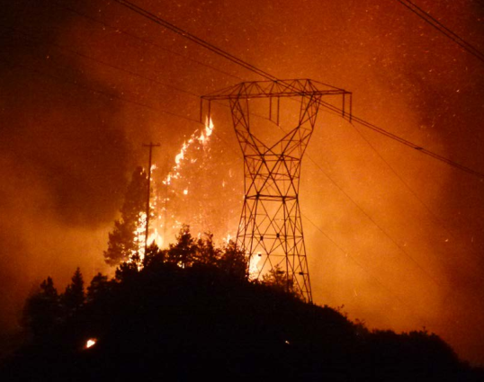
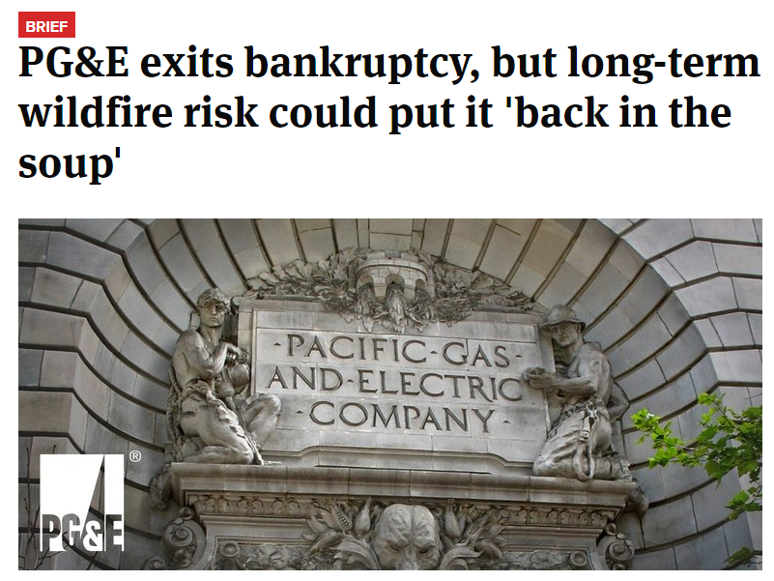
Transmission Lines: Development & Operations Friction
High up front capital costs & long siting, permitting & construction lead times
15 years or more not uncommon
Wildfire legal and financial risks
Risk mitigation includes preemptive shutoffs and blackouts

Slide 39
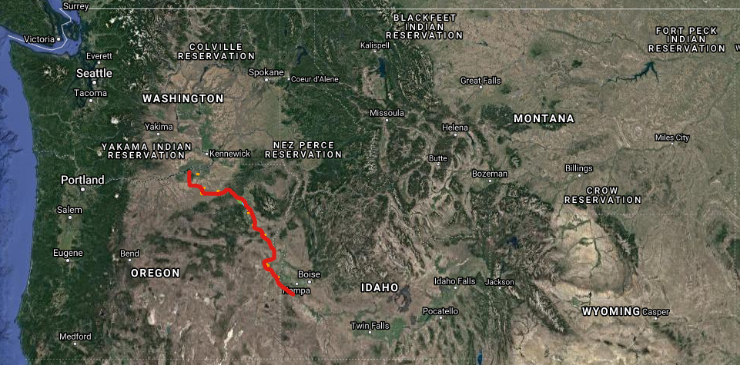
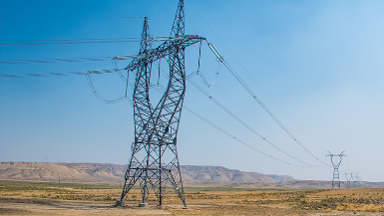
Boardman-to-Hemingway: Tx Line Case Study
300 miles
Need identified 2002
1,000 MW Capacity
Project defined 2006
Complete by 2026?
Raises serious questions about WA doubling electricity capacity and counting on Montana & Wyoming Wind
Idaho Power & PacifiCorp joint ownership
BPA not participating in construction or ownership
500 kilovolts

Slide 40
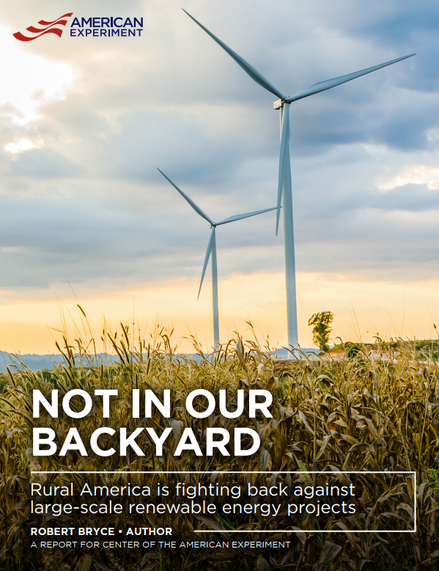
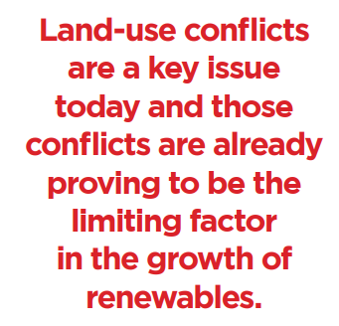
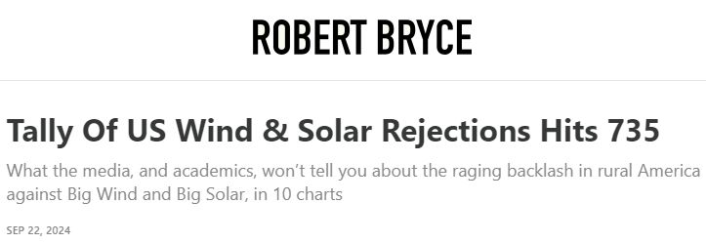
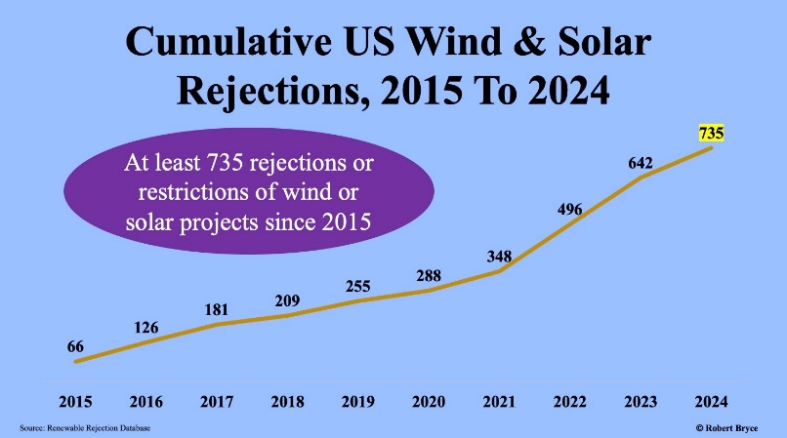
Land-Use Conflicts: Development Friction
Source: https://www.americanexperiment.org/reports/not-in-our-backyard
Tally Of US Wind & Solar Rejections Hits 735 - Robert Bryce (substack.com)

Slide 41
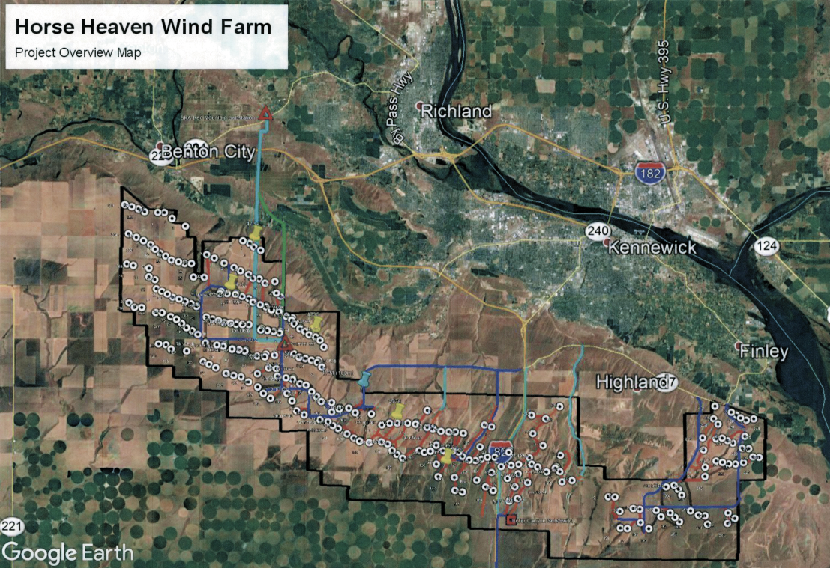
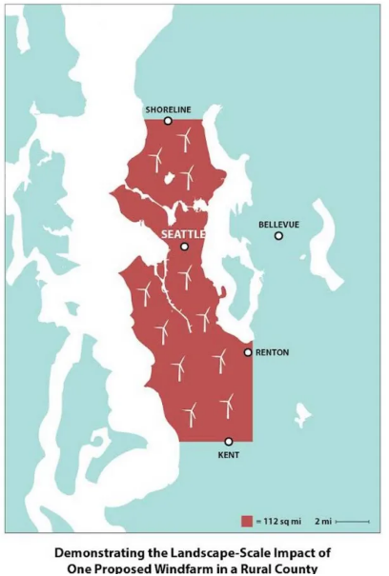
Not-In-My-Backyard: NIMBY Case Study
“communities and community members must have a seat at the table in designing programs and selecting projects.” WA 2021 State Energy Strategy
Benton County, Washington
Local Electricity > 95% CO₂ Free Today
Developer bypassing “locals” using State EFSEC
850 MW Nameplate
280 avg MW
47 MW
January
Effective Capacity
Contribution
133% x Seattle Land Area
+200 Turbines up to 600 feet tall
112 square miles

Slide 42
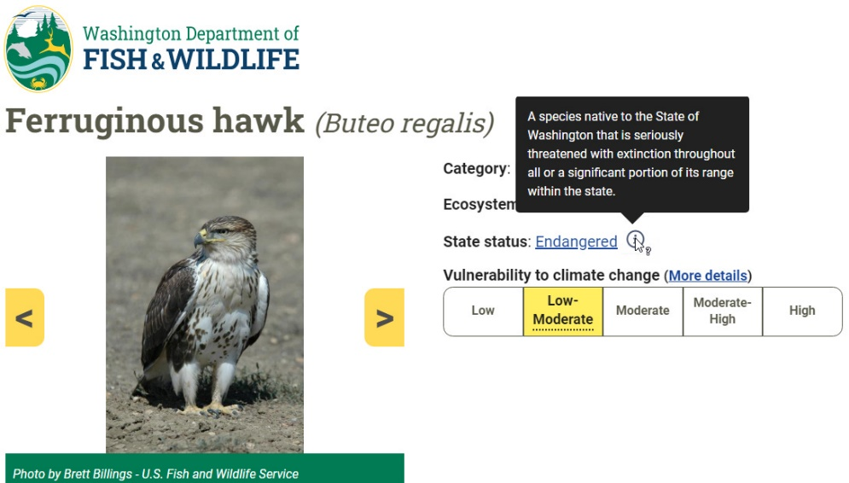
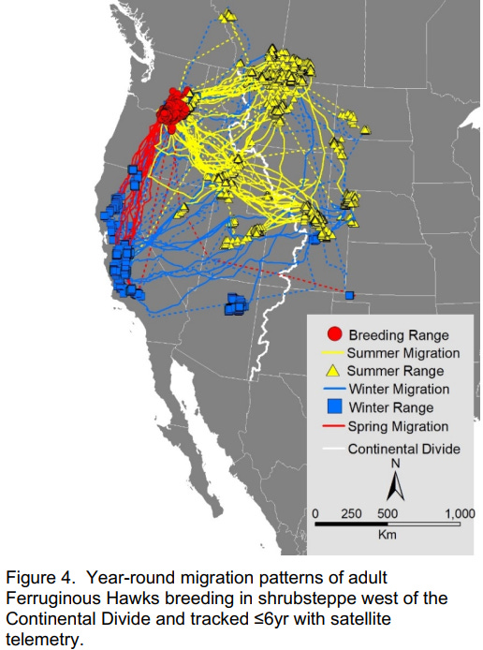
Endangered Species: Just Another NIMBY
Nowhere to Hide
Washington Department of Fish & Wildlife has identified “collision with wind turbines” as one of several direct sources of mortality

Slide 43
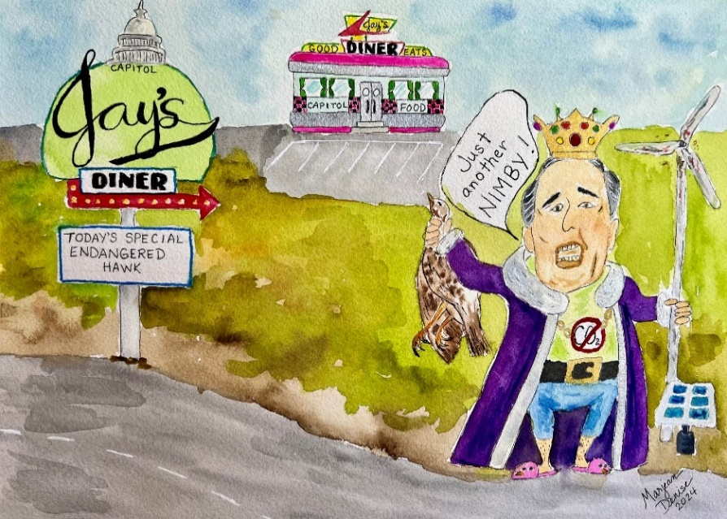
Inflaming the Rural/Urban Divide: “Green Tyranny”
Step 1
Replace Environmentalism with Climatism
Wrecking the Planet to “Save It”
Step 2
Regulatory Reforms
Eminent Domain on Steroids
Step 3
Push the Grid to a Reliability Cliff
More wind & solar over a bigger area … and fast!
Step4
Propaganda
Our “bold actions” will change the future of the planet & there’s no price too high for others to pay
"You've got to break a few eggs to make an omelette".
https://rickdunn.substack.com/p/bold-action-or-green-tyranny

Slide 44
Agenda
Northwest Close to Blackouts – How did we get here?
WA & OR Clean Energy Policies – Global & U.S. Perspectives
WA Energy Strategy – We’re Coming for Your Wind MT & WY!
Where Do We Go from Here? – Near and Long Term

Slide 45
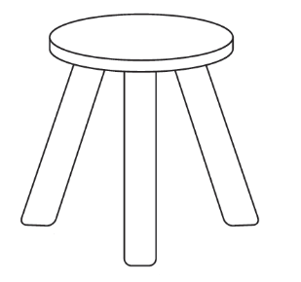
NW Utility Balancing Act: Becoming Increasingly Difficult
Hydropower Erosion
Increased spill & threats of dam breaching
Eliminating CO₂ valued above all factors
Coal-plant retirements & no new natural gas in WA & OR
Wind & Solar: Weather Dependent & Energy Dilute
Located remotely from population centers & require vast swaths of land due to need for extreme overbuild
Increasing Costs & Risk of Blackouts
Electricity
Health, Safety & Well Being
Affordable
Reliable
Environmentally Responsible

Slide 46
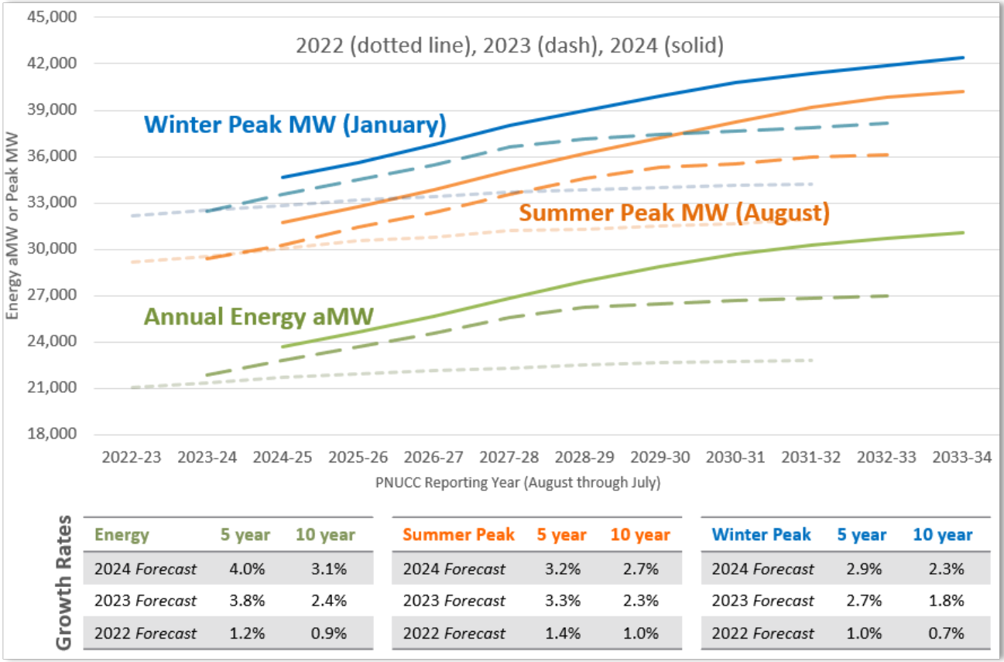
Northwest Demand +30% in 10 Years
Winter & Summer Firm Peak Requirements
Could Increase Nearly 10,000 MW in 10 yrs
https://www.pnucc.org/system-planning/northwest-regional-forecast/

Slide 47
Utility Forecasts: Highly Uncertain
Load Forecast Scenarios
High Electrification
Which is it?
Status Quo
What about Data Centers & other Electricity Intensive Loads?
Drives need for scalable, rapidly deployable, CO₂-free, & reliable generation

Slide 48
Pacific Northwest Generating Capacity Now & Possible Future
Nameplate Capacity
Average Year Energy
Unprecedented Development in an Anti-Development Era
In 25 years construct +28,000 aMW
=100 years of Hydro, Natural Gas & Coal Development
WA & OR Vision
Eliminate
Natural Gas & Coal
-12,000 aMW
x2 Electrification
+16,000 aMW
 | Average MW | Capacity Factor
Hydro | 16,271 | 47%
Natural Gas | 7,882 | 80%
Coal | 4,059 | 78%
Wind | 3,552 | 32%
Solar | 304 | 26%
Source: https://www.nwcouncil.org/energy/energy-topics/power-supply

Slide 49
PNW Hydro is Great! But Highly Variable
+3,000 to +9,000 aMW
Surplus May or May Not Show Up
Firm Generation Spoken For
+4,000 to +7,000 aMW
3 to 9 X
CGS
Nuclear Plant
In Some Months
https://www.bpa.gov/energy-and-services/power/resource-planning

Slide 50
BPA Transmission Lines: Critical to All Utilities
BPA Owns & Operates 75% of NW Grid
Source: BPA April 2023 Presentation “The Evolving Grid Update on the State of Transmission”

Slide 51
BPA Transmission: Interconnection Frenzy
Generator Interconnection Requests
300
BPA hasn’t built significant new
transmission lines in decades
Transmission Interconnection Requests

Slide 52
Land-Use vs. CO₂ Footprint: Finding Common Ground
What if we built:
As Little Transmission as Absolutely Necessary
Reliable Generation Plants
Small-footprint
Low or no-CO2
Closer to where people live
Up to 60% less CO₂ than coal
Natural gas is 100 to 1,000 X more power dense than wind and solar
New nuclear with safety perimeter at fence line will increase power density

Slide 53
Land-Use vs. CO₂ Footprint: Finding Common Ground
Energy contained in a gummy bear pellet of uranium fuel
= 2,000 pounds of coal

Slide 54
Small Footprint Nuclear: Long-Term Solution
Source: https://www.americanexperiment.org/reports/not-in-our-backyard
1,000 aMW of wind power = 500 to 1,000 square miles of land
720 MW Small Modular Reactor Complex = 0.05 square miles of land

Slide 55
New Nuclear: Gaining Momentum
ARDP Grant Recipient #1
Advanced Reactor Demonstration Program
ARDP Grant Recipient #2

Slide 56
New Nuclear: Gaining Momentum
ARDP Grant New Recipient #1
Breaking Ground in 2026
“completed by end of decade”
ARDP Grant Recipient #2
Breaking Ground Now
2030 Operational Goal

Slide 57
Amazon Steps Up for Site-1 SMR!
57
4 Modules Initially with up to 12 Total
80 Megawatts per Module
Original ARDP Grant #1, now DOE Loan Program Office
Amazon to purchase first 4 modules
Energy Northwest has option to build additional 8 modules
Additional power available to Amazon and northwest utilities
On-Line Goal = Early 2030s

Slide 58
Scalable, CO₂-Free, Reliable & Safe
Meltdown-Proof
Walk-Away-Safe

Slide 59
Benefits of zero-emitting firm capacity at 100% GHG reductions
Avoids 80 to 150 Seattle-Sized Wind Farms & 112 M solar panels
100% GHG Reduction Portfolios
Adding
Avoids
+1.2 GW CGS
-9.5 GW Storage
+5.3 GW SMRs
-44.8 GW Wind
-37 GW Solar
+6.5 GW Firm
-91 GW Non-firm
$-1.4B
CGS + NuScale SMRs reduce system costs by almost $8B per year relative to RE + Storage

Slide 60
Data Centers: Need Baseload Generation Now
Driving Nuclear Renaissance
Big Tech’s “Dirty Little Secret”
Natural Gas Power + Renewable Energy Certificates
“Greenwashing”
https://rickdunn.substack.com/p/wind-and-solar-green-industry-fantasyland

Slide 61
Natural Gas: Policies vs. Reality
How Natural Gas is Used in the Pacific Northwest
More than half of the total energy consumed in the region — either used directly for space and water heat or in industrial processes, or as gas-generated electricity. (Excludes transportation uses.)

Slide 62
Natural Gas: We need you, but WA/OR policies hate you
Pipeline Capacity Maxed Out
Increased NG electricity generation
“The region’s existing storage assets would not be able to make up the 90-day capacity deficiency if the region experiences a cold winter.”
replace decommissioned coal plant power
balance intermittent renewable sources

Slide 63
Capital Costs: Low & No-CO₂ Emissions Generation
Combined-Cycle Natural Gas
$1.2 billion per 1,000 MW
Wind
$2.3 billion per 1,000 MW
Solar:
$1.4 billion per 1,000 MW
Lithium-Ion Batteries
$1.3 billion per 1,000 MW
4-hour Discharge Duration
Increases Effective Capacity
Risk of Multi-day Energy Drain
High Capital $ Due to Overbuild
Costs: U.S. Energy Information Administration Northwest Power Pool 2022 $

Slide 64
Wind & Solar Grid Costs: Cautionary Tale from Germany
Residential/Industrial Avg. ¢ per kWh
Germany: 40/26.4
+39% wind& solar annual electricity
De-industrialization is occurring
Germany leads on:
concentration of wind & solar per capita
Highest priced electricity
https://www.iea.org/countries/germany

Slide 65
West Coast Residential Rates Increasing
West Coast Residential Rate Increases Since May 2019
California +75% Increase
CA is 280% x WA Rates
26% in-state wind & solar electricity
Oregon 34% Increase
Washington 24% Increase
WA/OR/CA = 12¢/15¢/34¢ per kWh

Slide 66
West Coast Industrial Rates Increasing
West Coast Industrial Rate Increases Since Jan 2019
California +133% Increase
CA is 406% x WA Rates
Oregon 36% Increase
Washington 42% Increase
WA/OR/CA = 6.4¢/7.6¢/26¢ per kWh

Slide 67
Unspoken Environmental Costs: Cradle-to-Grave
All energy conversion technologies involve Environmental Tradeoffs
Social cost of carbon should not be the only environmental metric

Slide 68
Wind & Solar: Land & Mineral Intensive
IMF economists predict metal prices would reach historical peaks
“for an unprecedented, sustained period of roughly a decade.”
500% to 1,800% Increase in Minerals per Watt of Electricity

Slide 69
Energy Transition: Mining Reality Check
16 years to bring new mine into operation
Mining critically needed and OK
as long as it’s somewhere else

Slide 70
Wind & Solar: Increasing Cost Curves
Power Purchase Agreement (PPA) Pricing
Temporary or Permanent?
Mark Mills Manhattan Institute: https://www.youtube.com/watch?v=sgOEGKDVvsg

Slide 71
Keep in Mind: It’s a Great Time to be Alive!
“We live longer, healthier, safer, wealthier, freer, more peaceful and more stimulating lives than those who came before us.”
Steven Pinker, Harvard Psychologist

Slide 72
Conclusions: Ideas Worth Considering
Be wary of climate catastrophizing as the basis for energy policies
Panicked energy strategies are force feeding inherently deficient wind & solar
Need intellectually honest life-cycle cost-versus-benefit analysis; financial & ecological
Environmental virtue signaling versus real global impacts
Data shows bending global CO₂ emissions & concentration curves is likely a longer-term prospect
Energy poverty is human poverty; we need more global energy, not less
Greenhouse effect saturates with increasing CO₂ concentration
“All of the above” sounds nice but . . .
Overbuilding wind, solar & batteries diverts intellectual & financial capital from reliable solutions
How about “always the best” reliable, small-footprint, low or no CO₂ technologies

Slide 73
Can We Please Find Common Ground
Natural-Gas-to-Nuclear (N2N) is worth considering
“How about an energy future of abundance and human flourishing, not one based on unprecedented land grabs, intermittency, variability, and scarcity.”
“I know it might seem like a long shot, but we must create a “safe space” for natural gas to be put back on the table in Washington and Oregon.”

