Slide 1
North Idaho: Time to be Normal
Sam Wolkenhauer, Labor Economist
October 2024

Slide 2
Inflation is subsiding Year over Year CPI Growth
Inflation
Source: Bureau of Labor Statistics

Slide 3
Job Creation is Slowing Nonfarm Employment, 3-Month Average Monthly Change (in Thousands)
Labor Markets
Source: US Bureau of Labor Statistics

Slide 4
Local Job Growth Plateaus Nonfarm Employment, Coeur d’Alene MSA in Thousands
Labor Markets
Source: Idaho Department of Labor

Slide 5
Idaho Normalizes, Keeps Growing Nonfarm Employment, Idaho in Thousands
Labor Markets
Source: Idaho Department of Labor

Slide 6
Idaho Normalizes, Keeps Growing Nonfarm Employment, Idaho in Thousands
Labor Markets
Pre-COVID
Trendline
Source: Idaho Department of Labor

Slide 7
Clear Signs of Softening Total Openings and Quits, (in Millions)
Labor Markets
Job Openings
Voluntary Quits
Source: US Bureau of Labor Statistics

Slide 8
Wage Growth is Slowing Annualized Wage Growth, Three Month Moving Average
Labor Markets
Source: Federal Reserve Bank of Atlanta

Slide 9
Signs of Distress are Low Layoffs and Initial Unemployment Claims, in Millions
Labor Markets
Source: Federal Reserve Bank of Atlanta

Slide 10
Consumers Keep Spending Real Personal Consumption Expenditures, in Trillions
Spending
Source: US Bureau of Economic Analysis

Slide 11
Mortgages Are Not Unwinding (Yet) 30 Year Fixed Rate Benchmark Mortgage vs Outstanding Average Rate
Interest Rates
Source: Federal Housing Finance Agency, Freddie Mac, Federal Reserve

Slide 12
Listing Prices Diverge Median Listing Price for Single Family Homes
Prices
Idaho
USA
Source: National Association of Realtors, Federal Reserve

Slide 13
Labor Force Growth has Cratered Ten Year Rolling Average of Annual Labor Force Growth, USA
Demographics
Source: Federal Reserve Bank of St. Louis

Slide 14
Demographics
Workers per Retiree are Falling Ratio of Working Age Population (25-64) to Retiree (65+)
Source: Congressional Budget Office

Slide 15
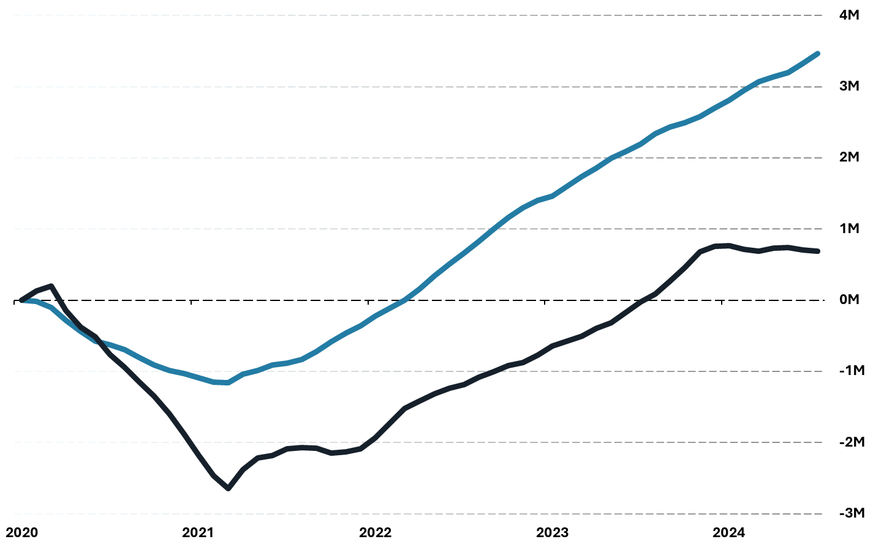
Labor Force Growth Runs on Immigration Net Change in Native Born Labor Force vs Foreign Born
Labor Force
Source: US Bureau of Labor Statistics

Slide 16
Big Picture: Normalizing in Idaho?
Many labor market indicators are softening, but this is relative to an abnormally tight economy in 2021/22. Idaho is not flashing signs of economic distress.
The housing market has not unwound, with affordability in Idaho remaining very low.
Demographic issues remain and will remain long after pandemic era effects. Bottom Line: Idaho seems to be getting its old (2018ish) economy back.

Slide 17
For more information on Idaho’s workforce,
please visit LMI.IDAHO.GOV
Questions?
Sam Wolkenhauer
Samuel.Wolkenhauer@labor.idaho.gov
(208) 457-8789 ext. 4451

