Slide 2
AGENDA
Conditions Forming (past)
The Outer Bands (present)
Where the Inland Northwest Stands
Where do we go from here?

Slide 3
About Lightcast
Lightcast is the world’s leading authority on in-demand skills, labor market trends, and talent intelligence.
Lightcast insight and expertise, powered by our best-in-class data on jobs and skills, is used by companies across the globe to better understand their own workforce and find new talent, by education institutions helping prepare their students for the job market, and by community leaders to develop new solutions for growth in their regions.

Slide 4
WORKFORCE PAST
Conditions Forming: The Baby Boomers’ Labor Market

Slide 5
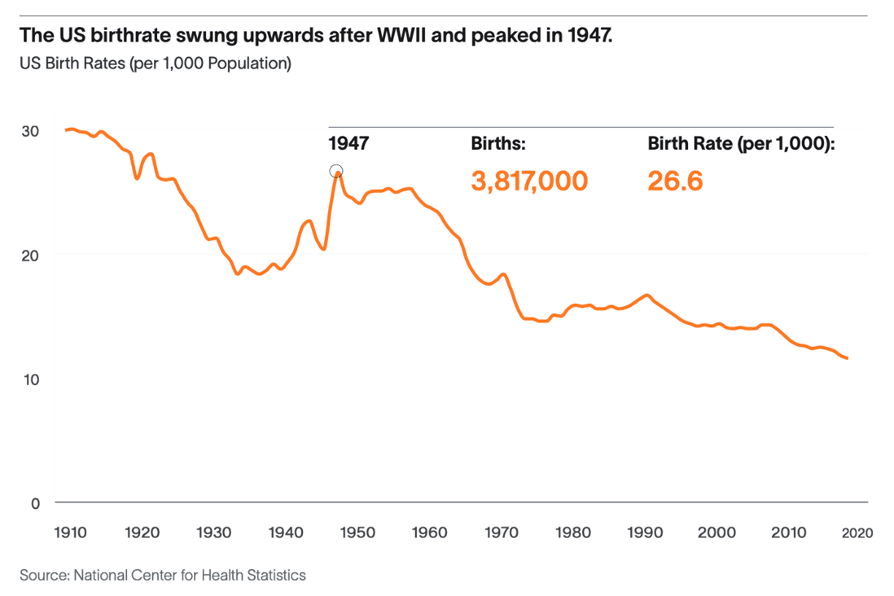
The 1970-90s Workforce Grew Rapidly For Two Main Reasons:
Birth rate was extremely high
Women entered the workforce in droves
THE RISING STORM

Slide 6
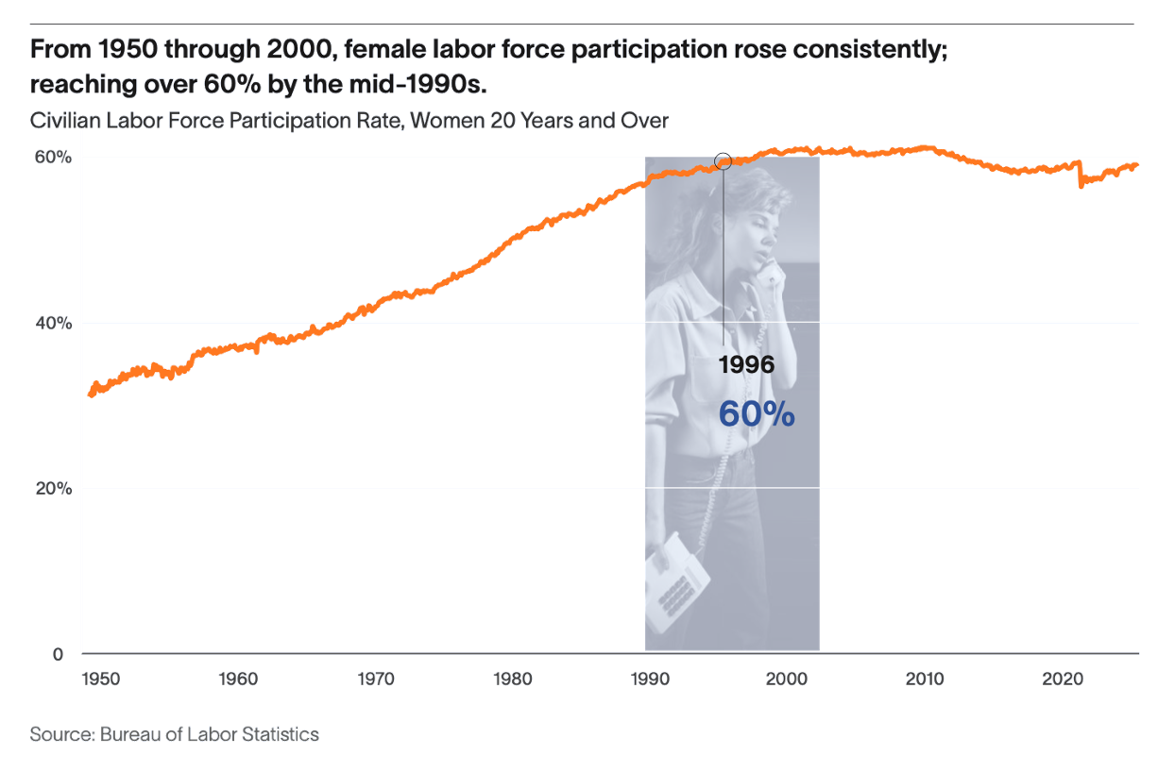
The Workforce Grew Rapidly For Two Main Reasons:
Birth rate was extremely high
Women entered the workforce in droves
THE RISING STORM

Slide 7
Higher Birth Rates And Women Entering Doubled Our Workforce Growth
College Enrollment jumped 100% from 1965 to 1975 and continued to soar for women
21.7M
42.5M
27M
1950-1970
1970-1990
1990-2010
Workforce increase by 20 year period Source: Statista 2021
THE RISING STORM

Slide 8
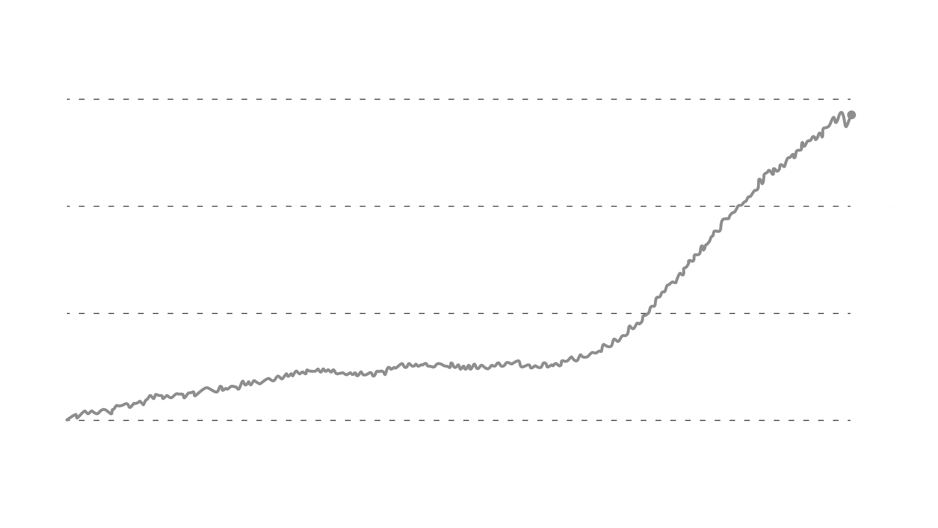
The Silver Tsunami The US Workforce soared as the Baby Boomer Generation began.
Baby Boomers born:
1946-1964
[Current Ages: 60-78]
US population, age 55+
40M
30M
20M
10M
1948
1955
1962
1969
1976
1983
1990
1997
2004
2011
2018

Slide 9
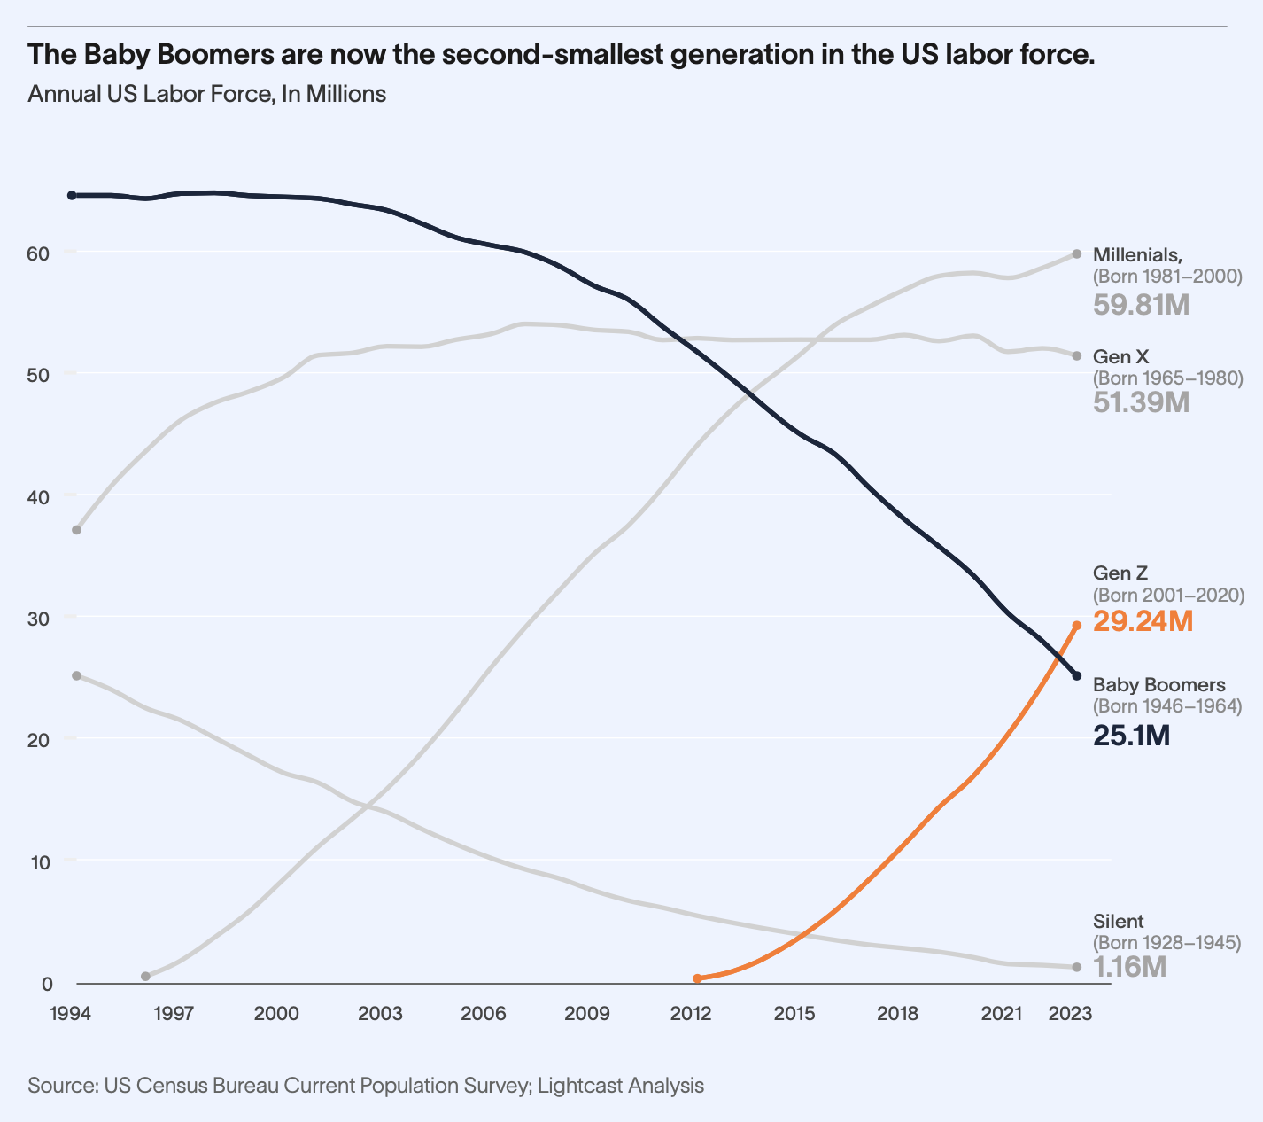
The Silver Tsunami Has Hit Shore
With Boomers heading out of the labor force, they are no longer working, but growing into a huge dependent population.
THE RISING STORM

Slide 10
WORKFORCE FUTURE
Landfall, est. 2028-2034
WORKFORCE PRESENT
The Outer Bands: Today’s Labor Market

Slide 11
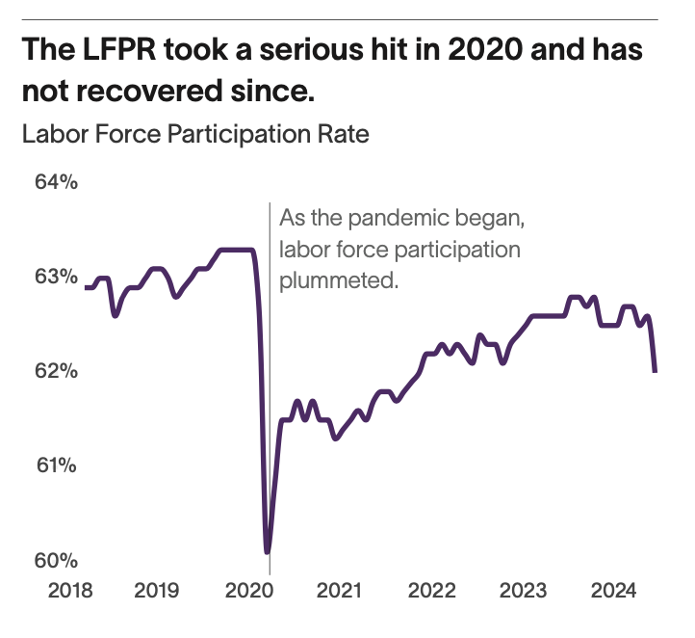
Outer Bands
The pandemic pushed an accelerator pedal down on trends that were already coming. People have left the labor force faster than we thought.
THE RISING STORM

Slide 12
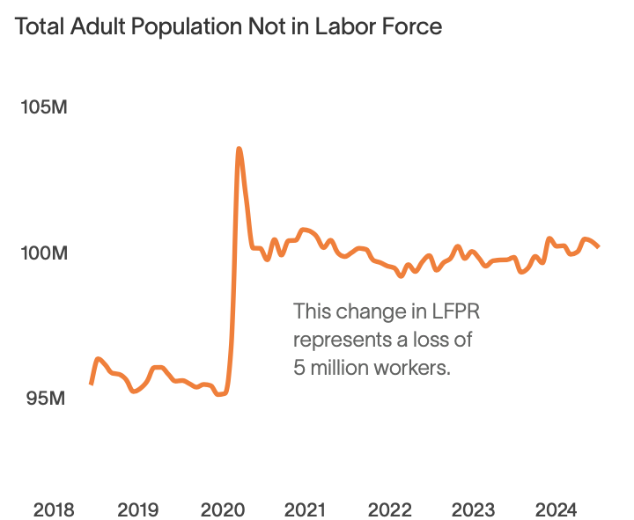
We lost 5 Million People Overnight

Slide 13
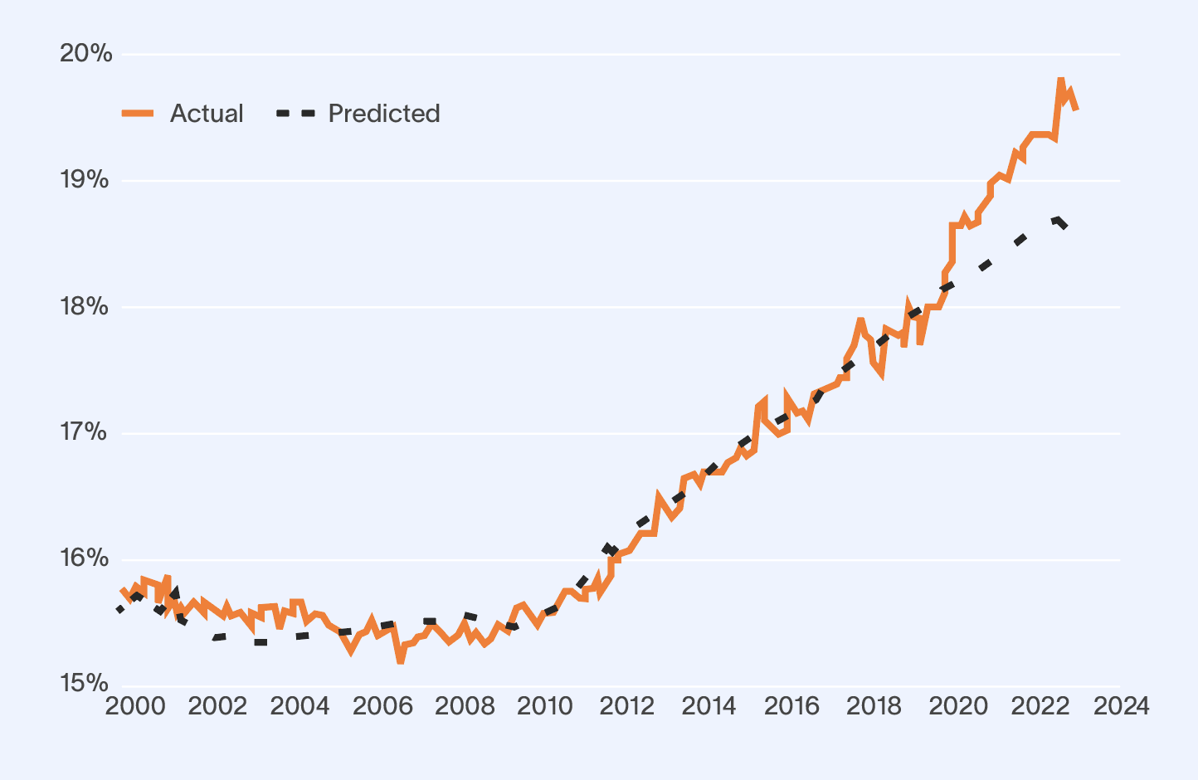
Boomers Are Exiting The Labor Force En Masse.
Out of the 5 million people who have left the labor force since 2020, 80% are over the age of 55.
THE RISING STORM

Slide 14
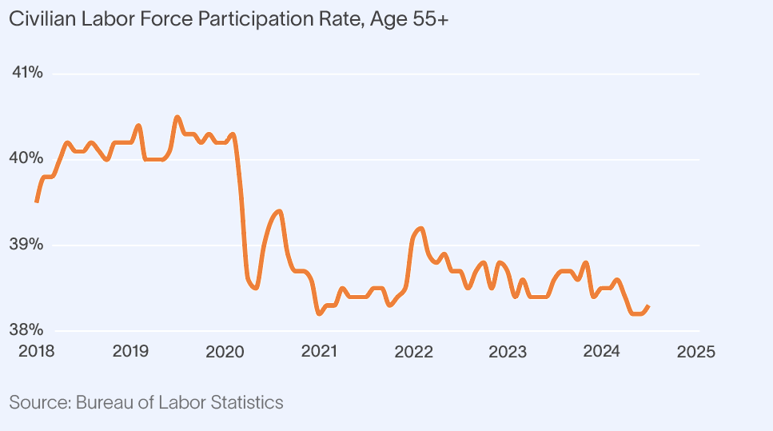
Labor Participation For Older Adults Dropped Sharply During The Pandemic.
A large number of Boomers opted to leave the labor force in 2020.

Slide 15
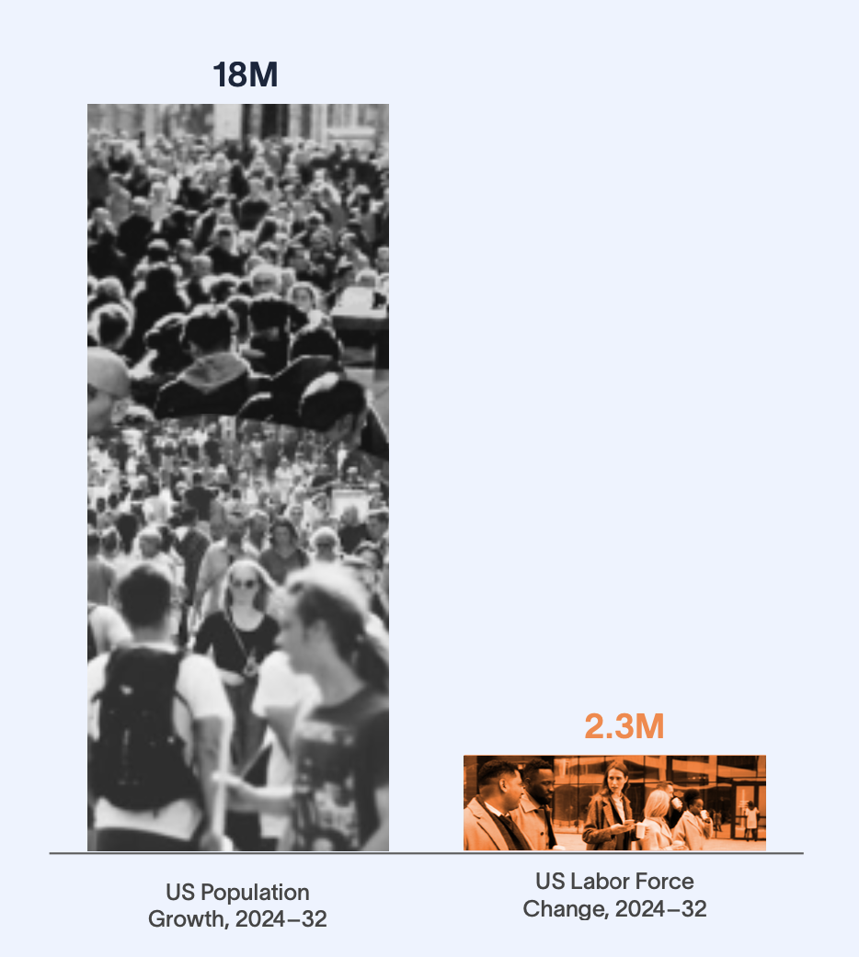
From 2024 to 2032, US Population Growth Will Outpace Labor Force Growth by Nearly 8 to 1.
THE RISING STORM

Slide 16
Increase in Consumers
Increase in Producers
THE RISING STORM

Slide 17
What’s Happening?

Slide 18
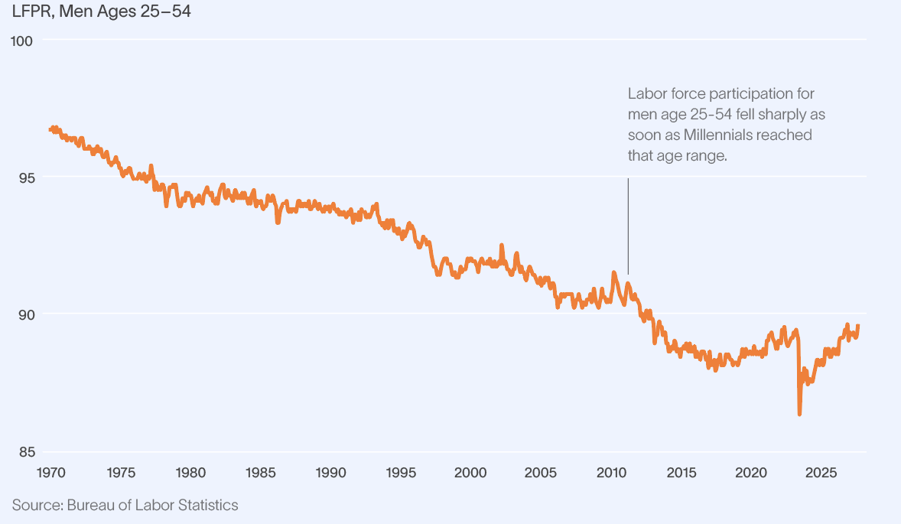
Prime-Age Male Workforce Participation Has Plummeted.

Slide 19
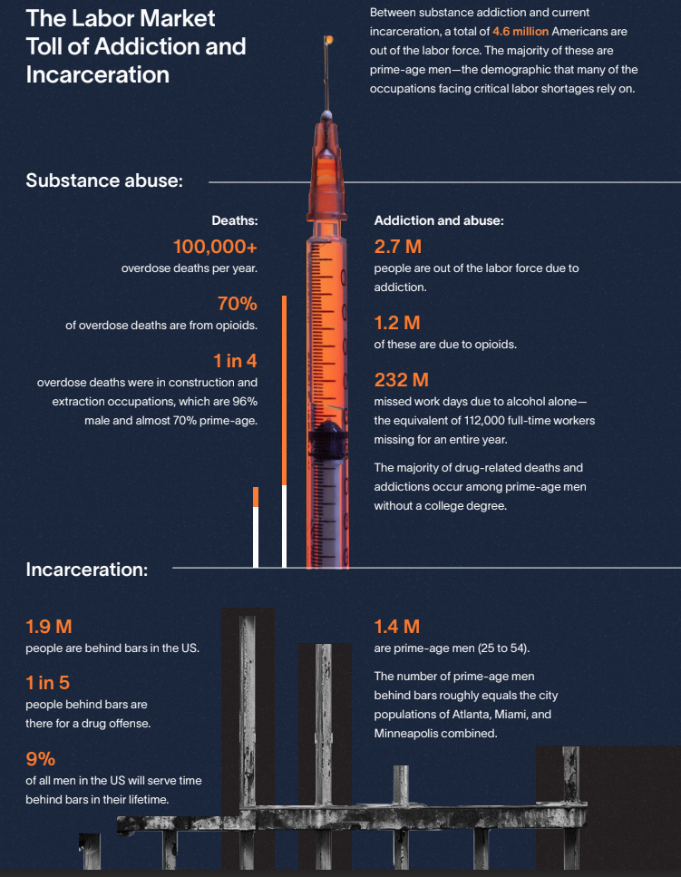
The Labor Market Toll of Addiction and Incarceration
Between substance addiction and current
incarceration, a total of 4.6 million Americans are
out of the labor force. The majority of these are
prime-age men—the demographic that many of the
occupations facing critical labor shortages rely on.
Among those that have served time behind bars, 60% are still without a job a year after their release. And the overall unemployment rate for those formerly incarcerated sits at a whopping 27%-- almost 7 times higher than that of the general population

Slide 20
THE RISING STORM

Slide 21
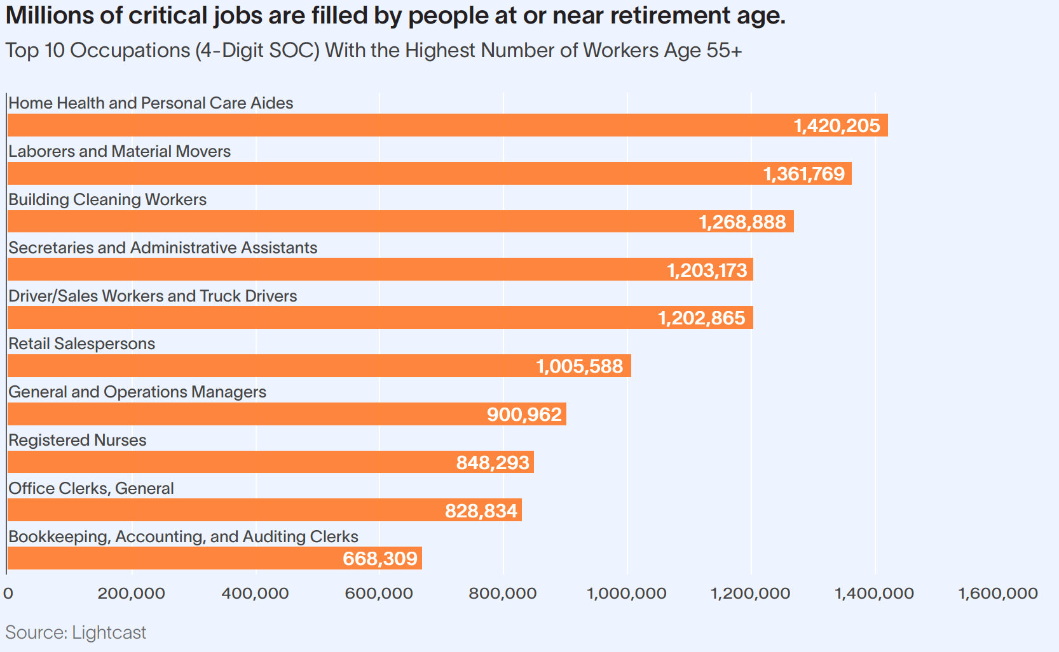

Slide 22
Starting in 2024 and lasting through 2027, the number of Americans turning 65 is reaching all-time highs, at a rate of more than 11,000 new 65-year-olds per day.
Context: US births in 2023 = 9,800 per day.

Slide 23
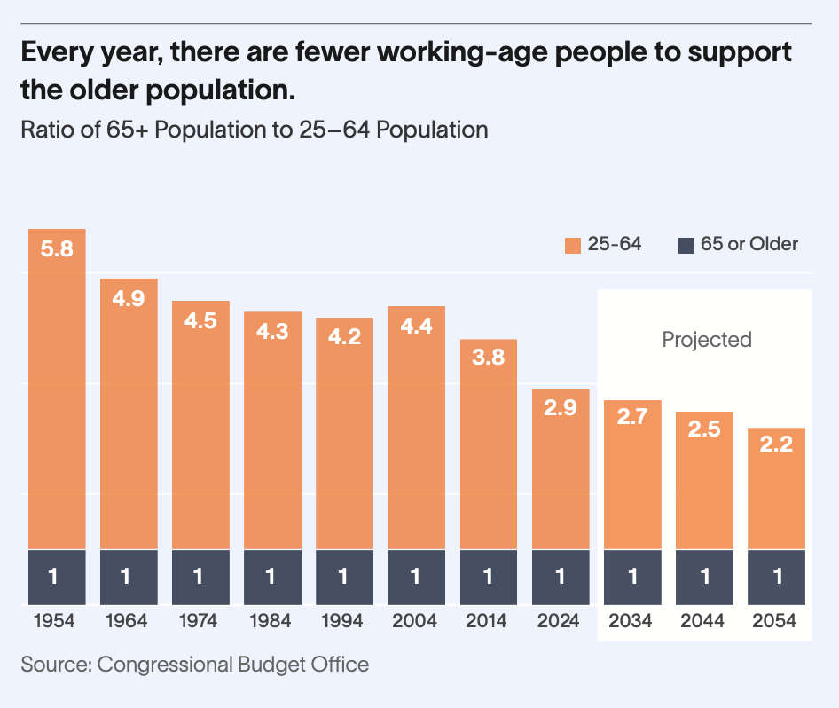
Workforce Entrance Imbalance Impending

Slide 24
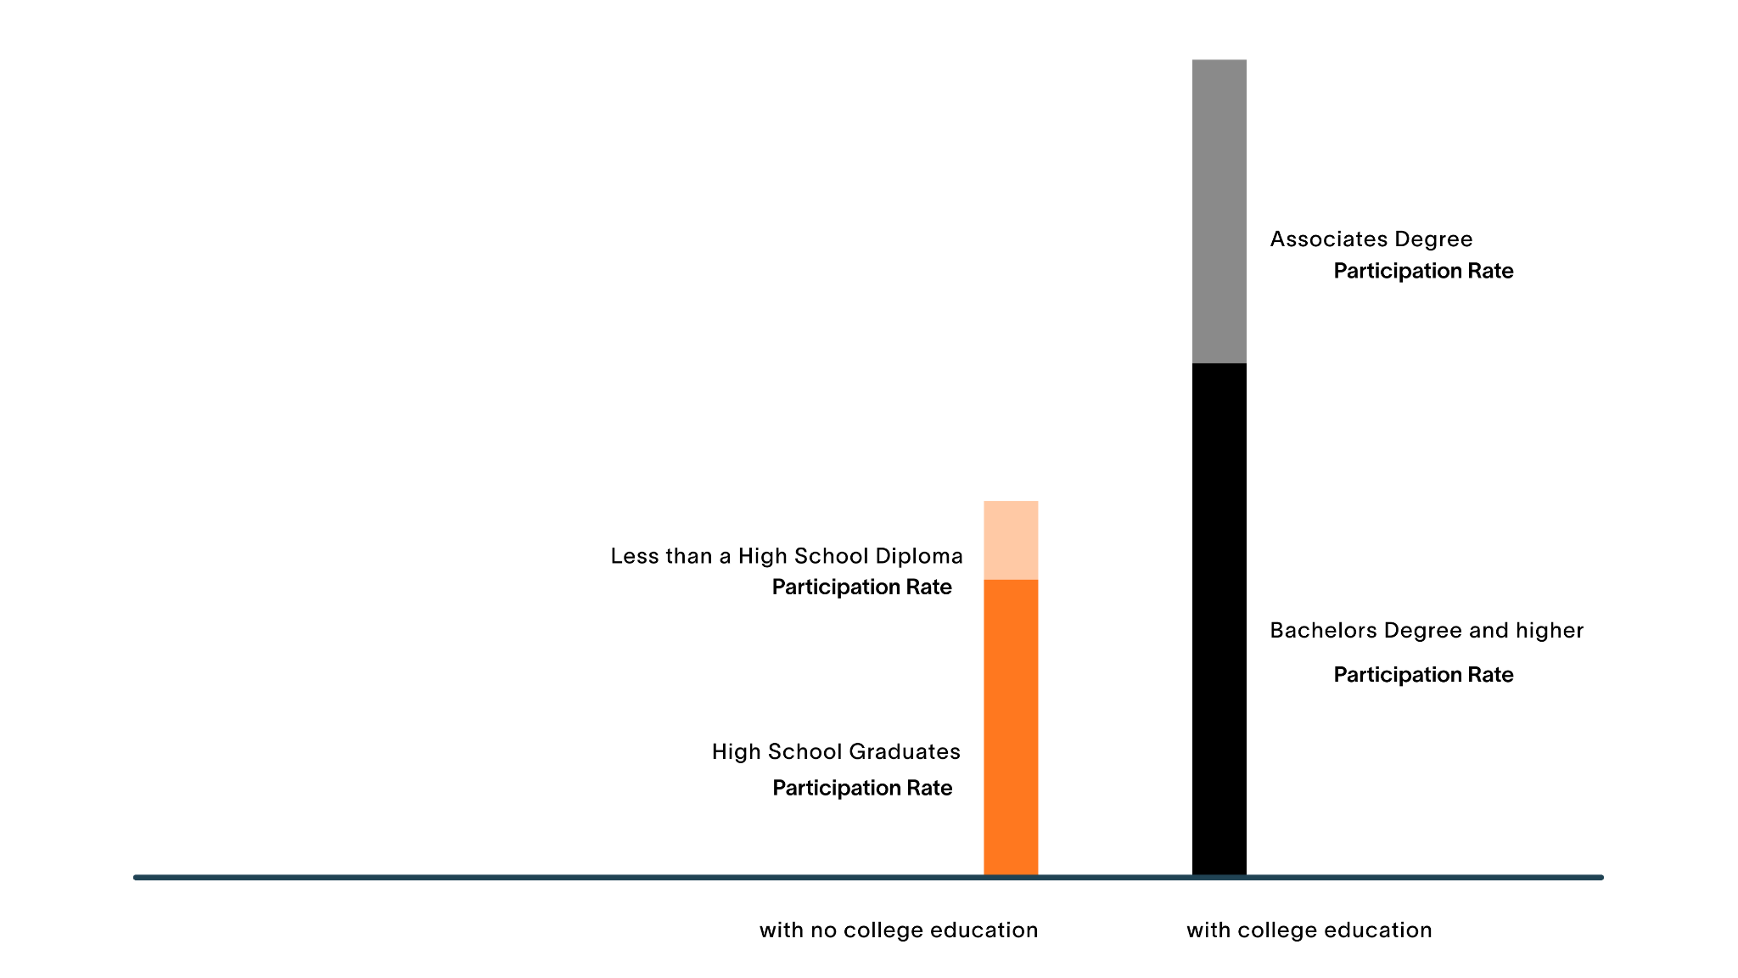
The U.S. is Already Highly Educated
36M
63%
And more highly educated people have a greater labor force participation rate
9M
65M
48%
36M
73%
57%
43M
101M
THE RISING STORM
Source: BLS, CPS Table A-4

Slide 25
But…
Roughly 60% of All Open Jobs do Not Require a College Degree.

Slide 26
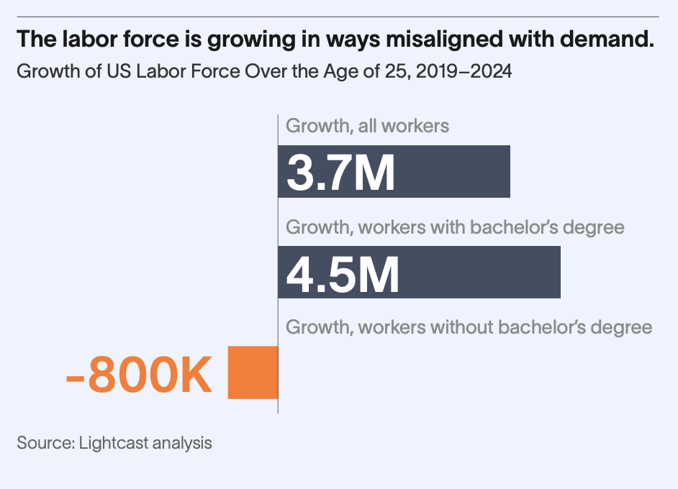
THE RISING STORM

Slide 27
WORKFORCE FUTURE
Landfall, The Decade Ahead

Slide 28
Where the Inland Northwest Stands
THE RISING STORM

Slide 29
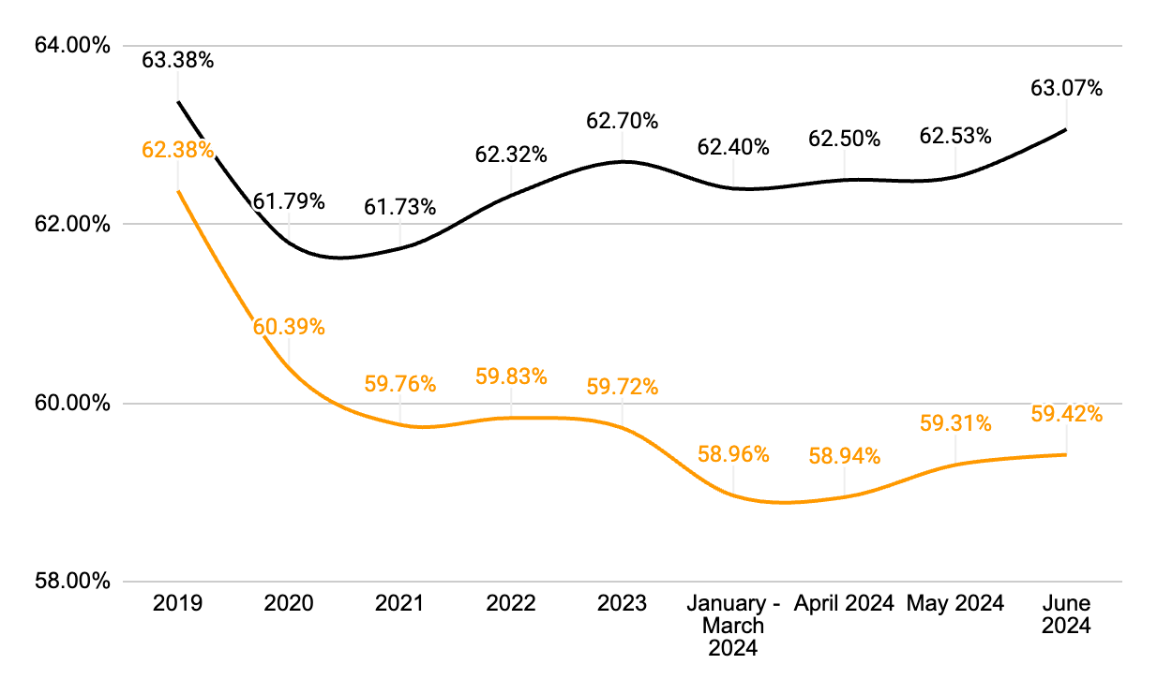
Labor Force Participation Rate
Inland Northwest • United States

Slide 30
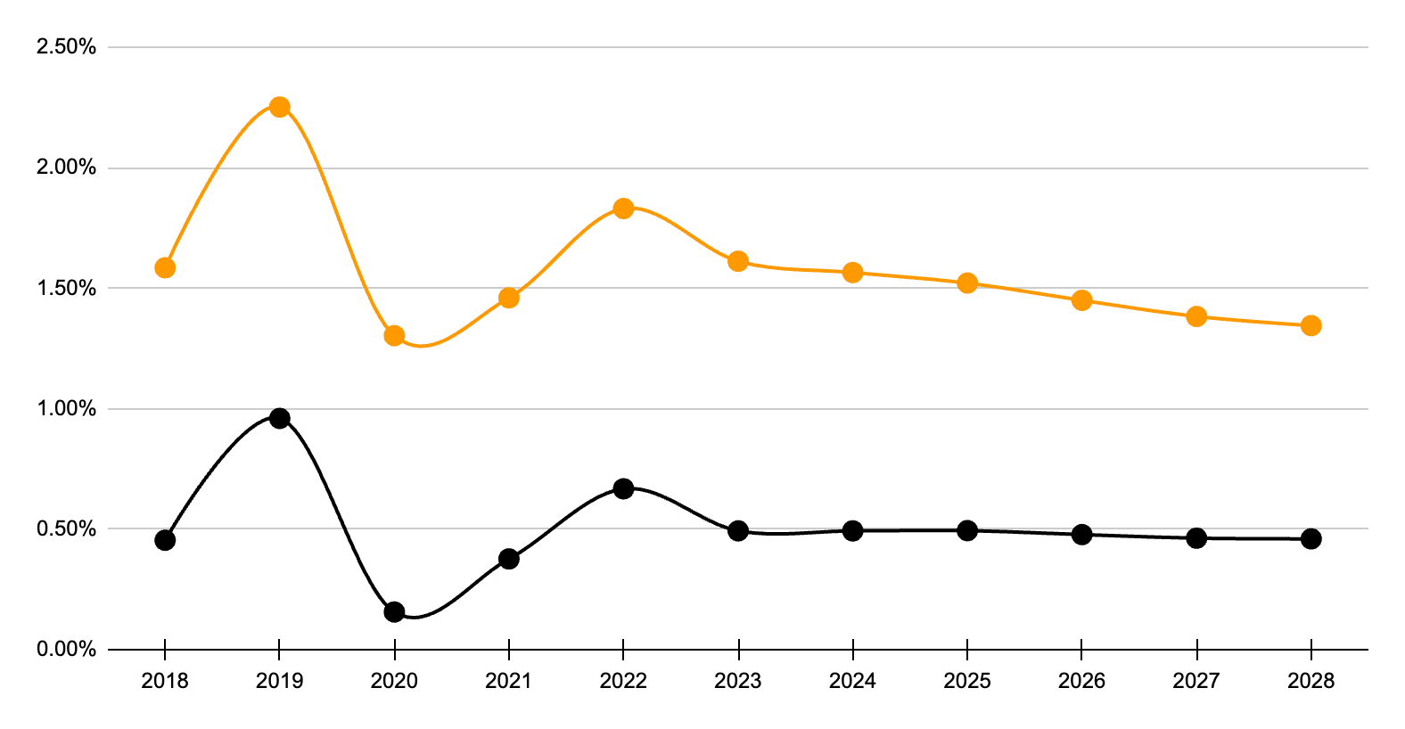
YoY % Population Growth
Inland Northwest • United States

Slide 31
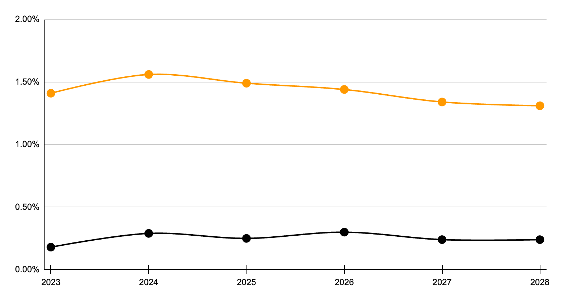
YoY % Working Age (15–64) Population Growth
Inland Northwest • United States

Slide 32
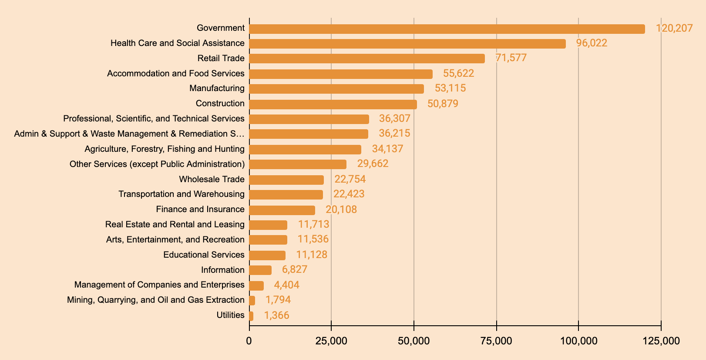
Industry Sectors
Inland Northwest
Notes:
21.6 times more ag jobs than the national average

Slide 33
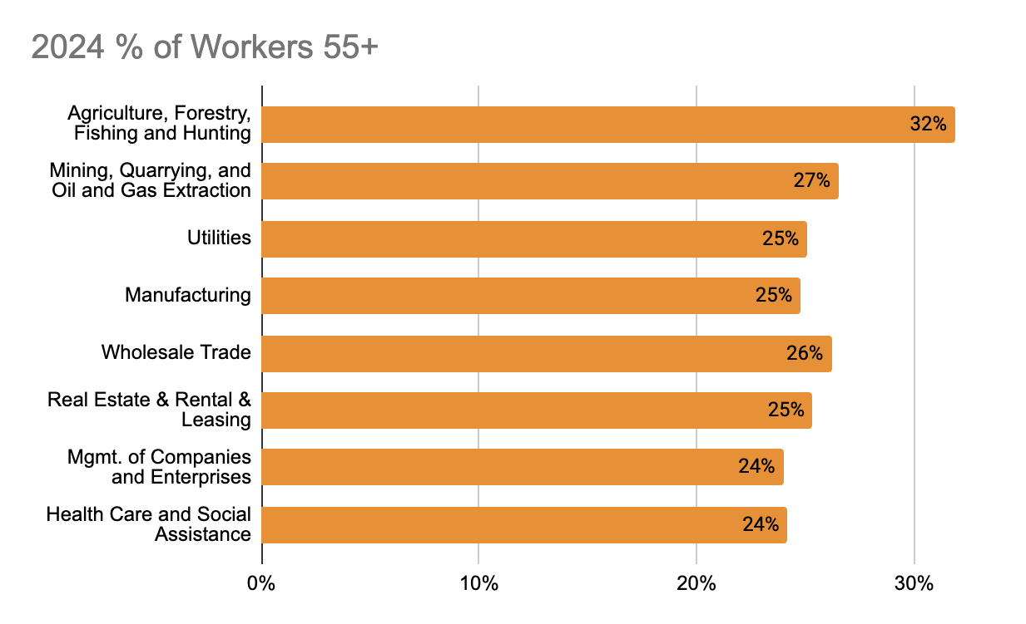
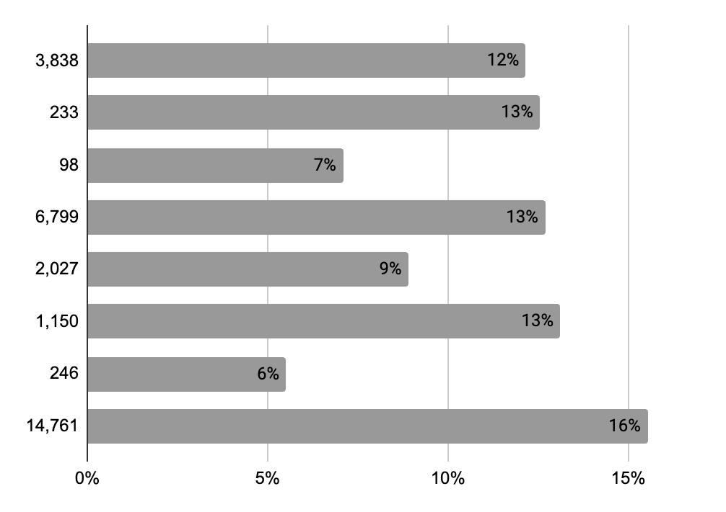
Inland Northwest Industries with High Retirement Risk
Several industries have nearly 1 in 4 workers who are 55+
2024 - 2032 % Job Change

Slide 34
Lopsided projections for the Inland NW…
Over the next 8 years, the increase in the working age population, ages 15-64 is just over 117k people
Projected increase in jobs by 2032 – almost 74k
In 2024 average age for retirement is 61
With a labor force participation rate hovering around 59%, this will cover 70k of those jobs
….who's going to do the work?
THE RISING STORM

Slide 35
WHAT WE CAN DO
Storm Preparedness

Slide 36
So, Where do we go from here?

Slide 37
IMMIGRANTS?
Who’s Gonna Do This Work?

Slide 38
Immigration is The One Source of Talent That is Keeping The US Labor Market Afloat.
Since late 2019...
102%
of the 3.7M increase
in the US labor force
was foreign-born.
In that time,
the US-born
labor force
dropped by
73K

Slide 39
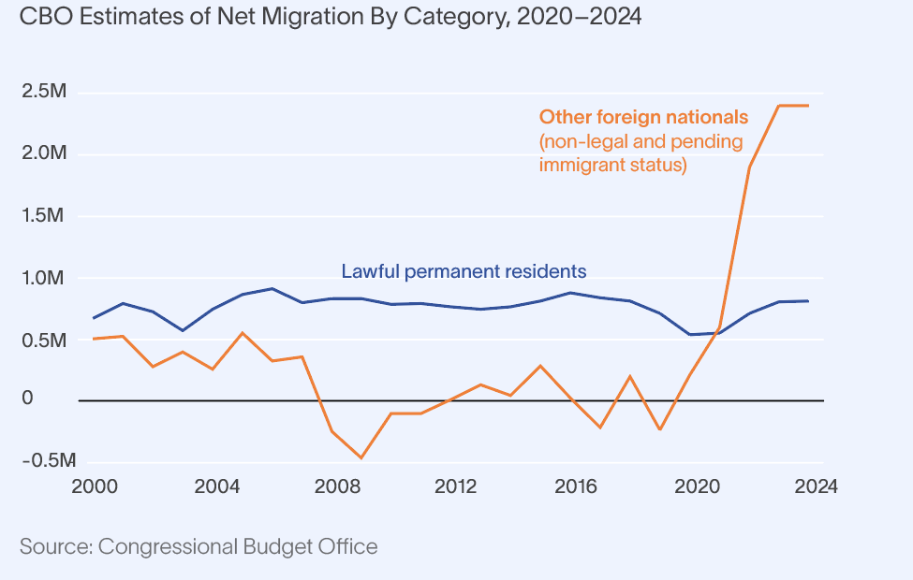
The Foreign-Born Population Was What Helped Solve The First Significant Outer Band of The Storm.

Slide 40
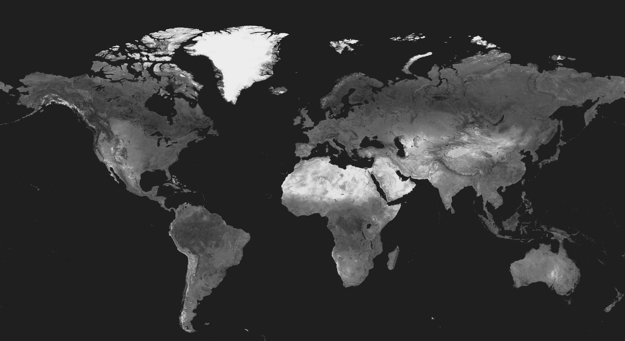
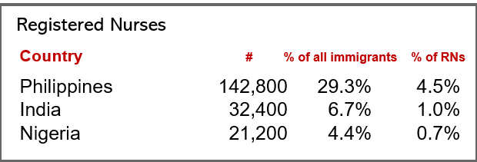
But What if it Can’t?
Birth rates have been falling and labor shortages growing around the globe— including in countries the US relies on for its workforce.
Mexico has a much lower unemployment rate than the U.S.
The Philippines currently has a shortage of 100,000 nurses. Starting in 2021, they started placing strict limits on those who want to emigrate.

Slide 41
Artificial Intelligence and Digital Skills?
Who’s Gonna Do This Work?

Slide 42
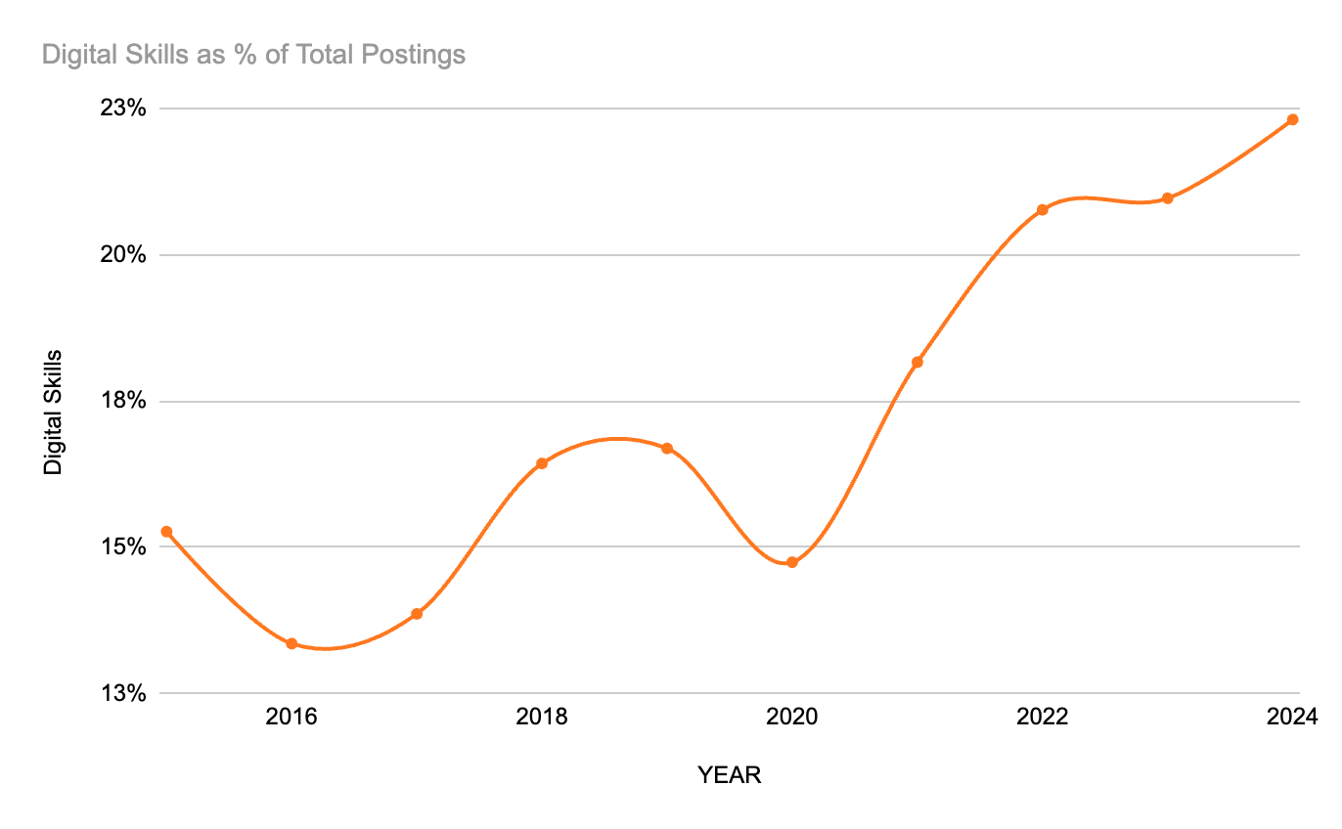
According to research from National Skills Coalition and Federal Reserve Bank of Atlanta, in the state of Washington:
95% of Healthcare Postings
90% of Arts, entertainment, and recreation Postings
86% of Agriculture, forestry, hunting
Washington In Demand Skills and Rise of Digital Skills

Slide 43
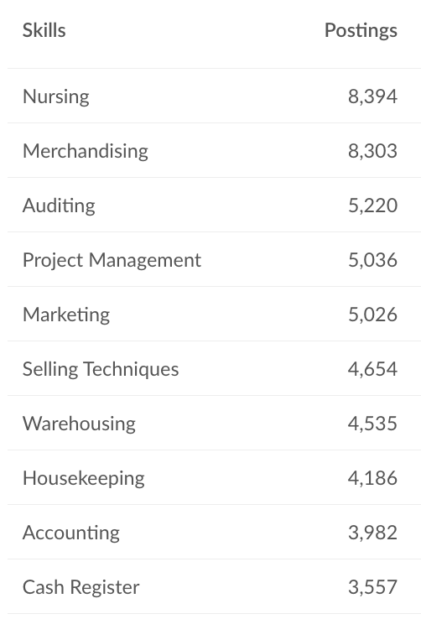
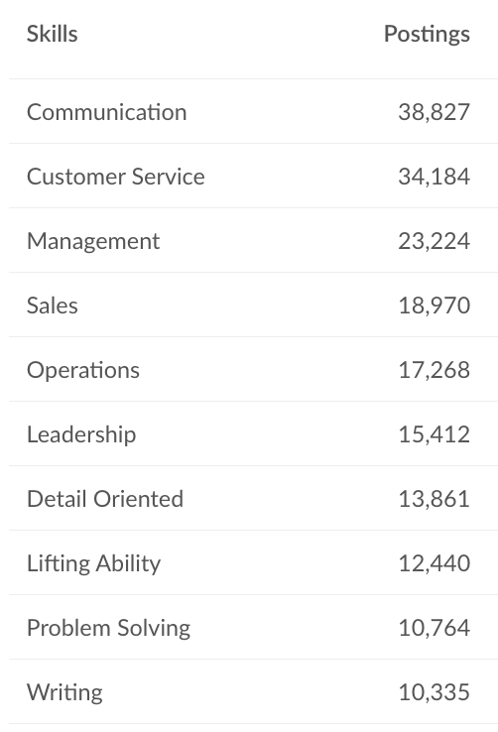
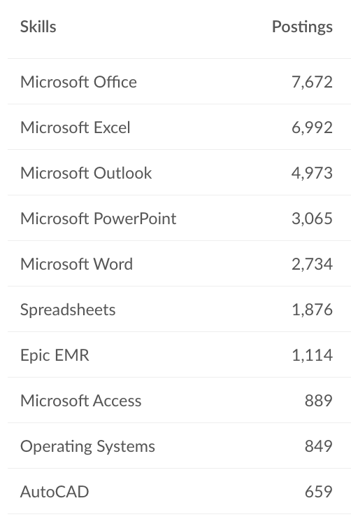
Inland Northwest In Demand Skills and Rise of Digital Skills
Specialized Skills
Human Skills
Digital Skills

Slide 44
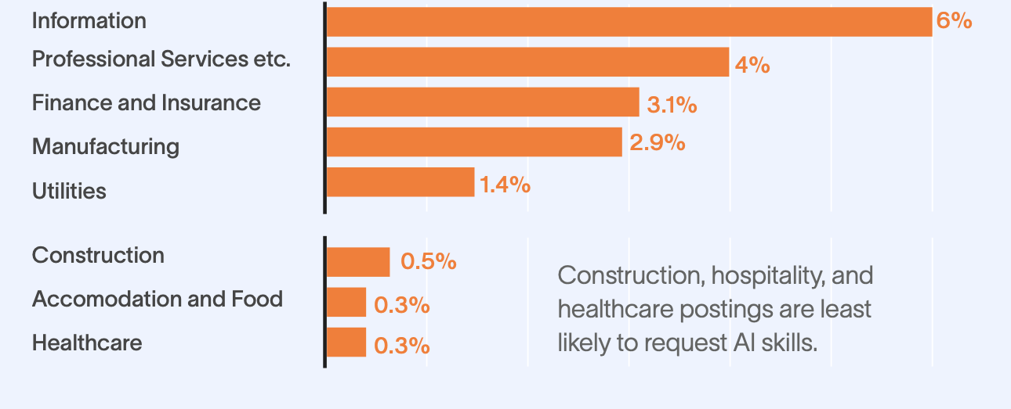
AI skills are in highest demand in industries with low danger of talent shortages.

Slide 45
Hiring Requirements?
Who’s Gonna Do This Work?

Slide 46
Revisiting Hiring Requirements
Educational Requirements:
55% of the Inland Northwest population doesn’t have a college degree.
47% of Washington Postings and 38% of Inland Northwest Postings since January require college degree
Justice Involved:
4,000 job postings since January implicitly or explicitly felon friendly in State of Washington
Estimated over 250,000 openings this year for the same occupations - State of Washington

Slide 47
SCAN
Phil Blankenship
phil.blankenship@lightcast.io
https://www.linkedin.com/in/phil-blankenship001/
To Download The Rising Storm

Slide 48
Thank you.

