Slide 1
Panhandle Area Council, Inc.
Revolving Loan Funds (RLF)
July 2024
Notes:
ID=d924773e-9a16-4d6d-9803-8cb819e99682 Recipe=text_billboard Type=TextOnly Variant=0 FamilyID=AccentBoxWalbaum_Zero

Slide 2
PAC Introduction
A regional economic development organization structured to promote and assist economic development within the five northern counties of Idaho.
SBA Certified Development Company (CDC)
Non-profit 501(c)(4) corporation (1972)
Members are cities, counties, and private sector
EDA designated economic development district for Region 1 (Idaho) and co-administrator of Statewide Revolving Loan Fund for Region 3.
PAC has lending staff residing in Boise and southern Idaho with over 60+ years of combined commercial lending experience and knowledge.

Slide 3
CEDA Introduction
A regional economic development organization with lending programs that serve north central Idaho and southeast Washington.
Non-profit 501(c)(3) corporation (1967)
Members are cities, counties, and private sector.
EDA designated Economic Development District for Region II of Idaho.
Idaho RLF for Region II via cooperative agreement with State and other Idaho Economic Development Districts.
CEDA is authorized to serve SE WA with USDA-RD programs.

Slide 4
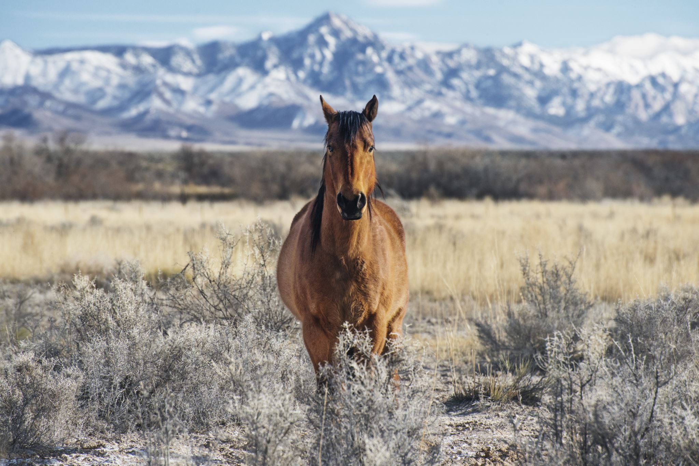
PAC Loan Programs
CEDA Loan Programs
Idaho RLF
SBA 504
PAC RLF
Regional RLF
CARES RLF
USDA IRP
Idaho RLF
EDA-CARES RLF
USDA-IRP
USDA-RMAP
USDA-RBEG
Regional - RLF

Slide 5
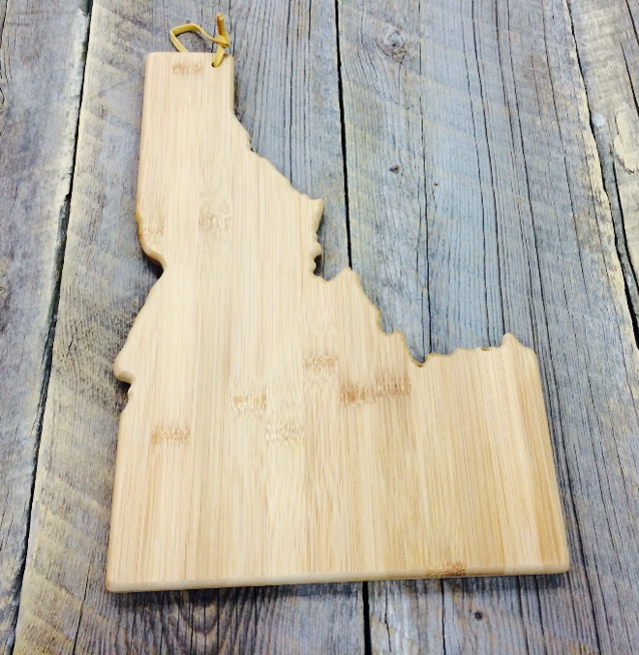
RLF FUNDS - Objective
Facilitate startup and growth of small business throughout Idaho
Partner with Commercial Lenders to improve access to capital for eligible businesses
Provide “gap” loans to qualifying applicants for the financing of fixed assets, working capital, construction, etc.
5

Slide 6
Use of Loan Proceeds
Fixed asset financing for the acquisition and/or improvement of capital assets including land, buildings, plant and equipment, including construction or renovation of existing facilities.
Funding of working capital needs
Refinance existing loans and leases to improve cash flow ability (subject to conditions)

Slide 7
Applicant Eligibility
An RLF Loan Applicant must:
Be a US Citizens or Permanent Resident Alien; and
Be a business which is authorized to conduct business in Idaho; and
Meet the definition of a “Small Business” as defined by the US Small Business Administration

Slide 8
Ineligible Projects
Projects that are speculative, illegal, or of prurient nature
Passive investments
Projects which provide applicants required equity contributions under other Federal agency loan programs.

Slide 9
The RLF is “gap” financing and, as such, is not created to compete with commercial lenders.
The maximum RLF loan amount available is $750,000 (per loan purpose)
Loan Amount

Slide 10
Minimum project equity is 10% of project costs
Borrower Equity

Slide 11
Standard Repayment Terms
Terms and amortization periods for repayment of the RLF loans are determined by the purpose of the loan, needs of the borrower, the degree of financing gap, benefits of the loan, the economic life of collateral, and perceived loan risk.
Typical amortization periods (maximum)
Real Estate: 25 years
Equipment: 10 years or economic life
Working Capital: 10 years

Slide 12
Interest rates are typically equal to or below current market rates.
Interest rates can be fixed or variable and determined during underwriting process.
RLF Interest Rates

Slide 13
Loan Fees
Origination fees typically do not exceed 2% of the RLF loan amount.
Borrower typically can finance all closing and soft costs.

Slide 14
Example Financing Structure
Typical Loan Structure:
Cost Purchase building $400,000 Renovations $ 50,000 Machinery/equipment $ 30,000 Soft costs $ 20,000 (appraisal, architect fees, etc) Total : $500,000
Financing Commercial Lender - 1st Lien Position $ 250,000 permanent loan (50%) PAC - 2nd Lien Position $ 200,000 permanent loan (40%) Down payment * $ 50,000 borrower Injection (10%) Total: $500,000

Slide 15
Commercial Loan
Commercial lender typically has a priority Lien on project assets.
Applicant/borrower negotiates the interest rate, fees, terms, etc. with the commercial lender.

Slide 16
Benefits to the Borrower
Low down payment preserves working capital (usually 10%)
Borrower can finance most closing costs.
Opportunity to obtain overall lower cost of the combined loans

Slide 17
Use the program as a competitive advantage for lower equity contribution, quick turnaround, etc.
Benefits to the Commercial Lender

Slide 18
PAC Contact Info www.pacni.org
Kristi Dunn
Senior Loan Officer
208-627-2410
kdunn@pacni.org
Wally Jacobson
Executive Director
208-660-8133
wjacobson@pacni.org
Shaun Woolley
Commercial Loan Officer
208-699-6549
swoolley@pacni.org
Brent Jussel
Senior Loan Consultant
208-293-2719
bjussel@pacni.org
Machele DuBois
Senior Loan Officer
805-458-9151
mdubois@pacni.org

Slide 19
CEDA Contact Info
John Lane
Business Development Finance Director
208-746-0015
jlane@clearwater-eda.org
Dodd Snodgrass
Executive Director
208-746-0015
dsnodgrass@clearwater-eda.org

