Slide 1
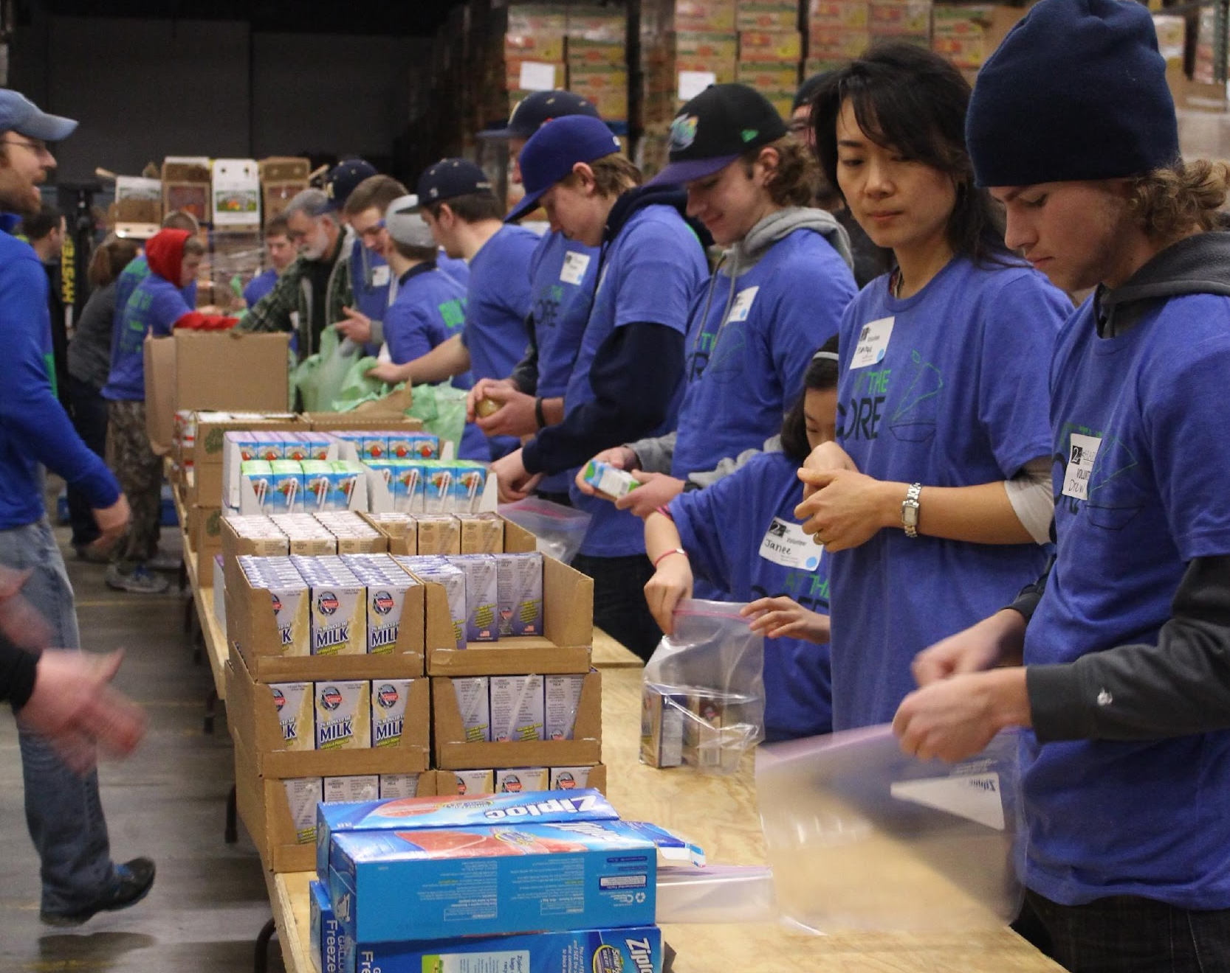
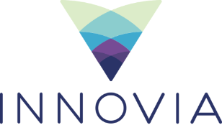
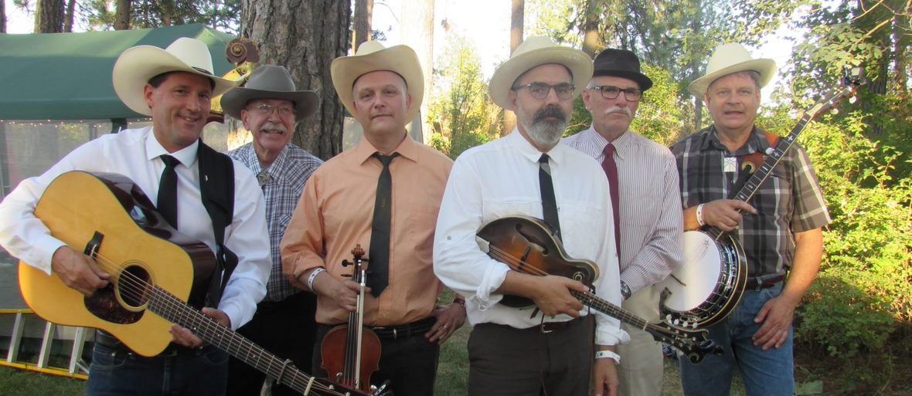
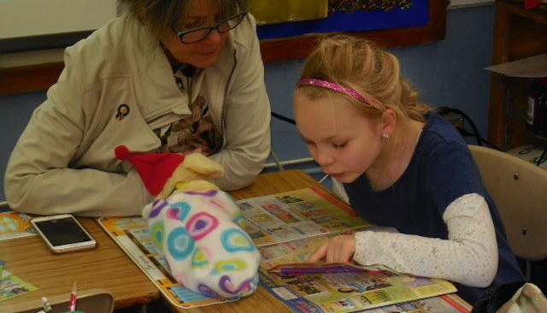
Notes:
Good afternoon. Thank you for having us here today. I’m Scott Ferguson….

Slide 2
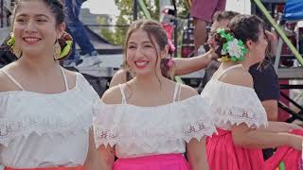
Innovia Brand Video
Notes:
Brand Video

Slide 3
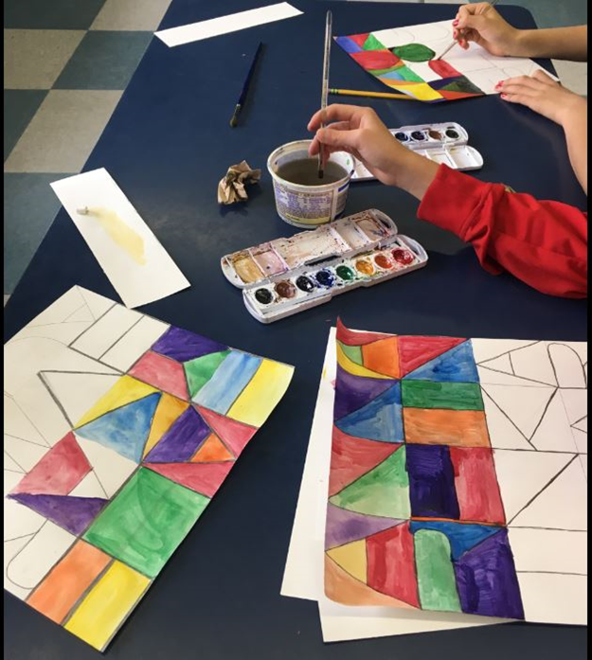
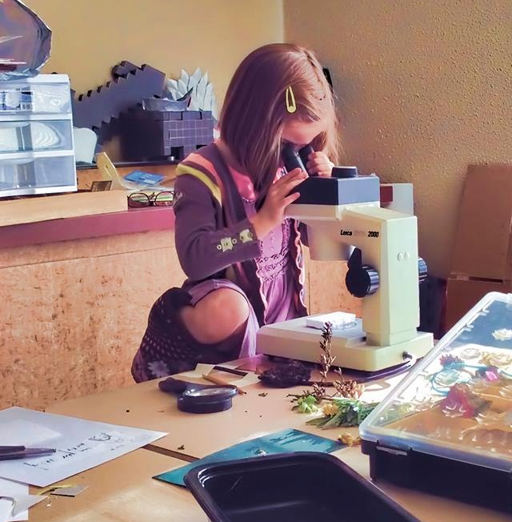
Donor Generosity 800 Funds $200 m in assets
Over 1,700 grants totaling
$10 million awarded in 2023
Notes:
Good afternoon. Thank you for having us here today. I’m Scott Ferguson….
Innovia established in 1974 - Looking forward to 50th Anniversary
Since then… $125 million throughout our 20-counties and beyond.
Thanks to the generosity of community minded donors throughout our region, We currently hold 800 funds representing $200 million in assets.
In our last fiscal year, we awarded 1,700 grants totaling $10 million in grants and scholarships.
Variety of program areas: Being a community foundation, our grants cover a broad range of impact areas: Health and Well being; education and youth development, economic opportunity, arts and culture and quality of life.
Here today to provide some context about how grant dollars are distributed through the foundation to support so many great causes and organizations

Slide 4
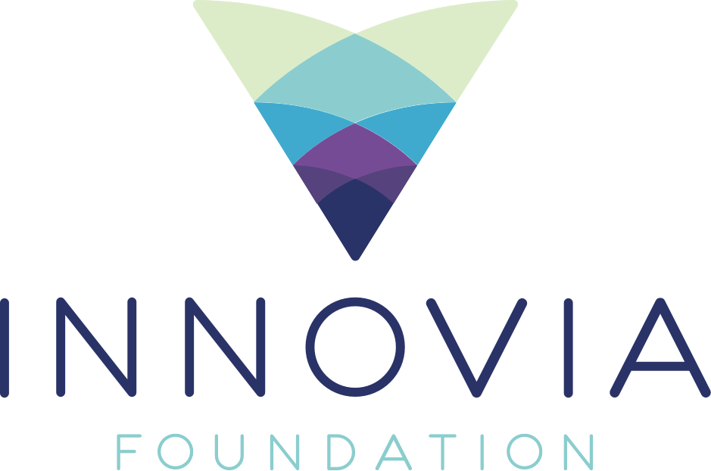
Community Grants
Notes:
Community Grants
The Community Grants Program is Innovia’s flagship grant program, funding all five of our impact areas across our 20-county service region. Comprised of approximately 90 pooled funds, this program awards $1 million each year. The maximum grant award is typically $15,000, with most grants averaging $10,000 for a one-year period
Ex- City of Troy
Ex- City of Cottonwood
Ex-

Slide 5
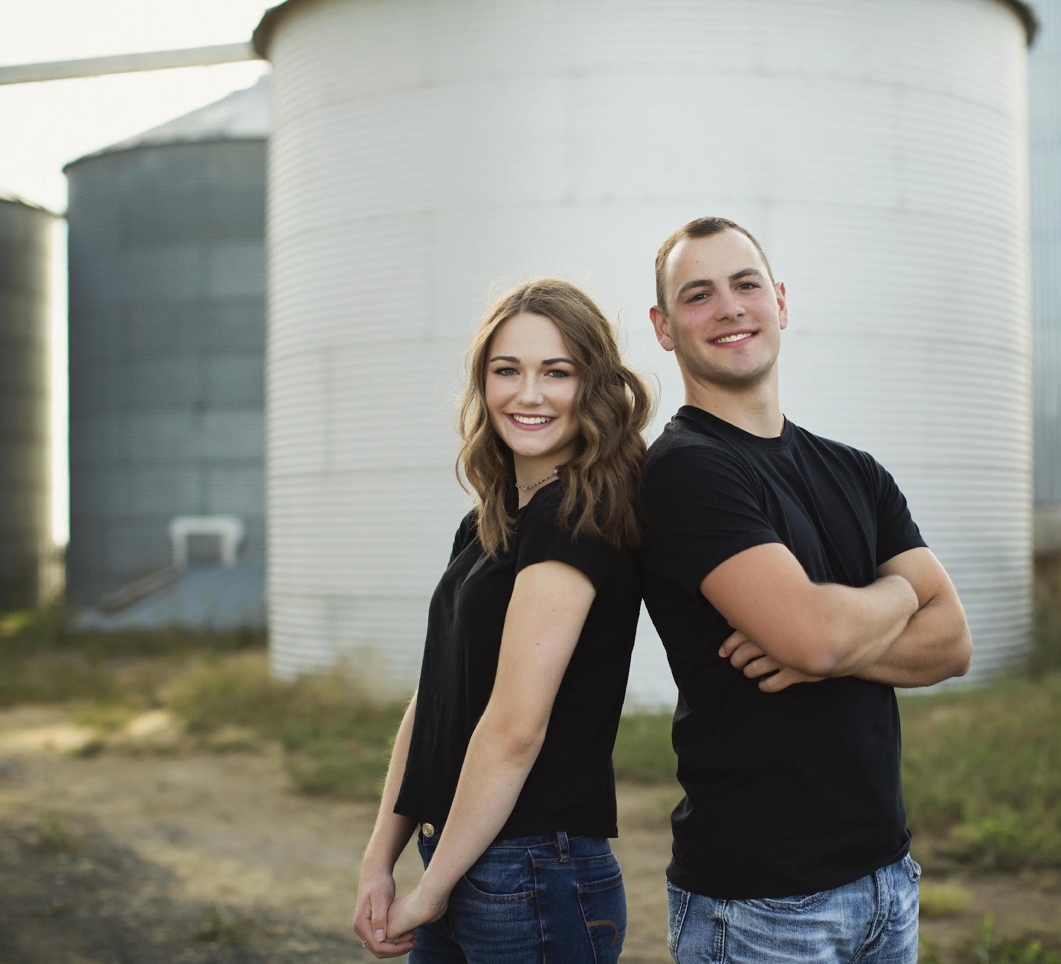
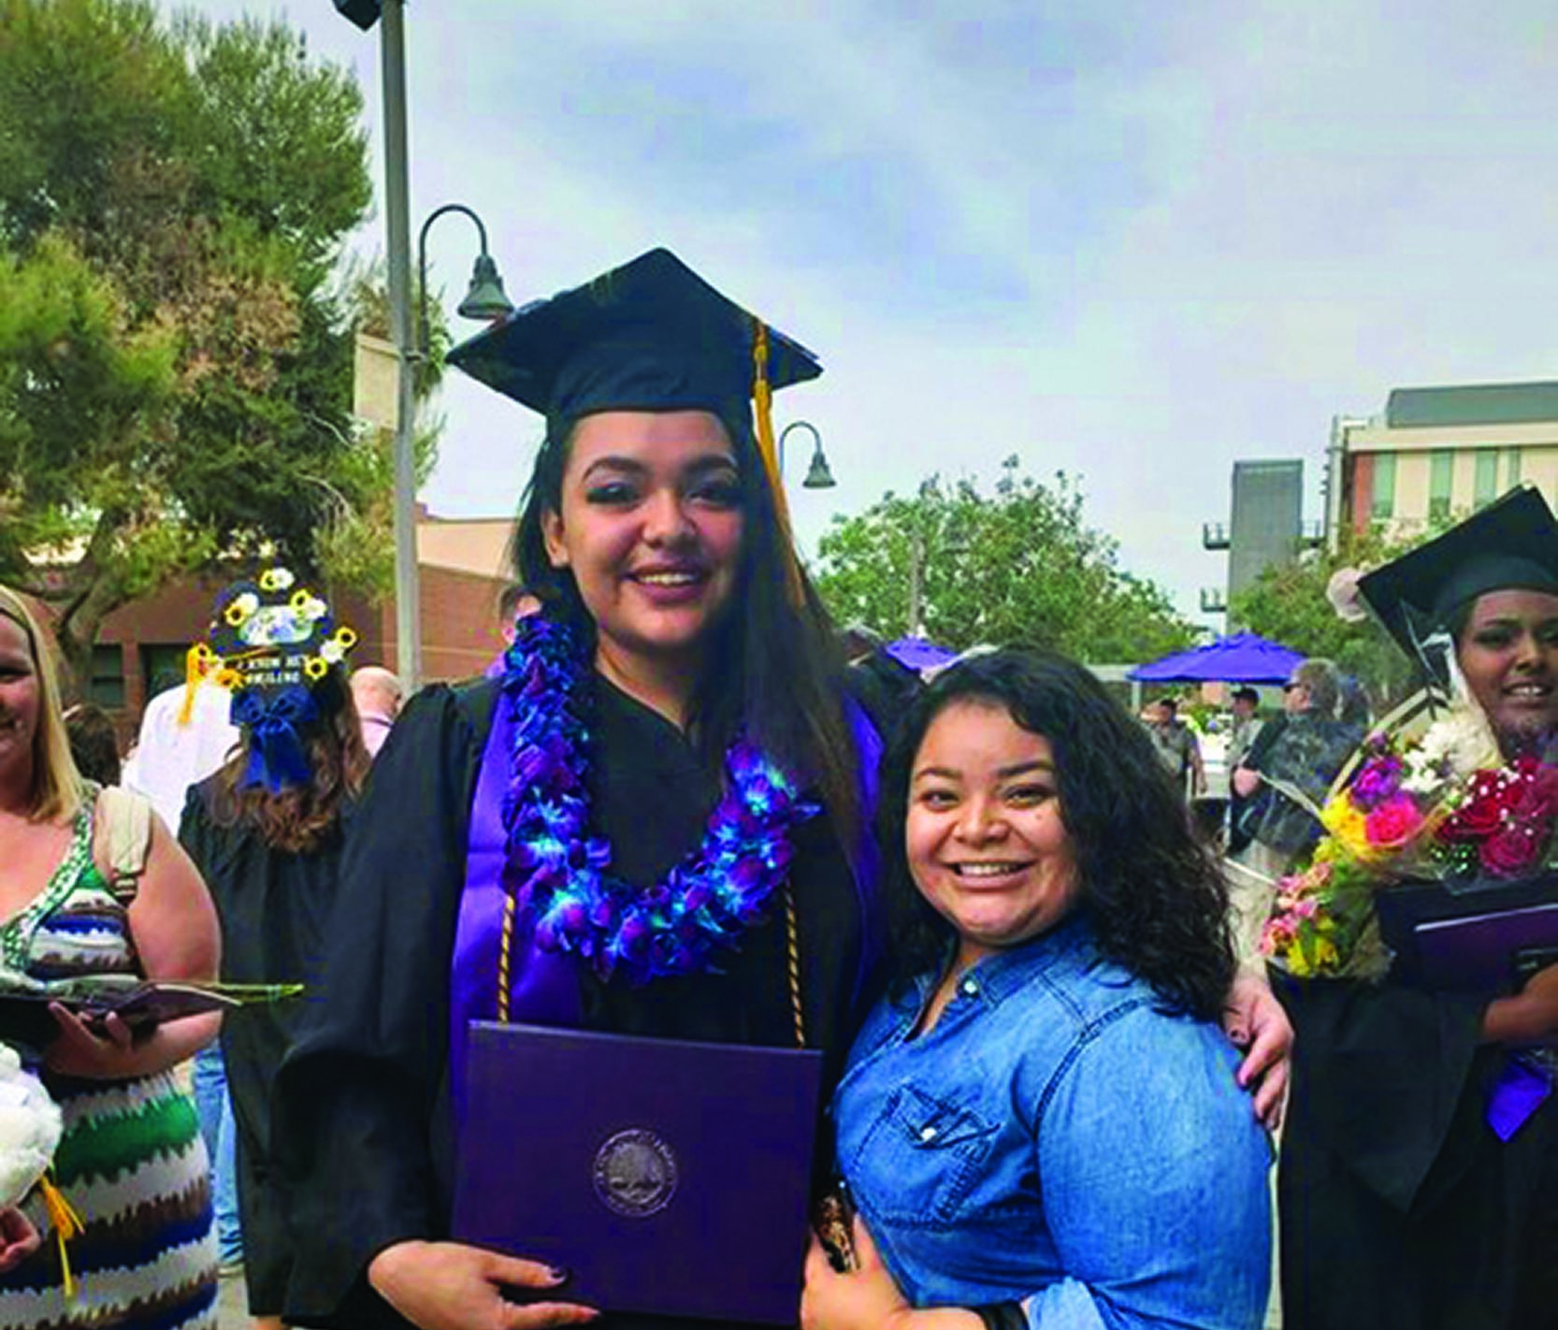
Scholarships
Notes:
Scholarship Programs at Innovia Foundation recognize that with education comes opportunity. Our donors agree. We work with donors to establish scholarships to help students achieve their higher education goals. Each year, we award more than 100 scholarships to deserving students who are college-bound or pursuing career training.

Slide 6
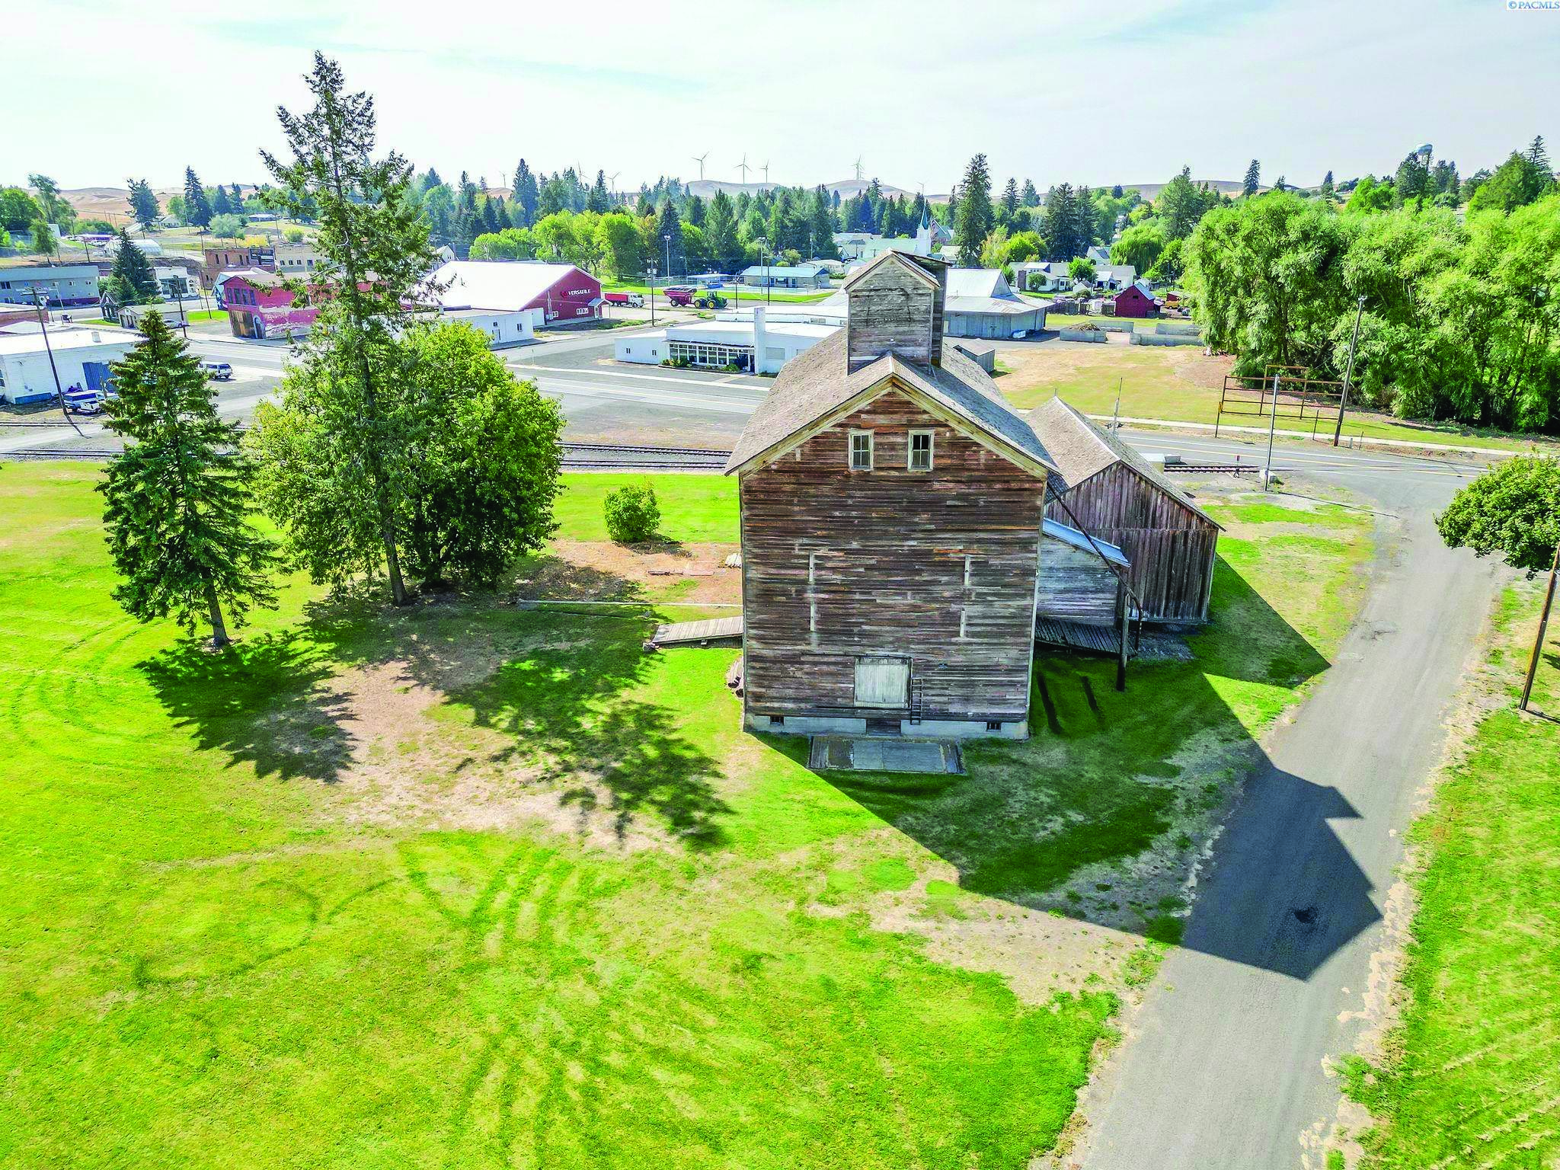
Community Initiatives
Oakesdale Old Mill Match
$120,000 matching challenge to acquire the JC Barron Flour Mill in Oakesdale, WA

Slide 7
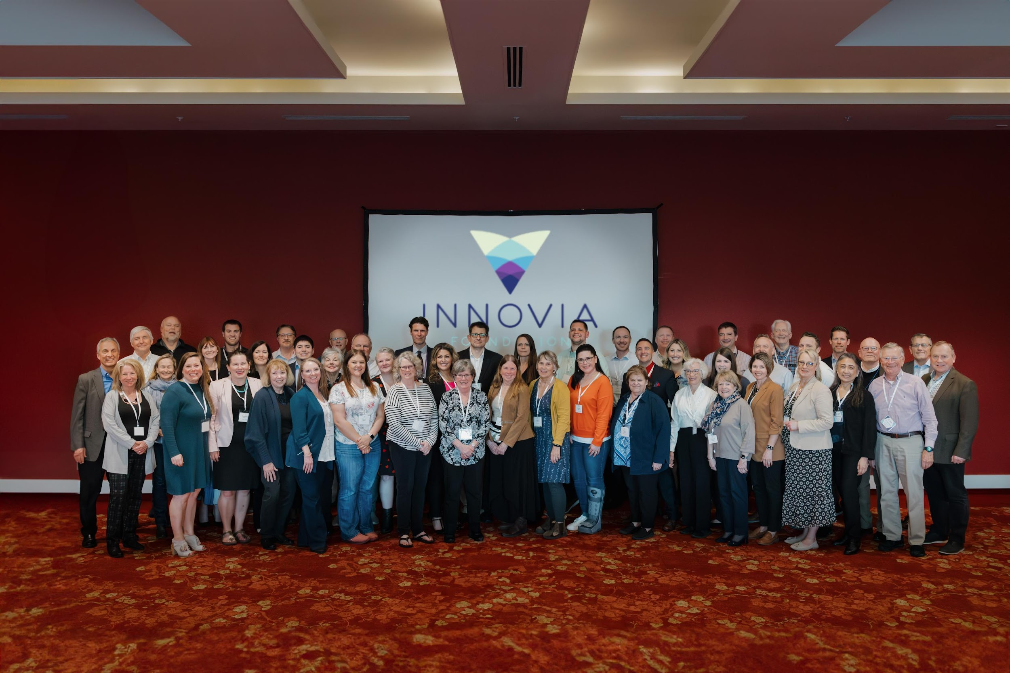
Community Initiatives Slide 2
Need slide of picture leadership council
Notes:
Community Initiatives
Community Heart & Soul
Overview
Resident-driven process engaging the entire population of a town.
Identifies what residents love about their community and their vision for the future.
Key Components
Focuses on community values, aspirations, and actionable steps to achieve desired outcomes.
Builds stronger, more connected communities through shared goals and collaborative efforts.
Benefits
Strengthens community bonds and fosters a sense of belonging.
Creates a unified vision for the future, driven by the residents themselves.
Innovia Foundation Leadership Councils
Role and Purpose
Leadership Council members act as ambassadors and advisors throughout Innovia Foundation’s 20-county region.
Advocate for philanthropic investments in local communities.
Impact
Strengthens community ties and enhances the effectiveness of local philanthropic efforts.
Ensures that community needs and priorities are addressed through targeted investments.
Rural Launch NW
Introduction
LaunchNW is a community-driven mission aimed at creating sustainable change.
Initially implemented in Spokane County, now expanding to rural communities in the 10 Eastern Washington counties.
Grant Funding
Rural communities can apply for funding to bring LaunchNW to their regions.
Grants aim to support local initiatives that align with LaunchNW’s objectives.
Community Engagement
Galvanizes local leaders and partners with every community sector.
Focuses on collaborative efforts to drive measurable, long-term change.
Impact and Vision
Aims to generate sustainable improvements for generations.
Emphasizes community involvement and leadership.
Wildfire Response
When wildfires raced through Whitman County, engulfing Malden and Pine City in September 2020, Innovia established the Pine Creek Fund where generous donors could support rebuilding homes and community infrastructure. Wildfires in Spokane County in August 2023 destroyed 369 homes – more than any other fire in Washington state history. Again, Innovia and generous donors partnered to establish response and recovery funds with more than $1.2 million contributed. Grants to nonprofit organizations provided for critical needs like food, clothing, gas cards, propane and emergency shelter. Future distributions will support the Spokane Region Long-Term Recovery Group as it leverages additional resources to help residents recover and rebuild
Conclusion
Unified Vision
All initiatives aim to foster community engagement, sustainable development, and local leadership.
Innovia Foundation is committed to supporting the unique needs of each community within its service region.
Call to Action
Encourage active participation and support for these initiatives.
Highlight the importance of community involvement in driving meaningful change.

Slide 8
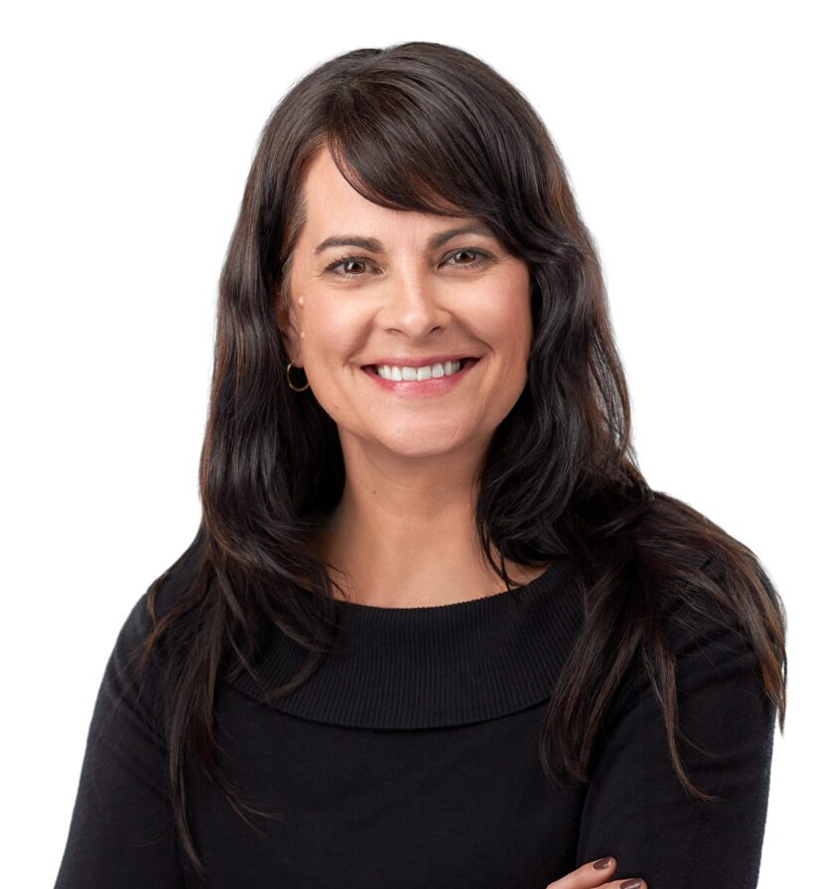
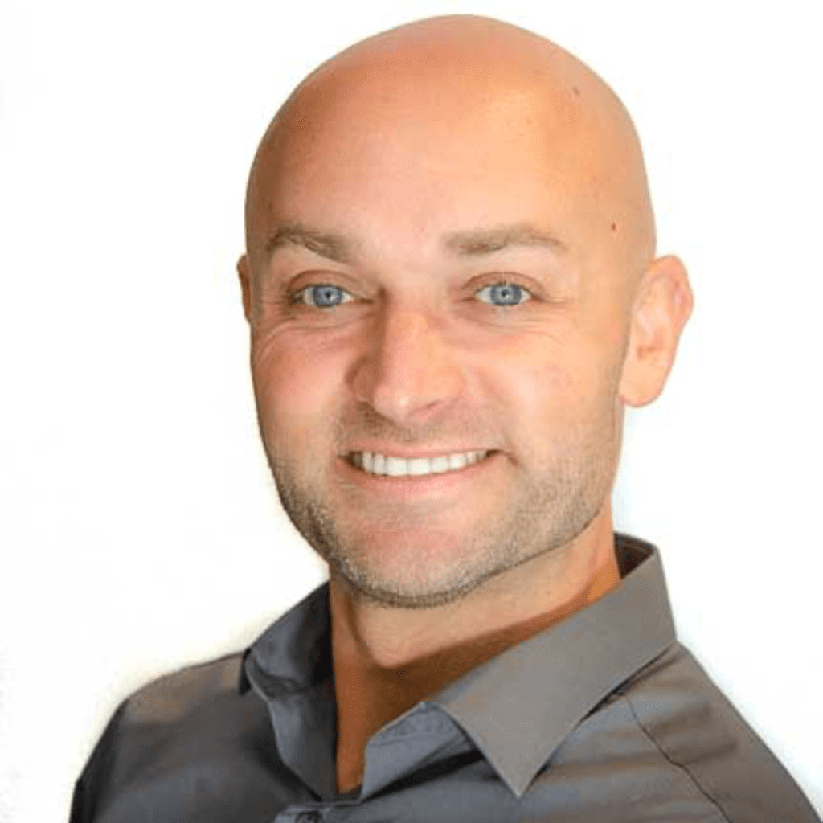
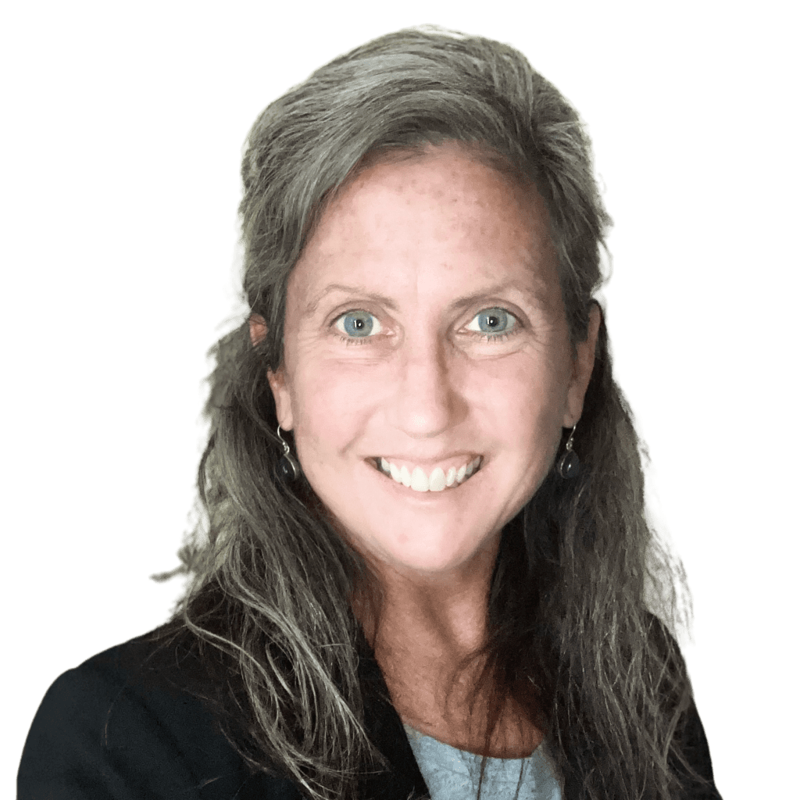
Regional Engagement Managers

