Slide 1
Introduction to Idaho Commerce
Business incentives, programs and resources that benefit companies and communities

Slide 2
Our Mission
As the lead economic development agency for the State of Idaho, the mission of the Idaho Department of Commerce is to:
Foster a business-friendly environment to aid in job creation
Support existing companies
Strengthen communities
Market Idaho

Slide 3
OUR TEAMS
Business Development Services
Rural Services
Business Attraction
Tourism
Community Development
Broadband
Marketing
Grants & Fiscal
44 Authorized Employees

Slide 4
OUR BUDGET
General Funds – $ 6.0 million
Dedicated Funds - $60 million
Federal Funds - $192 million
Total - $260 million

Slide 5
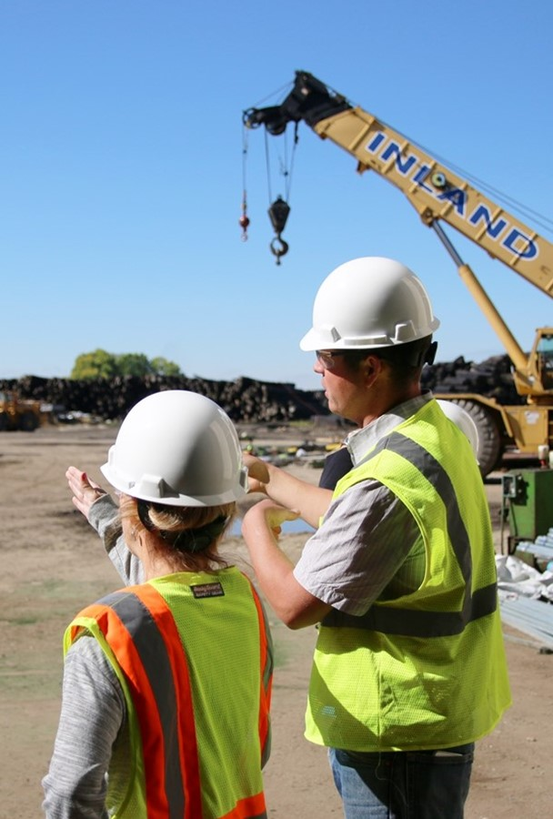
Business Development Services Part - I
Our primary role is to support companies already in Idaho
Secondary Role to help Build Industries
We make it our business to know how to help businesses
We are statewide connectors of people, resources, ideas, industries and capital
Look to us for information about workforce solutions and business incentives for Idaho companies

Slide 6
Business Development Services Part -2
Experts in developing reliable global business relationships
Export training workshops
STEP grants for companies
Financial Assistance Awards (FAA)
Idaho Online Global Marketing Program
International Trade Offices:
Asia Pacific Office
Mexico Office
Japan Office
Trade missions and trade shows
Rural Export Center for market research
.

Slide 7
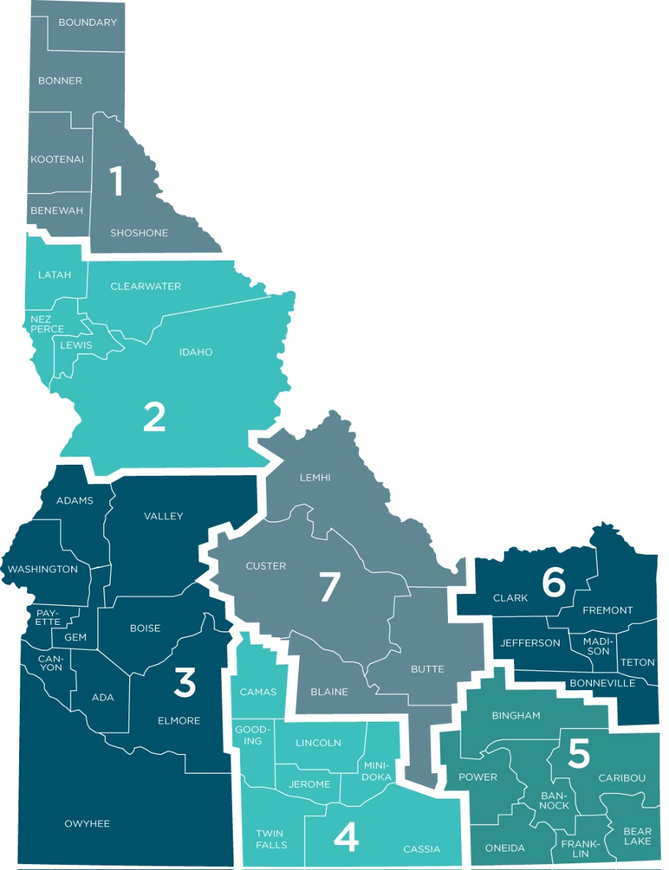
Business Development Services
Regions1- Jenny Hemly
Region 2+Valley County – Brent Haynes
Regions 3 – Tracy Day
Regions 4 & 5 – Tatum Clark
Regions 6 and 7 - Sharon Canady

Slide 8
Industry Focus
Aerospace - Jenny
Advanced Energy and Healthcare Technologies - Sharon
Food Technology and Natural Resources - Tatum
Outdoor Recreation and Defense Technology – Brent
Advanced Technology, Innovation and Entrepreneurial Ventures - Tracy

Slide 9
Rural Services
Rural Economic Development Professionals Program
Gem Grants Program.
Idaho’s Main Street Program
Northwest Community Development Institute
Private Activity Bonds
Idaho Rural Partnership
Assist with EDA ARPA Planning Grants
Placemaking
Co-ordinate State Plans and Strategies (44GO!)

Slide 10
Business Attraction Group
Consultative services to companies with an expressed interest in relocating their business to Idaho
Experts in understanding business incentives applicable to these projects and existing Idaho company expansions
Site visit coordination – virtual or boots on the ground
Gem State Prospector tool

Slide 11
Tourism
To increase travel and visitor expenditures throughout all of Idaho to increase tax revenues and employment
Natalie Jushinski is new manager
https://visitidaho.org/
https://commerce.idaho.gov/tourism-resources/research/

Slide 12
Broadband
Increasing connectivity for communities across the state
Households
Businesses
Libraries
Public Services
Health and Safety
https://linkupidaho-idahohub.hub.arcgis.com/

Slide 13
Community Development Block Grants (CDBG)
Public facilities infrastructure
New and rehabilitation projects
Economic development
Downtown revitalization
Economic redevelopment
Job creation
Fund activities that expand or construct new public infrastructure to support businesses creating new jobs
RCIF – Rural Community Investment Fund
Idaho Gem Grants is another potential funding source.

Slide 14
16 Partners in the Field
Rural Economic Development professionals located in communities around the state

Slide 15
Your Mission
To connect people, resources, ideas, industries, and capital for Idaho companies and communities.
Make your business to know how to help our Idaho businesses.

Slide 16
Business Incentives
Idaho Tax Reimbursement Incentive (TRI)
Idaho Business Advantage
3% Investment Tax Credit
Property Tax Exemption
Employer Tax Credit - 529 College
Workforce Development Training Fund
Data Center Sales Tax Exemption
Idaho Semiconductors for America Act

Slide 17
ASSISTANCE
Funding options
Workforce solutions
Supply chain sourcing
Infrastructure issues
Other questions and concerns
Introductions and referrals
https://business.idaho.gov

Slide 18
Other Incentives
Research and Development (R&D) Tax Credits
Workforce Opportunity Tax Credit
Hiring from target groups with significant barriers to employment (veterans, voc. rehab, ex-felons)
Idaho Launch - short-term training and funding opportunities
Workforce Development Council – employer & industry grants
Federal Tax Incentives for Historic Preservation
Utilities Programs for Businesses
Idaho Power
Avista Energy rebates
Rocky Mountain Power incentives

Slide 19
External Financing
Industrial Revenue Bonds (“Private Activity Bonds”)
REDIFIT – Rural Economic Development & Integrated Freight Transportation Program
Collateral Support Program for small businesses
New Markets Tax Credits

Slide 20
Client Cues: Involve Commerce
Capital expenditures - property, plant and equipment
Finding new customers/markets
Product research/commercialization/efficacy testing
Workforce decisions and needs
Infastructure needs
External financing needs
Industry connections

Slide 21
Engage With Us
commerce.idaho.gov
Idaho Commerce
@idahocommerce
Idaho Commerce

