Slide 1
Small Business Training and Education Center
Office of Economic Development & Competitiveness
Lynn Longan
Susan Herr
Small Business Team Manager
Small Business Program Manager
02/2024

Slide 2
We strengthen communities

Slide 3
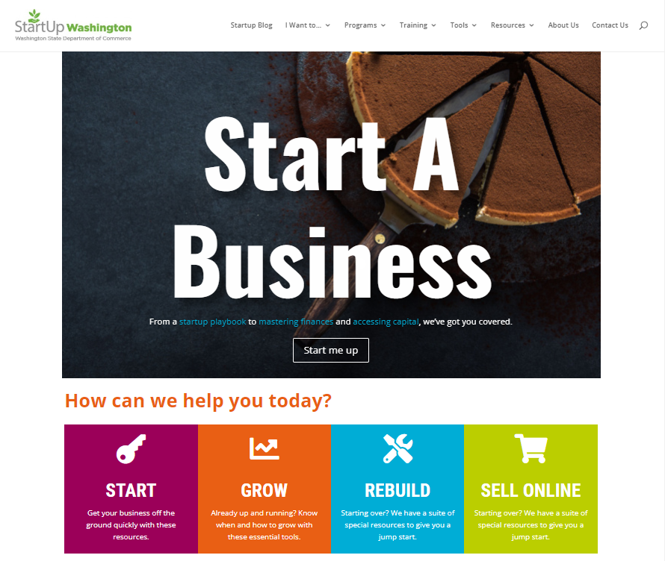
Small Business Training & Education Center
MyStartup365.com
Notes:
MyStartup365.com is the perfect place to start in your search for resources. If you can’t find what you are looking for be sure to fill out the “contact us” form in the upper right hand corner. Every inquiry comes to me and one of my team members. One of us will respond to you directly with an answer that specifically addresses your issue or question.

Slide 4
Resource Overview
6 The Startup Playbook Everything you wanted to know about starting a business but were afraid to ask.
6 SizeUp
Diagnostic tools to analyze and refine business models.
6 ScaleUp
Focused on acquiring financial mastery, gaining operational efficiencies, and seizing market share.
6 Thrive!
Designed to take second-stage companies to the next level.
6 Academies Building blocks to put your business on a solid foundation for future growth and success.
MyStartup365.com
Notes:
This is just a quick glance at some of the resources we offer. In the next few slides, I’ll list more and briefly describe them.

Slide 5
Starting a Business
Startup Playbook
SizeUp
GearUp (coming soon!)
Online Academies
Entrepreneurs
Building a Website
Creatives
Food Business Owners
MyStartup365.com
Notes:
Thinking of starting a business? I can’t think of anything more exciting! Before going to the Secretary of State I recommend you look at these resources, put together a solid plan (Visit a SBDC or SCORE counselor if you need help) and then apply for your business license. The more preplanning you do the better your chances of having long-term success and not becoming a statistic. The Startup playbook is based on the business guide at business.wa.gov. We just put it in an easy to follow, fun format. It’s not a comprehensive publication, you will still need to do your research and I do recommend the Washington Small Business Guide on business.wa.gov.
SizeUp is an online diagnostic tool to help you refine your business model, identify competitors, find suppliers, develop advertising strategies and more. You can run various scenarios, comparing your business to others in the area to see how your pricing, staffing, revenue projections and marketing strategies stack up, complete with local, regional, state and U.S. data comparisons.
GearUp will be a new program that is geared towards tourism related businesses.
The first online academy was developed in 2020, right in the throes of the pandemic and the shutdowns. It was inspired by MasterClass. Since then we’ve built more academies and made them specific to different industries such as the creative arts. Exciting news, just released is the food biz academy.

Slide 6
Growing Your Business
ScaleUp
Thrive!
CEO Roundtables
Entrepreneur in Residence
Export Vouchers
Mastering Financials
Disaster Planner
MyStartup365.com
Notes:
ScaleUp Business Training was designed to help established businesses increase profitability, build capacity, and spur growth. ScaleUp is a flexible time commitment and is delivered online through the ScaleUp online learning environment, live training sessions with roundtable discussion, and weekly Study Hall mentorship hours. This program is most beneficial for established business owners, with two or more years’ experience owning and operating a small business, and are currently based in Washington state. This program which normally costs $1,599 is currently provided at no cost to Washington State businesses through June 30, 2025, thanks to ongoing support from the Washington Department of Commerce.
For companies that are a bit more established, we call them second stage businesses, we offer the Thrive! program.
Private, for-profit companies that have been operating in a Washington State community for at least two years.
Employ between 6 and 99 employees.
Have both an appetite and aptitude to grow.
Provide products and services beyond the local area.
Thrive! is designed to take second-stage companies to the next level. At this stage of growth, businesses often experience internal and external roadblocks to that keep them from growing larger or more profitable, such as those related to human resources, operations, finances, marketing, competition or new markets. Companies that are accepted into the Thrive! program work with a team of national experts to explore the most pressing issues, using data, best practices and research tools that are usually only made available to the largest corporations. This actionable information helps CEOs make informed decisions about their businesses, allowing them to overcome roadblocks that historically, lead to 15 to 30% growth in revenue. There is a nominal fee for this program, but the Department of Commerce pays a portion of the cost.
CEO Roundtables
Entrepreneur in Residence
Export Vouchers - Qualifying small businesses in Washington State can be reimbursed up to $5,000 for export-related activities, including trade show and trade mission fees, travel, interpreter and translation services, training, international certifications and more.

Slide 7
Restarting Your Business
Restart Academy
SizeUp
Workspaces
Property and Site Search
MyStartup365.com
Notes:
Shortly after the shutdowns of the pandemic we realized that many small businesses were struggling to rebuild or even restart. Again, like the other academies, we developed the “restart academy”. These are some other resources we believe can help a business through their restart or rebuild phase.

Slide 8
Strengthening communities…together
SBA
Other Commerce Divisions
SBDCs
ADOs
Chambers
OEDC
WEDA
Other State Agencies
SCORE Offices
New Players
Non-Profits
WSMA
The Unknowns
Ports
Philanthropy
MBDA
Foundations
SBRN
City/County ED Offices
CDFIs
MyStartup365.com
Notes:
This is a diagram that helps us to understand all of the partners we work with in the Office of Economic Development and Competitiveness. It starts in the middle with OEDC and layered is our Associate Development Organizations (usually the Economic Development Councils, but sometimes the chamber or a port district). Each county has an ADO and that organization is appointed by the county commissioners. We at OEDC contract with them to do economic development in their respective counties. Then we work outward from there and you can see all of the organizations that we also work with. I know there are a lot of acronyms, but how can I say I’m a state employee if I don’t spew acronyms? I’m happy to help you with any of them if you would like…

Slide 9
Wondering what’s in it for you?
MyStartup365.com

Slide 10
MyStartup365.com
Lynn Longan
Small Business Team Manager
Lynn.Longan@commerce.wa.gov
(360) 490-1950
Susan Herr
Small Business Program Manager
Susan.Herr@commerce.wa.gov
(509) 220-6048

