Slide 1
What’s New in Energy Efficiency at Avista
July 24, 2024 | Presentation to the Inland Northwest Partners
By Renee Zimmerman, Energy Efficiency & Outreach Program Manager

Slide 2
Topics
Direct Install Lighting for Small Businesses
Business Partner Program
Energy Smart Loans (WA & OR)

Slide 3
Direct Install Lighting: Small Businesses
Customers Receive:
On-site visit by one of our lighting partners to identify potential lighting upgrades”
A detailed report of LED lamps, fixtures, and controls upgrade recommendations
Up to 100% off project costs on your professionally installed lighting equipment

Slide 4
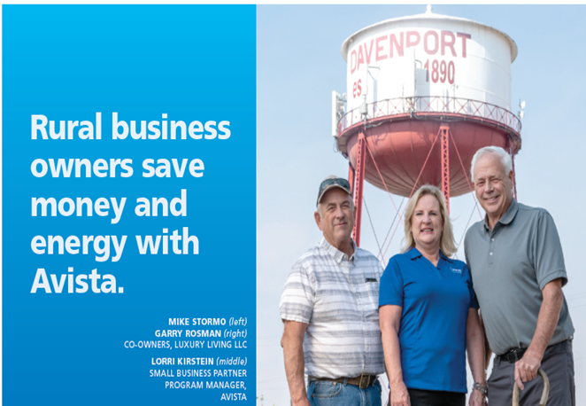
Business Partner Program
Program Highlight
Outreach effort designed to target Avista’s small business customers in WA and ID
Bring awareness of programs and services that can assist customers in managing their utility bill.
Topics
Energy Efficiency Rebates
Trade Ally Bid Assistance
Loan Program (WA only)
Direct Install Lighting
EV Charging Stations (WA only)

Slide 5
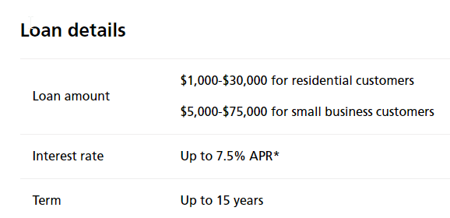
Energy Smart Loans (WA & OR)
Process
Customers work directly with PSCCU for the approval process and on bill repayment
Questions answered by PSCCU at 800.273.1550 or askus@psccu.org”
Once funded, loan payment will be added to the customer’s Avista bill.
Example: | $15,000 loan at 7.50% APR 180 payments $139.05 per month

Slide 6
Clean Energy Solutions
Inland Northwest Partners
Rendall Farley, P.E.
July 24th, 2024
Notes:
I’m going to talk a bit this morning about the exciting future of energy, the things we’re doing now and the opportunities ahead

Slide 7
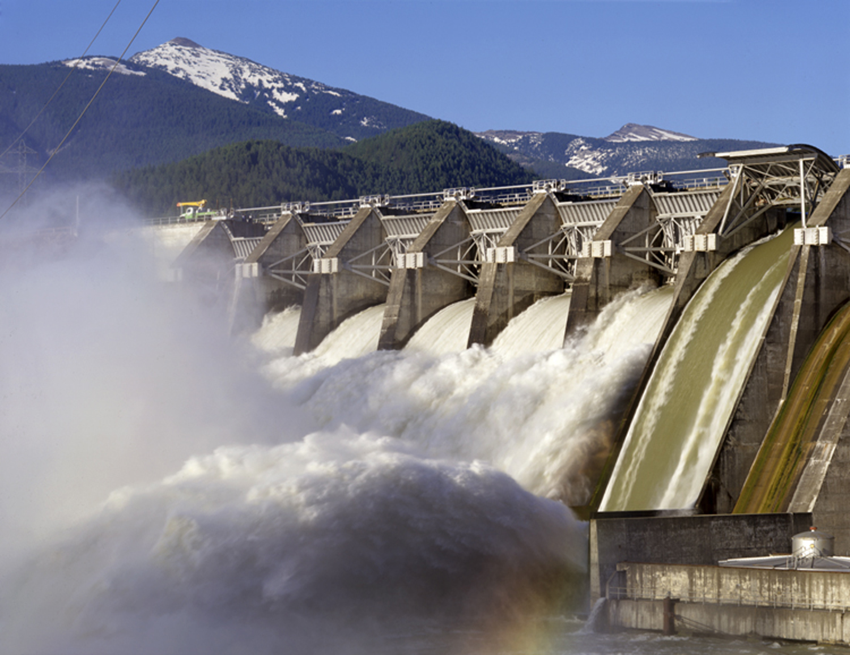
The future of energy is reliable & affordable
Notes:
Because the future of energy is not only reliable and affordable, as we’ve known it for many decades

Slide 8
The future is sustainable
Notes:
It’s sustainable, using more local and renewable sources of power

Slide 9
And – the future is electric!
Notes:
And at least in the case of transportation, it’s electric – and this is exciting!
Let’s dive a bit deeper now into transportation . . .

Slide 10
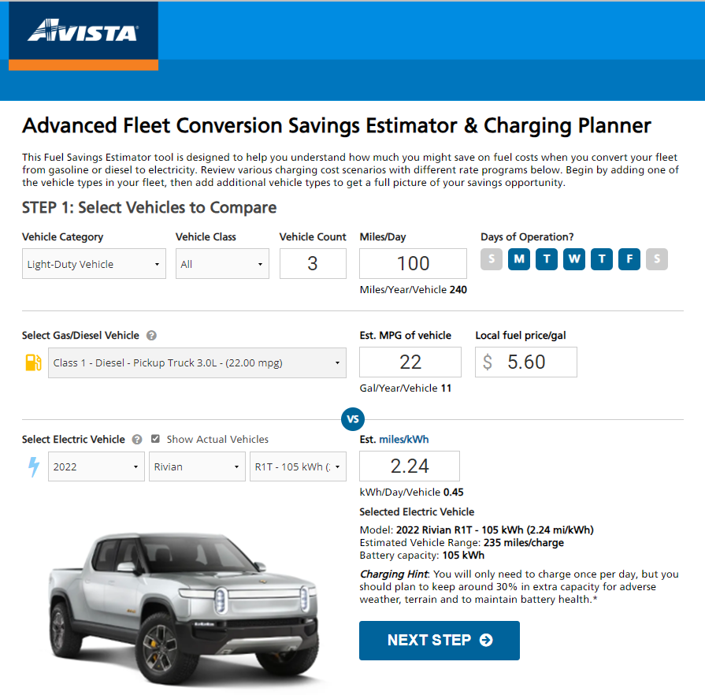
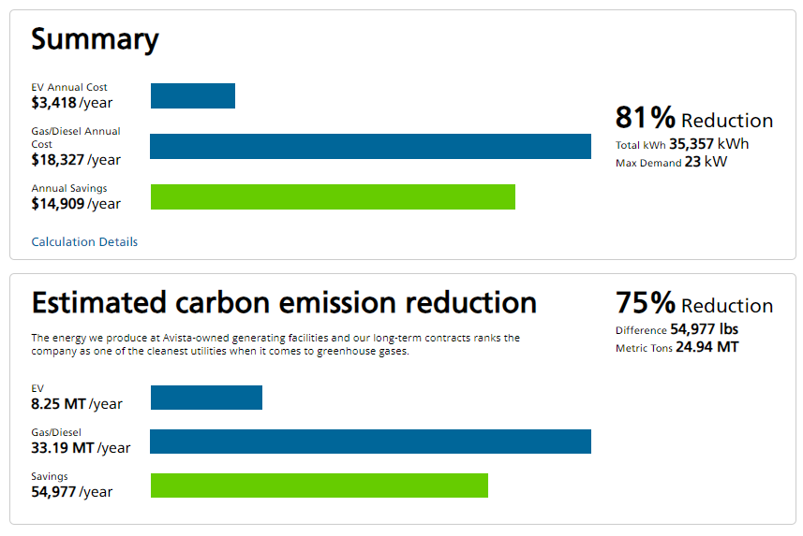
Electric Transportation – a better energy future
Check out our website for information and tools at: myavista.com/transportation
$1/gallon equivalent fuel cost → $1 billion in annual fuel savings for region
Downward rate pressure (flexible loads, better utilizing the grid)
80% carbon emission reductions, 100% local air pollution reduction (zero tailpipe emissions)
Advanced Vehicle-Grid Integration (VGI) opportunities
Notes:
The transition to electric transportation is in the early stages of accelerating growth. This is a major global phenomena that’s going to change the way we live. For the better – because it’s really about a better energy future, where you can reliably move people and goods at lower cost, with much lower pollution, and sustainably using local, clean energy sources.
$1 billion in annual fuel savings for our customers if light-duty vehicles electrified, even more with other forms of transport
Charging is a flexible load, providing beneficial revenue to help keep rates affordable
Transportation is the largest source of greenhouse gas emissions – and will be deeply decarbonized – a shift to electric transportation results in 80% carbon emissions reductions overall, 100% reduction local air pollution (zero tailpipe emissions)
The transition will pickup and accelerate due to another factor as well – electric equipment and vehicles are a better operator experience!
The utility can help customers evaluate their options and make good decisions in a number of ways, and in so doing help all customers that use the grid. This can be as simple as providing good information on our website, including easy to use cost-benefit tools, to more advanced consulting and programs to help customers for example, install low-cost and reliable charging for their business needs – whether that be for their employees, their tenants, the public, or their own fleet vehicles. TOU rates help influence beneficial behavior and save customers money on their electric bills, while reducing peak loads that translates to benefits for all customers.
Another way we can provide value is in targeted rural and non-profit programs to extend benefits to communities and low-income customers.
We’ve been doing these things and many more now according to a strategic plan for several years and are doing our part to accelerate beneficial electrification in a cost-effective way.
If interested check out our website to learn more and give us a call or email if you have any questions or suggestions.

Slide 11
Renewables & Storage Solutions – emerging opportunities
Check out our website for information and tools at: myavista.com – go solar
How might scalable distributed energy resources (DERs) provide:
Greater resiliency
More renewable energy
Community and low-income benefits
How might we partner with customers and communities to achieve shared goals?
Notes:
When it comes to renewables like rooftop solar, a lot of people are interested and want to figure out if it makes sense for their home or business. We’ve got a free solar estimator tool that helps customers get to the facts and make a good decision – something that they’re not always provided by solar developers and contractors that are trying to sell their products.
Increasingly in the future, we expect the performance and costs of batteries of various sizes to become better and better. How might we start to travel down the path where we partner with customers to get onsite solar, wind or other renewable energy sources paired up with battery storage in such a way the the grid is more resilient and effective or optimized – that enables more renewable energy over longer time periods – and that can provide new community and low-income benefits?
How might we design programs to partner with customers and communities to achieve shared goals? That’s what it comes down to, and we’re working hard to innovate and walk that path.

Slide 12
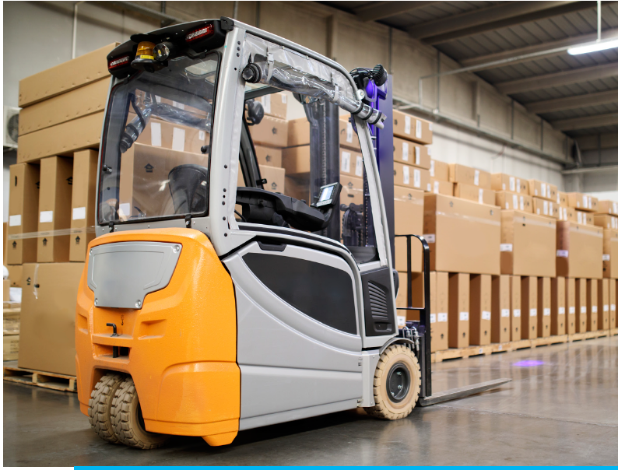
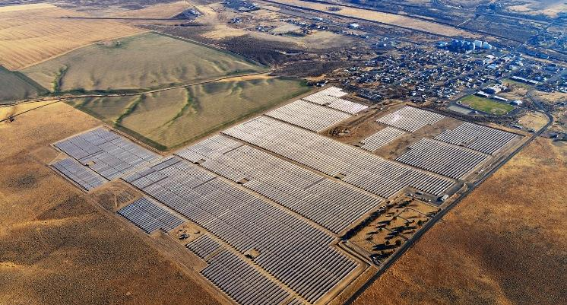
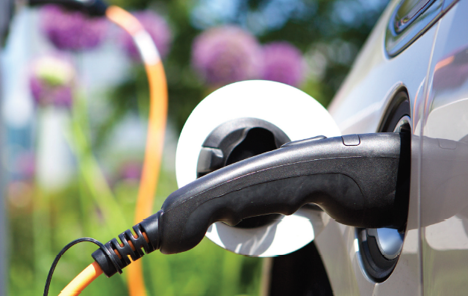
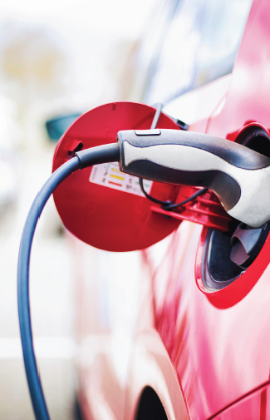
Clean Energy Solutions
Help customers discover what works best for them - low-hassle, cost-effective solutions - based on solid experience and best practices
Leverage programs to benefit all customers and communities
Look for partnerships and opportunities that will make a long-term difference
28MW “Solar Select” Community Solar Array in Lind, WA (2018)
Notes:
In the future there are a number of other products and services we can develop in-step with new technologies and market opportunities – what our customers need and want – for example energy management systems that communicate intelligently with the grid and help optimize energy use, virtual power plants, and vehicle-grid integration.
In all cases the basic principles of what we’re shooting for are consistent:
Help customers make good decisions for themselves with facts and intelligence, offer programs that achieve very high customer satisfaction, and leverage those programs so that all customers benefit – because we all share the common utility grid resources and can work together to use them most wisely and cost-effectively. In many cases, the utility can’t do that alone and must find partnerships to make things happen.

Slide 13
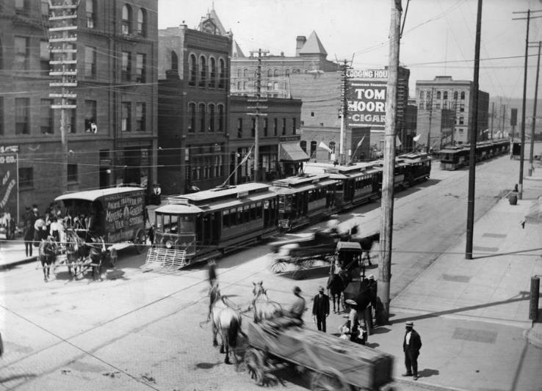
Our vision of the shared energy system is: Reliable. Affordable. Sustainable. And Electric! Let’s build a better energy future – together
Electric Trolley Streetcars in Downtown Spokane (ca. 1900)
Check out our website at myavista.com – save energy
Notes:
So that’s what I’d close with today, is an encouragement to everyone to get excited and think about how to make a better energy future, bit by bit, day by day we can do this – together.

Slide 14
Electric Transportation – a better energy future
Source: National Renewable Energy Lab, U.S Greenhouse gas emissions (2019)
Notes:
The transition to electric transportation is in the early stages of accelerating growth. This is a major global phenomena that is going to change the way we live. For the better – because it’s really about a better energy future, where you can reliably move people and goods at lower cost, with much lower pollution, and using local, clean energy sources.
Transportation is the largest source of greenhouse gas emissions – and will be deeply decarbonized
A shift to electric transportation results in 80% carbon emissions reductions overall, 100% reduction local air pollution (zero tailpipe emissions)
$1 billion in annual fuel savings for our customers if light-duty vehicles electrified, even more with other forms of transport
Charging is a flexible load, providing beneficial revenue to help keep rates affordable
The transition will pickup and accelerate due to another factor as well – electric equipment and vehicles are a better operator experience!

Slide 15
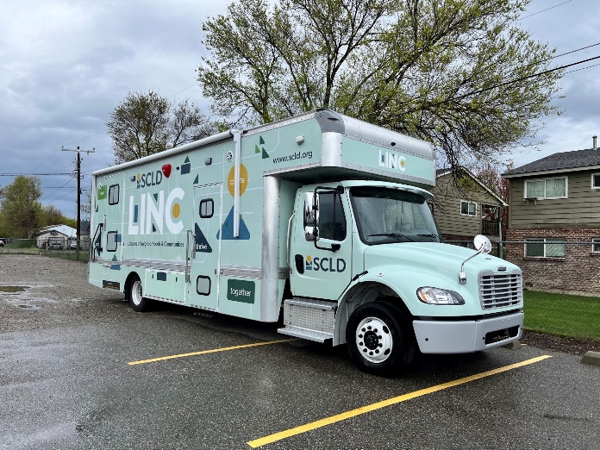
Community-Based Organization (CBO) Partnerships
Providing Community-based Organizations (CBOs) with EVs and charging
10 active partnerships to-date
Soliciting proposals for 2024
Prioritize EV charging in named communities and small rural towns; community centers, & libraries
Support electric school bus grants and charging infrastructure
CBI: 896 trips provided by CBO partners in 2022
Notes:
IRC, SNAP, and TEDD added to existing 7 CBOs from previous years, for a total of 10
Transitions
SRHD
Asotin Co. Health District
Rural Resources
Whitman Community Action Center (CAC)
Compassionate Addiction Treatment
COAST Public Transportation
Annual reports and feedback are provided by the CBO, including narratives such as the following example from Compassionate Addiction Treatment in Spokane: “The electric vehicle we received has improved our team's ability to transport individuals experiencing homelessness to a variety of appointments and needs. Team members that do not have adequate transportation are now able to provide transportation, which has significantly increased our impact due to increased access to appointments and outings . . . Having a car for our nonprofit has also had the added benefit of decreasing the amount of mileage that we have to pay to provide necessary services. We're very grateful for this opportunity to improve our impact within our community, while also decreasing our negative footprint on the environment.”

Slide 16
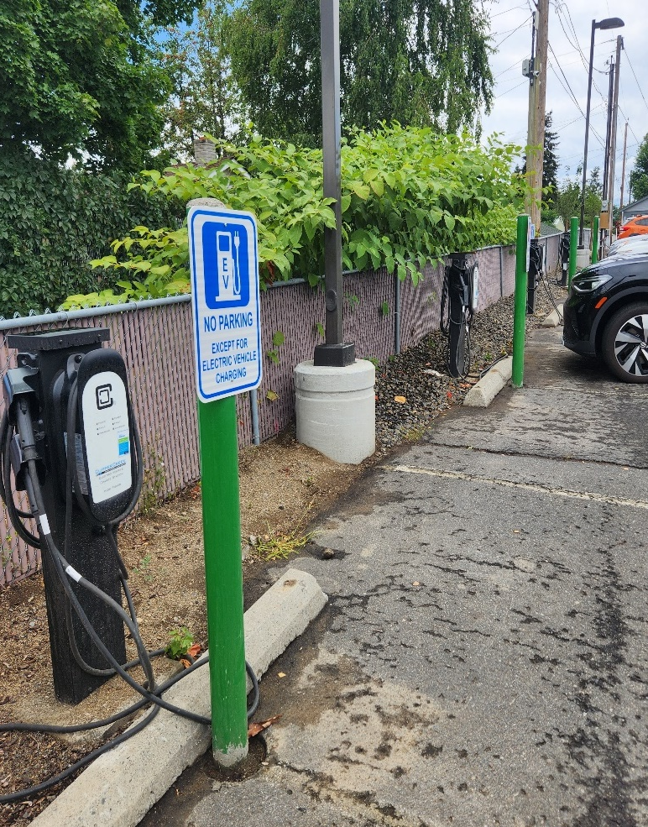
Charging Infrastructure Programs
2023 thru Dec | Commercial L2
# Ports Installed | 138
# Ports In-Service | 590
Installation Cost per Port including charger | $4,546
Lead Time | 17 weeks
Customer Satisfaction | 95%
Uptime | 95%
181 charging ports in Named Communities
No-cost installations for Community-Based Organizations (CBOs) and low-income multi-family housing
$2,000 Smart Charging program incentive for low-income residential customers

Slide 17
Public DC Fast Charging for Community Benefits
17 sites installed in Eastern Washington
12 sites (70%) in Named Communities (at Community Centers, Libraries, Rural Towns, etc)
Enables clean and affordable ridesharing innovations for communities
180kW DCFC at The HIVE in Spokane, WA – expandable to 1MW
See the regional charging buildout plan at: myavista.com/transportation
Send your questions and suggestions to: electrictransportation@avistacorp.com

Slide 18
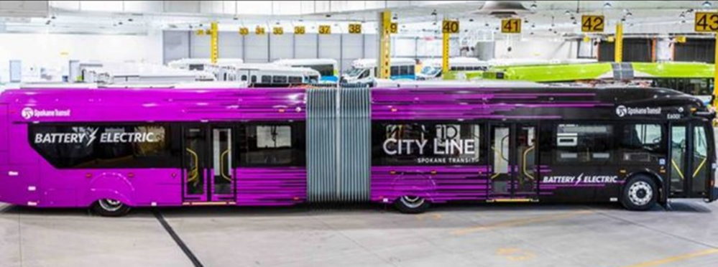
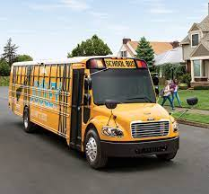
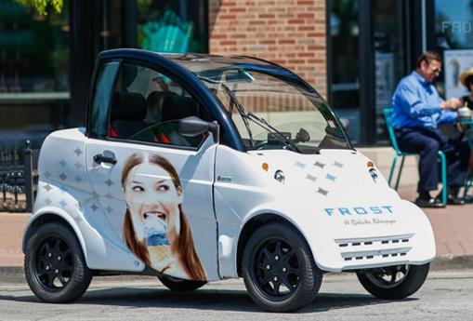
Growing Opportunities
Transit Buses and Shuttles
Ride Hailing
Car/Ride-Share & Micro-mobility
School Buses
Notes:
Ride hailing, ride sharing and car sharing all have great potential to serve MUDs with a higher percentage of low-income tenants, where adequate and convenient transportation is often a problem.
The business model for ride and car sharing is not well established. Many tenants in need do not have driver’s licenses, adequate insurance, or good driving records.
More entities involved in affordable housing, like Habitat for Humanity will be engaged and solicited for proposals as part of our ongoing CBO partnership efforts.
New platforms and business models such as Innova are worth exploring and demonstrating.
Helping a community member become an EV driver for Lyft, working on their own part-time in a flexible way, providing discounted rides to community members in need is another innovative idea worth pursuing.

Slide 19
Bill Assistance Overview
Inland Northwest Partners | July 2024
Notes:
PROGRAMS FOR COMMUNITY INVESTMENT

Slide 20
What is Bill Assistance?
Energy Burden is the percentage of household income that goes towards energy costs
High energy burden= >6%
Severe energy burden= >10%
Most forms of bill assistance are aimed at reducing energy burden to ≤6%
Bill assistance aims to reduce the energy burden of limited-income households
Result: Improved Affordability!
Notes:
I think it's important to understand what bill assistance is, and perhaps more importantly, what it aims to achieve

Slide 21
Bill Assistance at Avista: Goals & Purpose
Address Past-Due Balances
Provide Support During Hardships
Improve Affordability
Educate on Energy Conservation
Notes:
In addition to improved affordability, we also see bill assistance playing a few additional roles in reducing the energy burden
Avista has several different programs that fall under these categories, and those programs vary by state

Slide 22
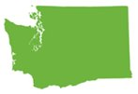
Bill Assistance Programs By State
 | Idaho | Oregon | Washington
My Energy Discount
Arrearage Assistance
Emergency Share
Project Share
Conservation Education
Low-Income Home Energy Assistance Program (Federal)
Notes:
Here's a look at which states offer which programs
My energy discount is our newest program, and it's actually relly revolutionized the bill assistance space. I'll share a bit more in the next few slides about that program.
We have two programs that fall under the umbrella of "arrearage assistance" /past-due balances; each has its own eligibility criteria and parameters
Project Share is a donation-based program that Avista employees and customers can contribute to. Avista really serves as a pass through for those funds - we pass 100% of them on to Community Action Agencies to distribute to folks in their communities.
Conservation Education is that program mentioned earlier that provides tools and materials to households to help reduce their energy usage
Low-Income Home Energy Assistance Program (LIHEAP) is a federally funded program that many of our limited-income customers are eligible for. Avista doesn't fund or administer this program, but we do apply the credits that customers receive to their accounts with us and LIHEAP does make up a significant amount of the bill assistance available broadly.

Slide 23
My Energy Discount
Program Features
Discounts are based on self-declared monthly or annual income
Jointly administered between Avista and agencies – and no paperwork required!
Available to Oregon & Washington customers
Participants remain eligible for other helpful programs through their local agencies, as well as other energy assistance
6% of enrolled customers will be randomly selected to verify their income through their CAA
Customers who have received income-qualifying assistance are auto-enrolled
Notes:
This is the program that I really want to highlight (look at your rack cards!)
It has had a significant impact on the number of eligible households we’ve been able to reach with bill assistance
This program launched in October 2023 here in WA, and back in October 2022 in Oregon
Go through features
Highlight again how critical it has been to increasing enrollments

Slide 24
Bill Assistance Saturation Rate
Saturation rate equals the percentage of estimated eligible customers who are receiving any form of bill assistance.
Approximately 188,000 Avista customers are eligible for various forms of bill assistance.
Historically around 19% of eligible customers have received some form of bill assistance each year.
Estimated eligibility is determined differently in each state. In Idaho information is obtained from CAP of Idaho. In Oregon, the estimated eligible amount was obtained from Empower Dataworks’ analysis completed in March 2022. Washington’s eligible amount is derived from Avista’s Performance Based Ratemaking (PBR) Metrics and is updated annually in January.
Notes:
Saturation rate is one of our key metrics for how our bill assistance programs are doing
It is the percentage of eligible households that are enrolled, and it has historically been around 19%
By reducing barriers to access, we have seen these numbers increase significantly in a very short period of time

Slide 25
Saturation by State: 2024 (Jan-June)
Idaho
Washington
Oregon
Eligible: 29,311 customers
Customers Served: 3,380
Eligible: 141,863
Customers Served: 40,836
Eligible: 16,987
Customers Served: 10,698
Estimated eligibility is determined differently in each state. In Idaho information is obtained from CAP of Idaho. In Oregon, the estimated eligible amount was obtained from Empower Dataworks’ analysis completed in March 2022. Washington’s eligible amount is derived from Avista’s Performance Based Ratemaking (PBR) Metrics and is updated annually in January.
Notes:
Here are the results of some of those efforts by state
This really highlights the investment that Avista is making in its community – reducing energy burden is a critical way to bring vulnerable and low-income communities along in the journey to Clean Energy. I think Avista is really committed to and engaging in this work.
Thanks for your time!

Slide 26
THANK YOU!

Slide 27
Clean Energy Implementation Plan Named Communities Investment Fund July 2024 Kristine Meyer

Slide 28
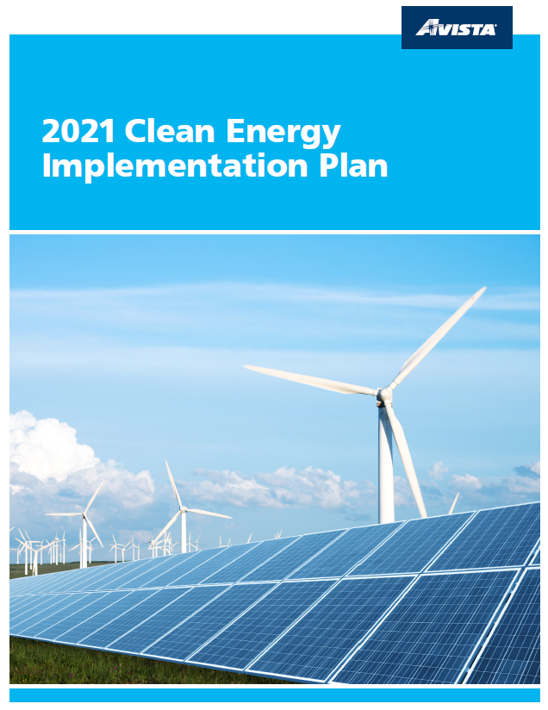
Clean Energy Transformation Act & Avista’s Implementation Plan
Clean Energy Transformation Act (CETA), Senate Bill 5116 passed by legislature in 2019
Applies to all WA electric utilities
Specific milestones to achieve 100% clean energy supply by 2045
Avista’s Plan for progressing towards the clean energy requirements of the Clean Energy Transformation Act (CETA)
Identifies interim and specific targets and actions to demonstrate progress towards goals and Customer Benefit Indicators (CBIs)
Approved by Washington Utilities & Transportation Commission in June 2022

Slide 29
CEIP Specific Actions & Targets
Pursuing all cost-effective, reliable, and feasible conservation, efficiency and demand response resources;
Maintaining and protecting the safety and reliability of the electric system; and
Ensuring that all customers are benefiting from the transition to clean energy through:
(i) the equitable distribution of energy and nonenergy benefits and reduction of burdens to Vulnerable Populations and Highly Impacted Communities (Named Communities);
(ii) long-term and short-term public health and environmental benefits and reduction of costs and risks; and
(iii) energy security and resiliency.

Slide 30
Equity in CETA
The heart of equity work in CETA is ensuring that all customers are benefiting from the transition to clean energy, with special emphasis placed on “highly impacted communities” and “vulnerable populations” = Named Communities
Vulnerable Populations
Communities that experience a disproportionate cumulative risk from environmental factors (such as unemployment, high housing costs); and sensitivity factors such as low birth weight and higher rates of hospitalization
Highly Impacted Communities
A community designated by the Department of Health based on the cumulative impacts analysis required by RCW 19.405.140 or a community located in census tracts that are fully or partially on “Indian Country” as defined in 18 U.S.C. Sec. 1151
Clean | Affordable | Reliable | Equitable
Utilities must use the cumulative impacts assessment (CIA) developed by the DOH to “designate the communities highly impacted by fossil fuel pollution and climate change in Washington”

Slide 31
Avista’s Named Communities
Specific Target and Actions for ensuring that all customers are benefiting from the transition to clean energy the equitable distribution of energy and nonenergy benefits and reduction of burdens to Vulnerable Populations and Highly Impacted Communities (Named Communities)
Vulnerable Populations
Highly Impacted Communities
142 census tracts in Avista’s service territory
36 Health Disparities
12 Socioeconomic or sensitive populations indicators

Slide 32
Named Communities Investment Fund
$2M
Supplement Energy Efficiency
$1M
Investments in Distribution Resiliency
$1M
Incentives & Grants
for customers or third parties
$500,000
Outreach & Engagement
$500,000
Other Projects, Programs or Initiatives
Specific Action dedicated to the equitable distribution of energy and non-energy benefits and reduction in burdens to Named Communities
Funding is limited to 1% or approximately $5.0 million of electric revenues, annually

Slide 33
Factors for NCIF Consideration: Equity Assured
Equity
Affordability
Implementation Plan Specific Actions
Community Identified Project
Customer Benefit Indicators
(1) Participation in Company Programs
Equity Advisory Group Initiatives
Energy Efficiency in Named Communities
(1) Improved awareness and energy efficiency for Spokane Tribe, multi-family and manufactured homes
(2) Increased Tree Canopy
(3)Increased access to products and appliances
(4) Increased awareness and engagement in EE programs
(5) Matching funds for EE grant applications
(6) Improved EE for those without stable housing
(2) Number of households with a High Energy Burden (>6%)
(3) Availability of Methods/Modes of Outreach and Communication
(4) Transportation Electrification
(5) Named Community Clean Energy
(6) Investments in Named Communities
(7) Energy Availability
(8) Energy Generation Location
(9) Outdoor Air Quality
(10) Greenhouse Gas Emissions
(11) Employee Diversity
(12) Supplier Diversity
(13) Indoor Air Quality
Access to Clean Energy
Community Development
Energy Security
Environmental
Public Health
Multifamily Building Split Incentive
Health & Safety for manufactured and mobile home
Single Family Weatherization
Community Energy Assistance
Small Business Energy Assistance
Equity lens requires unique consideration for each proposed project

Slide 34
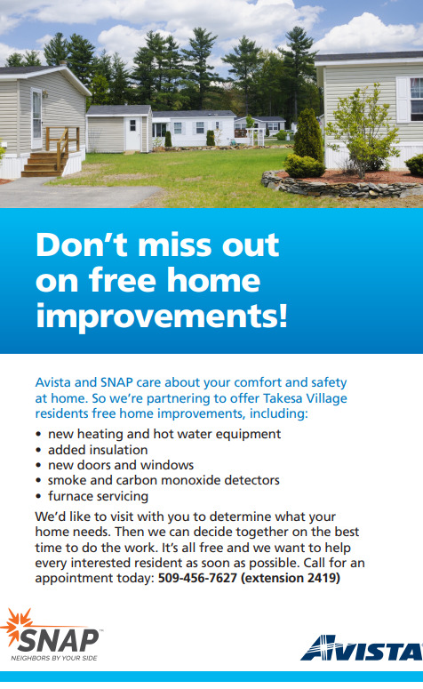
NCIF projects: Energy Efficiency
Health & Safety for Mobile Homes
Partnership with Spokane Neighborhood Action Programs (SNAP)
Phase 1 Mobile Home Co-Op
Phase 2 Manufactured Homes in Census Block with high low income

Slide 35
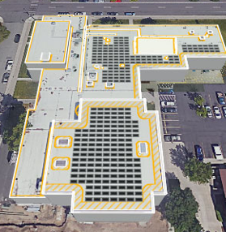
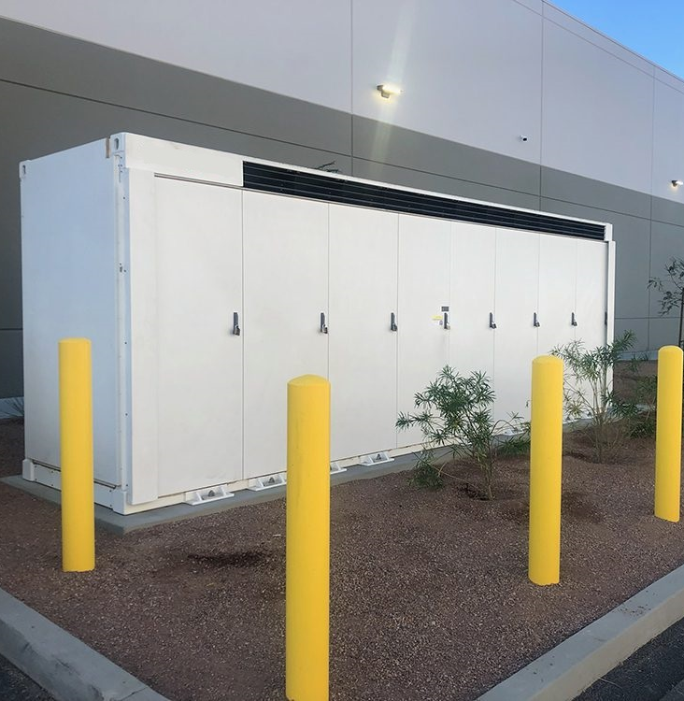
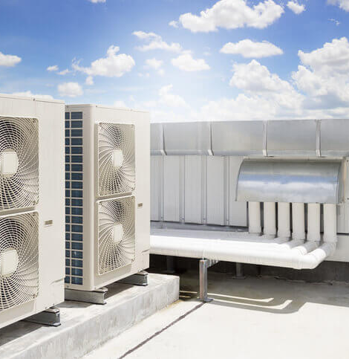
NCIF projects: Resiliency
Solar with battery back-up or generator for community center to serve as shelter, etc. during mass community events
100kW Solar Array
500 kW battery
Energy Efficiency
DC Fast Chargers

Slide 36
Thank you!

Slide 37
Wildfire Resiliency Plan: 2024
Paul Kimmell, Business & Public Affairs
July 24, 2024
Notes:
RBM
Thank you for this opportunity to present Avista's wildfire resiliency plan. We'll touch on the four basic elements of the plan and then get into what's new for 2024 – most notably Public Safety Power Shutoffs (also known as PSPS). We are looking forward to a great discussion today and to enhancing our partnerships with the communities we serve, especially during power outages and emergencies.

Slide 38
Guarding against growing risks
Avista is committed to keeping people and property safe. In 2020, we began implementing our 10-year Wildfire Resiliency Plan for preventing, mitigating and reducing the impact of wildfires.
We believe this is a wise investment in preparedness.
Notes:
RBM
It's no secret that wildfires pose a large and growing risk to millions of Americans, especially here in the Pacific Northwest. Avista is committed to keeping people and property safe. We believe this is a wise investment in preparedness and we're planning to spend $437M over 10 years implementing our Wildfire Resiliency Plan.

Slide 39
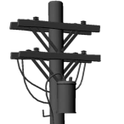
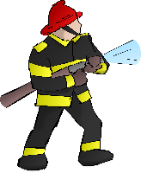
Elements of our wildfire plan
Reduce spark events & strengthen the grid
Grid Hardening
Reduce vegetation issues
Vegetation Mgmt.
Avista Wildfire Resiliency
Operations & Response
Situational Awareness
Increase protection & partnerships
Technology to increase awareness
Notes:
We have divided our Wildfire efforts into four primary areas:
Grid Hardening
Goal is to reduce spark potential and protect critical assets from the impacts of wildfire.
Includes infrastructure upgrades such as fiberglass crossarms, conversion to steel poles, installing fire resistant mesh on wood poles, replacing old equipment and conductor
Risk-Based Enhanced Vegetation Management
Identifies & removes trees which may become hazards across the entire system each year - Avista is committed to inspecting 100% of our non-urban areas every year to identify and remove risk trees.
Adding the use of LiDAR for transmission, satellite imaging for distribution feeder inspections – tools that allow us to see tree health, distance to powerlines, and other factors that allow our vegetation crews to more accurately pinpoint areas for work.
Situational Awareness
Adds automation to our system to allow remote monitoring and activation of key equipment based on risk
Monitoring the weather (Fire Weather Dashboard) to identify risk ahead of time to allow preparation and planning
Identifying areas of greatest risk via our WUI Map to focus program efforts
Operations & Emergency Response
Procedures for making system protection setting changes during significant weather events (FSM/PSPS).
Promoting partnerships with communities, first responders, public service providers, and landowners – anyone who shares our interest in wildfire-related issues and public safety.
Helping everyone be prepared for fire events with elements including planning, training, and alignment with first responders and field personnel.
Tracking the effectiveness of our Wildfire Resiliency efforts to help prove the value of our wildfire investments and strategies.
For 2024 we have reached “cruising altitude” with our Wildfire programs. All are fully implemented.
Programs that were previously coming up to speed such as Expedited Response, Fuel Reduction Partnerships, and the Safe Tree Program are now offered service territory wide and fully in place.
The Wildfire programs are running well and will continue to be improved over time to ensure we are delivering value.

Slide 40
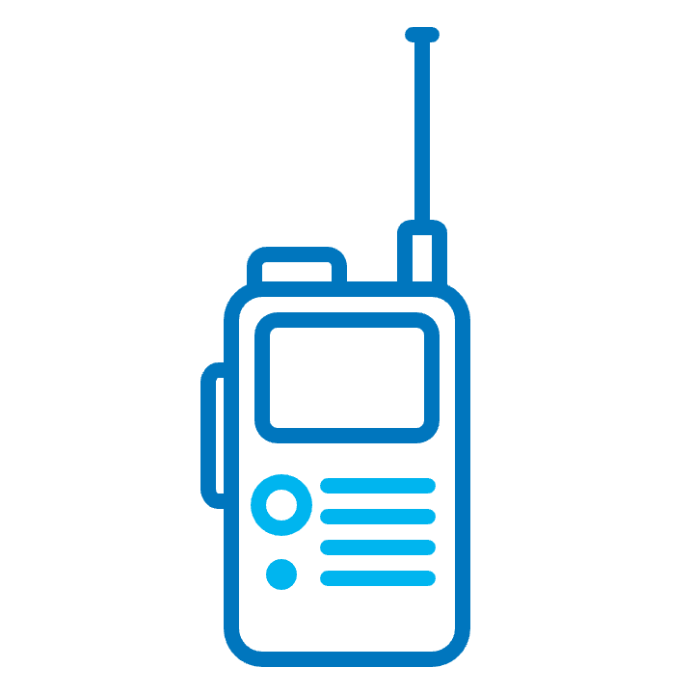
Our four-part plan includes:
Grid Hardening
Gradual shift to strategic undergrounding
2. Enhanced Vegetation Management
100% inspection of Risk Trees annually
3. Situational Awareness
AI Fire detection cameras
4. Operations and Emergency Response
Expanded fire protection settings
Public Safety Power Shutoff (PSPS)
Notes:
Matt/Ops Mgr
A quick review of our four-part plan, plus what's new for 2024...
GH: we are making investments to harden our electric line infrastructure to reduce spark-ignition outage events and to protect critical assets from the impact of wildfires. GH strategies include fiberglass crossarms, steel poles and new for 2024, a gradual shift to strategic undergrounding of specific distribution lines in our Tier 3 areas.
VM: we are also making investments to identify and remove dead, dying and diseased trees that are most likely to fall into our electric distribution lines. Starting in 2023, we increased our annual inspection of 'risk trees' from 20% to 100% annually. In addition to ground patrol, we are combining remote sensing technologies such as LiDAR and satellite imagery to aid in overall vegetation management decision making. We also work directly with landowners to remove trees that may grow into our system and replace them with utility friendly trees.
SA: new this year, we are partnering with state agencies to implement an AI fire detection cameras. We are installing 10 cameras to improve coverage to our State fire fighting agencies curretn networks. These cameras will be able to alert first responders to locations of new fire starts, which will mean quicker response times and smaller fires. We also continue to automate devices circuits supporting our non-reclosing protection strategy (Fire Safety Mode) and aligning short-term weather-related fire risk (assessed through our Fire Weather Dashboard) with system protection levels.
O&ER: we continue to focus on helping customers be better prepared for wildfires and partnering with emergency first responders before, during and after fire events. This includes fire safety training for Avista operations personnel and expedited response agreements (for transmission lines) with all Spokane County Fire Districts, WA DNR and ID Dept of Lands. New for 2024, we've expanded our fire protection settings and have added PSPS to our toolkit. More on this in coming slides...

Slide 41
Wildfire Resiliency goals
External Partners & Fire Professionals
Internal Employees
Promote public and worker safety around the impacts of wildfire
Minimize service disruptions caused by wildfires and other extreme weather events
Protect Avista from financial or reputational liability associated with wildfire
Notes:
In conversation, discuss our focus now on developing focus metrics around quantifiable risk modeling that incorporates our hardening efforts. Our future plan involves understanding how to quantify current risk as well as the risk reduction associated with mitigation efforts. This will allow us to appropriately prioritize our resources and show our overall wildfire risk reduction associated with our ongoing efforts over time… and as things continue to change.
Wildfire Resiliency Plan was established in June of 2020.
This is the 4th full year of working on the plan.

Slide 42
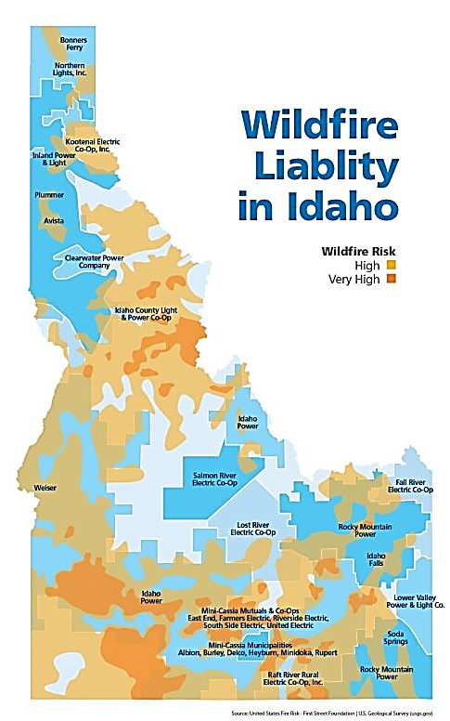
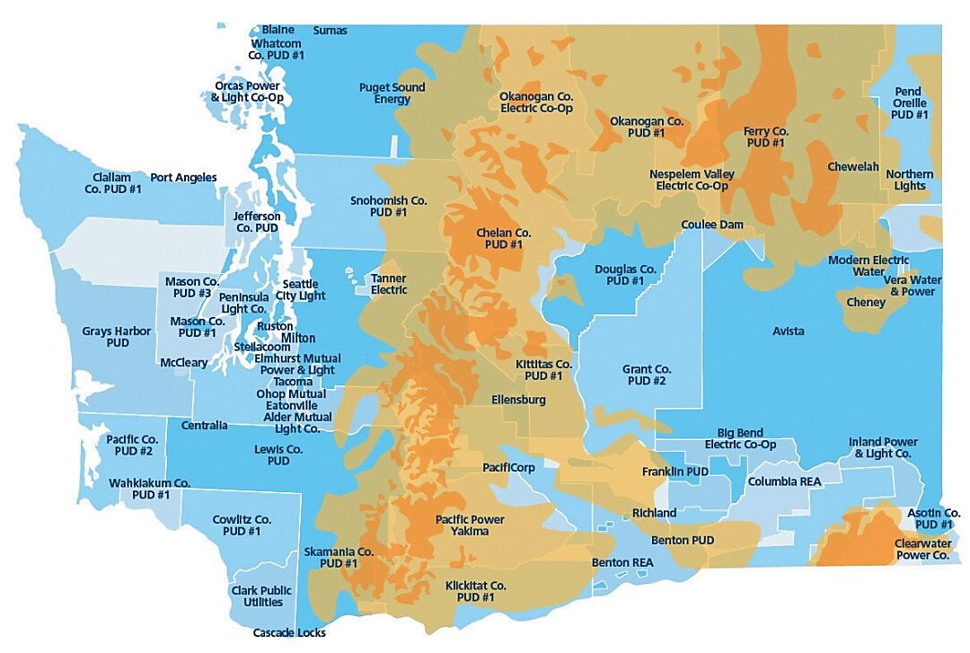
Avista service territory wildfire risk overview
Wildfire Liability
in Washington

Slide 43
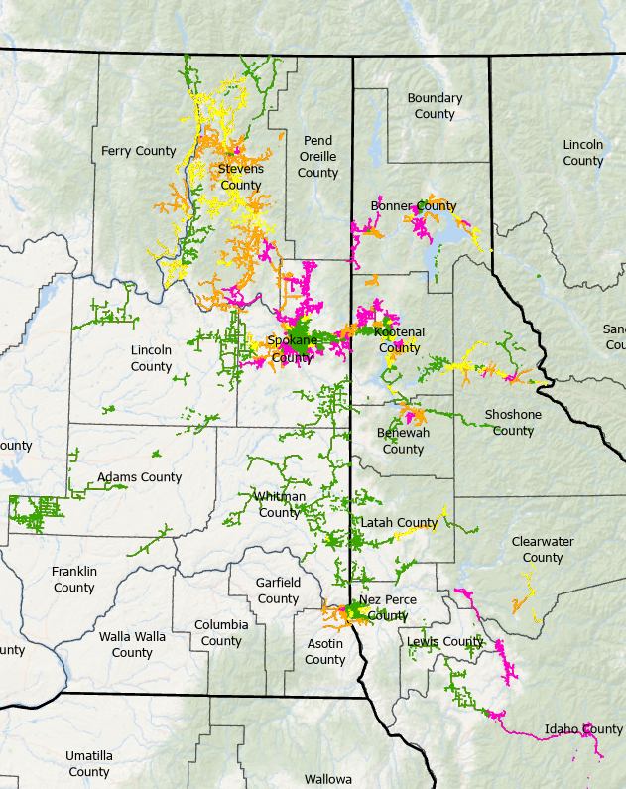
System Overview
ID Electric Customers | WA Electric Customers | Total
133,243 | 205,433 | 338,676
ID Service Area Pop. | WA Service Area Pop. | Total
351,586 | 903,982 | 1,255,568
Wildfire Risk | ID (miles) | WA (miles) | Total
Tier 0 | 1,180.8 | 2,669.5 | 3,852.7
Tier 1 | 349.3 | 779.5 | 1,128.9
Tier 2 | 418.2 | 1,056.3 | 1,474.5
Tier 3 | 619.4 | 651.9 | 1,271.3
Totals | 2,567.7 | 5,157.1 | 7,727.3
Notes:
RBM
Here's a quick look at our entire electric distribution system. This is Avista's Wildland Urban Interface (WUI) map that includes USDA's Housing Unit Impact dataset. This index represents the relative potential of wildfire to housing units, quantifying the potential impact of wildfire on human development. We also used inputs from USDA's Wildfire Hazard Potential data and Avista geo-spatial data and analysis to develop this map. Pink is Tier 3 – highest fire threat down to Green Tier 0, areas of minimum fire threat.

Slide 44
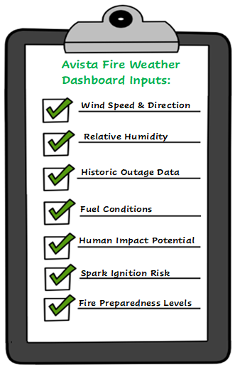
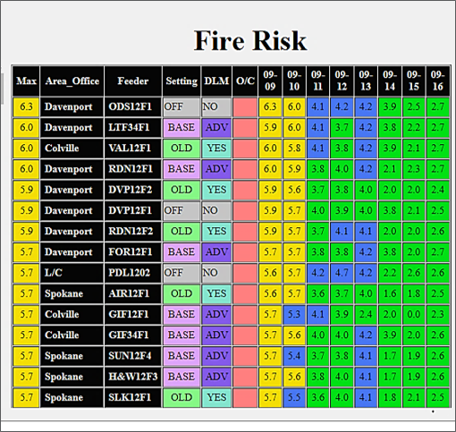
Fire Safety Mode & Protection Settings
Notes:
Matt/Ops Mgr
During wildfire season, we rely on our Fire Weather Dashboard to determine fire risk, which informs our operations and emergency response. Here is a snapshot of the dashboard, which takes into account a number of inputs including wind speed and relative humidity.
For more than 20 years, Avista has elevated the sensitivity of certain circuits on our system during wildfire season. Formerly, "Dry Land Mode", we renamed this safety strategy in 2023 to "Fire Safety Mode" to more clearly explain to customers why we make this operational shift. Here's how it works....<next slide>

Slide 45
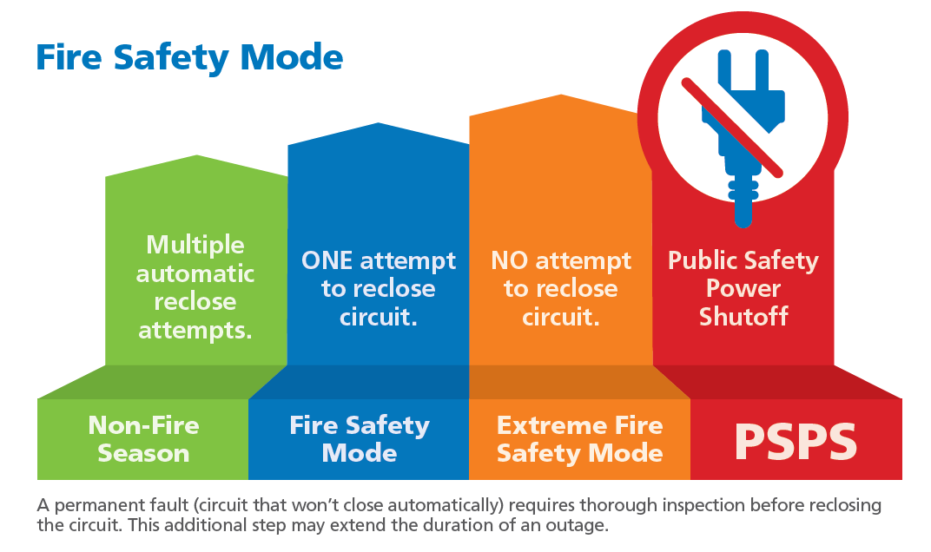
Full Range of Protection Settings
Notes:
Matt/Ops Mgr
The use of increased protection settings is a growing industry best practice and a significant part of Avista's strategy to reduce the risk of utility infrastructure-involved wildfires.
We move about 170 circuits into Base Fire Safety Mode for the duration of the wildfire season (typically July – Oct) to make the circuits more sensitive. When in "Base FSM" ("High" on the graphic) the circuit will try to reclose only once (vs. 2-3x in non-fire season) to try and fix a fault on a line. Fuses are operable which means the fault is isolated and the outage is contained.
We use our Fire Weather Dashboard to monitor fire risk. When high winds and dry weather are predicted, we can increase the sensitivity of certain circuits in specific geographic areas during the duration of the weather event. Based on the 2023 fire season and the growing risk of wildfire in Avista's service territory, we've made some significant changes to our protection settings for 2024:
Lowered the Fire Weather Dashboard risk threshold to trigger increased protection settings on our system.
Simplified our protection settings to Extreme FSM only (we eliminated "elevated FSM") meaning that if there a single fault on the line, there is no reclose attempt. The line will be out of power until a full patrol occurs. This means customers on that circuit can expect a longer outage time as crews will need to complete a 100% inspection of the overhead lines prior to re-energization, to ensure customer safety.
Added Public Safety Power Shutoff (PSPS) to our toolkit as a tool of last resort. In extremely dangerous weather conditions we may proactively turn off power on specific circuits to prevent a wildfire. More on this in the next two slides...
It is important to note that when we increase our protection settings to Extreme FSM or PSPS, it will be for a limited period of time and on specific circuits, depending on weather conditions. What this means for customers is the potential for more frequent outages of longer duration during wildfire season because we'll need to inspect the entire line before re-energizing.
Customers on these FSM circuits will receive notifications by email and/or phone of the potential for an outage. We strongly encourage our customers to contact Avista to make sure we have their updated contact information.

Slide 46
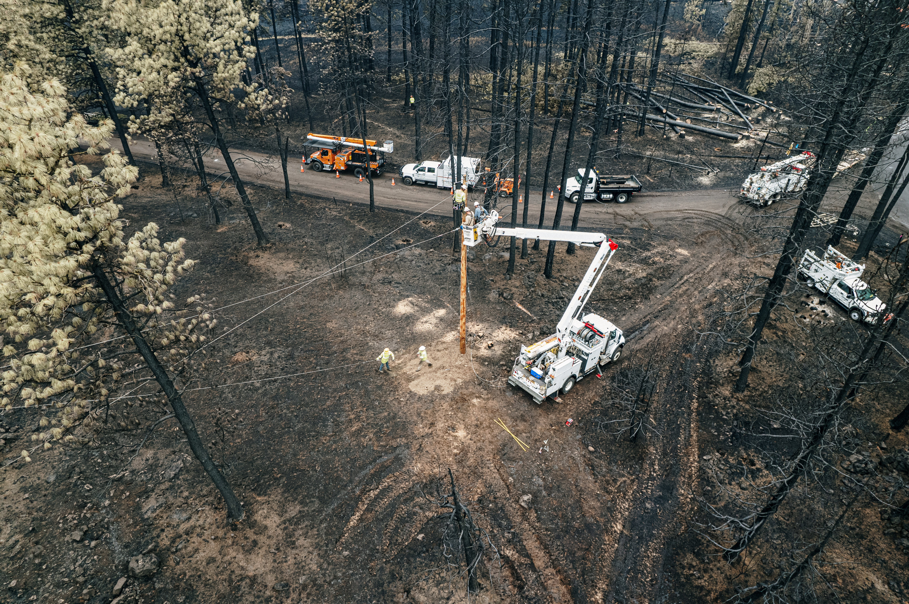
Public Safety Power Shutoffs (PSPS)
PSPS is preemptively turning off power to select locations prior to extreme weather impacts
Avista is prepared to use PSPS in 2024 - as a tool of last resort
We've developed criteria and customer support strategies necessary to implement PSPS
Collaboration with public safety partners, municipalities, tribes and key stakeholders is essential
Notes:
RBM
The ultimate wildfire protection setting is to preemptively turn off the power to select locations, called a PSPS or Public Safety Power Shutoff. By turning off the electric system prior to the extreme weather impacts, the potential for a utility infrastructure-involved wildfire and possible impacts to our customers is eliminated.
Avista is prepared to use PSPS in the 2024 wildfire season, as tool of last resort. <Note: all feeders are eligible for PSPS>
Using what we've learned from our peer utilities, we've developed decision criteria and customer support strategies necessary to implement PSPS, if it is deemed a prudent measure to protect our customers and communities.
Avista is committed to collaborating with our public safety partners, municipalities, tribes and key stakeholders to ensure we understand concerns and how best to support customers during Public Safety Power Shutoff activities.
We believe that our "Extreme" elevated fire protection setting is appropriate mitigation for most, if not all, of the forecasted weather conditions we experience during wildfire season.

Slide 47
Operations & emergency response
PSPS Watch
PSPS Warning
PSPS Execute
7-2 Days Out
2 Days – 1 Hour Out
De-energize
Notes:
Discuss how we are engaging other external partners for overall wildfire readiness. We are focusing on partnerships and relationships in this area of wildfire readiness with the goal of creating high level awareness across all communities and stakeholders, similar to 811 – call before you did because ultimately, this is much larger than a utility problem. It will take all of us to be successful.
Another measure Avista is implementing to protect customers safety is our Public Safety Power Shutoff plan, being implemented this year. We created this plan by collaborating with key external parties including firefighting agencies, first responders, and public safety partners, counties, tribes, and local governments. We created a Top 25 feeder list for our service territory – those feeders most likely to experience a PSPS event – to focus efforts there.
Elevation of operational levels is based on the Fire Weather Dashboard. Extreme Fire Safety Mode is now triggered at an FRI of 5.5 and continues until an FRI of 6.9. Avista will consider a PSPS when the FRI forecast is at 7.0 or greater. Avista may begin evaluating, planning and preparing for a potential PSPS when the FRI score is forecasted at 5.5 or greater (up to 7 days in advance of a potential weather event).
The PSPS Plan includes timelines for decision making:
PSPS Watch (7-2 days out from potential event)
PSPS Warning (2 days to 1 hour from potential event)
PSPS Execute (De-energization of the effected feeders/circuits)
PSPS decision makers are the Executive Board (Heather Rosentrater, Josh DiLuciano, Latisha Hill, Greg Hesler, and Kevin Christie) with guidance from the Director of Electrical Engineering and the Wildfire Resiliency Manager.
Working with an external provider for the Community Resource Centers (we are working to secure locations). Working with an external party to provide battery backup systems for life support customers.

Slide 48
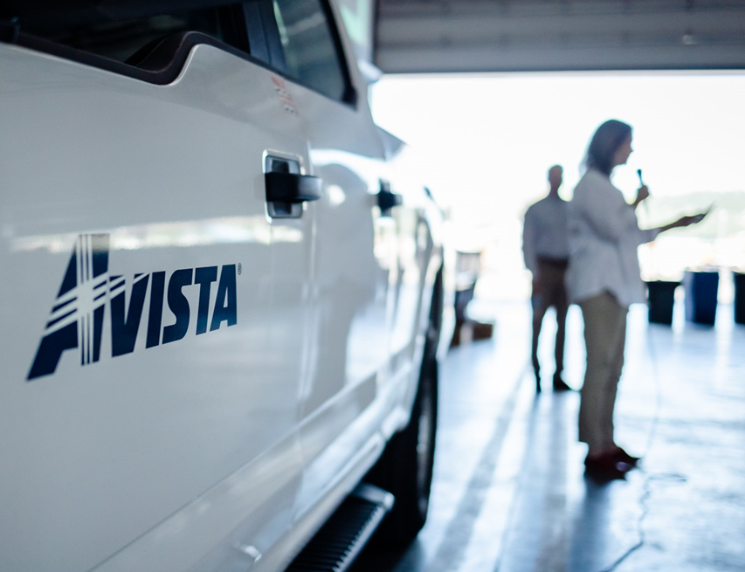
Community Outreach in 2024
Focus on PSPS
Public Safety Partners
Elected Officials & Municipalities
Community Leaders
Medically vulnerable customers
Commercial and Residential Customers
Community Engagement & Support
Outage map enhancements
Education & Outreach
Medically vulnerable customers
Community Resource Centers (CRCs)
Encourage Preparedness
Notes:
RBM
This year, we're focusing our outreach efforts on PSPS to ensure awareness and understanding of the potential for proactively shutting off power in the event of a catastrophic weather event:
Ensure our public safety partners, elected officials and municipalities and community leaders know about the key changes to our wildfire resiliency plan in 2024; and continue to pursue partnership opportunities with these key stakeholders
Identify and work with medically vulnerable customers to ensure they are prepared for the potential of extended power outages
Ensure our industrial, commercial and residential customers are aware of the changes to our wildfire resiliency plan for 2024
Continue to identify critical infrastructure across our ID and WA service territory
Our Year 1 PSPS plan includes four specific Community Support strategies:
Enhancements to our Avista Outage Map to show specific feeders/circuits are in PSPS "Watch" (7-3 days prior), "Warning" (2-1 day prior) and "Outage" (execute PSPS)
Focused education and outreach efforts including a variety of communication channels and Telephone Town Hall meetings (June) for all Avista industrial, commercial and residential customers
Proactive outreach to our medically vulnerable customers to ensure they are aware and prepared
Standing up Community Resource Centers (CRCs) in close proximity to outages, providing a cool respite, outage information, device charging and food/water.
Through all of our communications, we continue to encourage our customers to be prepared for the possibility of an extended power outage during wildfire season. We welcome partnerships with organizations and agencies to extend and augment the 'preparedness' message.

Slide 49
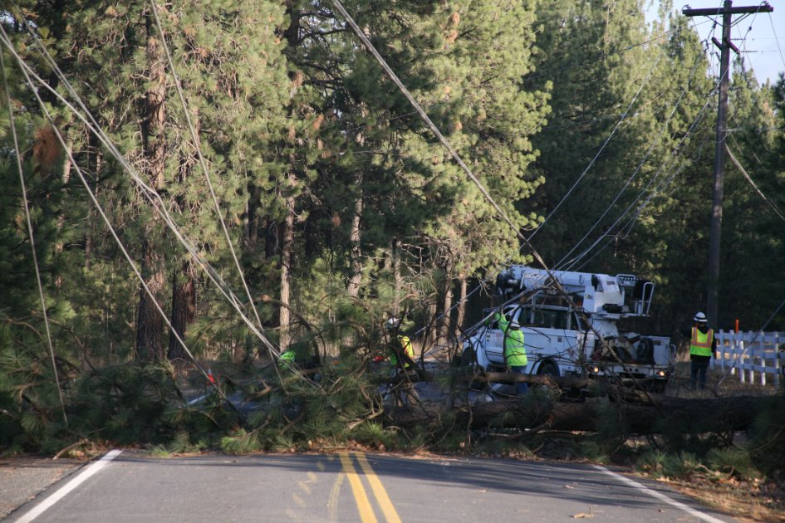
Discussion
Emergency Response in your County
What concerns you most about extended power outages during wildfire season?
What does your community need?
Who/how would you like to be notified?
Partnership opportunities?
Public safety
Community engagement
Outage preparedness
Next Steps…
Notes:
RBM and Matt/Ops Mgr
Now that you've heard about our plans for 2024, we'd like to talk a little more about PSPS and the potential impacts in your community.
What concerns do you have?
How do you think your community will respond to an extended power outage? <Note: duration is unknown>
What does your community need?
Notification process – who/how would you like to be notified? For PSPS, we will typically begin notifying key community partners at 72 hours prior to potential PSPS; residential customers will start receiving notification at 48 hours prior to potential PSPS <NOTE: residential customers could receive notification as early as 72 hours but it may not occur until 48. Depending on the severity of the event emergency management partners could be informed more than 72 hours in advance.>
What ideas do you have for partnership opportunities?
We'd like your suggestions for next steps, especially engaging leaders in the specific high fire threat communities to bring awareness and enhance partnership and support/reach the medically vulnerable in our communities

Slide 50
Thank you
Notes:
RBM
Thank you so much for your time! We look forward to continued conversation and partnership with you!

