Slide 1
Idaho’s Energy Programs
Inland Northwest Partners Summer Meeting
Idaho Governor’s Office of Energy and Mineral Resources (OEMR)
Kylie Bolland, Financial Specialist
July 24, 2024

Slide 2
Office of Energy and Mineral Resources (OEMR)
Mission: Coordinate energy and mineral planning and policy development and administer programs fostering reliability, affordability, sustainability, and innovation in a manner that responsibly enhances the state’s security, economy, and overall quality of life for its citizens.
Our focus: reliable, affordable, innovative, and sustainable power in Idaho

Slide 3
Programs
Provide Idahoans Access to Energy-related Programs and Opportunities
Develop and administer programs to advance Idaho’s energy priorities. | Support new and existing energy programs and opportunities in Idaho.

Slide 4
Current OEMR Programs
OEMR Programs
Program | Eligible Entity
Current
State Energy Loan Program | Residential, single-family homes
Idaho Awards for Leadership in Energy Efficiency (EE Awards) | Small business, large business, government agencies
Government Leading by Example (GLBE) | Rural cities, counties, school districts (public buildings)
Energy Resiliency Grant Program State Program + 40101(d) Federal | Utilities
Energy Efficiency & Conservation Block Grant (EECBG) | Cities & counties not eligible for formula EECBG funding
Upcoming
National Electric Vehicle Infrastructure Program (NEVI) | Private sector; including site hosts, developers
Idaho K12 Energy Efficiency | Idaho K12 public schools, school districts

Slide 5
State Energy Loan Program
  Offers low-interest residential loans for projects such as:
  Insulation
  Windows
  Weatherization
  HVAC
  Appliance
  Lighting
  Renewable energy
In the past two years, OEMR has provided over $939,943 primarily for solar PV & HVAC

Slide 6
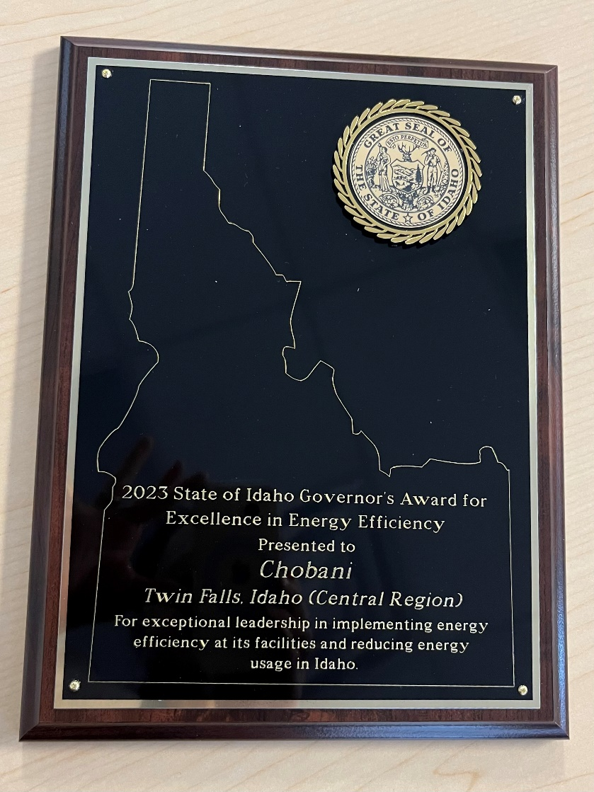
Idaho Awards for Leadership in Energy Efficiency
Honors businesses and government entities for achievements in reducing their energy consumption over the past year.
Three categories
  Small Business
  Large Business
  Government
2023 Awards
  15,998,491 kWh & $1,224,649 saved
  Governor’s Award: Chobani

Slide 7
Government Leading by Example
Assist rural governments in saving energy in existing public buildings
Free energy audits
Facilitate connections to grant opportunities
Examples:
Public libraries, courthouse buildings, city halls, post offices, wastewater treatment plants, school districts
Lighting upgrades, HVAC upgrades, insulation measures/weather sealing, installing occupancy sensors, programmable thermostats

Slide 8
Idaho Energy Resiliency Grant Program
Goal: Address energy needs and projects across Idaho through funding opportunities that support resilient, secure, reliable, affordable, and sustainable power in Idaho
State Program | IIJA 40101(d) (Federal)
$15,000,000 | $25,000,000
Round 1 projects completed in 2023-2024 around $4.4 million. Future rounds anticipated to focus specifically on wildfire resilience technologies. | Round 1 applicants currently under DOE review totaling around $8.5 million. Future rounds over the next few years.

Slide 9
ERGP State Program
Avista: Grid Hardening
South Hayden Lake
½ mile of overhead line converted to underground to harden grid in an elevated fire risk area.
523 customers served

Slide 10
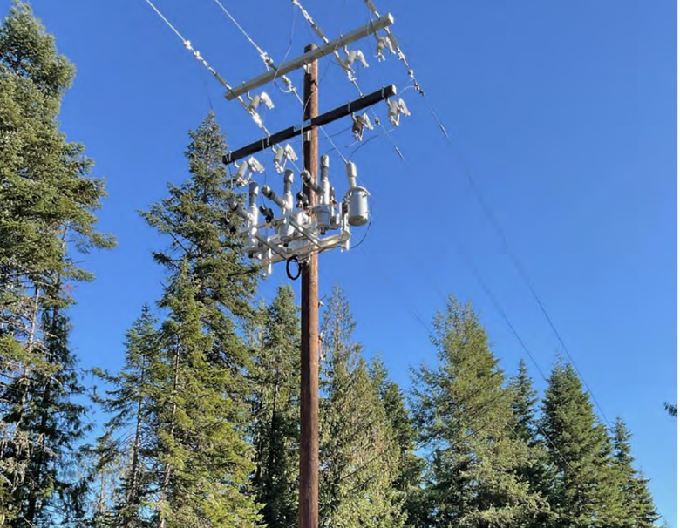
ERGP IIJA 40101(d) Program
Round 1 North Idaho projects currently under DOE review
    Vegetation management
    Spare substation transformer
    Relay technology to reduce outage time
    Aerial inspection equipment
    Undergrounding power lines

Slide 11

National Electric Vehicle Infrastructure Program
Established through the Bipartisan Infrastructure Law to provide states with federal funding to strategically deploy EV charging infrastructure and establish an interconnected network of EV charging stations across the US
Implemented in Idaho through interagency working group:
  ITD
  OEMR
  DEQ

Slide 12
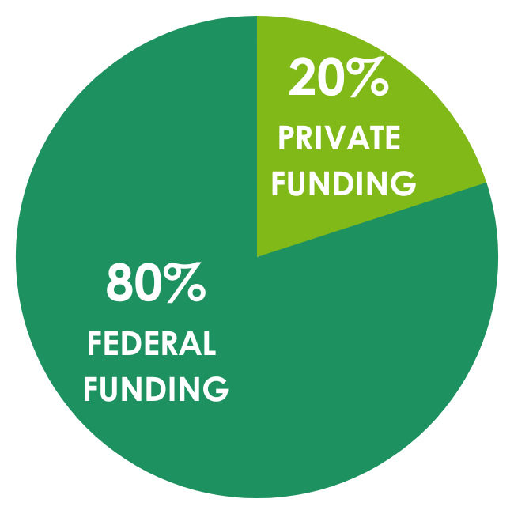
National Electric Vehicle Infrastructure Program
Federal Requirements Include:
Prioritization along interstate highway system
Must be along federally-designated AFCs
  w/in 1 mile
Fast-charging, 15 kWh, 4-port
Federal fund 80%, site-host/developer fund 20%

Slide 13
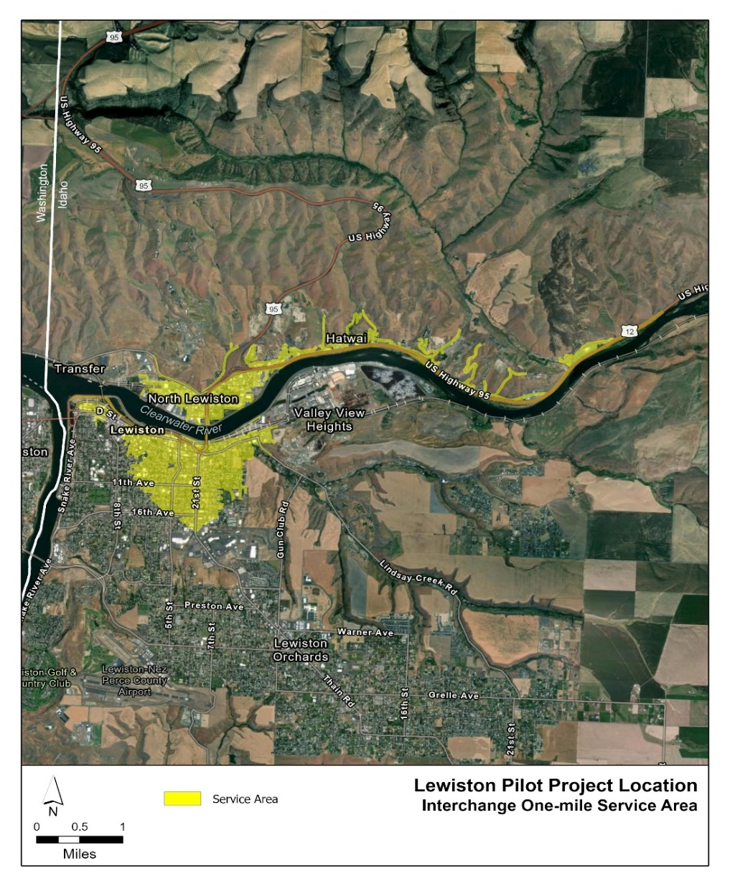
NEVI Round 1: Lewiston, Pocatello, Bliss
Round 1 sites chosen from early SFAS findings.
Initial rounds will focus on Interstates to fulfill federal requirements.
Subsequent rounds will be open to state-nominated AFCs including:
US-95, SH-12, SH-55, US-93,
US-30, and US-20

Slide 14
K12 Energy Efficiency Program
  Program currently under development
  Anticipated RFA release late 2024
  Energy retrofits in public K12 schools
  Approximately $3,000,000 in federal funding

Slide 15
Energy Efficiency Conservation Block Grant Program
Awarded competitive grants up to $100,000 to cities/counties for energy efficiency projects
Subawardee | Project
City of Lewiston | Energy efficient lighting upgrades in public library
City of Pierce | Weatherization of City Hall
Clearwater County | Energy efficient server for EMS station
Shoshone County | Weather sealing 90 windows & replacing two main doors to increase energy efficiency in City Hall
City of St. Maries | Energy efficient wastewater pump upgrade
Application closed. No current additional EECBG funding announced.
Formula funding still available.

Slide 16
Federal Themes in Grant Programs
NEPA
National Historic Preservation Act – Section 106
Davis-Bacon
Build America, Buy America (BABA)
And more!

Slide 17
www.oemr.idaho.gov
Grants Newsletter
Monthly Newsletter
Kylie Bolland kylie.bolland@oer.idaho.gov
(208) 332-1669
Contact Information

