Slide 1
Notes:
What is Investing in American initiative?
In order to help small biz better navigate the many opportunities through various legislation passed in recent years, including the
American Rescue Plan,
Bipartisan Infrastructure Law (BIL),
CHIPS and Science Act,
Inflation Reduction Act (IRA)
Spur public and private investment in critical sectors of the economy such as infrastructure, clean energy, semiconductors, and biotechnology.
These investments present opportunities for small businesses and the SBA wants to help educate about opportunities and provide resources to support pursuing those opps.

Slide 2
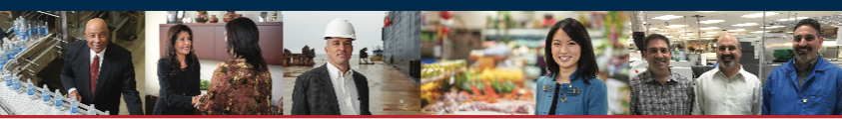
The SBA works to ignite change and spark action so small businesses can confidently
About the U.S. Small Business Administration
START • GROW • RECOVER
Notes:
Business lifecycle

Slide 3
Your Local SBA District Office
Serving most of Washington state and northern Idaho with offices in Seattle and Spokane
Seattle
Spokane

Slide 4

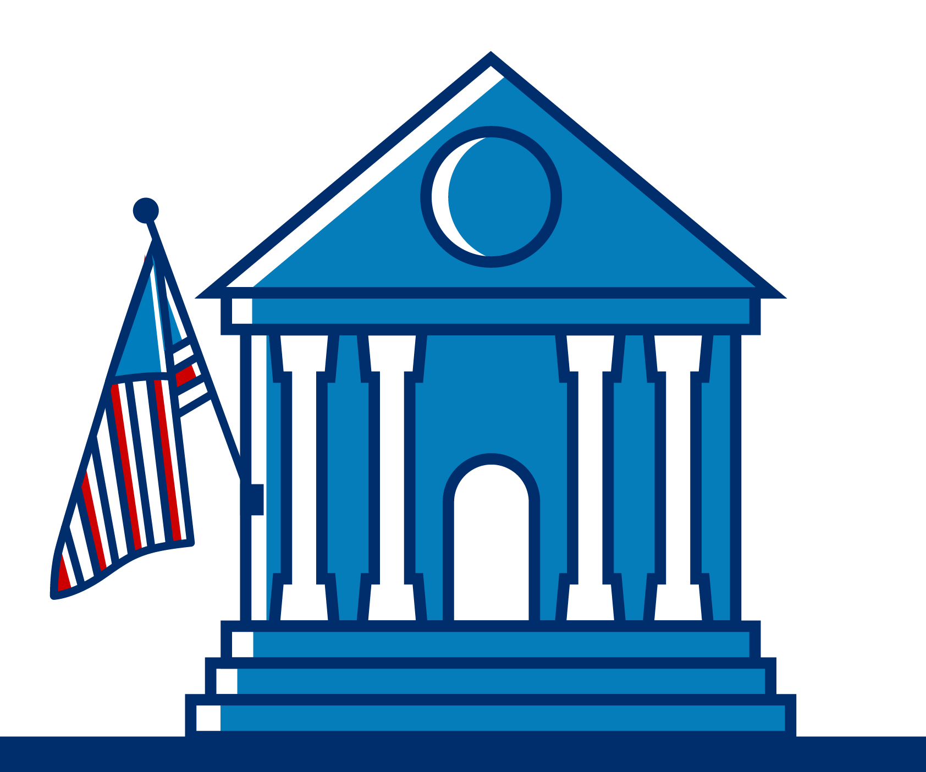



You’ve likely heard about SBA programs like …
Equitable
access to capital
Increase contracting opportunities
Supported by business advising
Notes:
What does this look like when focused on a local level?
Our local team is honing in to provide equitable access to capital, and, increase contracting opportunities for small businesses.
Both of these areas of growth are supported by a robust network of technical assistance providers helping entrepreneurs get from idea to reality.
We’re expanding our network of lenders to include more community-based banks, credit unions and Certified Development Financial Institutions - or CDFIs – to make sure no small business is left behind when it comes to financing.
And, we’re provided the financial education to help small business owners be more confident, knowledgeable and successful when it comes to managing their business finances.
We’re also working to expand the number of federal contracting opportunities for small businesses.
With the massive infrastructure package and increase small business set-aside goals, there’s never been a better time than now for businesses to grow and diversify their customer portfolio by doing business with Uncle Sam.
We’re coordinating with the experts in federal procurement and local government to help small businesses get certified and get contracts.

Slide 5


Wildfire Season
Prepare Your Business
Recover with SBA Disaster Loans
An estimated 25% of businesses don’t reopen after a major disaster.*
Prepare your business by visiting SBA.gov/prepare
Low-interest, long-term loans may cover:
Real Economic Machinery & Inventory
Estate Injury Equipment
*According to the Institute for Business and Home Safety (IBHS).

Slide 6
Investing in America

Slide 7
Investing in America By the Numbers
~$1.8 trillion investment in infrastructure, clean energy, and critical technologies across BIL, IRA, and CHIPS
Hundreds of thousands of small businesses work in key industries
  ~200,000 Residential Building Construction small businesses
  ~230,000 small manufacturers
  ~300,000 rural small businesses
  ~250,000 small businesses engaging in new R&D
Up to nearly $25k in energy efficiency tax credits and rebates for households through the Inflation Reduction Act (varies by household income, other factors)
An estimated $50 billion in government contracting opportunities for small businesses alone
Notes:
Small biz boom – record 5.5 million in 2023, 97,000 in WA
Bipartisan Infrastructure Law (BIL)
CHIPS and Science Act

Slide 8
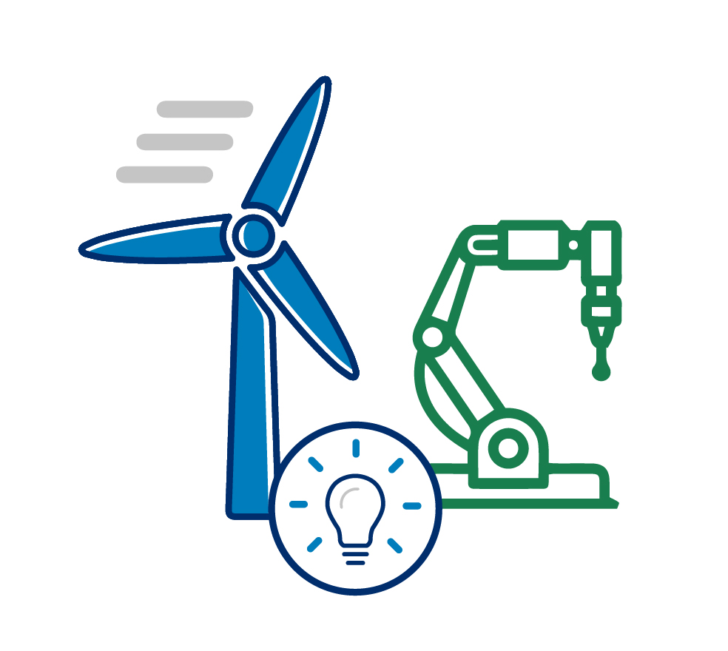
Opportunities for small businesses
Manufacturing grants
Home repair and construction
Government contracting & subcontracting
High-speed internet contracting
Rural and agricultural small businesses
Notes:
Manufacturing grants
New federal grants to become more energy and water-waste efficient means more opportunities for your business to save and grow
Home repair and construction
Rebates and tax credits will make home energy projects more affordable to your current and potential customers, leading to more customers for your business
Government contracting & subcontracting
More federal, state, and local contracts means more opportunities for small businesses to receive contracts and grow
Rural and agricultural small businesses
Loans and grants for rural small business or agricultural production firm
SCORECARD

Slide 9
SBA’s Investing In America Small Business Hub
Visit SBA's Investing in America Small Business digital resource hub at sba.gov/IIAhub for more information about each of these programs in one place, including:
Program overviews
How-to guides
Available opportunities for small businesses
How SBA can help your business pursue these opportunities
Additional programs coming soon: Critical technology – tech hubs and R&D tax credits, clean vehicle fleet upgrades, rural energy, and more.

Slide 10
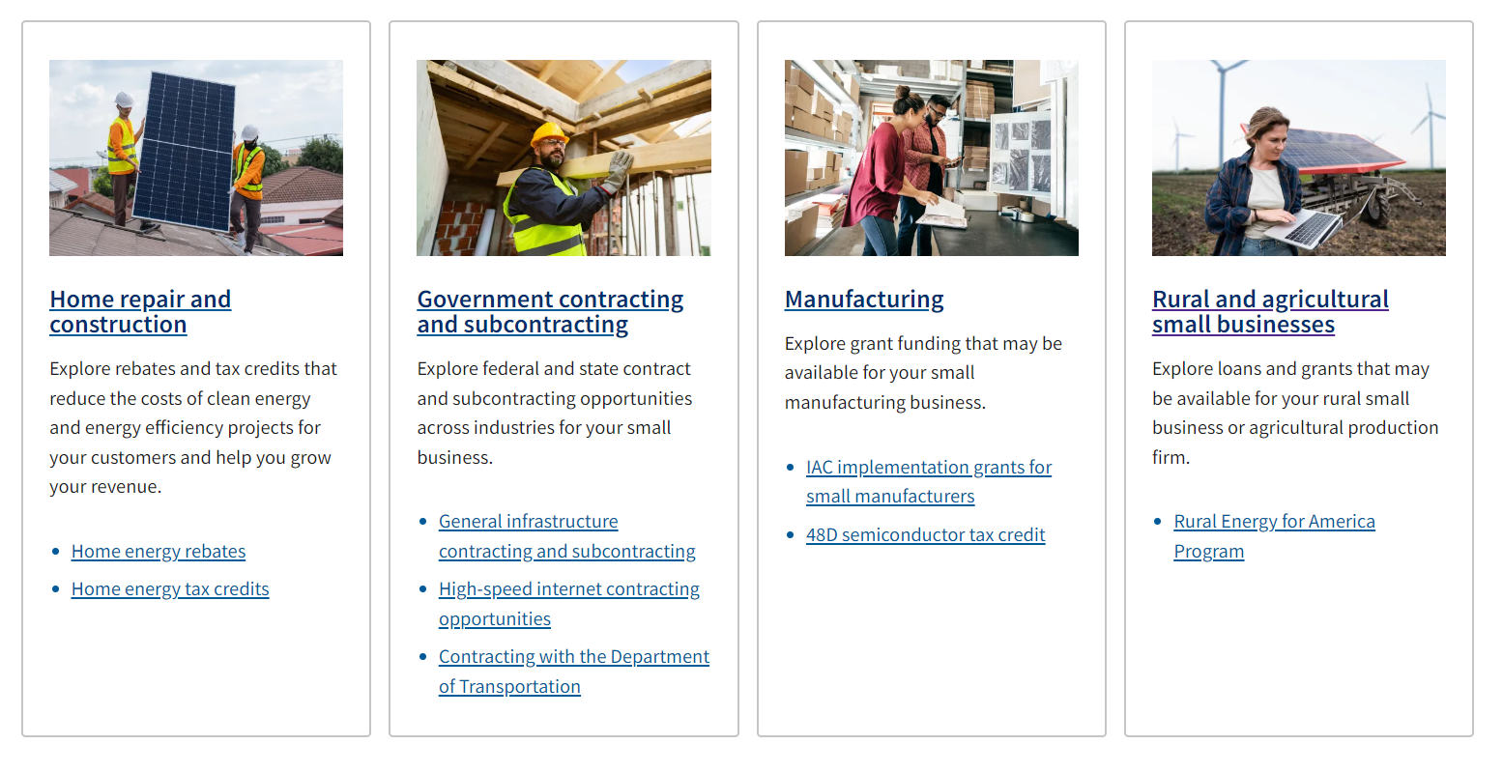
SBA’s Investing In America Small Business Hub sba.gov/IIAhub

Slide 11

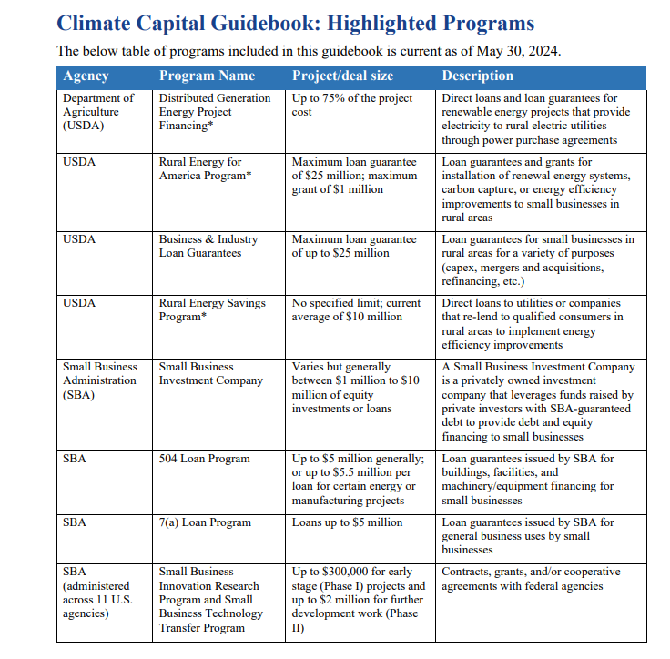
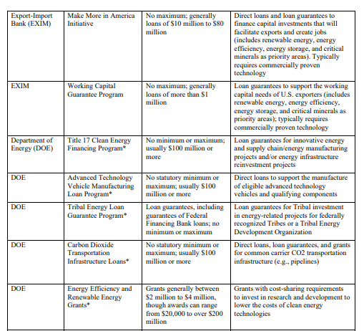
*NEW* Climate Capital Guidebook of Federal Funding Sources
Climate Capital Guidebook

Slide 12
How can SBA programs pair with IIA opportunities?
Up to $500,000 in working capital through the 7(a) program
Long-term, fixed rate financing of up to $5 million through the 504 loan program
Financing
Surety bonds
Certifications for small businesses that want to do business with the federal government
Coaching and training
Find an investor for your business through's SBA's licensed Small Business Investment Companies (SBICs)

Slide 13
Notes:
What is Investing in American initiative?
In order to help small biz better navigate the many opportunities through various legislation passed in recent years, including the
American Rescue Plan,
Bipartisan Infrastructure Law (BIL),
CHIPS and Science Act,
Inflation Reduction Act (IRA)
Spur public and private investment in critical sectors of the economy such as infrastructure, clean energy, semiconductors, and biotechnology.
These investments present opportunities for small businesses and the SBA wants to help educate about opportunities and provide resources to support pursuing those opps.

Slide 14
SBA 504 Program
The program is the SBA’s long-term financial tool for economic development
Provides funding for fixed assets:
  Real estate acquisition, building improvements and ground-construction
  Machinery and equipment acquisition and installation
  Refinancing of equipment term loans
  and deeds of trust or mortgages
Typical structure is 50-40-10 (start-ups and special purpose buildings will require more money down)
Certified Development Companies (CDCs) partner with private lenders

Slide 15
Benefits to the Borrower
Low down payment which preserves working capital (usually 10%).
Below market fixed interest rates.
Long term financing (10, 20, or 25 year terms).
Borrower can finance most closing fees and soft costs.
Collateral is usually limited to the subject real estate with third party lender in first lien and SBA in second lien position.

Slide 16
Lifting the Cap on Energy Public Policy Projects
* NEW *
Revision to SOP 50 10 7.1, page 306, paragraph D.1.c.i.
  The $16,500,000 cap on Energy Public Policy projects is removed.
Revision to procedures related to extension of disbursement period (SOP 50 10 7.1, Section C, Chapter 2, Paragraph A.2.a.
  Currently SBA requires 504 loan be disbursed within 48 months from the date of approval;
  Effective April 30, 2024 – the decision authority on disbursement extension requests is delegated to SLPC when appropriate.
* There is no time interval between submitting more than one Manufacturing or Energy Public Policy projects, as long as each project is independent, viable, and meets eligibility requirements.

Slide 17
Let’s Meet your Certified Development Companies Serving the Inland Northwest and Beyond!
Ameritrust CDC – Mark Willis
Capital Matrix – Ann Munroe
Evergreen Business Capital – Robin Amrine
Northwest Business Development – Aliza Seay
Panhandle Area Council – Wally Jacobsen

Slide 18


AMERITRUST CDC
We are a Certified Development Company promoting the profitability and prosperity of small businesses in Washington State by providing low cost, fixed rate commercial real estate financing in partnership with the US Small Business Administration.

Slide 19

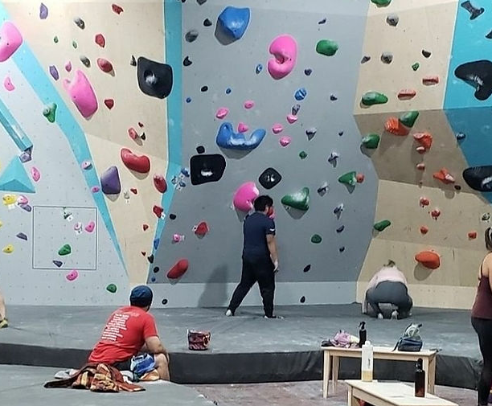
Insight Climbing and Movement
Insight Climbing and Movement is an expansion of Island Rock gym, a women owned business located in Bremerton, WA.
The project was the purchase and renovation of a building that offers over 3,500 square feet of climbing terrain, including bouldering, 25 and 45 degree training walls, an adjustable treadwall and fitness studio.
This project created 10 new jobs for the community.

Slide 20

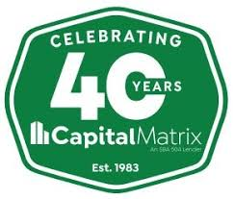
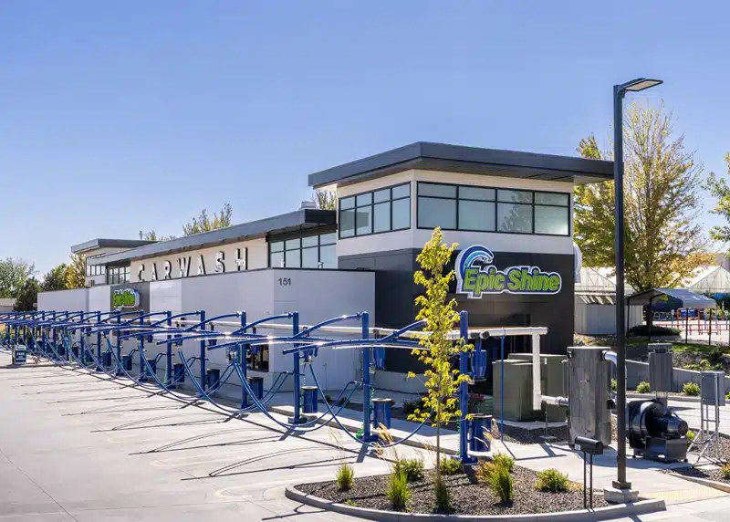
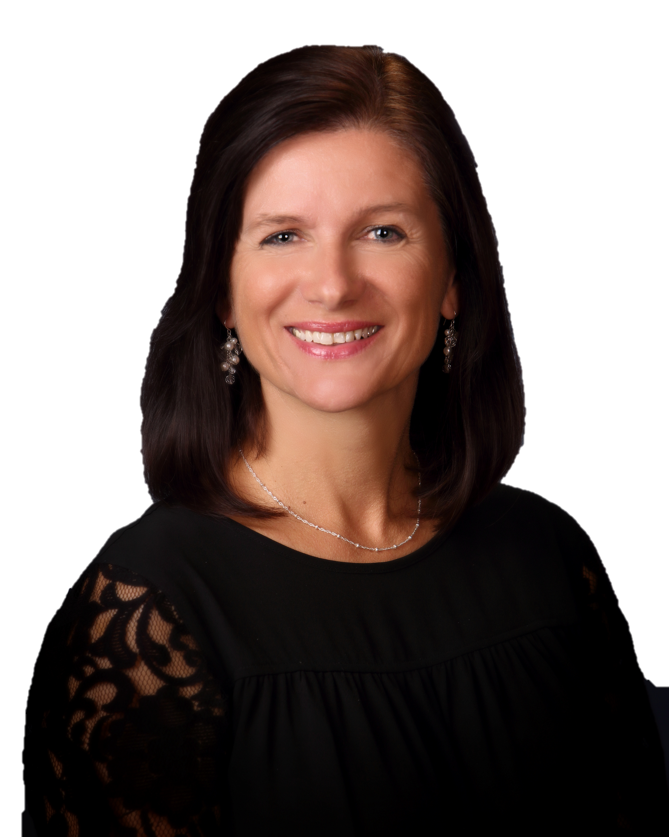

Capital Matrix is a CDC located in Boise, Idaho and promotes the SBA 504 loan program to lenders and small businesses in the state of Idaho, Washington, Montana and Utah.
Over the last few years, Capital Matrix assisted with the financing of several EPIC Shine car washes. Due to the size of a car wash project, borrower was maxed out on SBA 504 financing after two car washes. To qualify for an additional $5 million in SBA funds, borrower installed solar panels on the third and fourth car wash. The solar panels result in at least 15% of energy consumption from renewable energy sources, meeting SBA green requirement.

Slide 21
Who is Evergreen?
We facilitate the premier financing tool for owner-occupied commercial real estate:
The SBA 504 Loan
We partner with lenders in Idaho, Washington, Oregon, and Alaska to fund small business growth
With 44 years of experience, we have…
Helped create over 23,760 JOBS
in the PNW
Assisted with nearly
$6 BILLION
in capital improvements
Provided over
3,400 LOANS
totaling +$2 billion
www.evergreen504.com
Robin Amrine – VP & Loan Officer (208) 929-6282

Slide 22
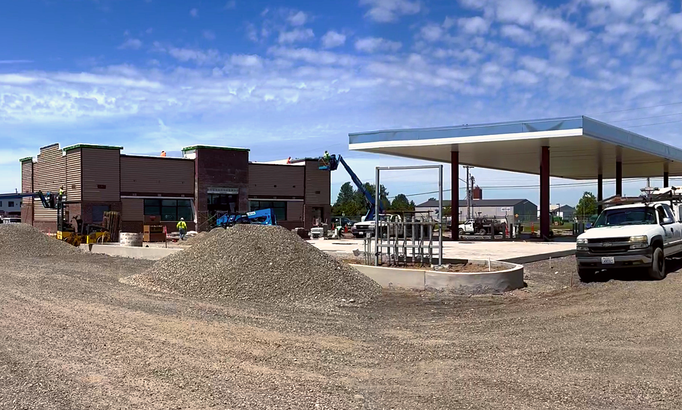

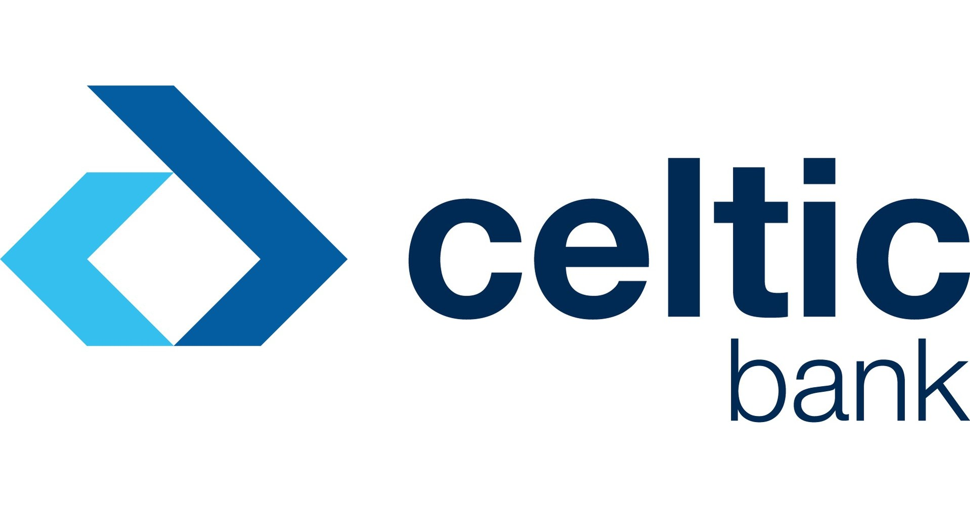
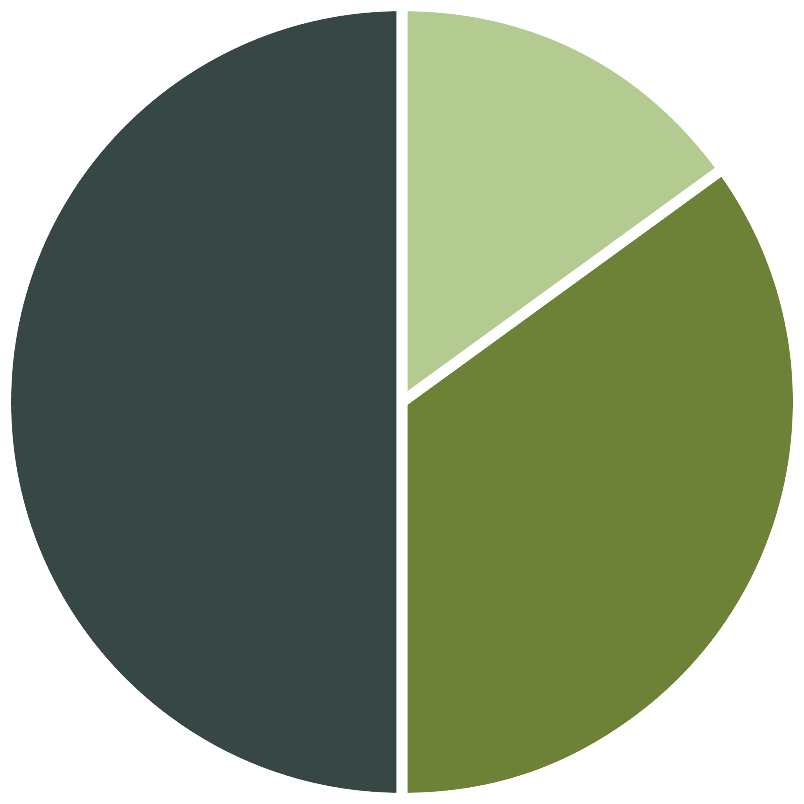
SP Petroleum, Inc.
CDC: Evergreen Business Capital
TPL: Celtic Bank
Project Amounts
Third Party Lender | $6,385,000.00
SBA 504 | $4,469,500.00
Borrower | $1,915,500.00
SP Petroleum, Inc. is a new, minority-owned truck stop/gas station/convenience store in Lynden, WA near the Washington and Canadian border. It is owned and operated by Lakhwinder “Lucky” Malhi and his wife Rajvinder.
The business is strategically located near many warehouses and shipping/receiving centers that sees hundreds of trucks load and unload daily. The business will also benefit from heavy traffic volume through the nearby Washington and Canadian border.
The project utilized the SBA 504 Green Program. The business installed solar panels on the roof of the canopy that lead to an anticipated energy reduction of 15.25% for the business.
BORROWER
15%
TPL
50%
SBA 504
35%
Eligibility
Public Policy Goal | Reduce Energy
Jobs Created/Retained | 12 Created
Est. Energy Reduction | 15.25%
www.evergreen504.com
Robin Amrine – VP & Loan Officer (208) 929-6282

Slide 23
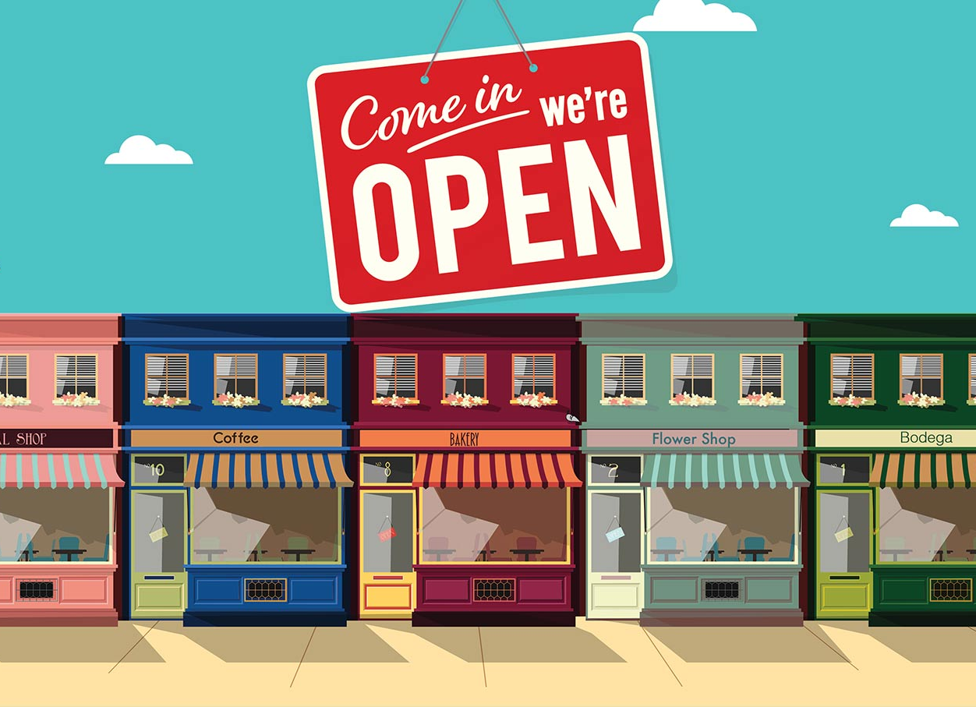
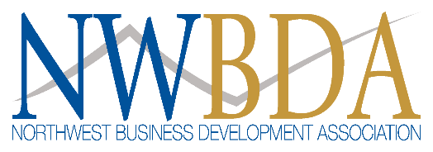

Premier SBA 504 Lending Partner
Certified in 1981 to facilitate the SBA 504 Loan Program. We are license by the U.S. Small Business Administration to originate, fund and service SBA 504 loans.
Currently serve all of Washington, Oregon and 10 northern counties of Idaho.
We are non-profit and give back to the communities we serve through economic development. In 2023 NWBDA disbursed $100,000 in the communities we serve to support economic development. Our affiliated company disbursed another $60,000.
Our Mission is to promote small business success, job growth and community economic strength by serving as the Northwest’s premier resource connecting borrowers and lenders as well as the Government to provide small business loans.
Our vision is to provide every eligible small business in the Inland Northwest access to capital on reasonable terms. Through this, we can achieve BIG dreams for SMALL businesses!

Slide 24
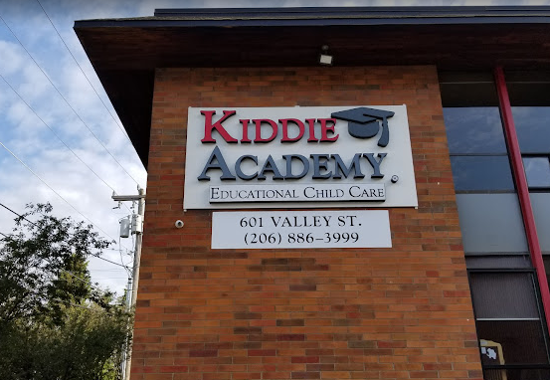

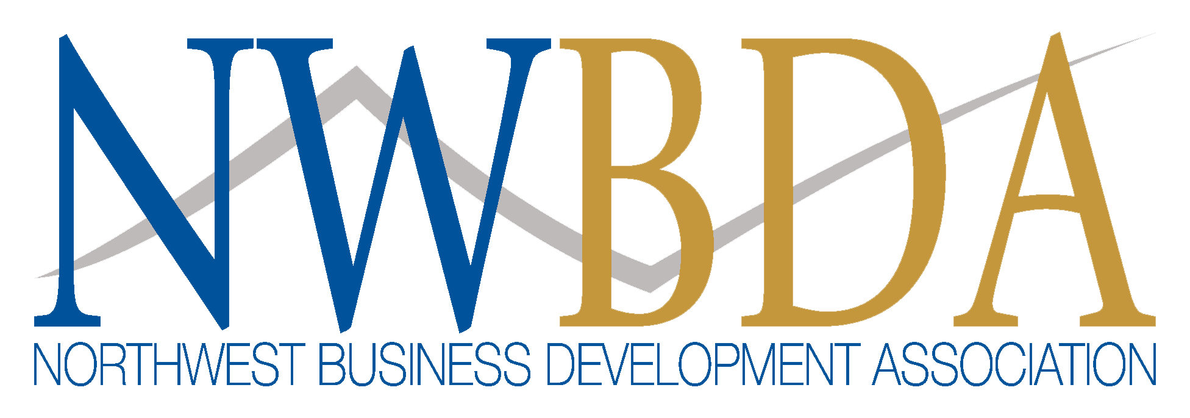
Kiddie Academy Seattle
Educational Child Care
NWBDA Success Story
Total Project | $12,510,000 | 100%
Third Party Lender | $6,255,000 | 50%
SBA 504 Debenture | $5,004,000 | 40%
Borrower Injection | $1,251,000 | 10%
Energy Goal for qualification was the reduction of existing energy consumption through the retrofit of the applicant’s existing leased facility. The retrofit reduced energy consumption of that facility by at least 10%, regardless of the energy usage of any other facilities the applicant operates.
This Green Energy Project created 10 jobs

Slide 25
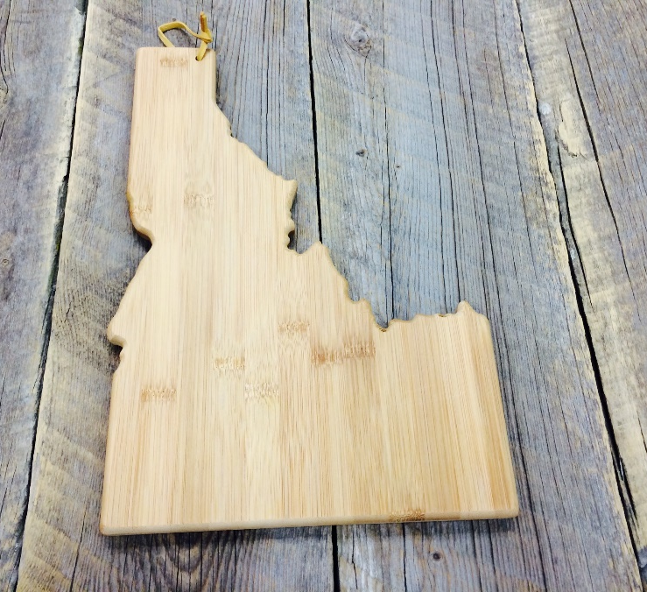

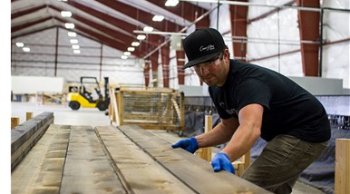
Panhandle Area Council, Inc.
A non-profit economic development organization incorporated in 1972, located in Hayden, Idaho with satellite offices in Boise and Twin Falls.
Certified by the SBA to promote and administer the SBA 504 Loan Program
EDA Certified Economic Development District
Community Project Development (grant writing/admin)
Revolving Loan Fund Program for Small Businesses
Operate Incubator/Co-Workspace (12 tenants)
Serving Idaho
CDA Wood
Post Falls
www.pacni.org

Slide 26
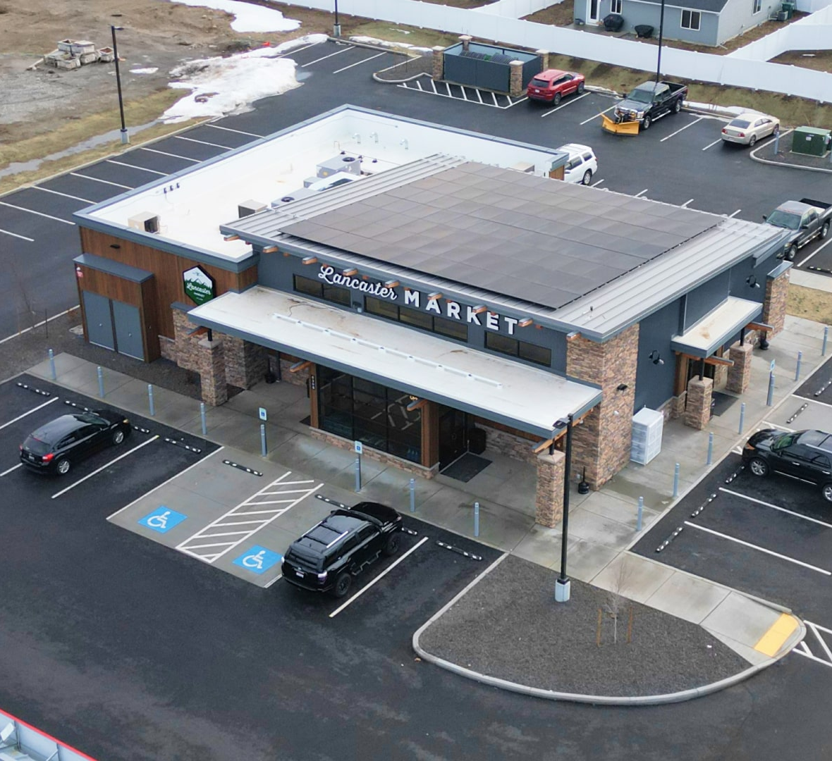
Panhandle Area Council, Inc.
Borrower: Hayden Market, LLC dba Lancaster Market ($1,080,226)
TPL: Washington Trust Bank ($3,032,681)
CDC: PAC (Debenture – $1,952,455)
Debenture Funding: August 2024
Jobs Created/Retained: 11
Success Story: Lancaster Market is an owner/operator of several upscale gas station/convenience stores in north Idaho. Lancaster Market financed their first store in 2016 with an SBA 7(a) loan and an SBA 504 loan for this new facility (expansion) would be in excess of SBA’s lending limit to one borrower. The applicant elected to utilize the SBA Energy Public Policy goal that enabled utilization of a $5,500,000 (maximum) 504 Gross Debenture. Energy needs for the project will be partially supported by a Solar System.
Solar System
Lancaster Market engaged Partner Energy to analyze and measure power capacity of a solar system designed to meet the Energy Public Policy requirements. A 35-kW roof top solar system was selected.

Slide 27

Questions for our Friendly CDCs?

Slide 28
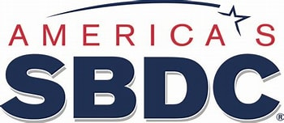

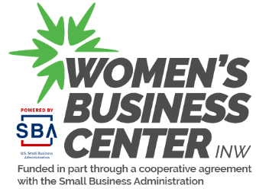
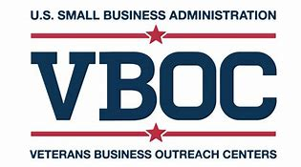
How to put this all together!
Utilize the No Cost High Value SBA Resource Partners Near you!

Slide 29
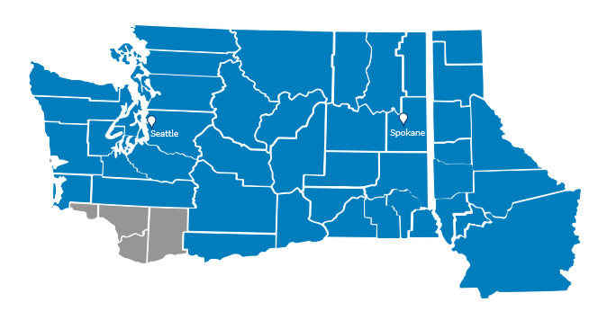


Your Local SBA District Office Can Help
Seattle District Office
2401 4th Ave., Suite 450
Seattle, WA 98121
(206) 553-7310
Spokane Branch Office
801 W. Riverside Ave., Suite 444
Spokane, WA 99201
(509) 353-2800
Connect with Us
www.sba.gov/wa
@SBASeattle
linkedin.com/showcase/sbaseattle
infosdo@sba.gov
Email alerts: www.sba.gov/updates

Slide 30

Special Bonus Session today from 2:30 to 3:30
SBA Office of Advocacy – Listening Session with Jenn Clark – Regional Advocate Region 10 (AK, ID, WA, OR)

Slide 31

How are we doing?
Please take a minute to let us know
www.sba.gov/feedback

