Slide 1
To Kill Your Community

Slide 2
1
FORGET THE WATER
-
QUALITY AND QUANTITY

Slide 3
2
DON'T ATTRACT BUSINESSES

Slide 4
3
DON'T ENGAGE YOUTH

Slide 5
4
DECEIVE YOURSELF

Slide 6
5
SHOP
ELSEWHERE

Slide 7
6
DON'T PAINT

Slide 8
7
DON'T
COOPERATE

Slide 9
8
LIVE IN THE PAST

Slide 10
9
SHUT OUT YOUR SENIORS

Slide 11
10
REJECT EVERYTHING NEW

Slide 12
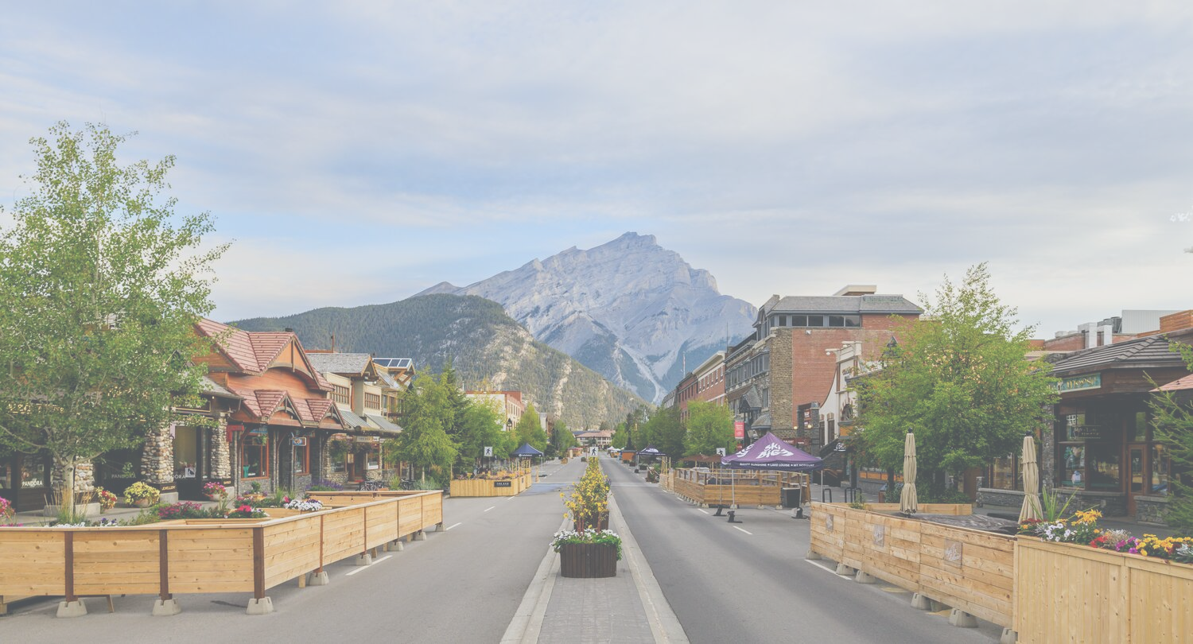
11
IGNORE OUTSIDERS

Slide 13
12
GROW COMPLACENT

Slide 14
13
DON'T TAKE
RESPONSIBILITY

Slide 15
THERE'S ALWAYS A WAY...
TO SUCCEED.
www.13ways.ca
+1 (587) 573-1313
13WaysInc
13ways.community
info@13ways.ca
Doug13Ways
Griff13Ways

