Slide 1
The Outdoor Recreation Economy: Impacts, Trends, and Strategies
Megan Lawson, Ph.D.
megan@headwaterseconomics.org

Slide 2
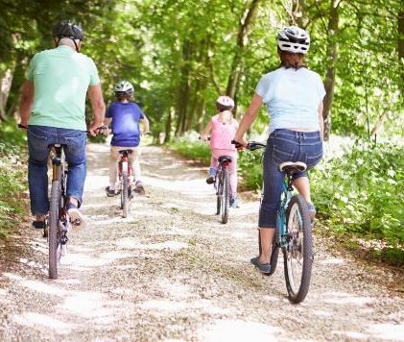
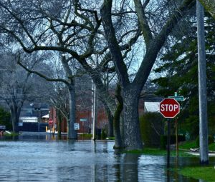
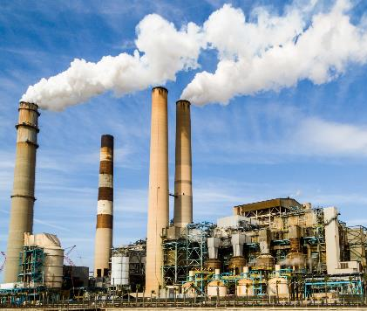
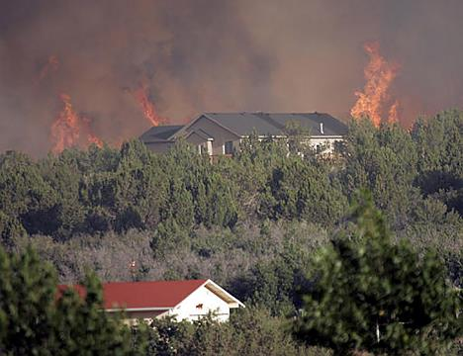
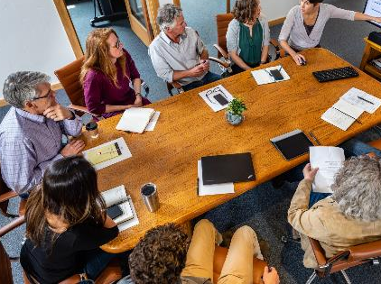
Independent Nonpartisan Research
https://headwaterseconomics.org

Slide 3
Overview
1
What is an outdoor recreation economy?
Outdoor recreation in the Inland NW
3
So you want to be an outdoor recreation town…
2

Slide 4
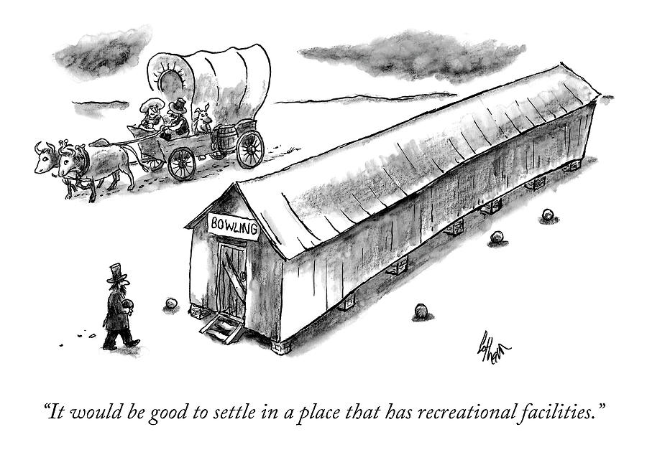
Recreation brings more than just tourism
1
Notes:
Cartoon: Frank Cotham

Slide 5
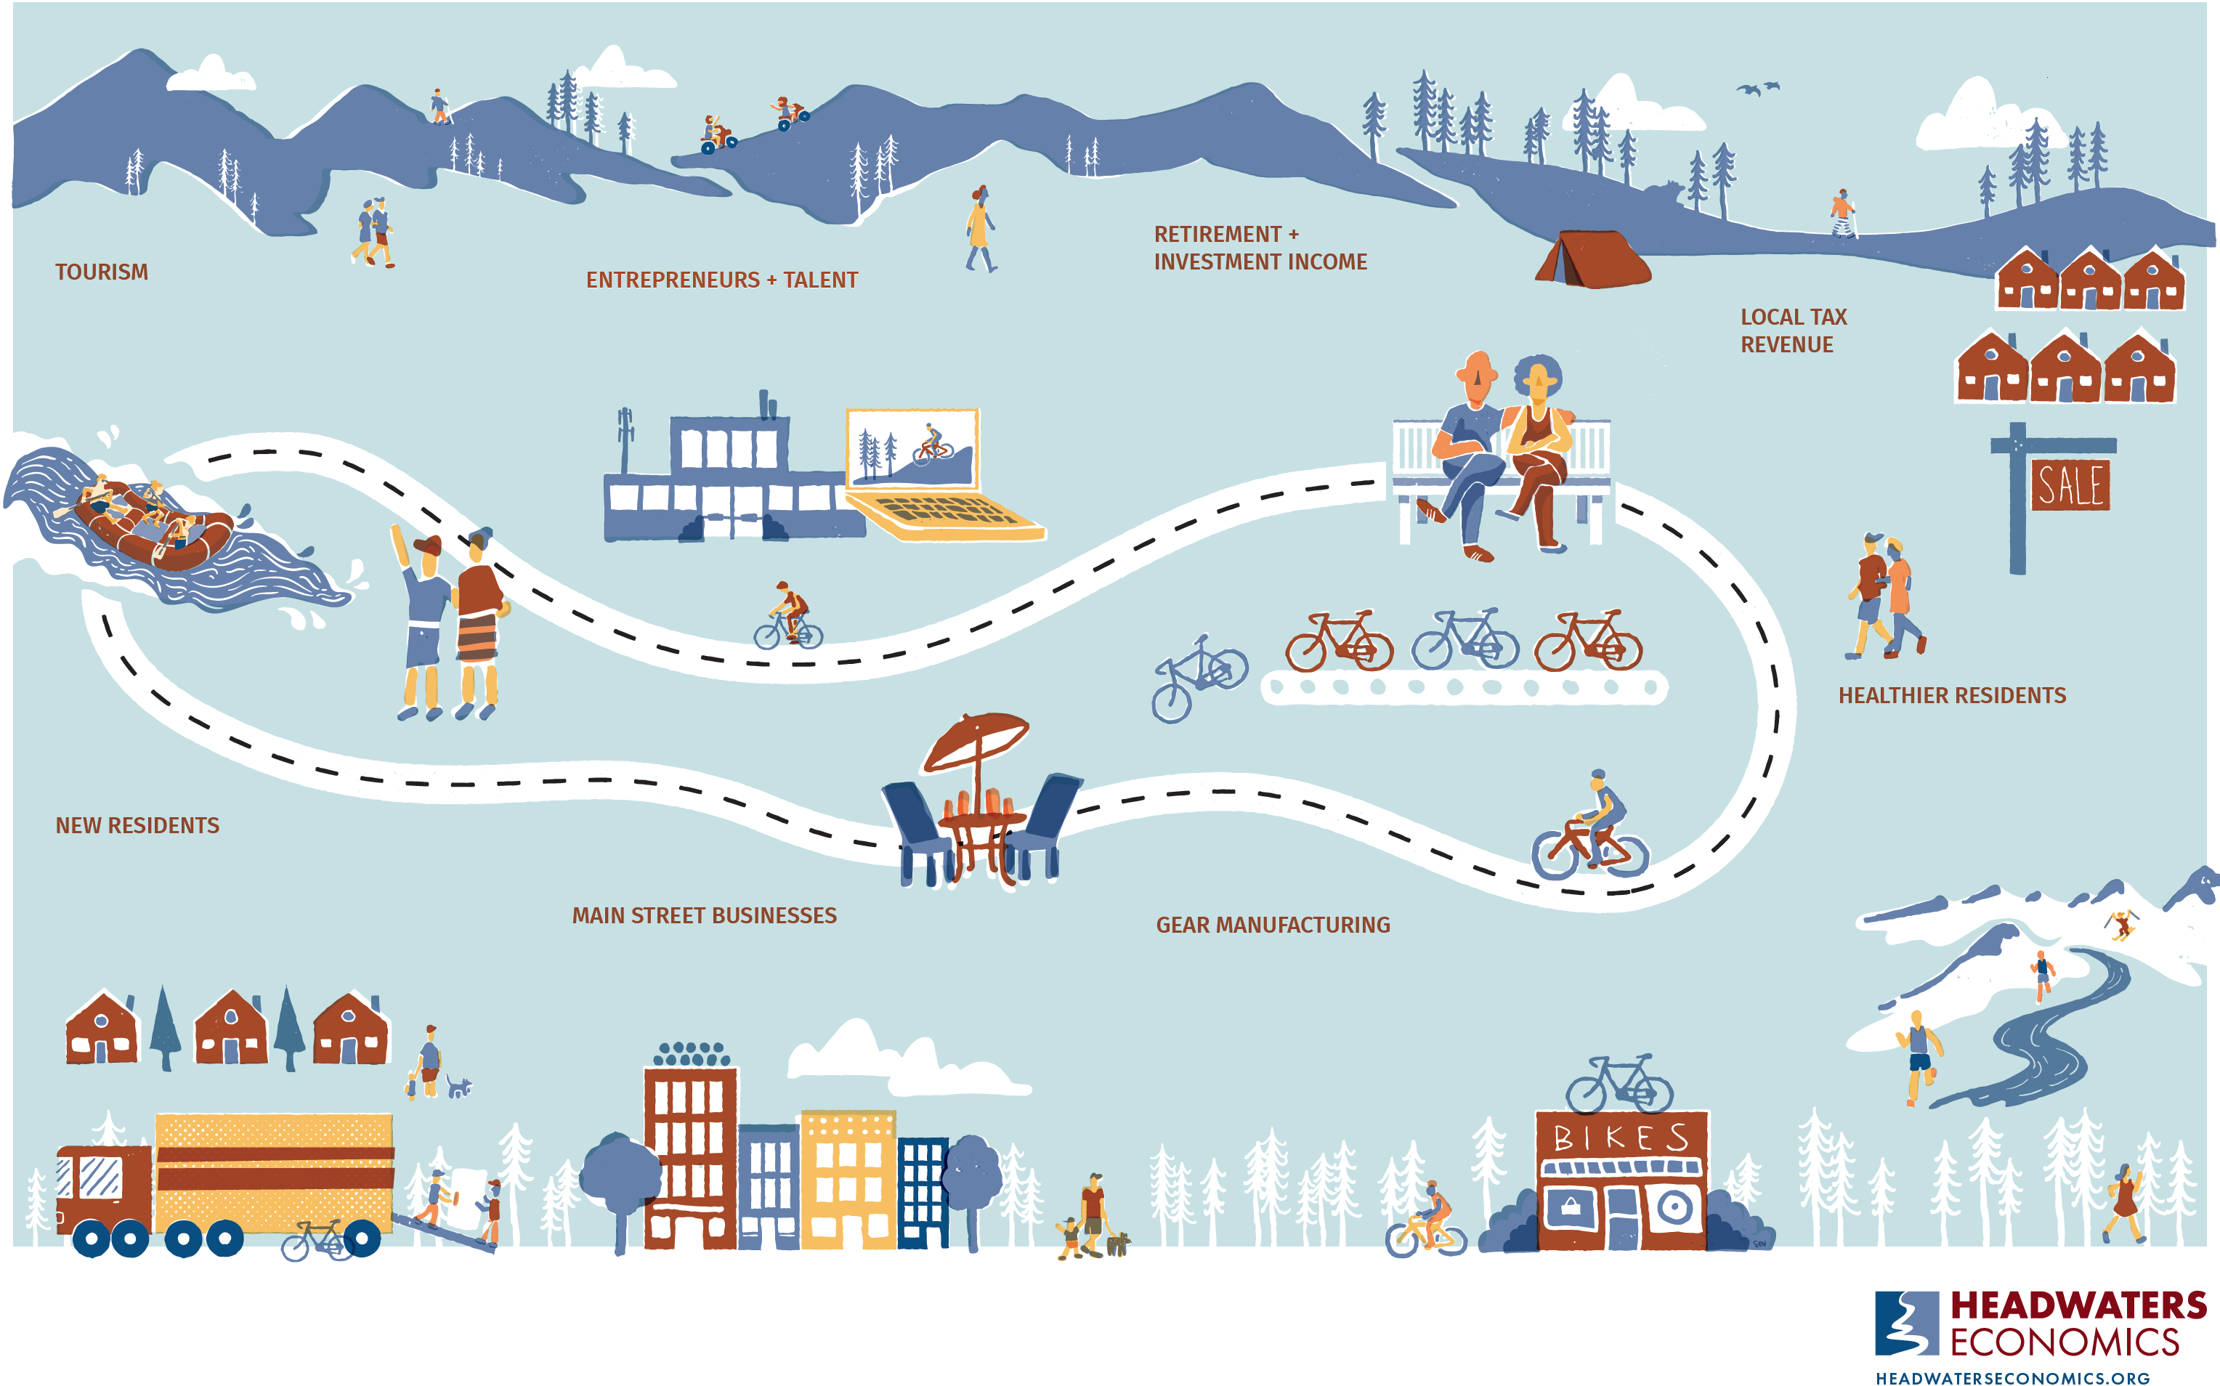

Slide 6
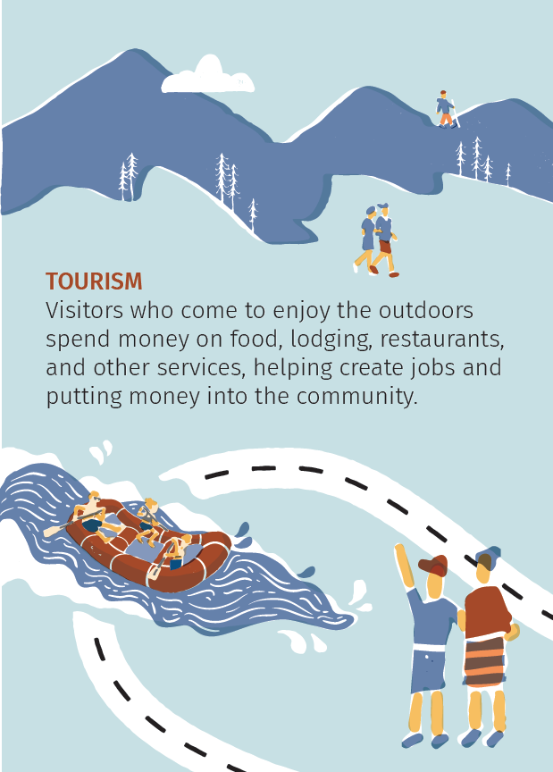
1

Slide 7
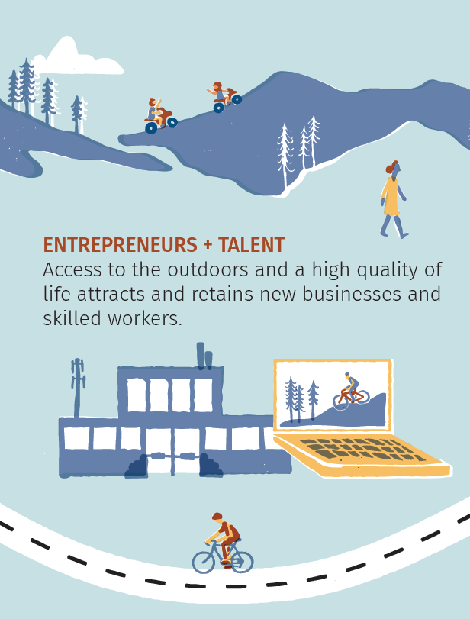
2

Slide 8
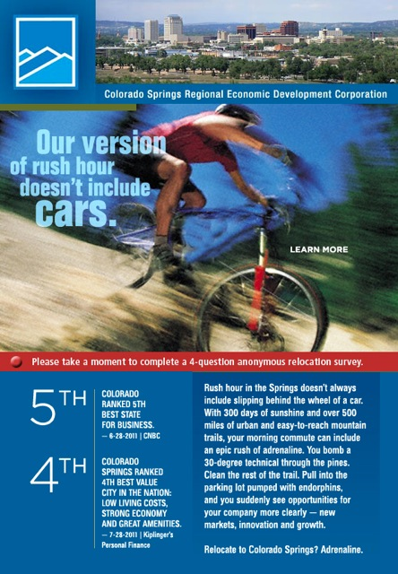
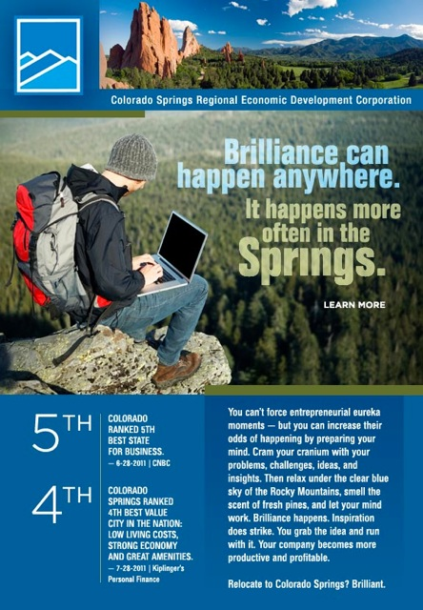
Recruiting businesses and talent
1

Slide 9
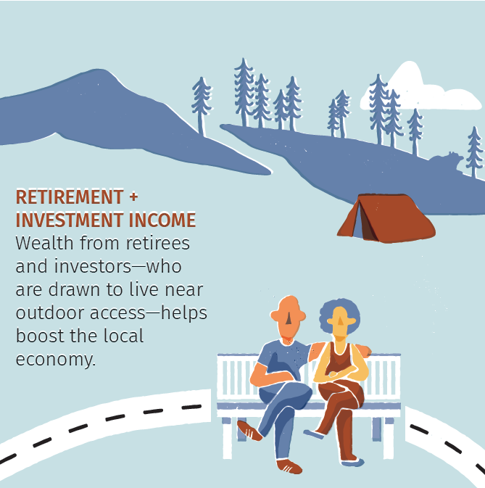
3

Slide 10
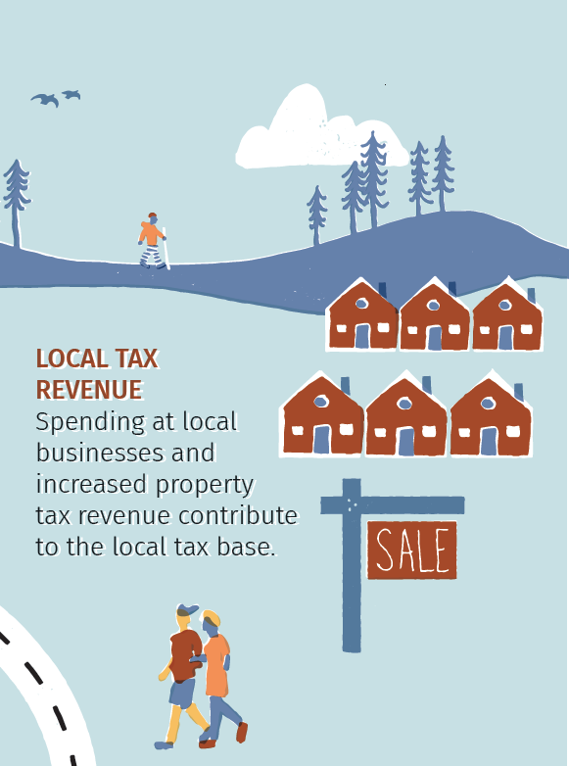
4

Slide 11
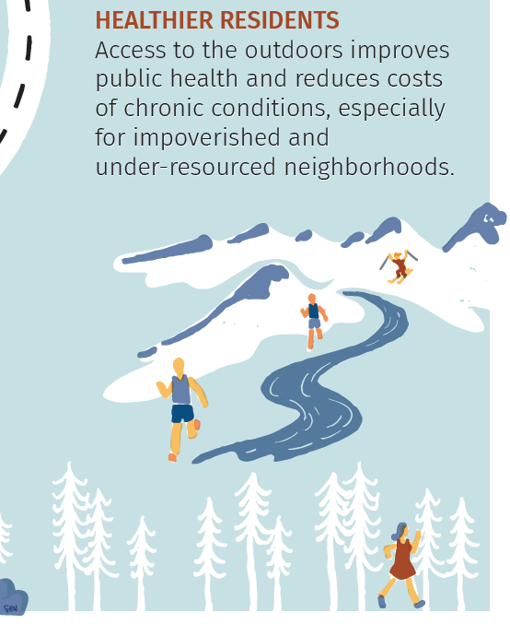
5

Slide 12
6

Slide 13
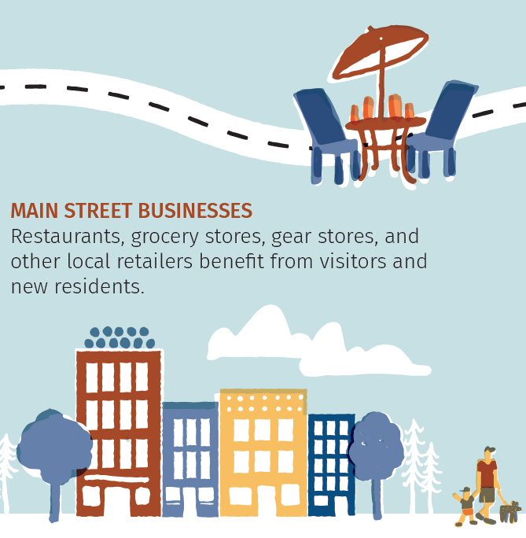
7

Slide 14
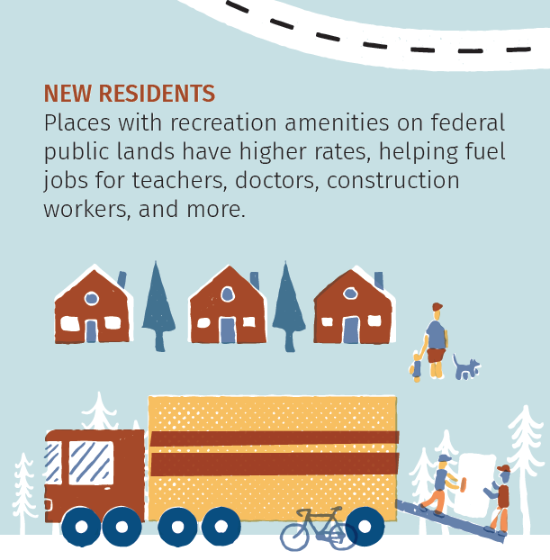
8

Slide 15
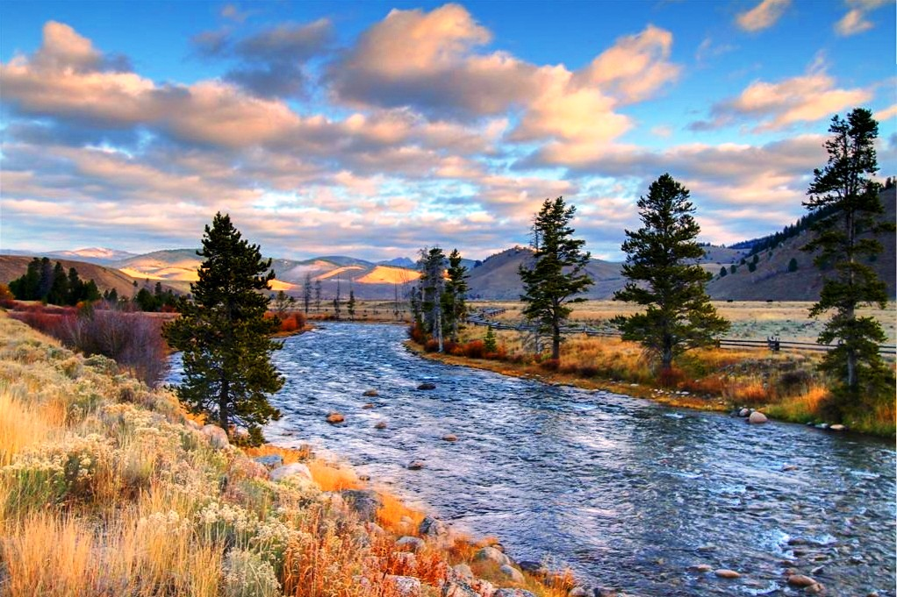
What is a “recreation economy”?
1
Definition by the US Department of Agriculture:
High share of employment and income from tourism
High share of second homes

Slide 16
What is a recreation economy NOT?
1
Unilateral
A silver bullet

Slide 17
Poll
www.menti.com
Code: 8818 6361

Slide 18
Trends in the Inland NW
2

Slide 19
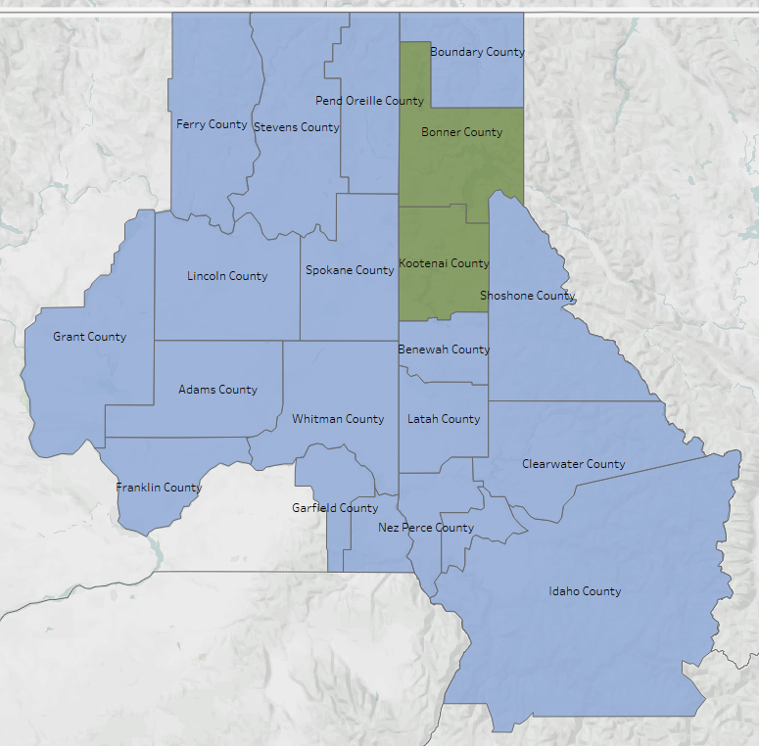
Recreation economies in the Inland Northwest
2
2 of 21 counties classified as “recreation-dependent”

Slide 20
Recreation economies bring more people
2

Slide 21
Wages are lower
2

Slide 22
Wages are lower… but growing faster
2

Slide 23
Recreation economies bring wealth
2

Slide 24
Recreation communities are expensive
2

Slide 25
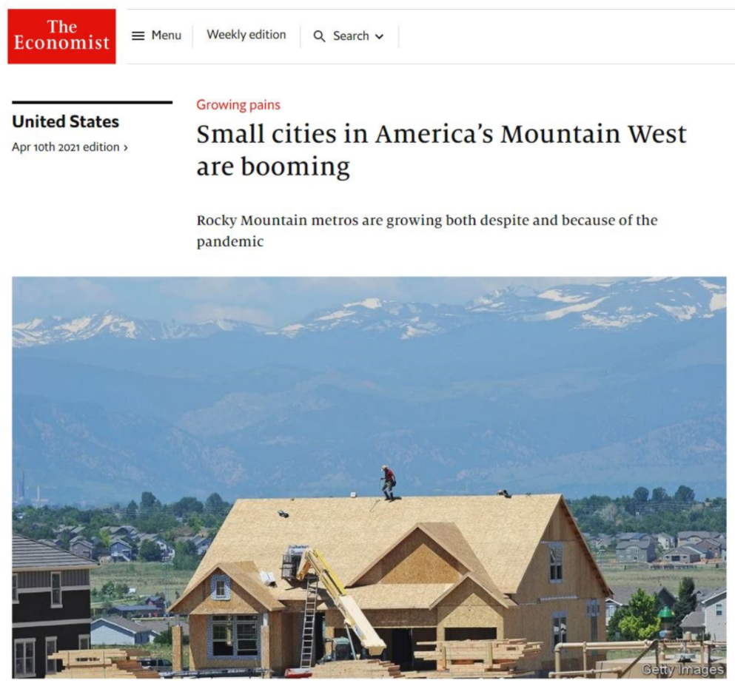
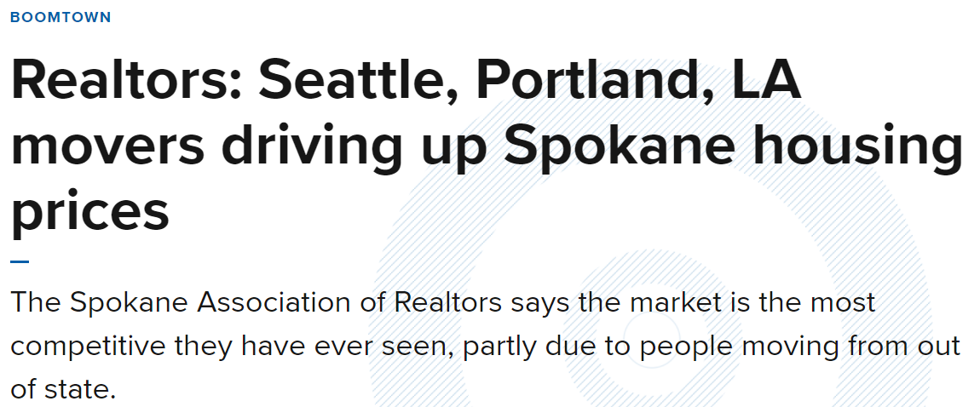
Opportunities for recreation economies
2
Notes:
CityLab 2/21/2021

Slide 26
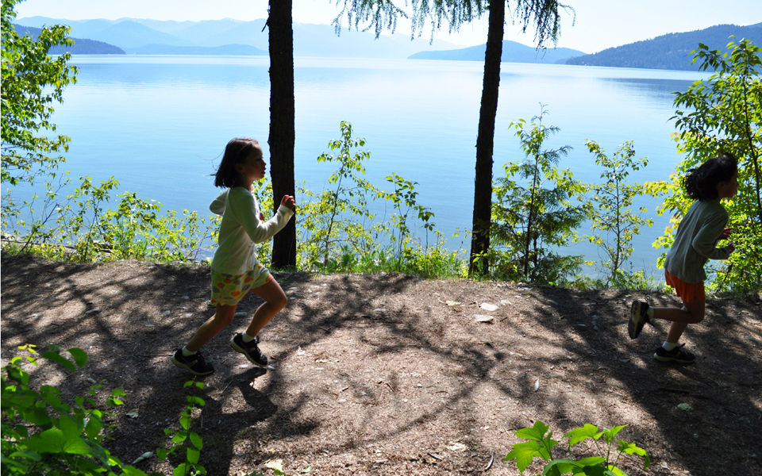
Sandpoint, Idaho
2

Slide 27
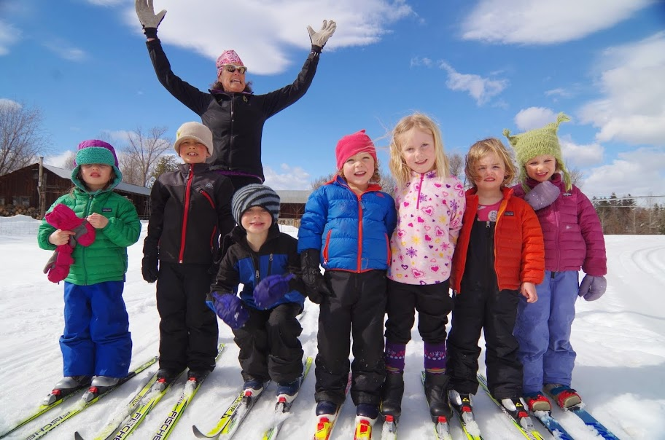
Methow Valley, Washington
2

Slide 28
Methow Valley, Washington
2
$1 → $6 return

Slide 29
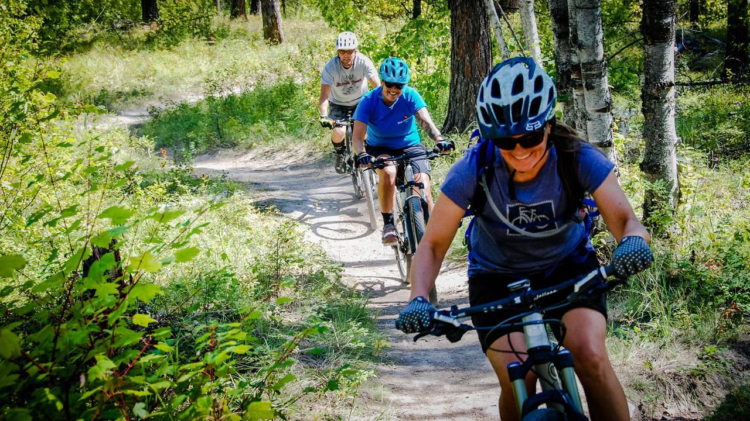
Whitefish, Montana
2

Slide 30
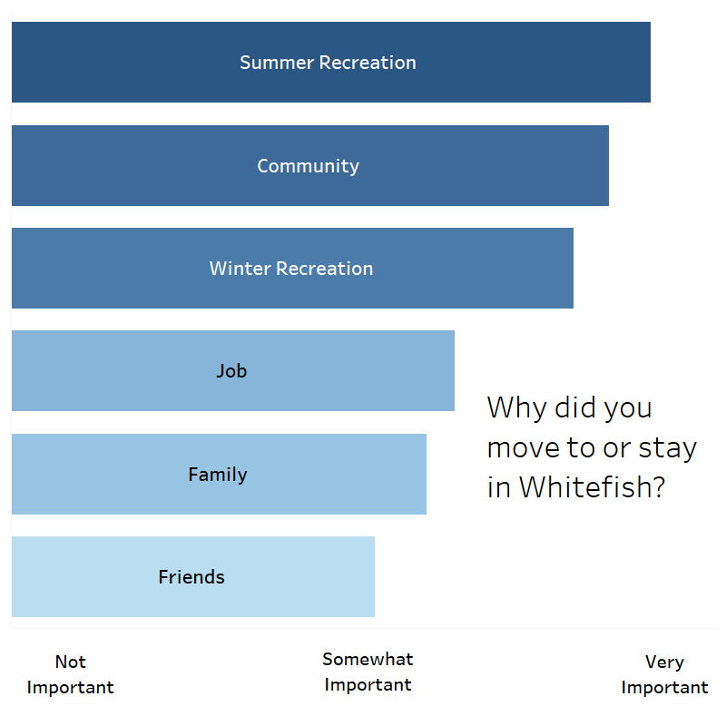
Whitefish, Montana
2

Slide 31
Whitefish, Montana
2
$1 → $2.50 return

Slide 32
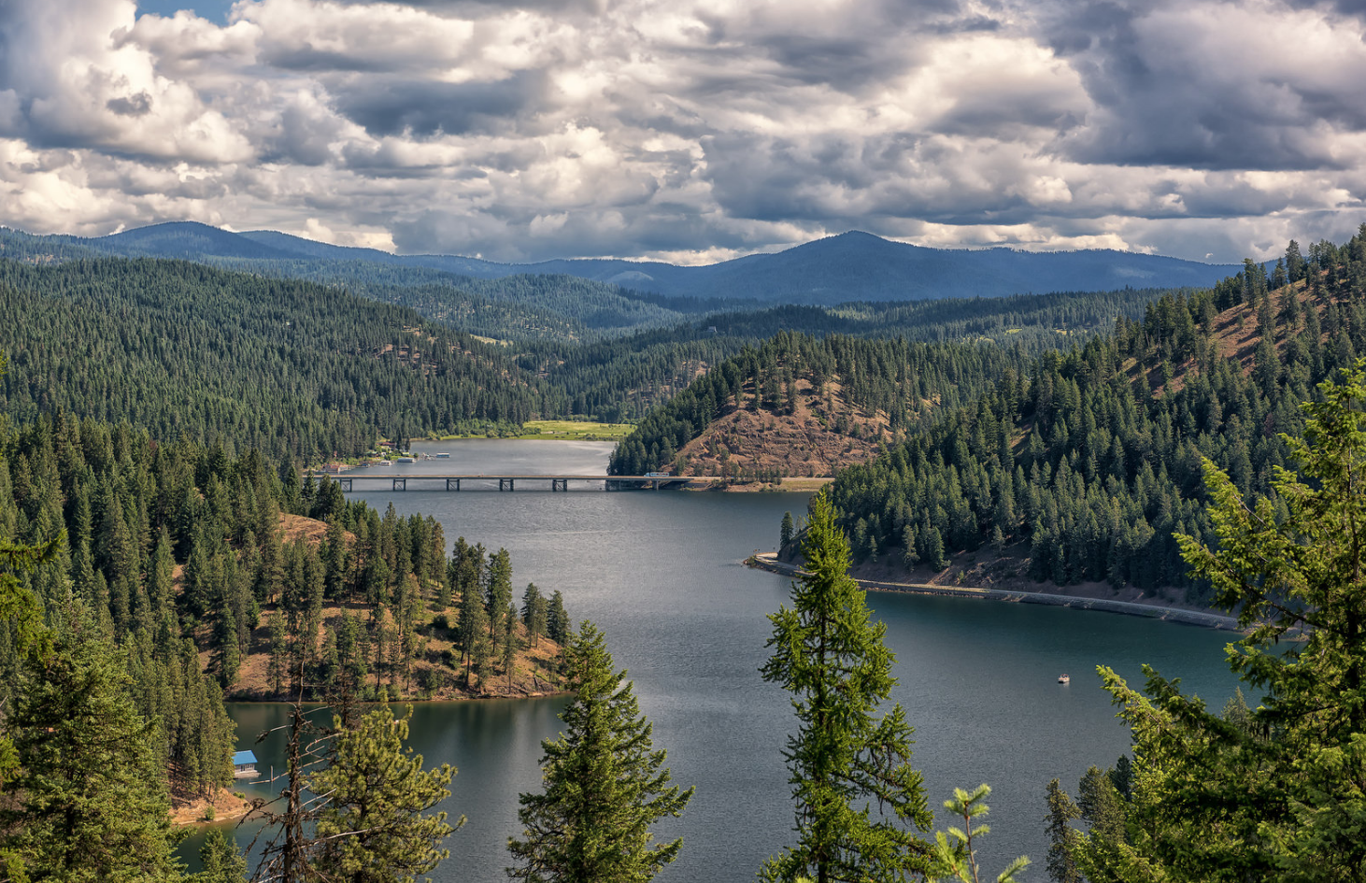
So you want to be an outdoor recreation town
3

Slide 33
So you want to be an outdoor recreation town
3
1
Tourism+
2
3
4
5
6

Slide 34
So you want to be an outdoor recreation town
3
1
Tourism+
2
Invest
3
4
5
6

Slide 35
So you want to be an outdoor recreation town
3
1
Tourism+
2
Invest
3
Anticipate
4
5
6

Slide 36
So you want to be an outdoor recreation town
3
1
Tourism+
2
Invest
3
Anticipate
4
Connect
5
6
Notes:
.

Slide 37
So you want to be an outdoor recreation town
3
1
Tourism+
2
Invest
3
Anticipate
4
Connect
5
Measure
6

Slide 38
So you want to be an outdoor recreation town
3
1
Tourism+
2
Invest
3
Anticipate
4
Connect
5
Measure
6
Partners

Slide 39
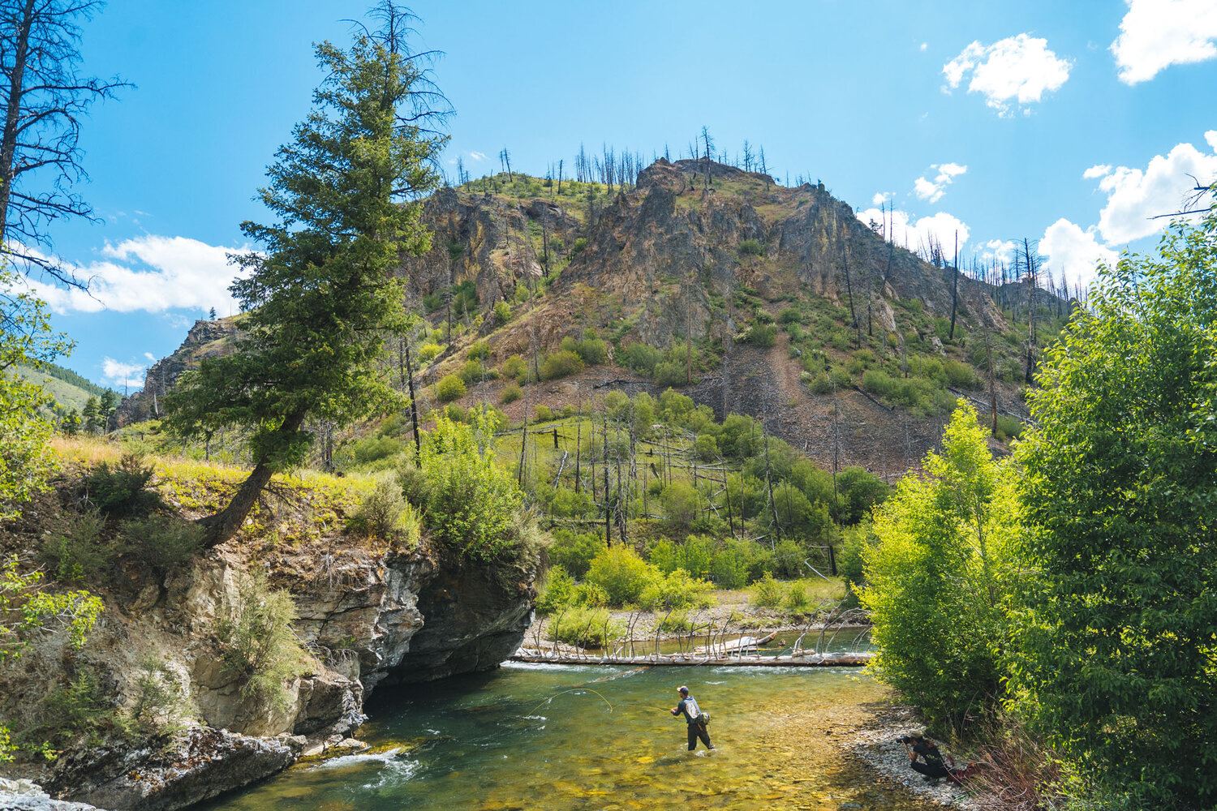
Three things to remember:
1. Outdoor rec = diversification opportunity
2. Alive and well in the Inland NW
3. Doesn’t happen well by accident.

Slide 40
Thank you!
Megan Lawson, Ph.D
megan@headwaterseconomics.org
406-570-7475

