Slide 1


Slide 2


Slide 3
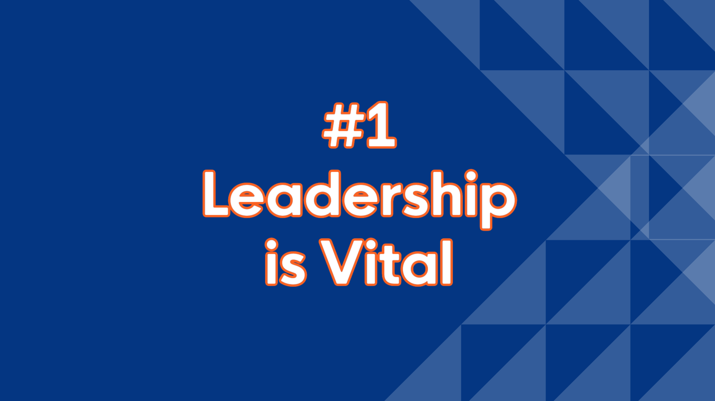
Notes:
If you want to start something amazing in your town, you need good leadership. Each program we heard about took foresight and people open to trying something new. It took leadership that was willing to put money behind their vision. It took cohesiveness. We all know this can be tough. Good leadership takes people willing to get educated in community development. It may take several elections to get the right group. But, key leadership is the one constant that we need in our communities to make great things happen.

Slide 4
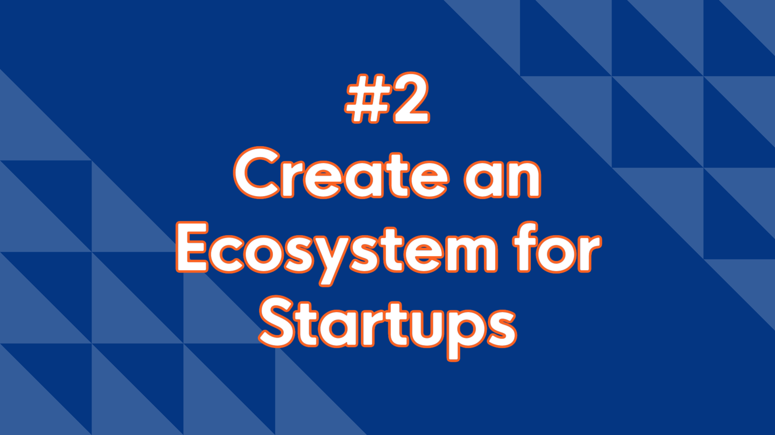
Notes:
Whatever industry you want to attract, they will need a supportive ecosystem. What can you do to support more startup companies? Startups are responsible for the growth of our communities. We need to do whatever we can to support them. How can you help them raise capital? Who do you know that you can partner with to create a great ecosystem in your community?

Slide 5
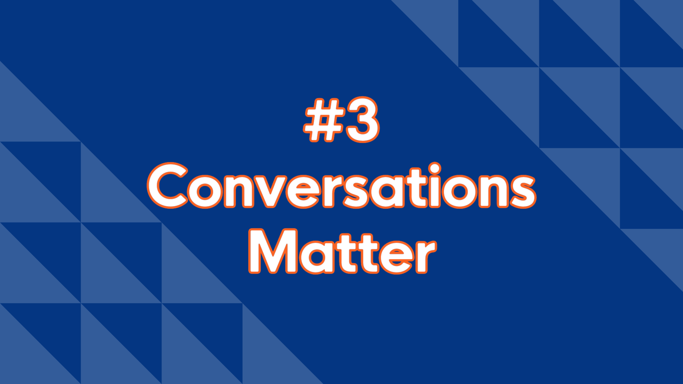
Notes:
Many times, we think we know what our community wants. We think we already know who needs to be involved in the process. But, we need to do a better job talking to people. One-on-one. The ones who are stopping progress – Roadblock Roger. The ones who have never been asked anything – Network Bias. Talk to the people we are trying to help and serve. These conversations can help break down a lot of barriers. And, they can help us make sure we are building the community people are going to use.

Slide 6
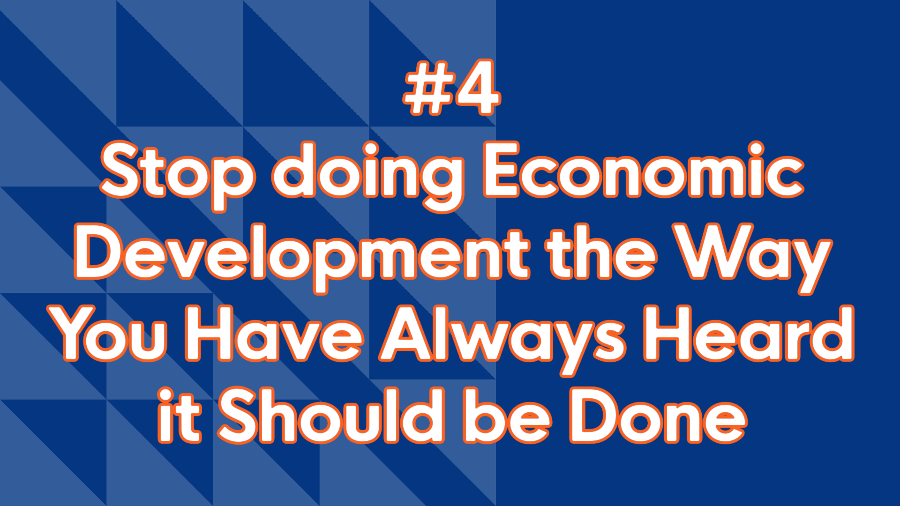
Notes:
Don’t be scared to do something different. Change it up. Go out and find the businesses that you would like to bring to your community and bring them there, even if you have to buy it yourself! Work with your existing businesses on a succession plan. Match them with high school and college kids who are interested in that field. There is more than one way to do economic development.

Slide 7
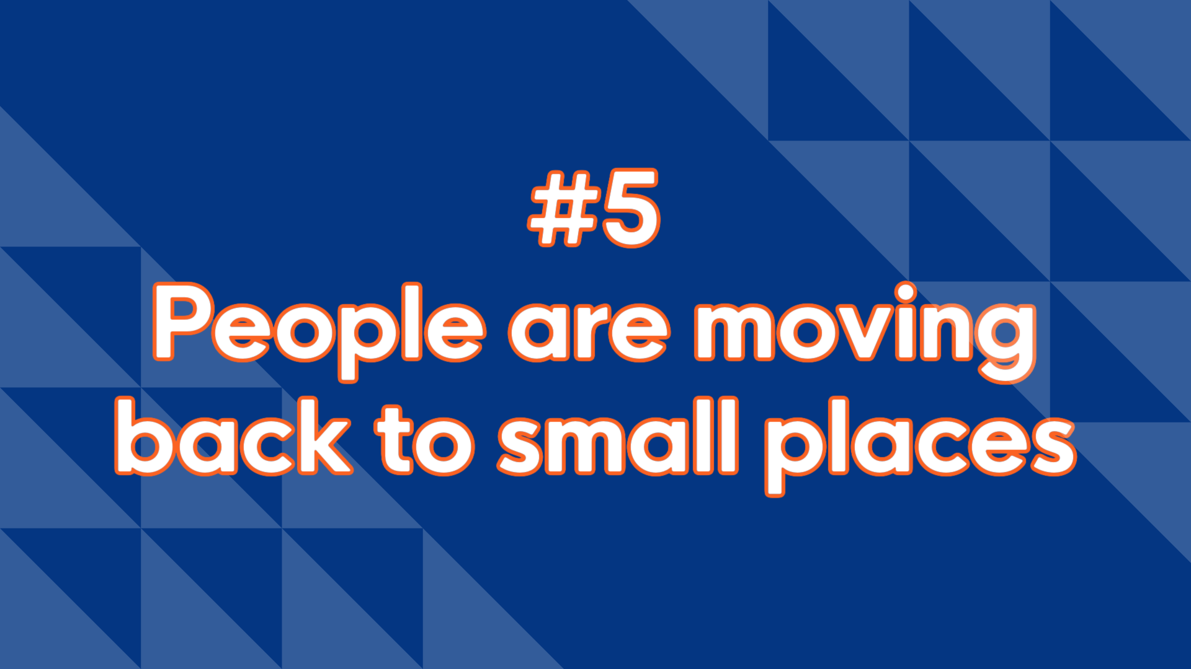
Notes:
Build the community people want to live in. Walmart is replicating small towns. They are copying us! So, maybe we really do have something to sell. They still need amenities. They need high speed internet. They need walkable spaces. Put some thought into how your community can tweak what you have and adapt to these new citizens coming to your town.

Slide 8
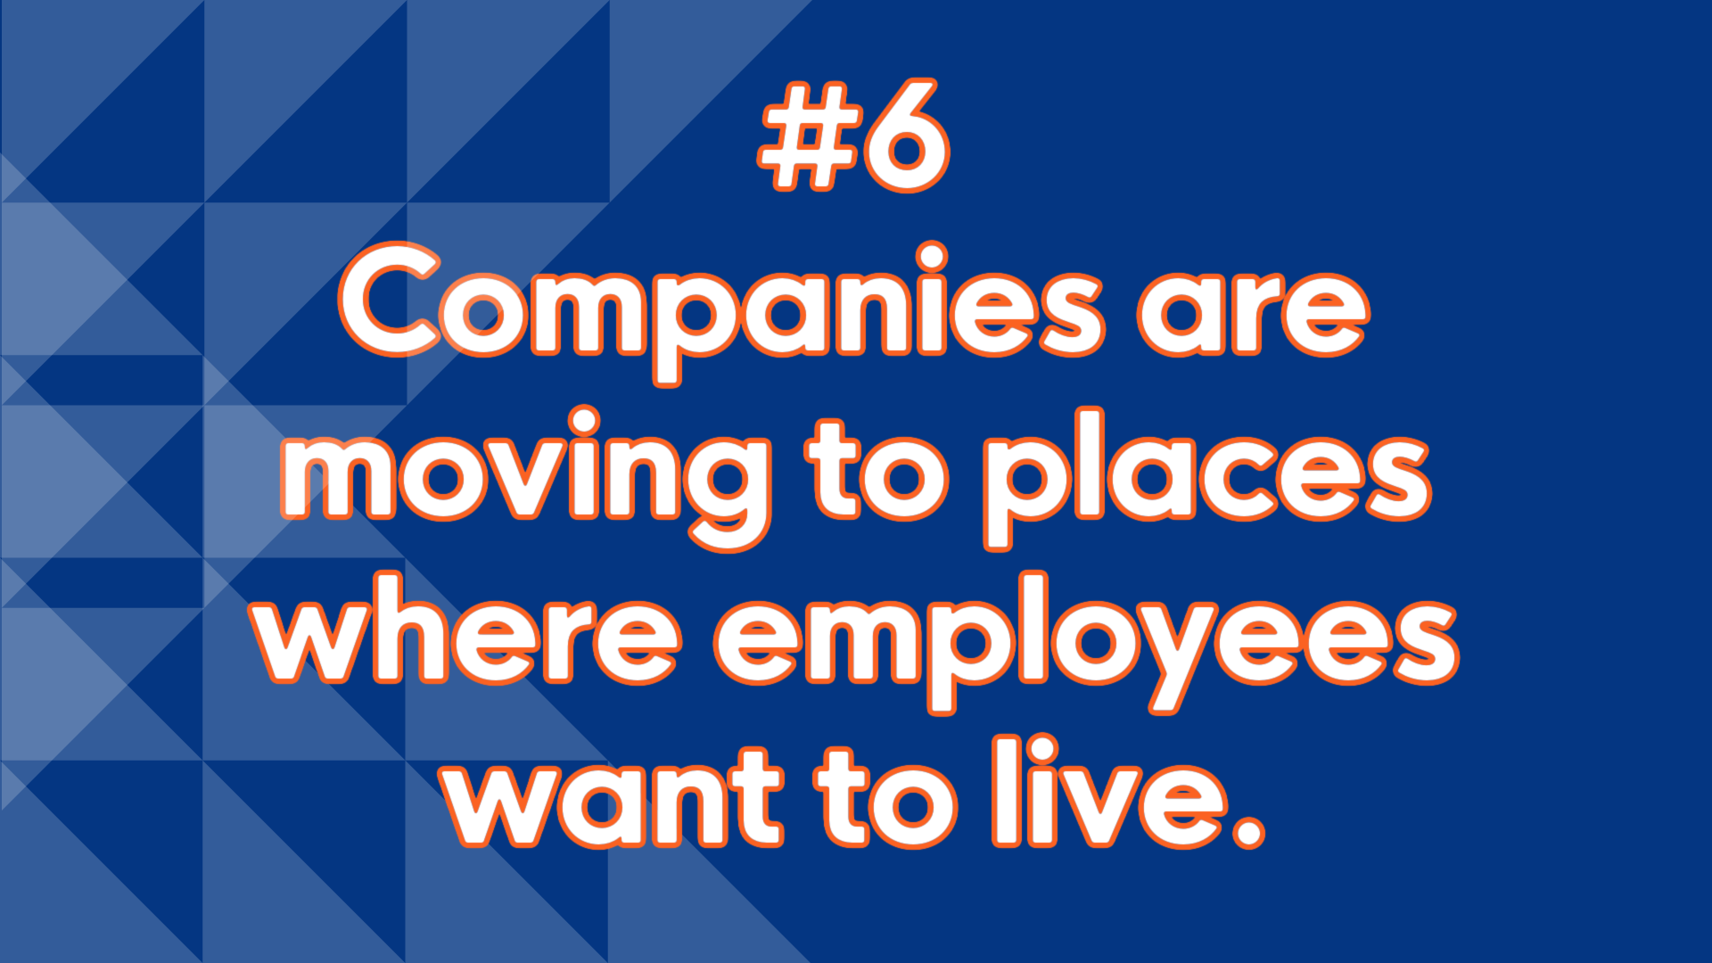
Notes:
What does that look like? Take a look at your downtown. If your downtown is thriving, it is a good indication your town is thriving. If it is not thriving, what can you do to Recast Your City? How can you bring small scale manufacturers downtown to occupy buildings, sell their wares, do tours of “how it is made”? Create a community that people don’t want to escape.

Slide 9

Notes:
It can feel overwhelming when you are trying to make positive changes in your community. Start small. Do one thing. Don’t do all the things. Pick one thing. Get everyone on board for one thing. Invest your time and money into that one thing. Give it time to grow into something great. Projects can take a long time. Go for the small wins to help build momentum quickly.

Slide 10
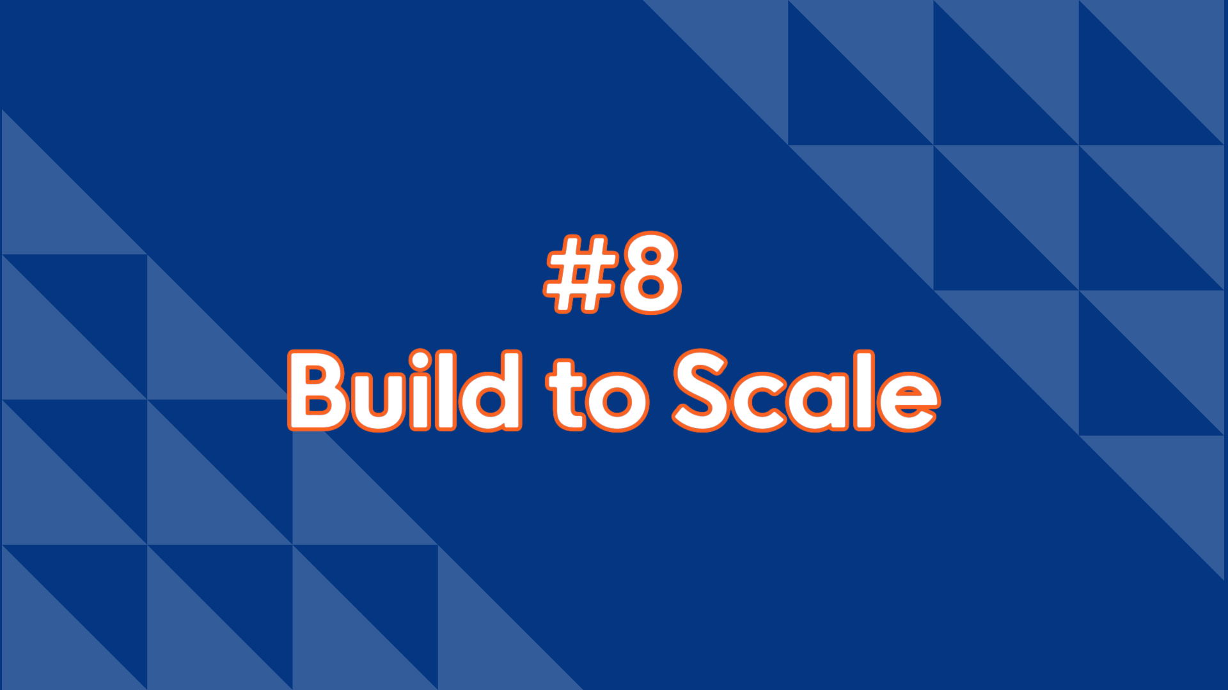
Notes:
You don’t have to break the bank. Start by helping the person who is creating one job. One job matters. Scale according to your community and your budget.

Slide 11
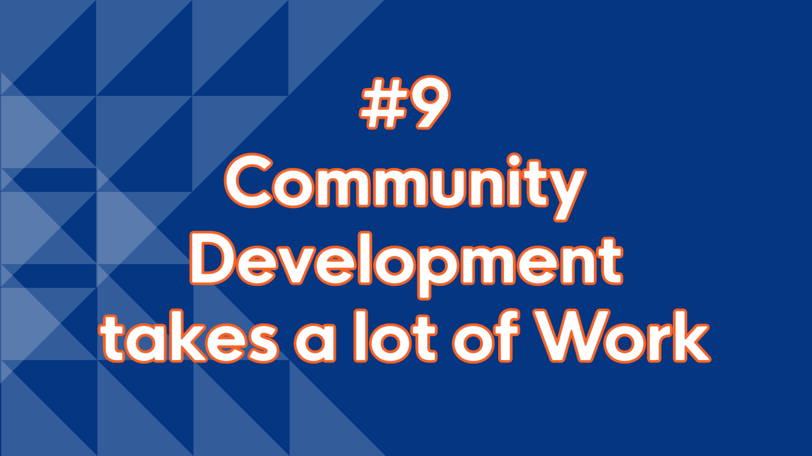
Notes:
Great ideas and programs all take planning, vision and long-term dedication. It doesn’t happen overnight. It is important to create a continuity plan so that the work can continue regardless of who gets elected.

Slide 12

Notes:
In a world of big box retailers, be original. Find what makes your town special and unique and do that. Let your originality shine through your businesses, your landscape, your people. Don’t feel like you have to be like everyone else. Be something fresh!

Slide 13


