Slide 1


Slide 2


Slide 3
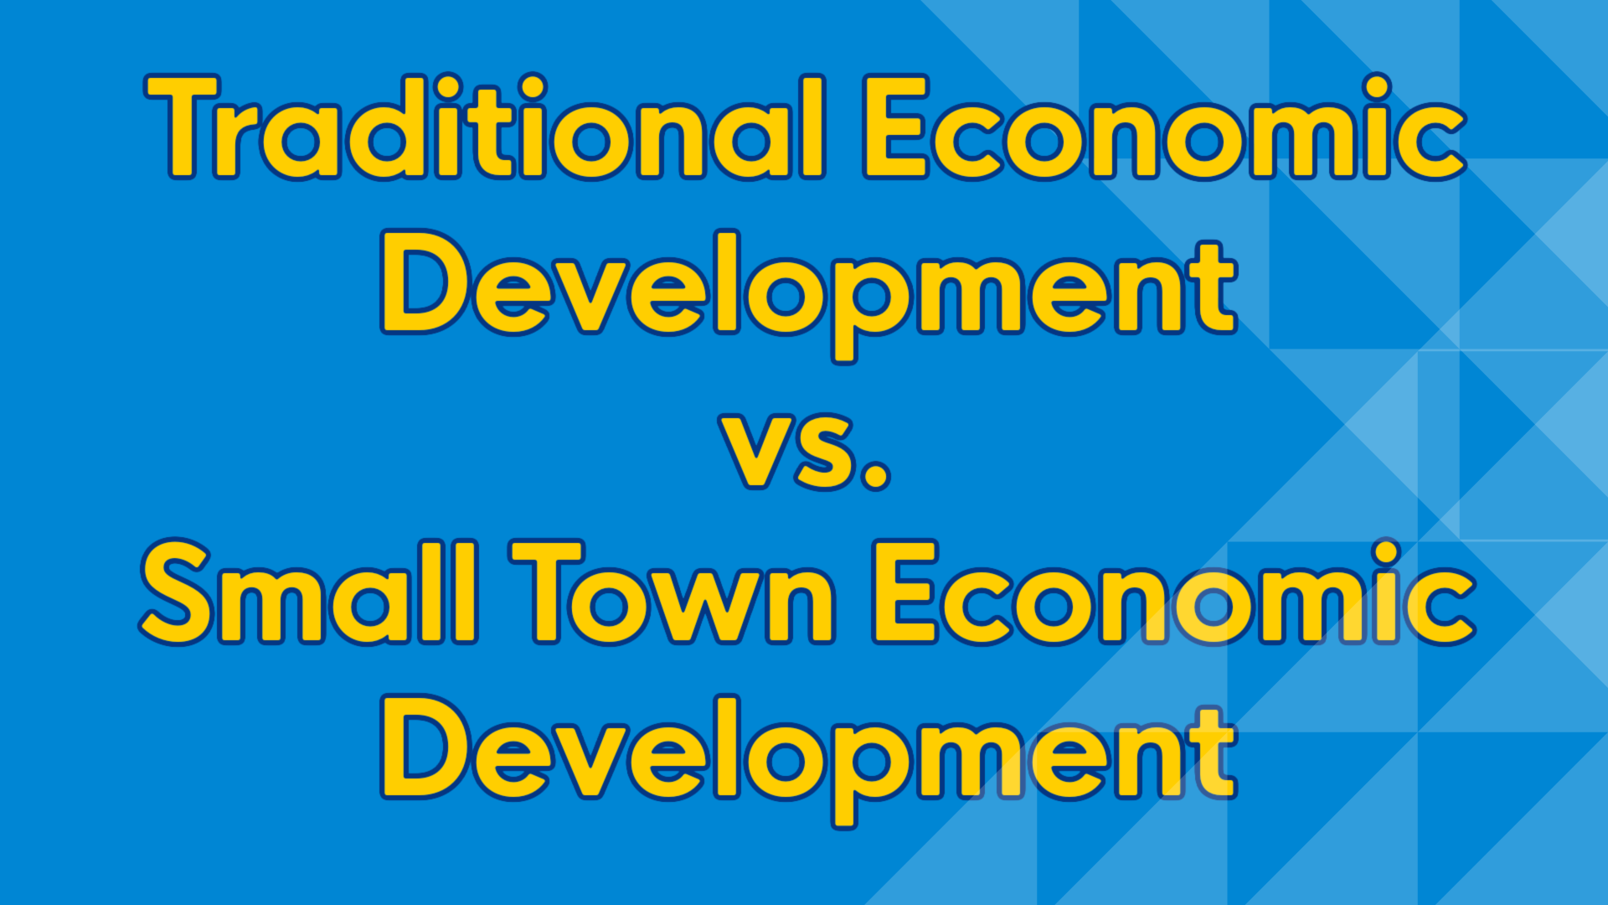

Slide 4


Slide 5
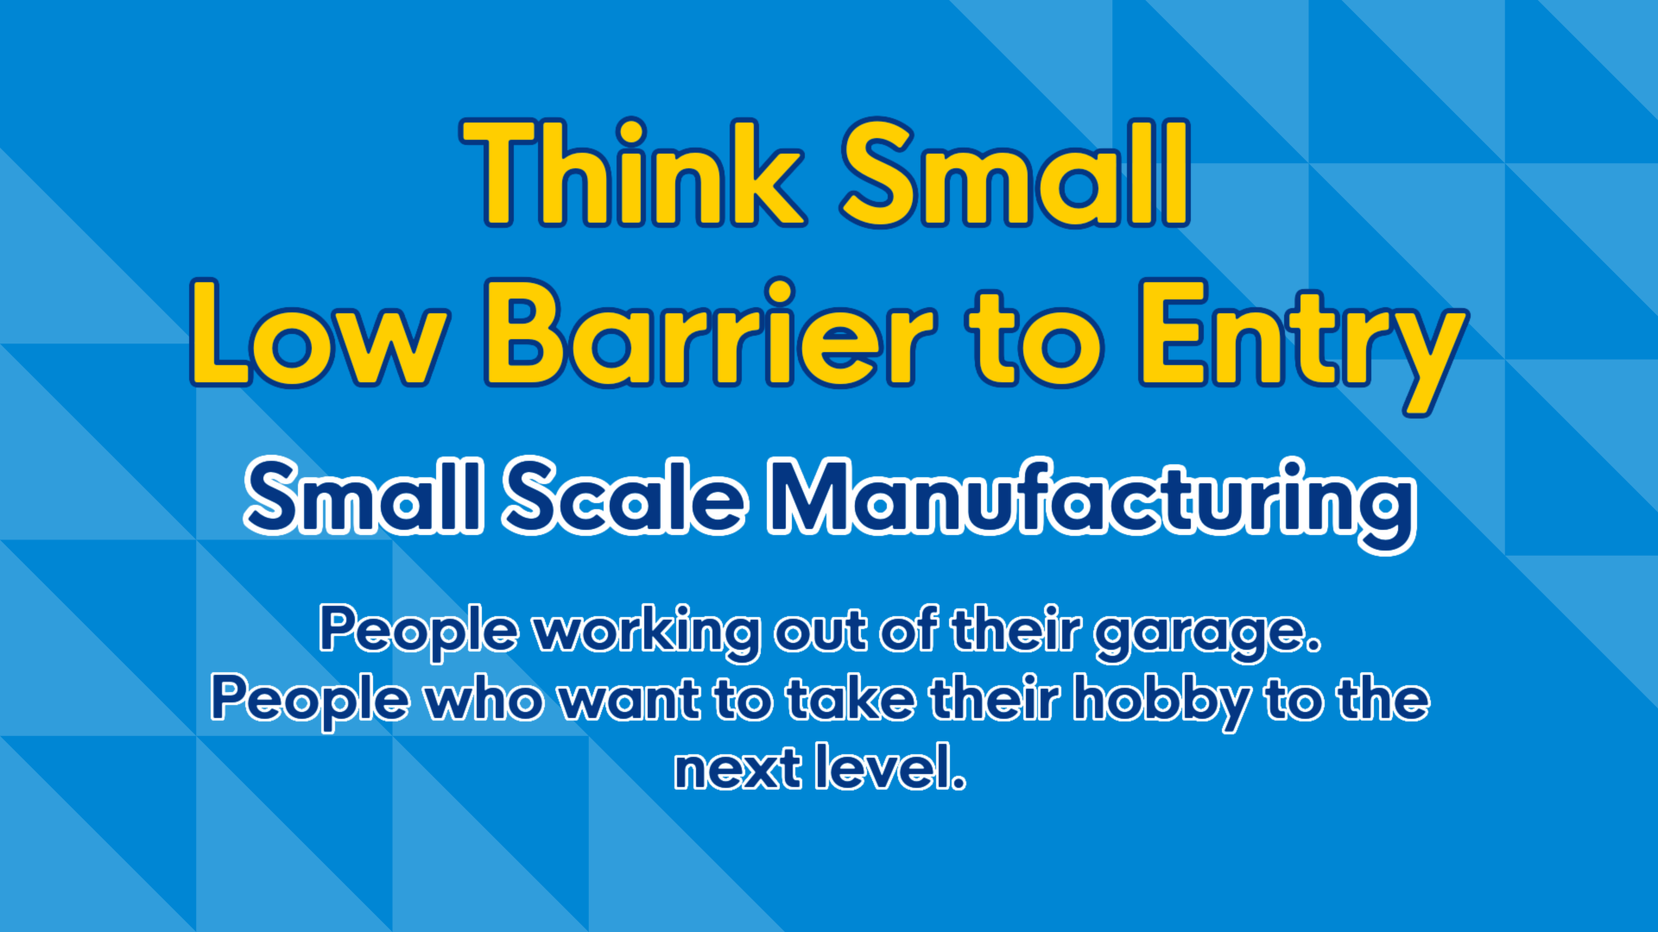

Slide 6
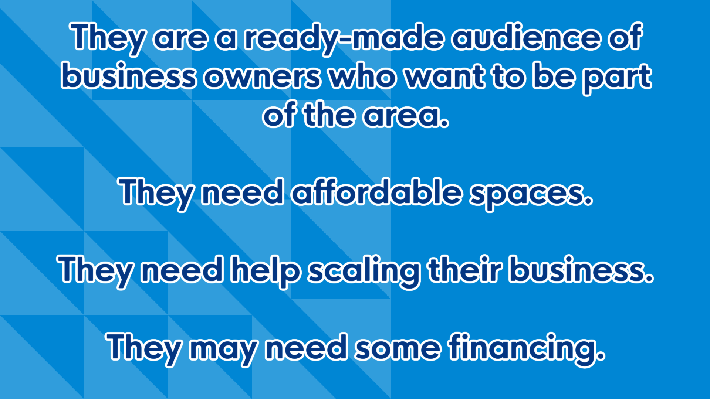

Slide 7


Slide 8
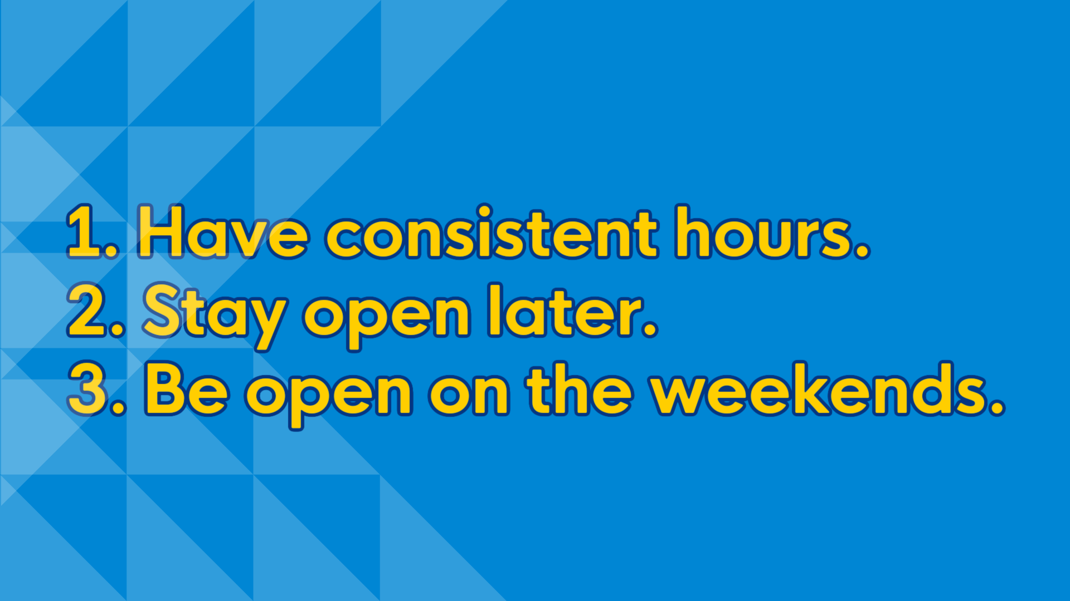
Notes:
Retailers - they want off on weekends, and to leave at 5:00. They need another worker to stay open late and/or on weekends.
What if you could help them figure that out? Help them navigate consolidating their hours/days of the week. Close on their slow day so they could pay someone to be open on the weekend. Get a few retailers/restaurants to do this and market downtown at the same time. Plan an event. Do our part to make it successful until people get into he habit of shopping downtown
Mom and pops - when they get tired, they will just close the doors. They don’t have a succession plan. Do you know their limits? Covid pushed a lot of them out of business or into early retirement. What does that look like now?

Slide 9
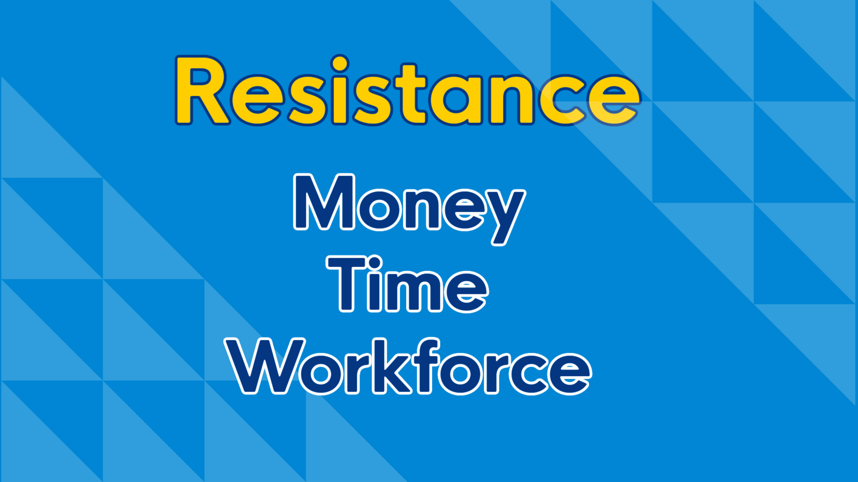

Slide 10
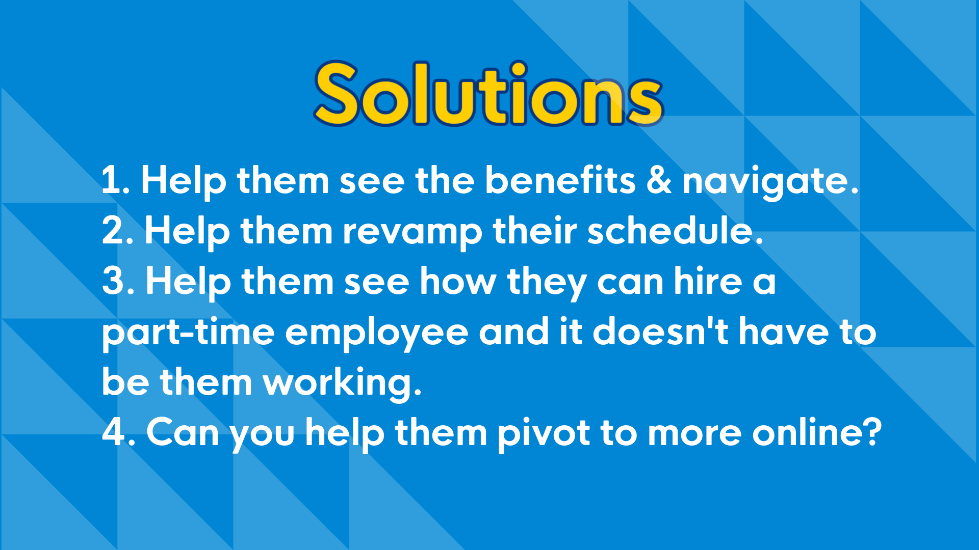

Slide 11


Slide 12


Slide 13
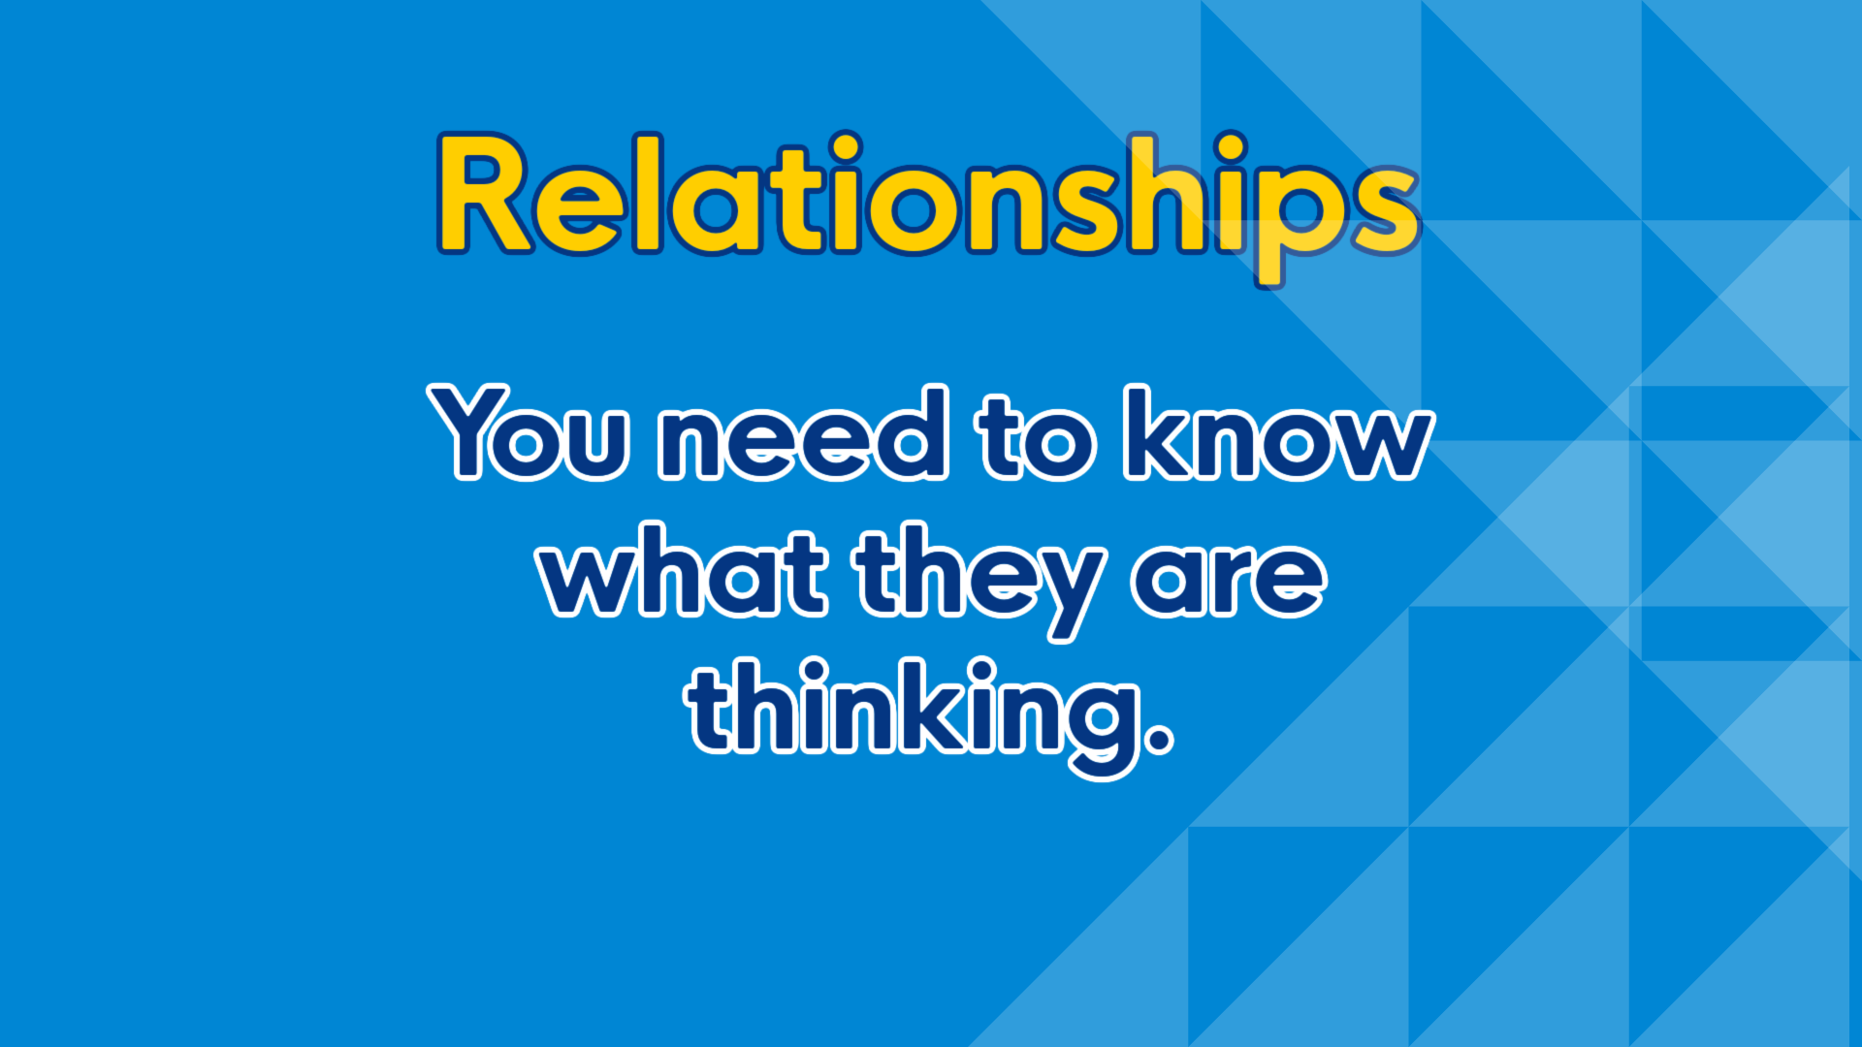

Slide 14
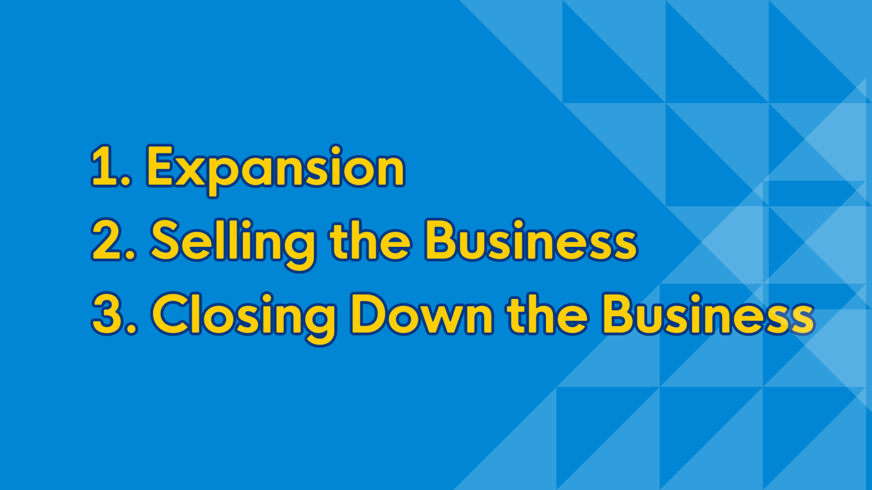
Notes:
They may choose to close down the business because they are done. They don't want the hassle.
This is detrimental to your town.
Economic impact study – show them what the business means to the town.
#3 is NOT AN OPTION for your community.
Jobs are lost.
Economic impact of that business is lost.

Slide 15
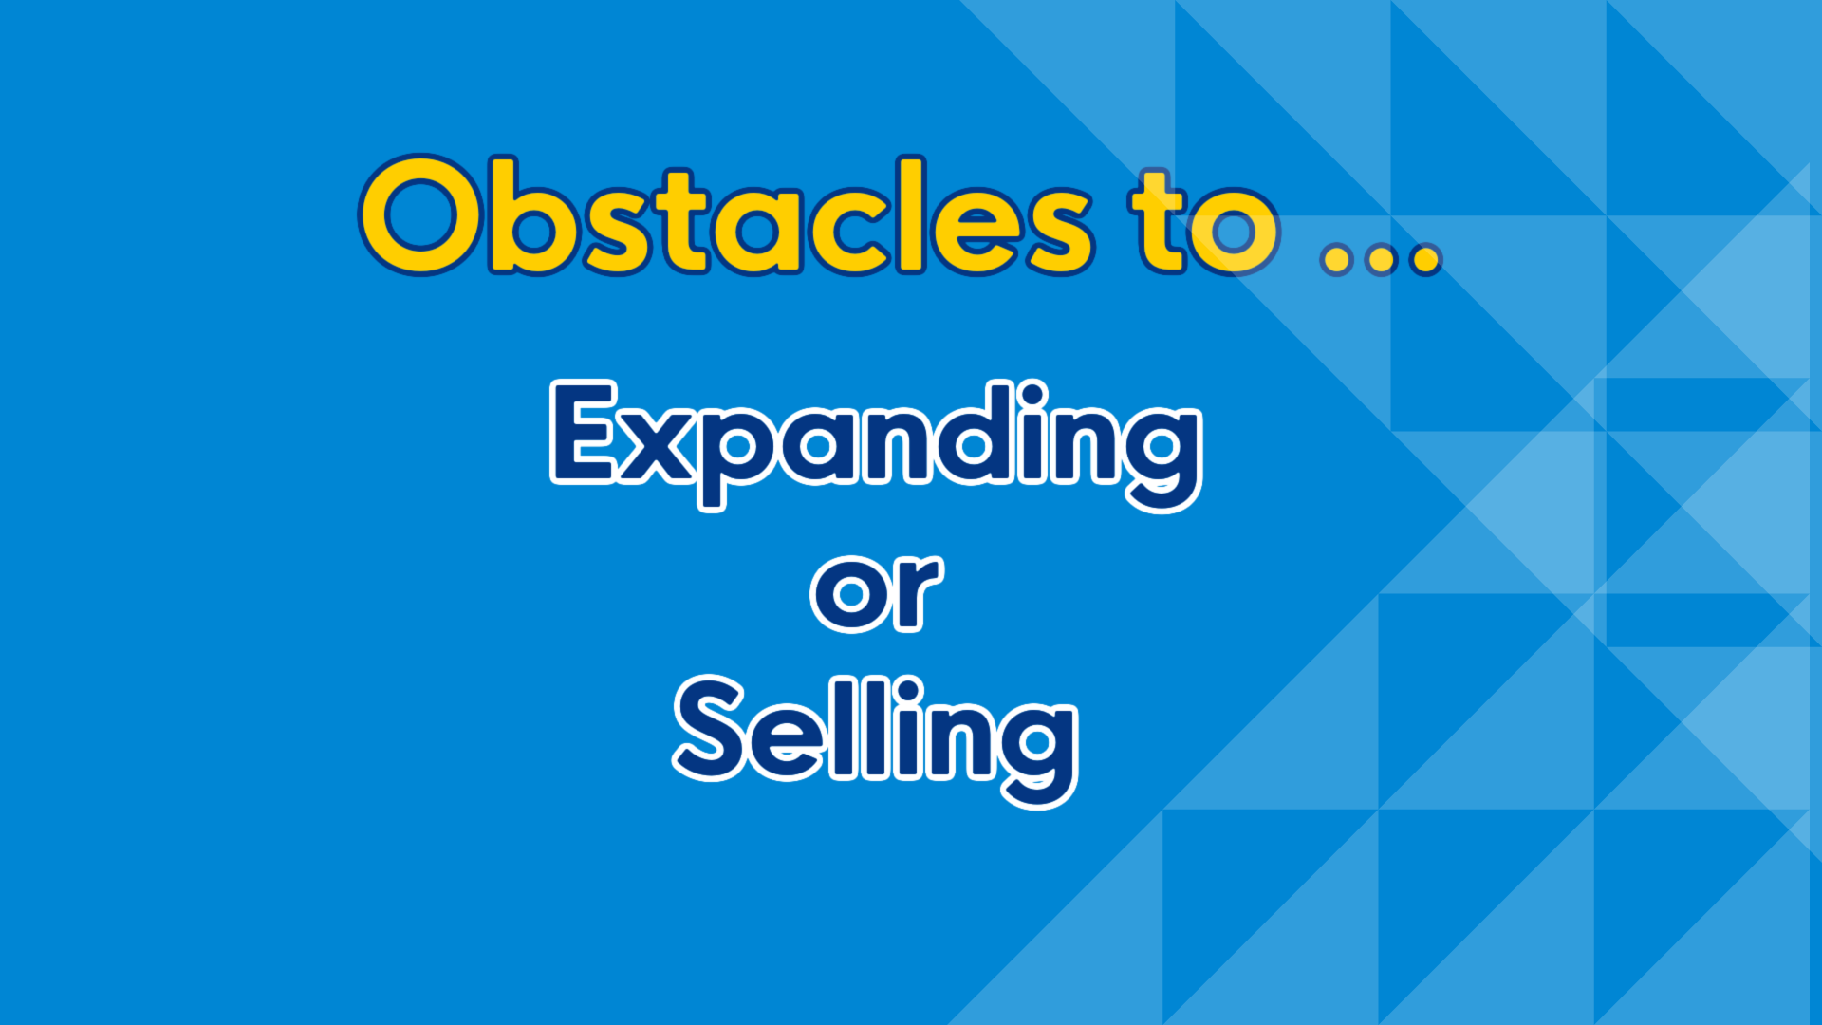
Notes:
Expanding is the easiest option – how can we help them expand?
What do they need?
Equipment? People? New Management? Vendors? Supply Chain

Slide 16


Slide 17

Notes:
They feel like it is too much work. Help them.
Get a team of people to help you – the realtor, the accountant, the contractor, someone to value their business.
Grant or loan them some money. Collect it when they sell.

Slide 18
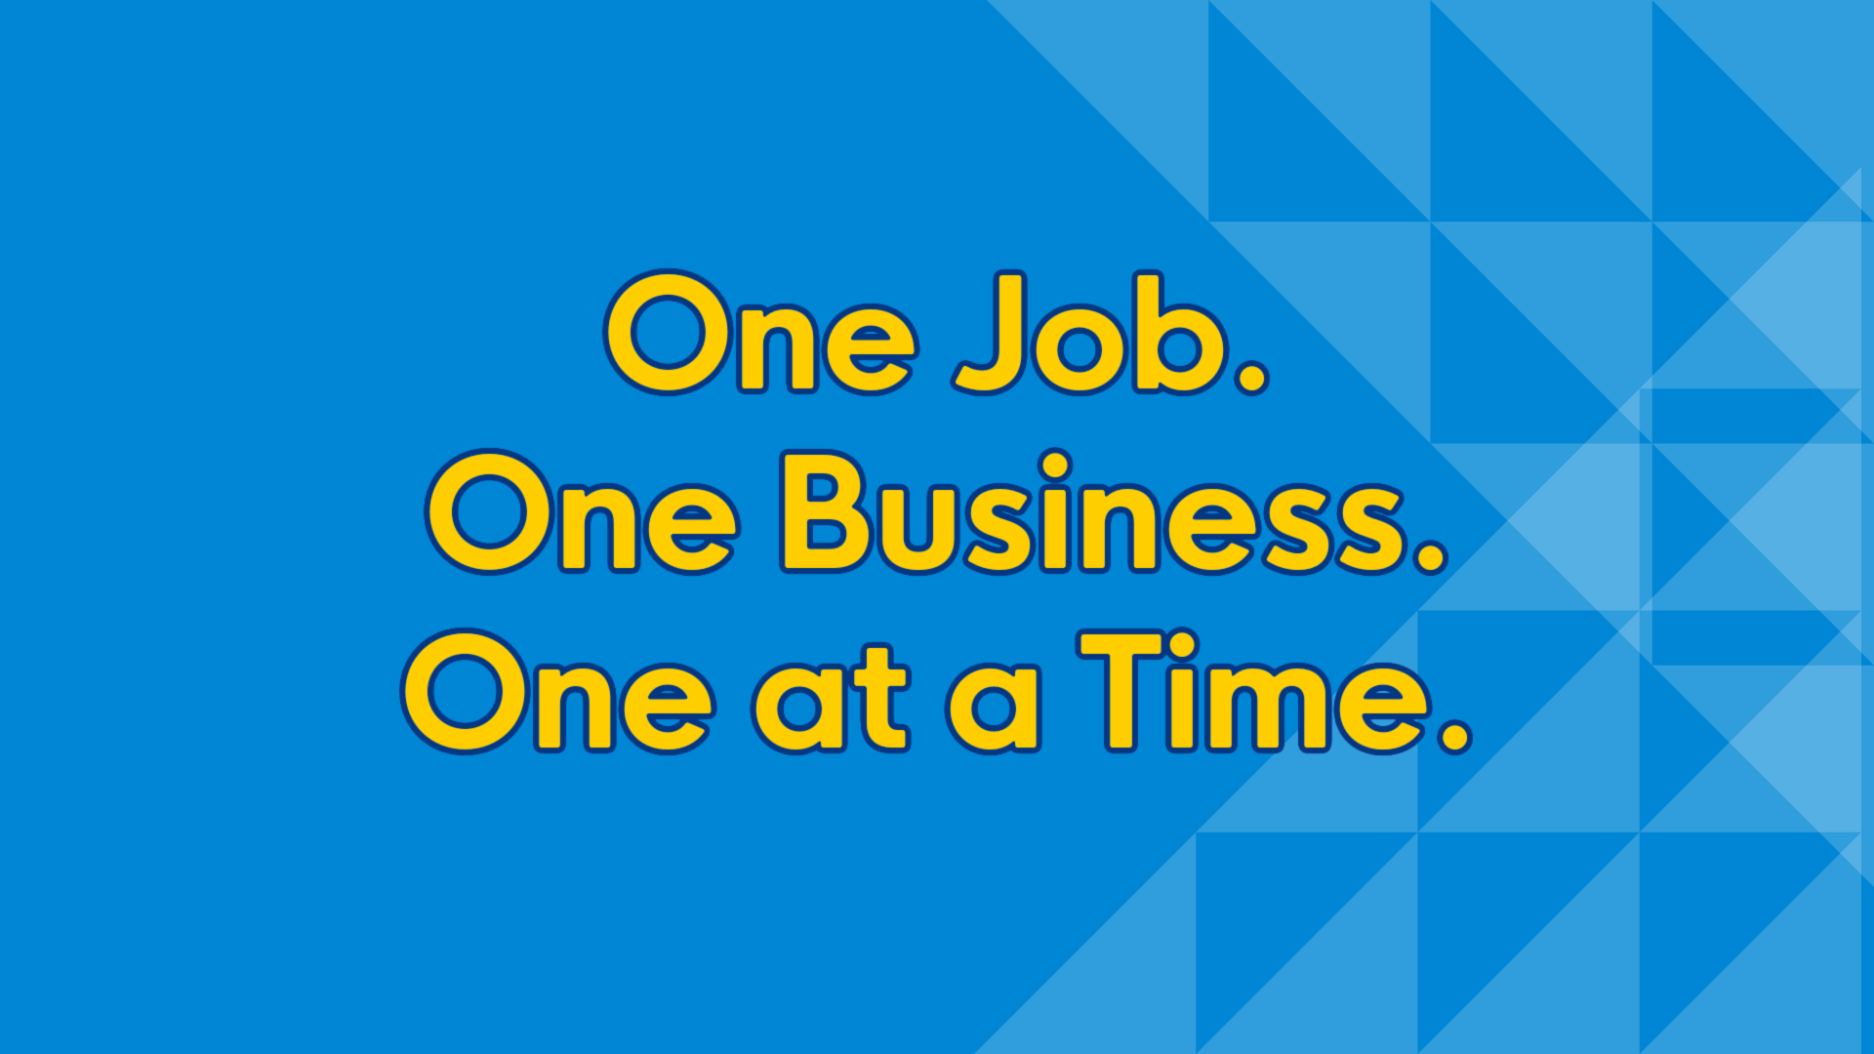
Notes:
How can you help them before it is too late.
What we do for one we DO NOT have to do for all. Be unique. Each business needs something different.

Slide 19


