Slide 3
Notes:
Forbes - https://www.youtube.com/watch?v=8KWPW1uu038
https://www.youtube.com/watch?v=rZu8xfTU2Uk

Slide 5
Notes:
Where do you find these people?
Got to start talking. We have to start noticing!!! Watch FB.
Big Dream Gathering!

Slide 8
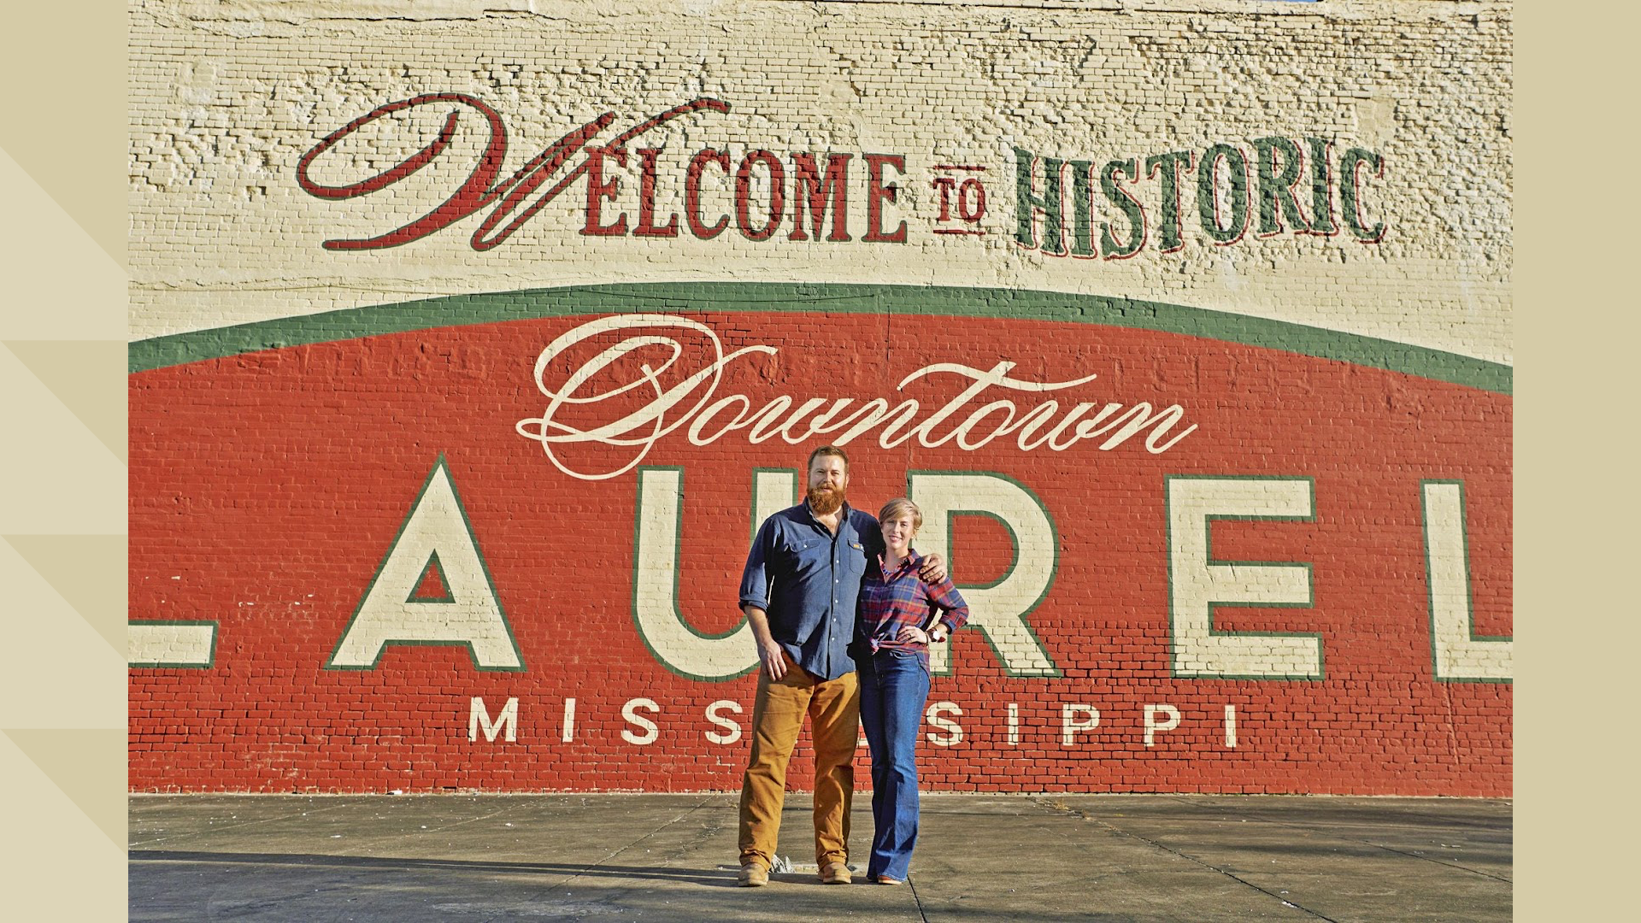
Notes:
Laurel MS – 18,000 population

Slide 10
Notes:
Notice them! Cheer them on. Be their cheerleader.
Align your vision for the town with theirs.
How can you help them be successful.
Story about my local couple renovating homes.

