Slide 1
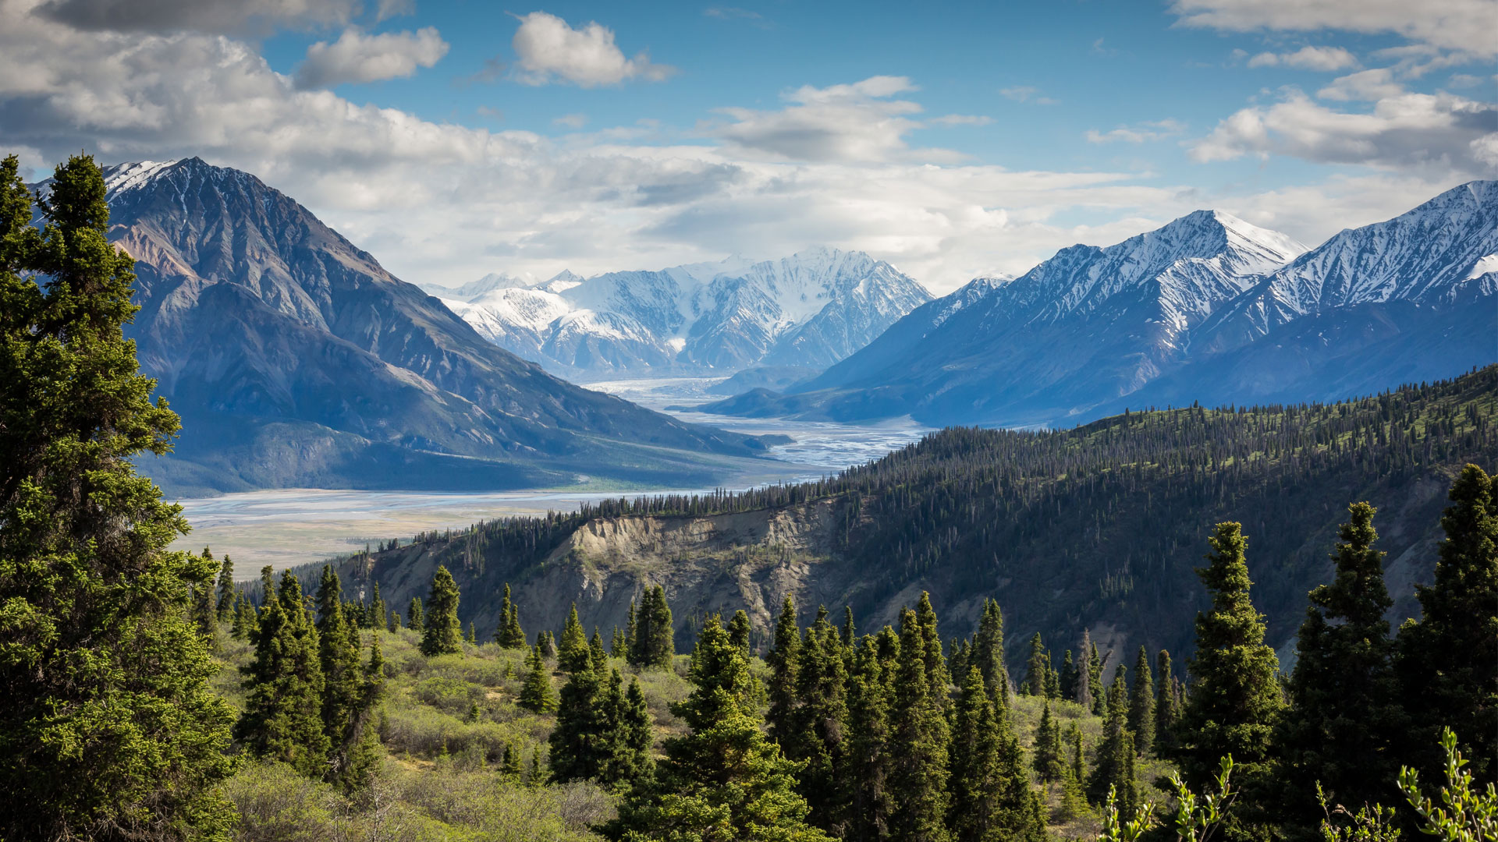
The Great Demographic Transition
The Great Demographic Transition
Sam Wolkenhauer, Labor Economist

Slide 2
Topics for Today
Returning to a world of physical limitations
Labor Supply
Demographics

Slide 3
America’s Labor Market
Total Nonfarm Jobs, in Millions
Labor
Source: US Bureau of Labor Statistics

Slide 4
The Labor Shortage
Total Job Openings vs Unemployed People
Labor
COVID
Shortage
Functioning Market
Source: US Bureau of Labor Statistics

Slide 5
Labor
What is wrong with our labor supply? Where are all the workers?
Skill Level Mismatch
Retirements
Disabilities of Despair
Childcare Availability
Gig Work
Marginal Attachment

Slide 6

Setting a Baseline
Population by Age and Gender, Nigeria (in Millions)
Demographics
Source: United Nations World Population Dynamics

Slide 7

The End of Unbounded Chinese Growth
Population by Age and Gender, People’s Republic of China (in Millions)
Demographics
Source: United Nations World Population Dynamics

Slide 8




Asian Labor Force Decline
Population by Age and Gender, Japan + South Korea + Thailand + Vietnam (in Millions)
Demographics
Source: United Nations World Population Dynamics

Slide 9

European Twilight
Population by Age and Gender, European Union (in Millions)
Demographics
Source: United Nations World Population Dynamics

Slide 10

Even Mexico is Tapering
Population by Age and Gender, Mexico (in Millions)
Demographics
Mexican Birthrate
1980: 4.8
2020: 2.1
Source: United Nations World Population Dynamics

Slide 11

Thank You, Millennials!
Population by Age and Gender, United States of America (in Millions)
Demographics
Source: US Census Bureau

Slide 12
The Death Cross
People Turning 65 vs those Turning 18 by year
Labor
Source: US Census Bureau

Slide 13
Annual Working Age Population Growth by Decade
*So far…
Labor
Source: US Census Bureau

Slide 14
Labor Force Decline
Labor
Contributions By: | ■ Retirements
 | ■ Disability
 | ■ Other
Source: Idaho Department of Labor

Slide 15
The Big Picture
We are transitioning out of an economic era where abundant global labor and trade created an extremely low-cost environment.
We are entering a new era of demographic decline, lower trade levels, labor shortages, and higher cost structures.

Slide 16
For more information on Idaho’s workforce,
please visit LMI.IDAHO.GOV
Questions?
Sam Wolkenhauer
Samuel.Wolkenhauer@labor.idaho.gov
(208) 457-8789 ext. 4451

