Slide 1
Shocks, Mistakes and Replays
INP
October 13, 2022
Spokane Valley, Washington
John W. Mitchell

Slide 2
Mid-October
Looming Election and Perhaps Recession
Inflation for a New Generation
Supply Shocks-Natural and Man-Made
The Specter of Nuclear Conflict a la the Early 1960s
Tight Labor Markets-Employed plus Openings Larger than Labor Force
Globally Central Banks Have Shifted Gears to Fight Inflation
The Pandemic’s Long Shadow Continues to be Revealed
Jerome Powell is Channeling Paul Volcker
The Housing Boom is Fading-Prices Weakening
Financial Markets had a Terrible Q3
With Halloween-October is Always a Scary Month

Slide 3
Job Growth Update August 2022 Data
Year over Year Change – 50 States Up
Source: BLS, ASU
Tennessee 17
Pennsylvania 18
New Mexico 19
Utah 20
Michigan 21
Kentucky 22
North Dakota 23
Arkansas 24
Oklahoma 25
Virginia 26
Wyoming 27
Delaware 28
Maine 29
Idaho 30
Montana 31
South Dakota 32
Texas 1
New Jersey 2
Florida 3
New York 4
Georgia 5
Oregon 6
Nevada 7
Massachusetts 8
Washington 9
Illinois10
Rhode Island 11
California 12
North Carolina 13
Colorado 14
Arizona 15
South Carolina 16
Indiana 33
West Virginia34
Maryland 35
Connecticut 36
Minnesota 37
Vermont 38
Iowa 39
New Hampshire 40
Louisiana 41
Hawaii 42
Missouri 43
Alaska 44
Alabama 45
Wisconsin 46
Nebraska 47
Ohio 48
Mississippi 49
Kansas 50

Slide 4
Real GDP Growth
Q1 2020 to Q2 2022 Revised
Recovery in Output Complete-Mid 2021
Second Quarter Revised Up
% Pt. Contributions Consumer Goods -.61, Services 1.99 in Q2
Inventory Change -1.91 % Pts. In Q2 and 5.01 % Pts.in Q4
Net Exports 1.16 % Pts.
Residential -.93% Pts.
Just in Time, Just in Case, Changed Demand, Supply Disruptions Order More

Slide 5
Employment
30 Months To Labor Market Recovery
September Gain 263,000
September Labor Force -57,000 after 786,000 Gain in August
Unemployment to 3.5%
Participation Rate 62.3% Versus 63.4% February 2020
Wage and Salary Employment up 22 Million since April 2020
September Not in LF But Want Job –Not Looking 5.8 Million

Slide 6
How Many Times Have You Seen Labor Markets as Tight?
Employed Plus Vacancies Larger Than Labor Force 169,036,000 Vs. 164,689,000
Almost Everywhere-Job Application with menu? P.O., Hiring Bonuses and Bounties
Labor Force PR 1.1% Point Below Pre-Pandemic Levels
Perspective: 2000 67.1%, 2016 62.8% and Now 62.3%
Part off This is Aging Boomers Retiring- 2018-20 66-70 Retired 61.5% July 2021-Oct 2021 63.3% 71 and Older 82.3% Rising to 83.3%-Will They Come Back? 55 and over population not in LF 60.7% = 59% do not want a Job and 1.7% Do: Dvorkin and Isaacson
Slower In-Migration-High LFPR
Brookings August 24th-Long Covid -3 Million Impacted Long Covid-out of LF or reduced hours- UK, Minneapolis Fed Similar Findings
Output Constrained by Lack of People
How Many Tom Brady's out There?

Slide 7
Hints of Slowing?
Job Openings 10.1 Million in August Down from 11.2 Million in July
Quits Rate 2.7 in August Unchanged
August 6.3 Million Hires and 6 Million Separations-Higher Hires and Higher Separations
Initial Claims Have Edged Up From 50 Year Lows
Anecdotal Suggestions of Easing Labor Difficulties-Beige Book “Nearly all districts reported some improvement in labor availability.” September 7th
September Slower Wage Growth-More Modest Job Growth

Slide 8
Annual Change CPI 2020-22
August 2022 CPI 8.3% Core 5.3%
PCE 6.2% Core 4.9%
Annual Average 2021 4.7% Up From 1.2% in 2020
Global Issue-Not Just US-August
EU 9.1% UK 9.9% Turkey 80.2%
Instability Threat
US Year to August Food 11.4%, At Home 13.5%
Gasoline 25.6% New Cars 10.1%
Electricity 15.8%, Piped Gas 33%
Shelter 5.7%%
High Frequency Experience-News Focus

Slide 9
Prices
Signals, Information, Relative Prices for Trade-offs, Incentives-Amazing System for Organizing, Allocating and Using Dispersed Knowledge in Society
In Recent Years-Not Major Issue-Now Problem Number One for The Population
OLD ISSUES
My Raise is from My Hard Work and I am really Mad that it is gone!
Angst-Retired, Falling Asset Values, Unindexed Pensions Plummeting Real Value
Unexpected Redistribution-Lenders, Borrowers, Pensioners-Remember Many are Borrowers and Lenders –Loosing on Deposits-Making Out On Mortgage-From The Old To The Younger with Fixed Mortgage
Taxed on Inflation
Shift in Focus to Protect
Unemployment with 3.5% rate-impacts relatively few-Inflation Impacts Everyone

Slide 10
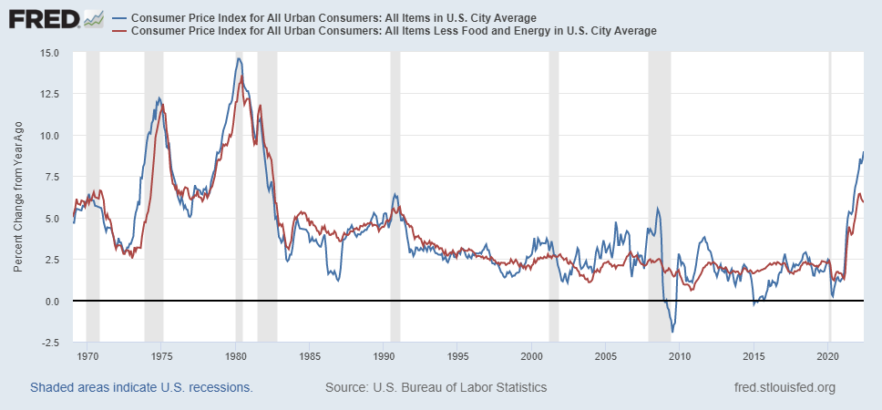
Long Term Perspective
New To Most of You

Slide 11
Powell was Channeling Paul Volcker at Jackson Hole and Fed Meeting
The FOMC “ overarching focus right now is to bring inflation back down to our 2 percent goal. Price stability is the responsibility of the Federal Reserve and serves as the bedrock of our economy. Without price stability, the economy does not work for anyone. In particular, without price stability, we will not achieve a sustained period of strong labor market conditions that benefit all.”
“ sustained period of below trend growth”
“While higher interest rates, slower growth, and softer labor conditions will bring down inflation, they will bring some pain to households and businesses.”
“anticipates that ongoing increases in the target range will be appropriate” 9/21/22
Slower Growth, Higher Unemployment and Higher Funds Rate 9/21/22

Slide 12
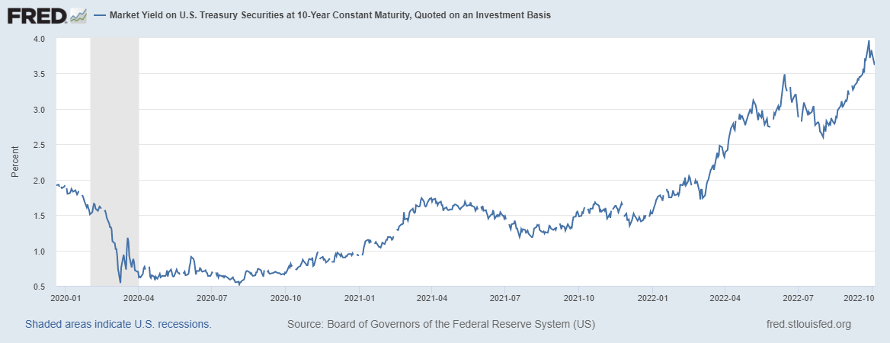
The Unwinding
Pandemic Policy-Rates to Zero in March 2020,Quantitave Easing-Buying Treasuries and Mortgage- Backed Securities-Started in March of 2020
Bought $120 B Per Month until last November started to wind down purchases-ended in March
This Month $60 Billion Treasuries and $35 B MBS-Running Off
Raised Rates 5 Times: .25%, .5% and .75% Three Times
The Transmission Mechanism!

Slide 13
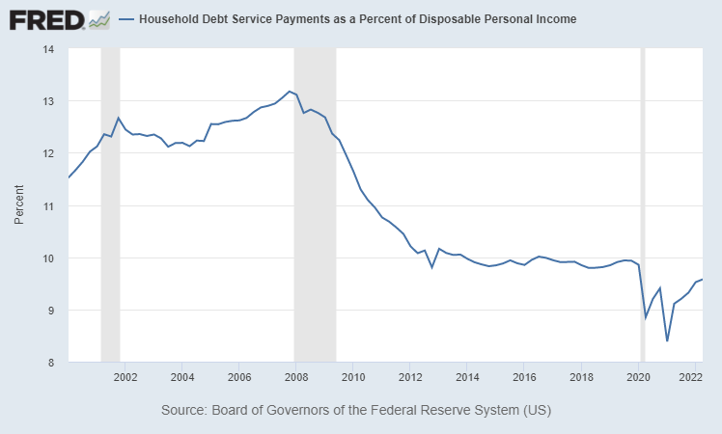
Households
Q2 Financial Assets Down $7.7 Trillion
S&P 500 -24.7% 10/11/22
Changes in Net Worth HH & Non-Profits (Trillions)
Debt Service (% DPI)

Slide 14
MISTAKES with 20/20 Hindsight
Missing the Tightness of the Labor Market-the Distortions, Falling Participation Rate-Using Unemployment Rate Not Vacancies/Workers
Expected More Transitory Elements on the Inflation Side-Supply Chain Fixes
Should Have Reacted Sooner to Excessive Fiscal/Monetary Stimulus
Perhaps Lulled by the long period of inflation being below target. August 27, 2020 FAIT Introduced

Slide 15
Fiscal Policy
In 2020 CARES Act, Omnibus Covid Relief Act and in 2021 the $1.9 Trillion-American Rescue Plan: More Stimmies, Funds for State and Local Governments, Rental Assistance, Pension Bailouts, Higher Premium Subsidies for ACA, Vaccine Funds, Refundable Child Credit-Stimmies in March 2020, December 2020 and March of 2021
2021 Infrastructure Bill about $1 Trillion-$110 Billion for Roads Bridges, Funds for Public Transit, Rail Improvements, Electric Charging Stations, Broadband Access
CHIPS Act-2022 Subsidies, Incentives for Semiconductor Production and Government Sponsored Research- New Industrial Policy-Partly Pandemic Legacy

Slide 16
The “Inflation Reduction Act”-
Climate Actions, EV Incentives, Tax Credits with Income and Locational Requirements, Research Incentives, Tax Credits-Production for Renewables, Battery, Nuclear
Beefed Up IRS
Corporate 15% Minimum Tax-Tax on Buybacks
Extended Pandemic Insurance Subsidies
Medicare Negotiate Some Drug Prices-Price Controls-Penalties
Deficit Reduction $737 Revenue with $300 Billion to Deficit Reduction 10 Years
Executive Action
Debt Forgiveness Actions-$10,000-$20,000 Forgiveness-with income Limits $125,000 to $250,000 Families- add about $420 Billion to Deficit-Lower Payments as % Income-Forgive More Quickly-Nothing Done to Address The Why of Costs

Slide 17
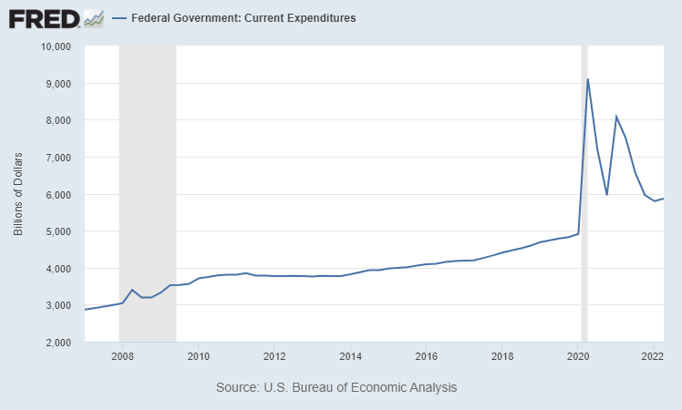
When You Look Back From 2030-35
Unknowns
Who Pays the Business Taxes?
Will the Supply Chain be Able to Respond?
New Drug Supply?
Global Response?
Industrial Policy? Chips Act? IRA?
Size of Government?
What will you be driving?

Slide 18
Combing Through The Data
The Fed has Shifted Gear-5 Rate Increases-Higher Rates Working Through the System
Real Incomes Declining
Inverted Yield Curve-Short Term Rates above Long Term
Recession Headlines in the Media-Most Americans think we are in One!
Global Weakness-Europe/China-Energy Threat in Europe, Covid Response China
Tight Labor Markets-Strong Balance Sheets
Beige Book-Softening, Rising Employment, Moderation in Price Increases-Sept.7th
Consumer Sentiment Rose Sept. U of Michigan, NY Fed Moderating Inflation Expectations

Slide 19
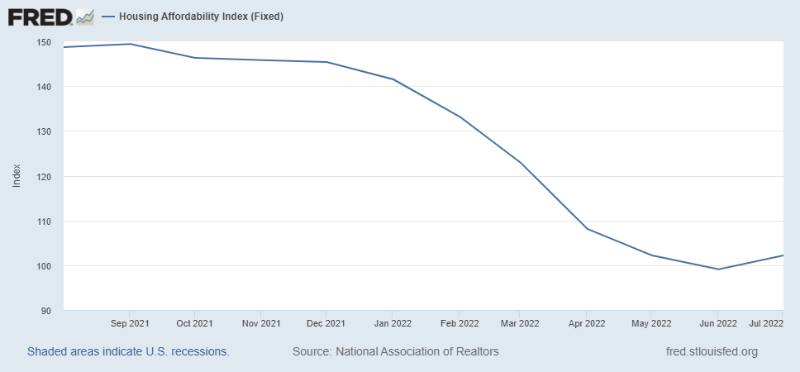
Housing
Slowdown Underway
Heady Period 2020-2021-Preferences, Pandemic, Demographics
Years of Underbuilding after Great Recession
Case Shiller July-National Index up 66.5% Since July 2006 Peak 15.8% YoY Slowing, Seattle 14.5% Portland 11.7%- Prices Declining
Tampa, Miami and Dallas on Top
FHFA Q2 22 P.O. House Price Index-All States Up-Florida #1, AZ#2, NC#3, ND #50, ID 13th, WA 20th
Deteriorating Affordability –Generational Implications- NY Fed Consumer Survey-Renters Record Low for Probability of Owning Home
Existing Home Sales down for 7 Months in NAR-Median Sales Price Peaked in June
Recent Data Have Price Declines

Slide 20
Building Permits
Census Bureau
US Up 1.4% To August
 | To August 2021 | To August 2022
Idaho | 13,946 | 14,992
Washington | 37,598 | 35,789
CDA | 1,453 | 1,902
Lewiston | 0 | 105
Spokane | 2,414 | 3,129
Tri-Cities | 1,508 | 1,543

Slide 21
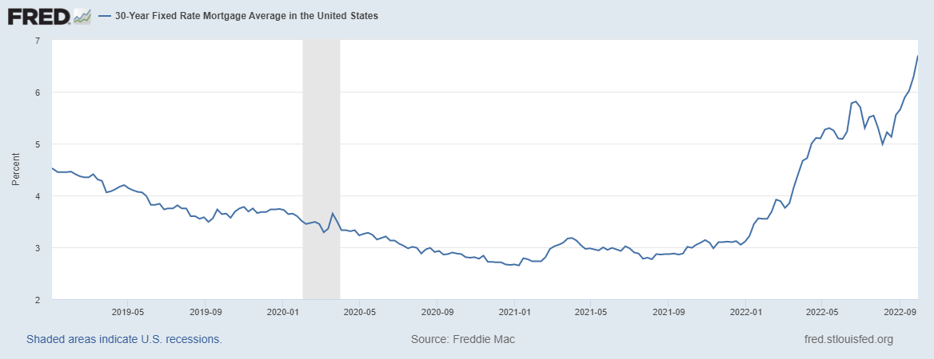
Mortgage Shock

Slide 22
Washington February 2020=100
August Unemployment Rate 3.7%

Slide 23
Idaho February 2020 =100
August Unemployment Rate 2.7%

Slide 24
At Least A Slowdown Probably a Recession and Slide into a Different World
In 2022 GDP Growth 0-.5%- Down from 5.9% Last Year and .5-1.5% in 2023
CPI Inflation 7-8% Up from 4.7% in 2021 and 3.5-4% Next Year
Idaho Job Growth August WBC Consensus/ State 3.5-3.6%% in 2022 and 2-2.5% 2023
Washington 4.1% in 2022 and 2.6% in 2023
Policy Uncertainty and Dispersion of Outlooks-Economist 7/10/22, NABE October Forecast 3.1% Point Difference 5 Highest and Lowest for 2023 GDP
Will the Fed go too far? Or let up too soon?

Slide 25
Covid’s Long Shadow
Labor Force Reduction
Supply Chain Re-Evaluation-More Inventory, Alternatives, Friend Shoring, Security-Implies Higher Prices-Globalization Retreat
Demonstrated Alternative-Business Arrangements and Locational Patterns-Hybrid
Broken Agreements Forbearance, Deferrals, Rent Holidays, Payment Suspensions
Income without Work or Production-Stimmies, Unemployment Comp More Than Earnings, Reduced Work Requirements, PPP- Long Term Implications
Next Shock? Policy Response
Educational Disruption-Long Lasting

Slide 26
PLUS
Gray Tsunami
War in Europe
Climate Change Re-Arrangement
The Question Now is Soft Landing or Hard?

