Slide 1
The New Inflation Environment
Inland Northwest Partners
October 13, 2022
Grant Forsyth, Ph.D.
Chief Economist
Grant.Forsyth@avistacorp.com

Slide 2
Outline
CPI inflation vs PCEI inflation.
Fed’s forward guidance on consumer inflation.
Existing home price growth.
CPI inflation vs. input inflation.
Exporting U.S. inflation.

Slide 3
CPI vs. PECI Consumer Inflation, 2020-2022
A growing difference
Source: BEA, BLS, and author’s calculations.

Slide 4
Fed Consumer Inflation Outlook, 2022-2023
Ooops!
Add 2.5 p.p. for CPI Inflation
Add 0.5 p.p. for CPI Inflation
Source: Federal Reserve and author’s calculations.

Slide 5
Regional Metro Existing Home Price Growth, 2015-2022
May keep inflation elevated even with lower energy prices.
1Q 2021 historic low for U.S. 30-yr conventional rate: 2.65%. Current rate nearing 7%.
Source: FHFA and author’s calculations.

Slide 6
Producer Level Inflation: Intermediate Inputs, 2019-2020
Some deflation
Excludes finished capital goods and imports
Source: BLS and author’s calculations.

Slide 7
Producer Level Inflation: Intermediate Inputs, 2021-2022
Out inflating the CPI in some cases
Source: BLS and author’s calculations.

Slide 8
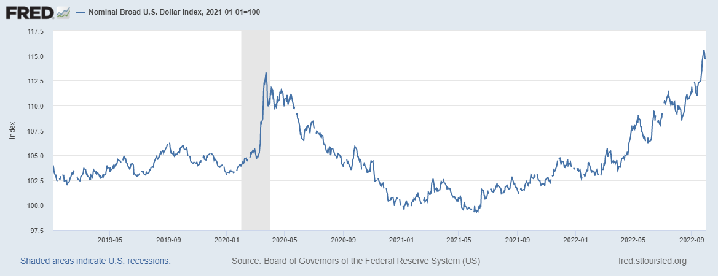
Exporting U.S. Inflation: The Dollars Appreciation
Dollar dominated commodities and debt more expensive

Slide 9
Questions?

